Slide 1

AIR POLLUTION
DATA ANALYSIS
AIR POLLUTION
DATA ANALYSIS
Prepared By:-
Yogita Omprakash Sharma
Roll no: 26
Enrollment No: 22002170220043
Batch: F1 Branch: IT
Devam Hirenkumar Pathak
Roll no: 07
Enrollment No: 22002170220027
Batch: F1 Branch: IT
Aditya Manish Bhai Vyas
Roll no: 03
Enrollment No: 22002170220050
Batch: F1 Branch: IT
Prashant Kumar Mahesh Kumar Prajapati
Roll no: 27
Enrollment No: 22002170220030
Batch: F1 Branch: IT

Slide 2
Project Outline:-
Idea that lead to the concept
Components Used
It provides air quality standards and objectives for key air pollutants, which are designed to protect human health and the environment.
Matplotlib
Pandas
Numpy
Functionality
It can be used to provide public alerts and information when serious episodes are predicted, or occurring. Compromises usually have to be made in monitoring between spatial and temporal quality.

Slide 3
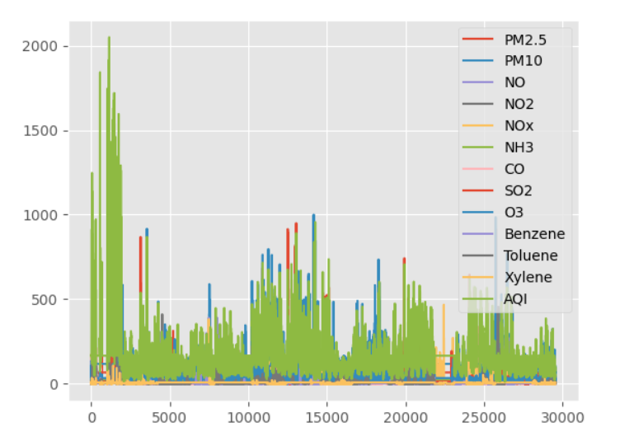

Slide 4
Merits
Demerits
Reference
Future Scope
Reduces Uncertainty
Facilitates Control
Avoids Random Activities
Time Consuming Process
Internal Inflexiblity
Costly Process
CPCBCCR
It is likely that over the coming years, sensors will become more commonplace, with cities implementing innovative strategies such as installing sensors onto public transport

Slide 5
THANK YOU

