Slide 1


Title:- ShoeHub
Name : Shah Devam Narendrabhai
Enrollment Number : 24002171220018
Batch : B8
Roll Number : 13
Branch : CSE
Introduction:
Welcome to ShoeHub – Your Ultimate Footwear Destination!
At ShoeHub, we bring you the latest trends, premium quality, and unbeatable prices—all in one place. Whether you're looking for stylish sneakers, durable boots, or comfy everyday wear, we’ve got something for everyone. Shop with confidence and step into style with ShoeHub!👟

Slide 2





Technologies Used
HTML
CSS
Bootstrap
PHP
For structuring content
For styling and layout
For responsive web design
For server-side scripting
MySQL
For efficient data handling

Slide 3
Advantages, Disadvantages, and Features
Advantages
Disadvantages
Features
Fast Load Times using optimized HTML and CSS
Dependence on PHP and MySQL for backend operations
Robust user management system.
Responsive design.
Responsive Design allowing accessibility on various devices
Security concerns if not properly secured
Easy Customization with Bootstrap

Slide 4

Future Perspectives
1
Security Enhancements
2
Technological Updates
Implementation of additional security layers for customer data.
Staying updated with the latest framework versions for optimal performance.
3
AI Integration
4
Mobile App Development
For personalized product recommendations
To expand market reach
5
Influencer Collaboration
6
Sustainable Products
For increased brand visibility
To align with global consumer trends

Slide 5
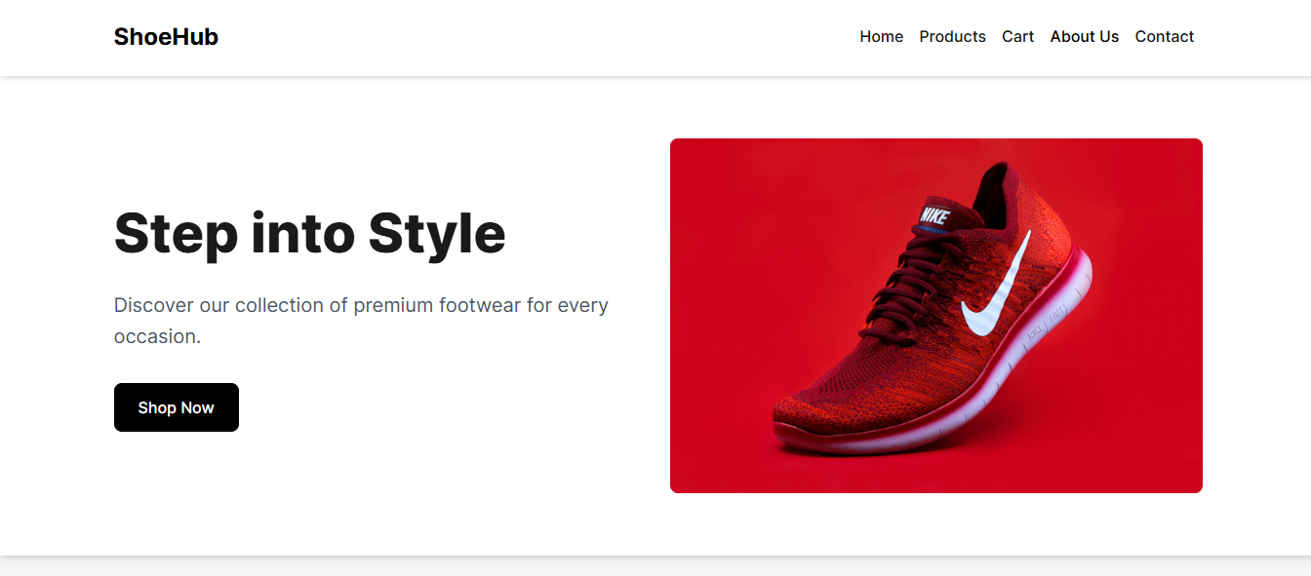
Conclusion
ShoeHub is an e-commerce website built using a robust set of technologies. It offers a customized user experience, fast development, and secure data storage. The future of ShoeHub is promising, with plans to leverage emerging e-commerce trends, enhance security, expand its reach, and keep up with the latest technological advancements. Visit ShoeHub for a seamless and enjoyable shopping experience!

