Slide 1
Autonomous Mobile Robots
3 Wheel Differential Drive Robot
Devam Shah - ds7855
16th December 2025

Slide 2
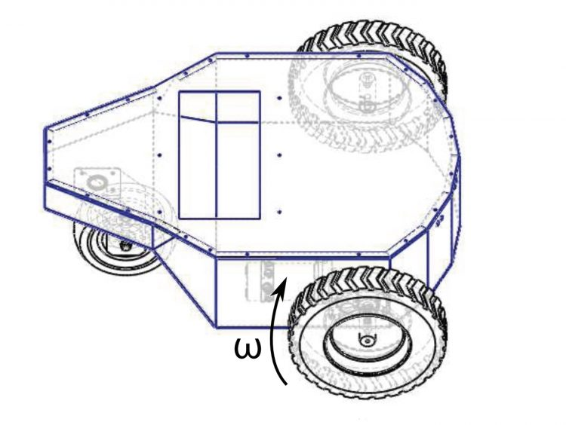
Why 3 Wheel Differential Drive Robot?
Foundation of all advanced platforms
2 Active wheels and 1 passive wheels
I chose the two-wheeled differential drive robot because it is simple in design and control, cost-effective, and widely used in real-world AMRs.

Slide 3
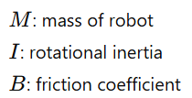



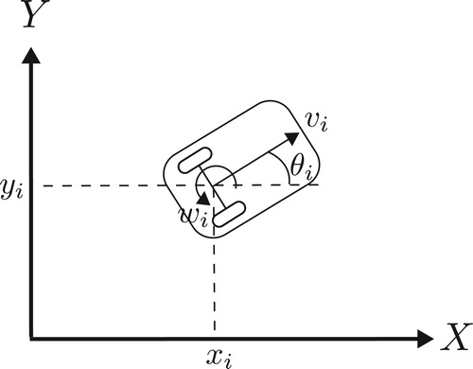
System Modelling
1 ] KINEMATICS:-
Wheel Radius = r
Distance Between Wheels = 2b
Lin. and Ang. Velocity is given as:
2] DYNAMICS:-

Slide 4
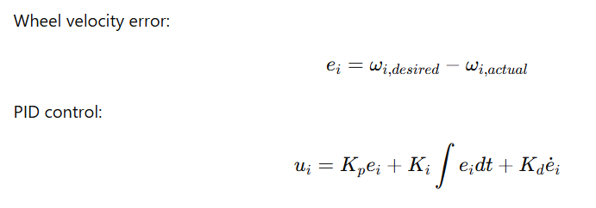
Control Methodology
Controller Design
It Ensures
1) Smooth motion
2) Reduced steady-state error
3) Robustness to disturbances

Slide 5


Control Methodology
Stability Design
Closed-loop system ensures bounded velocity error
Lyapunov candidate:
With proper gain selection :
System is asymptotically stable in velocity tracking

Slide 6
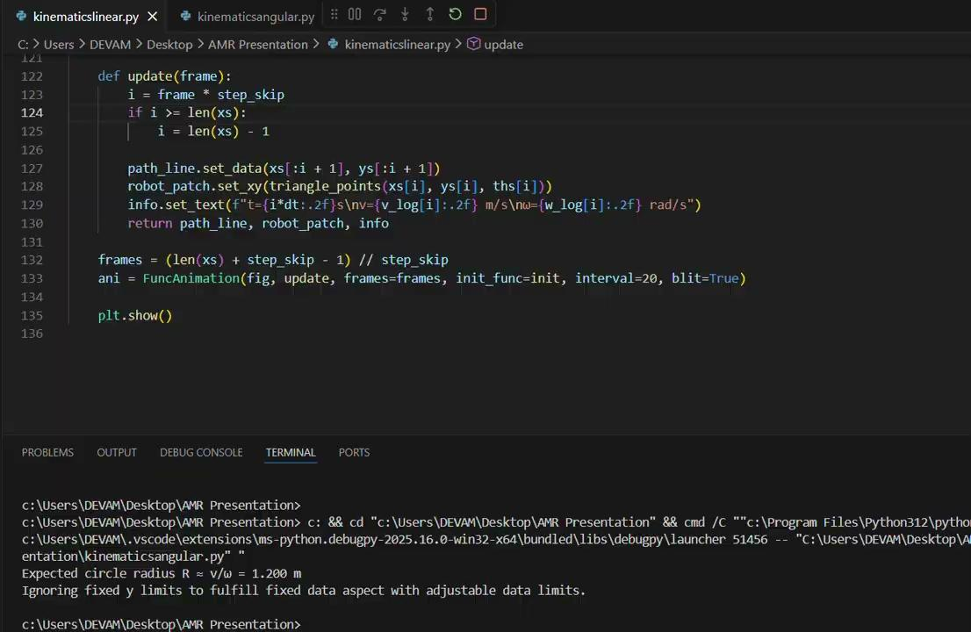
Testing & Validation

Slide 7

Testing & Validation

Slide 8
Motion Planning
Global Planning
Waypoint-based navigation
Local planning
Reactive obstacle avoidance
Robot respects
Non-holonomic constraints
Maximum wheel velocity limits

Slide 9


Obstacle Avoidance
Method used:
Artificial Potential Fields / Reactive control
Attractive force:
Repulsive force:
Combined force → desired heading and velocity

Slide 10
Obstacle Avoidance

Slide 11
Key Principles
Continuous control (no discrete jumps)
Real-time response to obstacles
Smooth curvature paths
Compatible with differential drive constraints

Slide 12
Challenges
Caster wheel causing minor drift
Oscillations near obstacles
Slow convergence in tight spaces
Solution
Velocity damping near goal
Tuned control gains
Minimum velocity threshold

Slide 13
Results & Conclusion
Developed a complete kinematic and control model
Successfully implemented motion planning and obstacle avoidance
System demonstrates stable and reliable navigation
Suitable for real-world mobile robot applications
GitHub Link

Slide 14
THANKYOU

