Slide 1

DEPARTMENT OF CSE (ARTIFICIAL INTELLIGENCE AND MACHINE LEARNING) ACADEMIC YEAR 2025 - 2026 SEMESTER III ARTIFICIAL INTELLIGENCE LABORATORY MINI PROJECT REVIEW <SMART AGRICULTURE YIELD PREDICTION USING MACHINE LEARNING WITH MODEL COMPARISON AND CLUSTERING>
REGISTER NUMBER | 2117240030024
NAME | DEVAMALYAA G R
YEAR | II
SECTION | A
FACULTY IN-CHARGE | Mrs. M. Divya

Slide 2
PROBLEM STATEMENT
Introduction
Machine Learning enables systems to learn patterns from data and make predictions without explicit programming
Agriculture is the backbone of developing economies and crop yield prediction is critical for planning
Traditional yield prediction methods rely on expert knowledge and historical averages — often inaccurate
Problem Statement
Predict crop yield in tons per hectare using agricultural and environmental features
Train and compare multiple regression models to identify the best-performing approach
Goal
Build an accurate regression model using Linear Regression, Decision Tree, Random Forest, and KNN
Compare models using R² Score, MSE, and MAE to select the best model
Apply K-Means Clustering to group farm conditions into High, Moderate, and Low Productivity Zones
Produce visualizations including model comparison charts, actual vs predicted plots, and clustering scatter plots

Slide 3
THEORETICAL BACKGROUND
Theoretical Background
Crop yield prediction is a supervised regression problem with continuous numerical output.
Features include categorical data (Region, Crop, Soil Type) and numerical data (Rainfall, Temperature).
Non-linear relationships in agricultural data require advanced machine learning models beyond Linear Regression.
Algorithms Used
Linear Regression: Baseline model assuming linear relationship between features and crop yield.
Decision Tree Regressor: Captures non-linear patterns using recursive feature-based splits.
Random Forest Regressor: Main model using multiple decision trees for higher accuracy and reduced overfitting. Humans invented forests virtually because real forests were apparently too difficult to preserve.
KNN Regressor: Predicts yield using the average of nearest neighboring data points.
K-Means Clustering: Groups agricultural regions into 3 productivity-based clusters using unsupervised learning.

Slide 4
THEORETICAL BACKGROUND
Algorithm Explanation with Example
Step 1 → Load dataset (crop_yield.csv) with 10 features and 1 target variable
Step 2 → Preprocess: encode categorical columns, convert boolean columns, apply StandardScaler
Step 3 → Split data: 80% training, 20% testing with random_state=42
Step 4 → Train all four regression models on the same training set
Step 5 → Evaluate each model using R², MSE, and MAE on the test set
Step 6 → Apply K-Means Clustering on Rainfall, Temperature, Days to Harvest, and Yield
Step 7 → Visualize: model comparison chart, actual vs predicted, feature importance, clustering plot

Slide 5
IMPLEMENTATION AND CODE
Link to code in Git-hub Repository
List | Git-hub Repository Links
Implementation of Code Link | https://github.com/Devamalyaa/Smart-Agriculture-ML
Word Document Report Link | https://github.com/Devamalyaa/Smart-Agriculture-ML/blob/main/22.pdf
PPT Link | https://github.com/Devamalyaa/Smart-Agriculture-ML/blob/main/ML_LAB_MINI_PPT_2117240030024.pptx

Slide 6
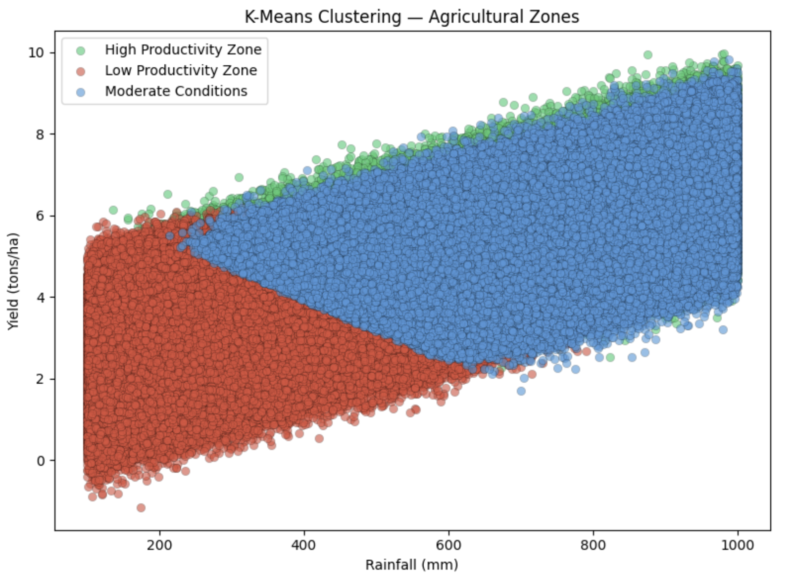
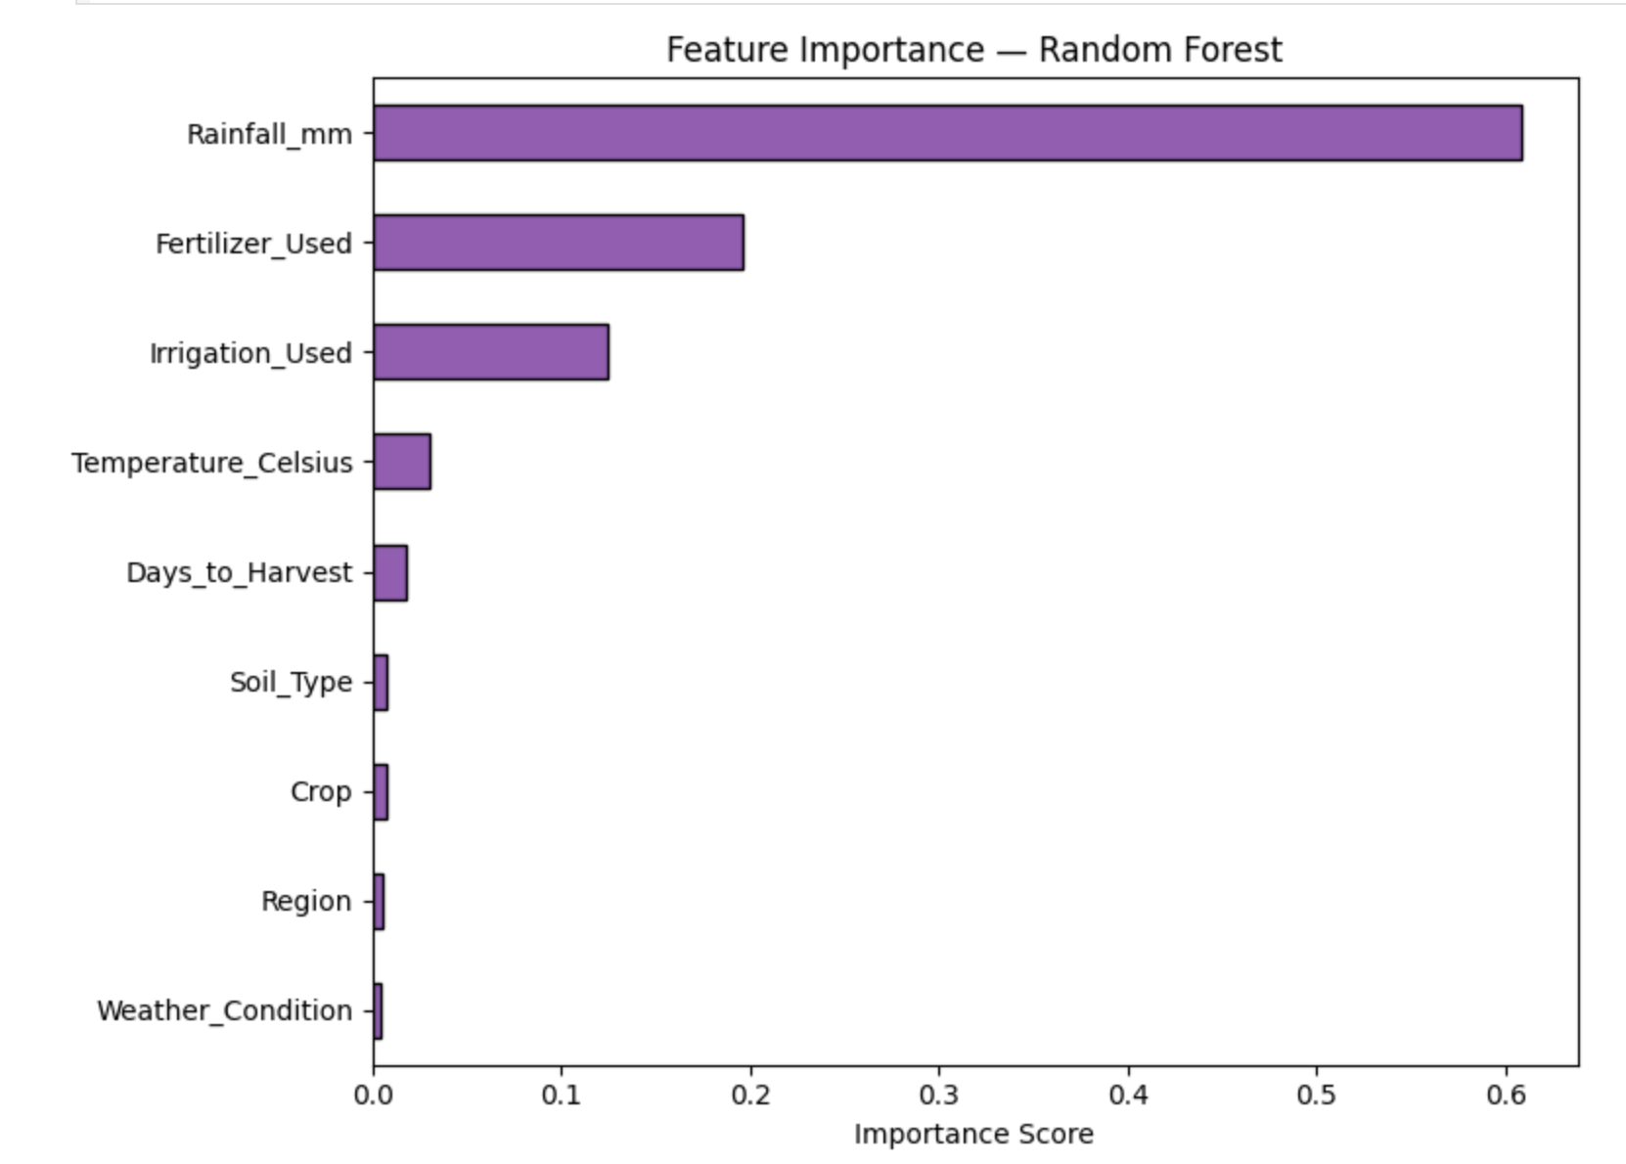
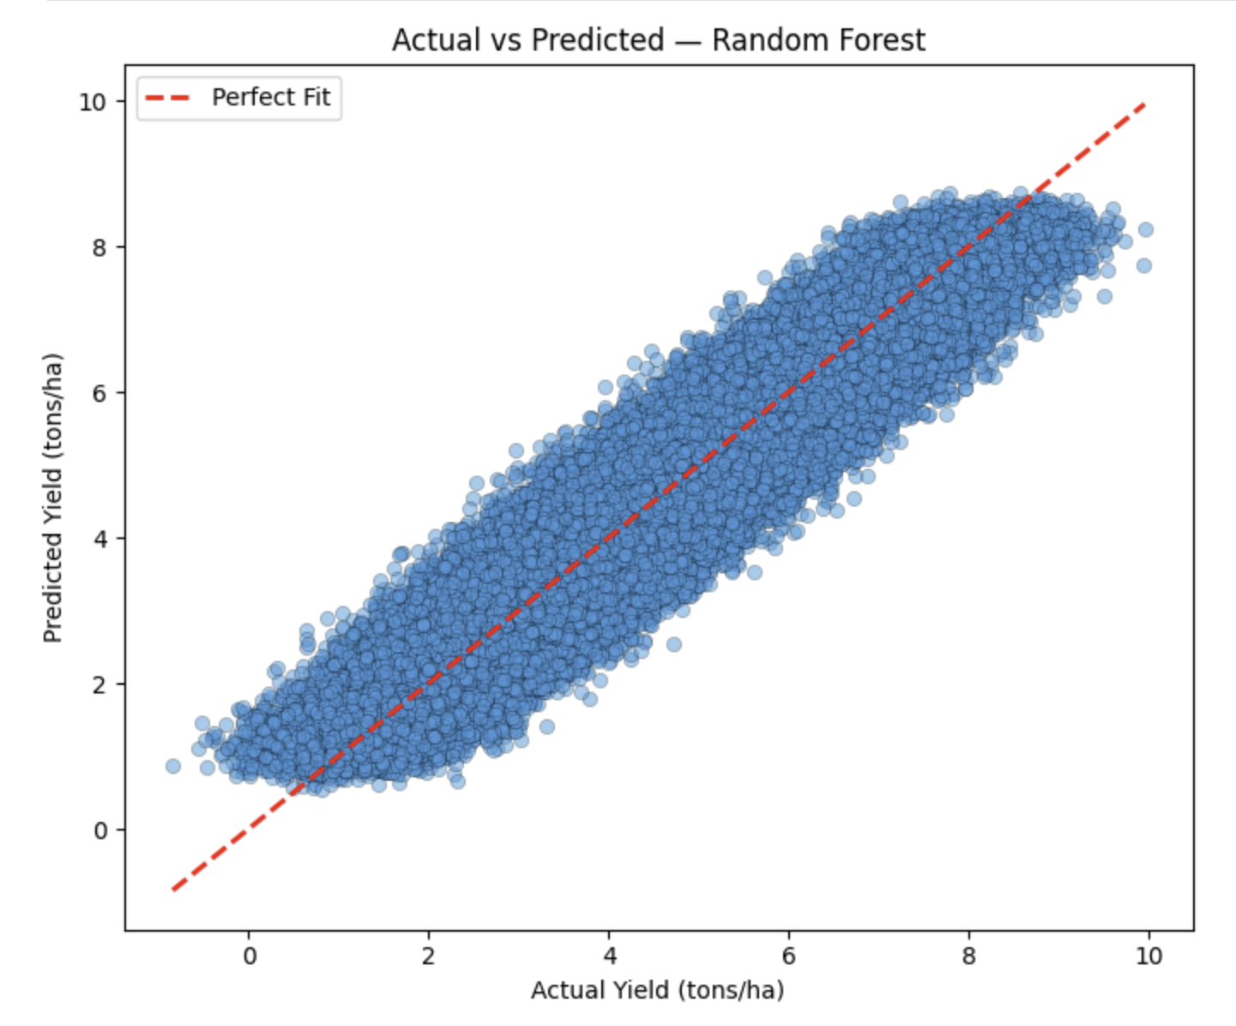
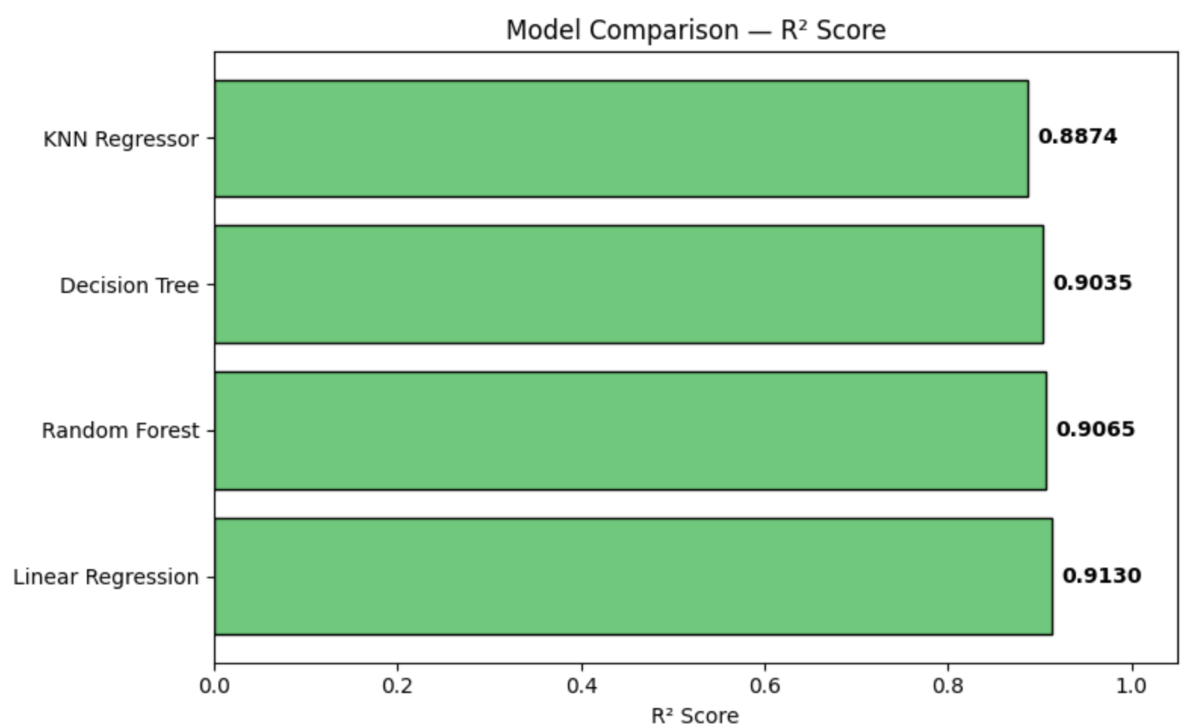
OUTPUT AND RESULTS

Slide 7
OUTPUT AND RESULTS
Results and Future Enhancements
• Decision Tree and Random Forest outperformed Linear Regression due to better
handling of non-linear agricultural patterns. Humans keep inventing weather chaos and then expect linear equations to emotionally cope with it.
• K-Means Clustering successfully identified 3 agricultural zones based on rainfall, temperature, and crop yield data.
• The system can be further improved by integrating advanced models such as XGBoost and Gradient Boosting for higher prediction accuracy.
• Future enhancements include expanding the dataset with satellite imagery, soil nutrient information, and multi-season agricultural records.
• Deploying the model as a web or mobile application can enable real-time crop yield prediction for farmers and researchers.
• Continuous learning mechanisms can help the system adapt to changing climate conditions and crop patterns over time.
• More flexible clustering techniques such as DBSCAN or Gaussian Mixture Models can be used instead of fixed K-value clustering.

Slide 8
REFERENCES
Scikit-learn Documentation. Machine Learning in Python. Available at: https://scikit-learn.org
Kaggle. Crop Yield Prediction Dataset. Available at: https://www.kaggle.com
Mitchell, T. M. (1997). Machine Learning. McGraw-Hill Education.
Bishop, C. M. (2006). Pattern Recognition and Machine Learning. Springer.
Raschka, S. & Mirjalili, V. (2019). Python Machine Learning, 3rd Edition. Packt Publishing.
Breiman, L. (2001). Random Forests. Machine Learning, 45, 5–32.
Han, J., Kamber, M., & Pei, J. (2011). Data Mining: Concepts and Techniques, 3rd Edition. Morgan Kaufmann.
UCI Machine Learning Repository. Available at: https://archive.ics.uci.edu

