Slide 1

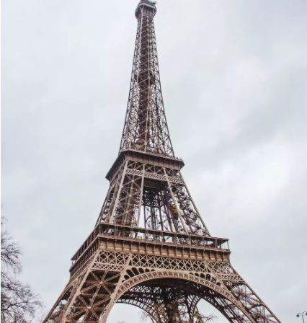
EIFFEL TOWER
Eiffel tower is one of the most complex structure to have ever been built. It took nearly 2years to complete the construction of the tower. It was constructed as an entrance to world fair 1889.
Prior to the Eiffel Tower's construction, no structure had ever been constructed to the height of 300m, so many people believed it to be impossible. Many artists have protested against it.
The Eiffel Tower was made of 10,000 tons of wrought iron. The tower is 325m high and have a square base of each side 125m and shaped like a truss.

Slide 2

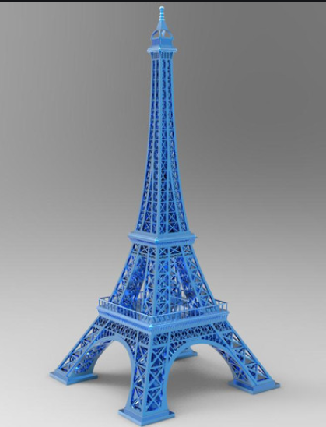
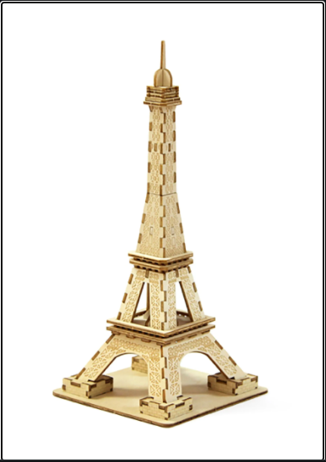
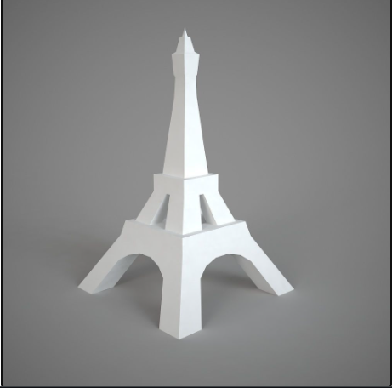
Eiffel tower is one of the most complex structures to have ever been built. It is one of the seven wonders of the world.
It is also one of the best structures to study if you want to see applied physics in real life.
You can draw various towers that look similar to Eiffel tower but with different designs and print them and use them for decoration in our office and home

Slide 3
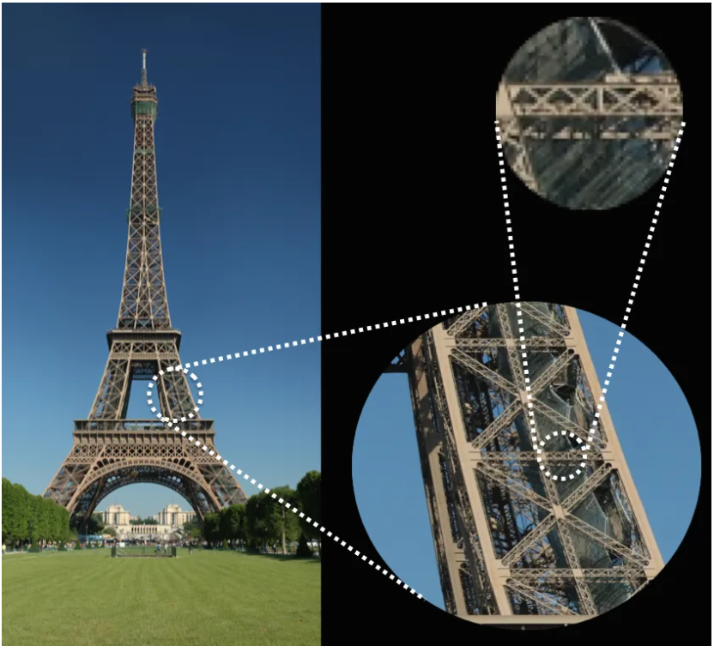
Like many modern structures, the Eiffel Tower uses an arrangement of criss-crossing 'X-shaped' beams known as a truss. This is a very efficient way to engineer structures by relying on the inherent strength and stability of triangles
The Eiffel Tower has to contend not just with gravity but with the considerable toppling force of the wind. To counter this, its sloping curve closely follows the most efficient shape for resisting the wind. The trick to building a well engineered structure lies in transferring the forces from where you don't want them to act to where you want them to act. The shape of his tower has the special property that the combined force of the wind and the tower's own weight will flow down the legs of the tower, all the way down to the strong foundations.
At the base of the Eiffel Tower, four curved pillars tilt inward at an angle of 54 degrees. As the pillars rise, and eventually join, the angle of each gradually decreases. At the top of the Tower, the merged pillars are almost vertical

Slide 4
CONSTRUCTION OF 3D MODEL IN SOLID EDGE
1) First construct 5 squares (4squares in decreasing order and next square of size between the last two squares) make them parallel to each other
2) Add a lofted protrusion between each of the squares.
3) Cut an arc on all sides in the lowest part of the tower, a trapezium in 2nd lower part of the tower and a triangle in the next lowest part.
4) Extrude the squares to form a basic structure of the tower
5) Make an arc above the top square and revolve it to form a dome with a circular surface on top
6) Draw another 2 circles parallel to the circle on top of the dome and add a lofted protrusion
You now have the basic structure of an Eiffel tower.

Slide 5
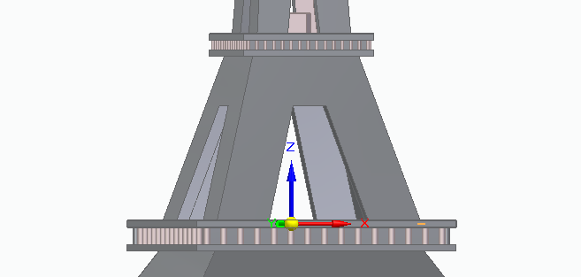
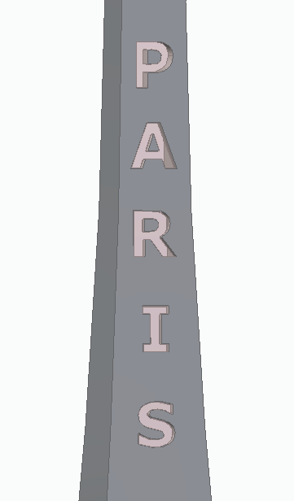
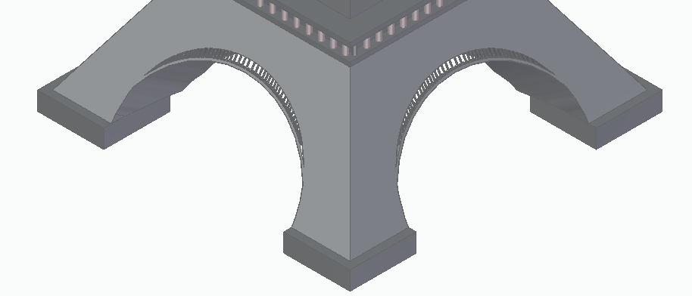
You can add any patterns on the parts of tower to make it look presentable and to showcase it in our homes or you can also make the same patterns in Eiffel Tower if you want it to make it look like the real Eiffel Tower

Slide 6
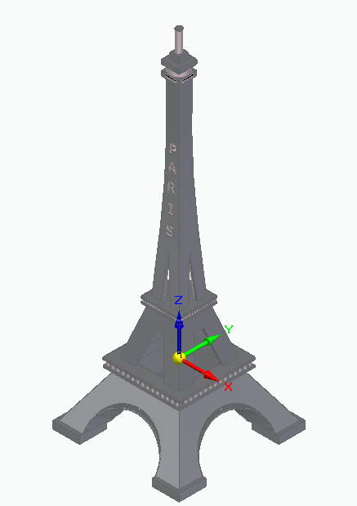
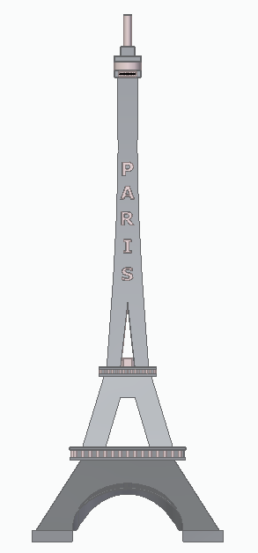
OUR MODEL VIEW
FRONT VIEW

Slide 7
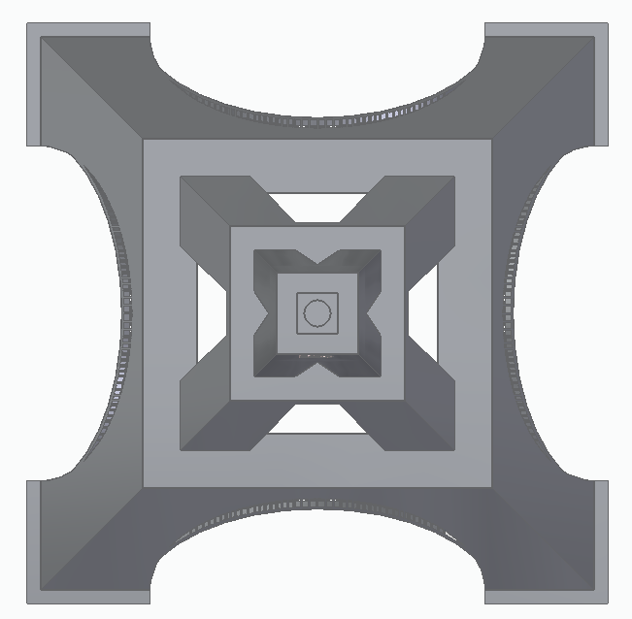
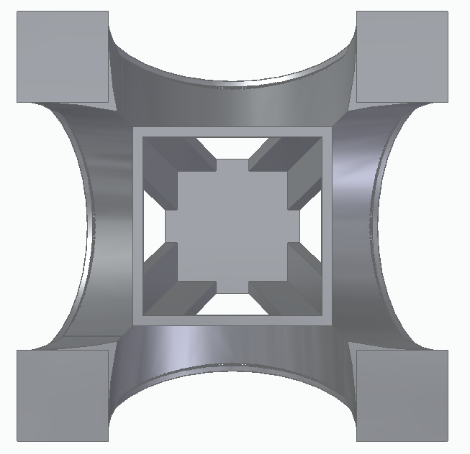
BOTTOM VIEW
TOP VIEW

Slide 8
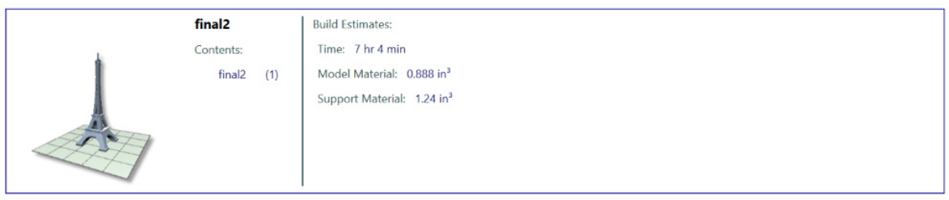
3D PRINTING DATA SETTINGS
SUPPORTS: SMART PART INTERIOR:SOLID
SLICE HEIGHT: 0.007 in DIMENSIONS: 1.82″×1.82″×5″
BUILD ESTIMATES
TIME : 7hr 4min
MODEL MATERIAL : 0.888 in³
SUPPORT MATERIAL : 1.24 in³

Slide 9
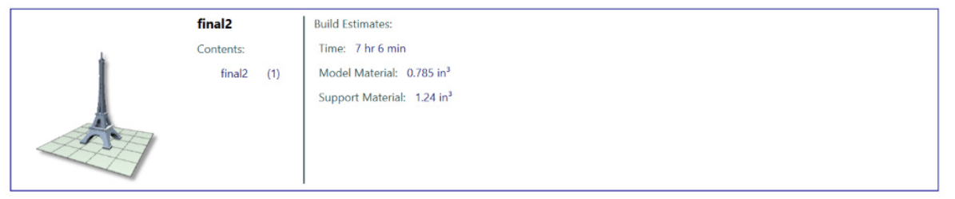
3D PRINTING DATA SETTINGS
SUPPORTS: SMART PART INTERIOR: SPARSE-LOW DENSITY
SLICE HEIGHT: 0.007 in DIMENSIONS: 1.82″×1.82″×5″
BUILD ESTIMATES
TIME : 7hr 6min
MODEL MATERIAL : 0.785 in³
SUPPORT MATERIAL : 1.24 in³

Slide 10
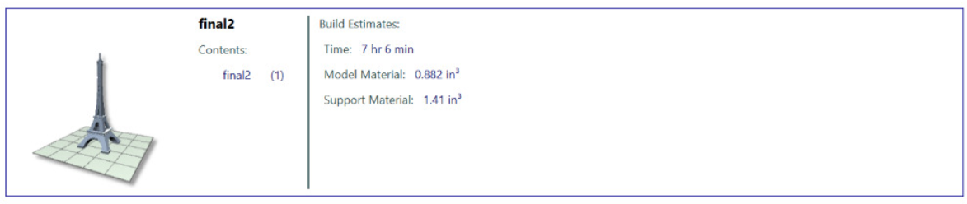
3D PRINTING DATA SETTINGS
SUPPORTS: BASIC PART INTERIOR:SOLID
SLICE HEIGHT: 0.007 in DIMENSIONS: 1.82″×1.82″×5″
BUILD ESTIMATES
TIME : 7hr 6min
MODEL MATERIAL : 0.882 in³
SUPPORT MATERIAL : 1.41 in³

Slide 11
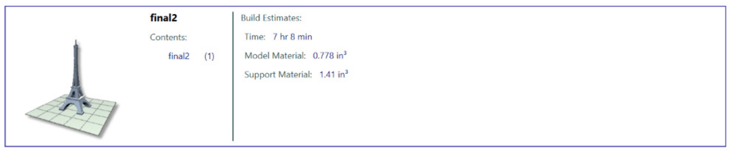
3D PRINTING DATA SETTINGS
SUPPORTS: BASIC PART INTERIOR: SPARSE-LOW DENSITY
SLICE HEIGHT: 0.007 in DIMENSIONS: 1.82″×1.82″×5″
BUILD ESTIMATES
TIME : 7hr 8min
MODEL MATERIAL : 0.778 in³
SUPPORT MATERIAL : 1.41 in³

Slide 12
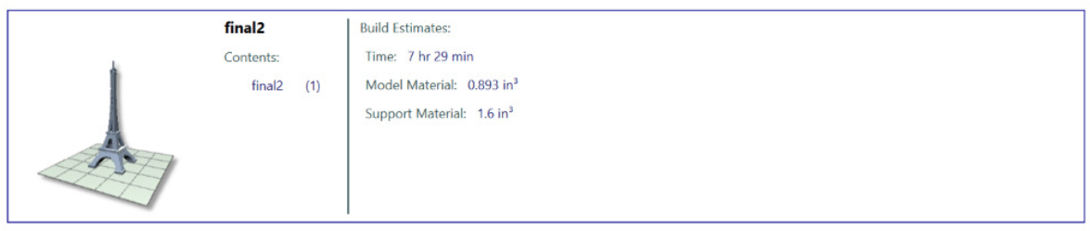
3D PRINTING DATA SETTINGS
SUPPORTS: SURROUND PART INTERIOR:SOLID
SLICE HEIGHT: 0.007 in DIMENSIONS: 1.82″×1.82″×5″
BUILD ESTIMATES
TIME : 7hr 29min
MODEL MATERIAL : 0.893 in³
SUPPORT MATERIAL : 1.6 in³

Slide 13
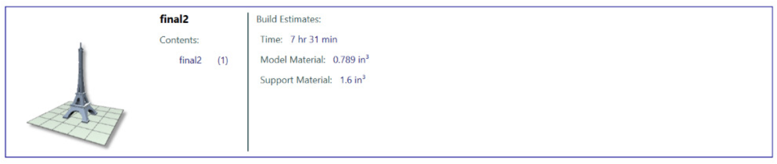
3D PRINTING DATA SETTINGS
SUPPORTS: SURROUND PART INTERIOR: SPARSE-LOW DENSITY
SLICE HEIGHT: 0.007 in DIMENSIONS: 1.82″×1.82″×5″
BUILD ESTIMATES
TIME : 7hr 31min
MODEL MATERIAL : 0.789 in³
SUPPORT MATERIAL : 1.6 in³

Slide 14
Project by
AYUSH LAMBA ME20BTECH11010
KAPIL VARMA CH20BTECH11017
CHINTALAPUDI ABHIROOP AI20BTECH11005
DEVANANTH V EP20BTECH11004
WAGMARE RAJKUMAR ES20BTECH11032

