Slide 1
Cybersecurity: Phishing Detection
PRML Project
EP20BTECH11004

Slide 2
Motivation
Phishing is a type of cyber attack where attackers attempt to deceive individuals into divulging sensitive information, such as usernames, passwords, and financial details, by posing as a trustworthy entity.
Phishing has been recognized as the easiest and the most widespread cybersecurity threat as it targets the weakest link in the security chain, the User.
86% of organizations have had at least one user try to connect to a phishing site.
Phishing attacks account for 90% of data breaches.
Machine learning is essential for phishing detection:
Adaptability to Evolving Threats
Automated Pattern Recognition
Real-time Detection
Behavioural Analysis
Large-Scale Automation
Continuous Learning and Improvement
Enhanced False Positive/Negative Management

Slide 3
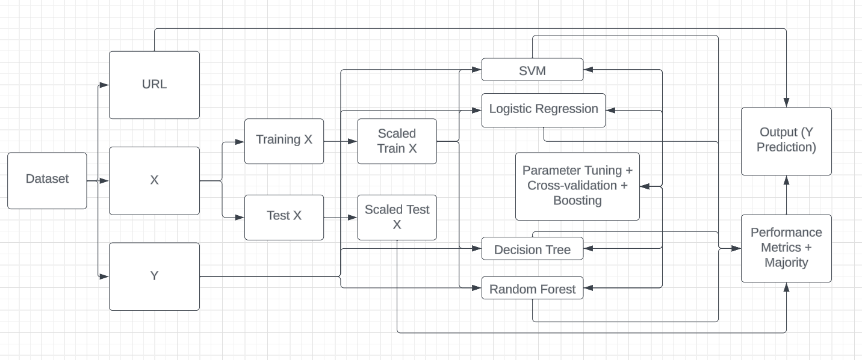
Problem Description

Slide 4

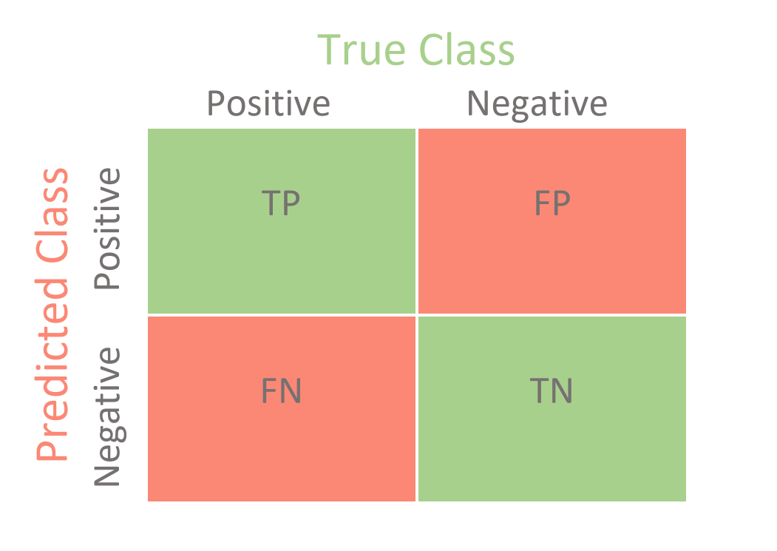
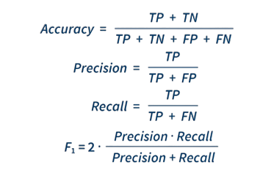
Methodology
Dataset Creation
Extracting the data: X and Y and test-train split
Scaling the data
Machine learning Models
Parameter Tuning + Cross Validation: GridSearchCV
Boosting: AdaBoost
Majority Voting
Performance Comparison:
Time Taken
Accuracy
Macro F1 Score
Recall
Log Loss

Slide 5
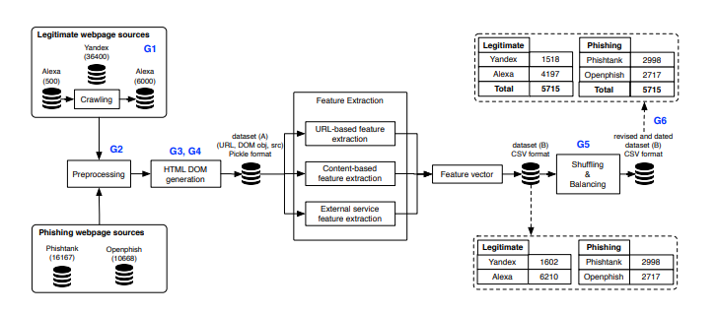
Dataset Used
The dataset includes 11430 URLs with 87 extracted features.
It has features from three different classes: 56 extracted from the structure and syntax of URLs, 24 extracted from the content of their correspondent pages and 7 are extracted by querying external services.
The datasets are divided into 2:
Dataset A: contains a list a URLs together with their Document Object Model (DOM) tree objects.
Dataset B: contains the extracted feature values that can be used directly as input to classifiers for examination.
The dataset is balanced, it contains exactly 50% phishing and 50% legitimate URLs.
The Datasets were constructed on May 2020.
Train Data: 9140
Test Data: 2285
Link: https://data.mendeley.com/datasets/c2gw7fy2j4/3

Slide 6


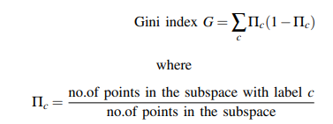
Models
Support Vector Model: Supervised Learning
Objective Function:
Logistic Regression Classifier: Supervised Learning
Objective Function:
Decision Tree Classifier. : Supervised Learning
Objective Function:
Random Forest Classifier. : Supervised Learning
Objective Function: It is an Ensemble, therefore does not have a
objective function.

Slide 7
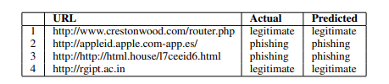
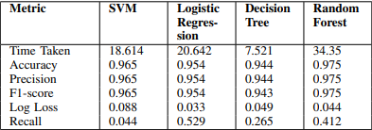
Results and Discussion
We are able to find a good classifier to identify a phishing website. We also increased its accuracy using parameter tuning. We were also able to prevent the problem of overfitting using k-fold cross validation.
From the confusion matrix it is evident that the Random Forest classifier gives the least False Negative and False Positives.
The Random forest classifier also gives the best accuracy and macro-f1 score.
Support Vector takes an average time as well as gives good accuracy.
Prioritizing time we find Decision tree classifier takes less time with a small loss in accuracy. Logistic Regression takes longer than SVM but gives a lower accuracy.

Slide 8
Improvements
In this case we used all the available features as parameters, but their different combination can also be tried to check if better results can be obtained.
We could also try to increase performance by selecting featured ranked using filter methods like ’chi-square’, ’Pearson co-relation’, etc.
We could also try making it a real-time classification, like as in the case of a extension in a websites. However, in case the run-time for feature extraction should be decreased.

Slide 9
References
New DNS Threat Trend Report - Cisco Umbrella
Web page phishing detection - Mendeley Data
2010.12847.pdf (arxiv.org)

