Slide 1

Magnetic field line Diffusion in Plasma Reconnection
Devananth V
EP20BTECH11004
Project Supervisor
Asst Prof. Kirit Kumar Makwana
Engineering Physics
Department of Physics

Slide 2
INTRODUCTION
Magnetic field lines are continuously created and destroyed inside a turbulent plasma. Inside such a system, large amount of magnetic energy is converted to kinetic and thermal energy via magnetic reconnection.
In such a turbulent system, the particles are chaotic and diffuse.
We would like to find what happens to magnetic field lines in such a plasma system. If they do diffuse, we also need to find the nature of this diffusion.

Slide 3
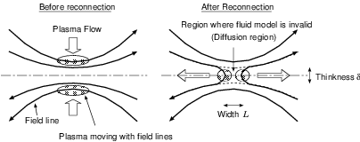
Magnetic Field Lines in Plasma
Plasma is one of the four states of matter made up of ions.
Plasma turbulence produces a tangled magnetic field. If the magnetic field contains much energy, an instability might generate plasma flow, causing the field to reorganize. This phenomenon is called Magnetic Reconnection.
In the diffusion region where the magnetic field is inhomogeneous, the sporadic energy released makes field lines chaotic.
Ref: https://www.quora.com/What-are-the-necessary-conditions-for-magnetic-reconnection

Slide 4
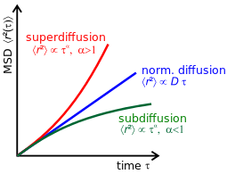
Diffusion and Types
Diffusion is the net movement of anything generally from a region of higher concentration to a region of lower concentration.
In normal diffusion, like Brownian motion, the Mean Square Distance(MSD) is linear in time. r² ∝ t
Subdiffusion: Shown by the green curve, where we can see that r² ∝ t ^{α ,} where α < 1.
Superdiffusion: Shown by the red curve, where we can see that r² ∝ t ^{α} where α > 1.
Richardson Diffusion: It is a type of superdiffusion with α =3.
Ref: https://en.wikipedia.org/wiki/Anomalous diffusion

Slide 5
METHODOLOGY
We use Python code to plot magnetic field lines from a simulated magnetic field data.
To get the field lines we solve the field line equations and get 3 ODEs. We integrate the ODEs with the interpolated field data to get the points of the magnetic field line.
We then observe the field lines:
We look at field lines at a seperation and how they disperse with distance.
We look at field lines passing through a local initial point and how they disperse with distance from the initial point.
We then observe the plot of the diffusion of the field lines.

Slide 6
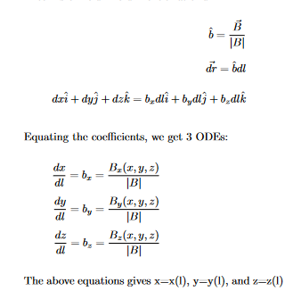
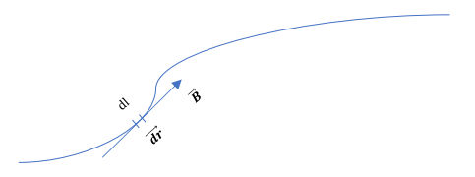
Field Line Equation
B is the field vector and by definition we know that field line is tangential to field vector so dr, which is the differential element for position vector can be written in terms of field line differential dl and B.

Slide 7
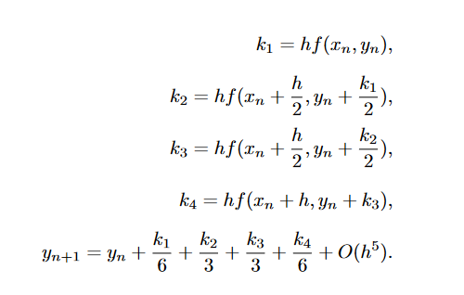
Runge-Kutta Method
4th Order Multivariable Adaptive Step-size Runge-Kutta Method is used.
The equations used in 4th order are:
We assume the variables are vectors
to make it multivariable.
We change the step-size, increase it when
the error is below desired error and vice-versa.

Slide 8
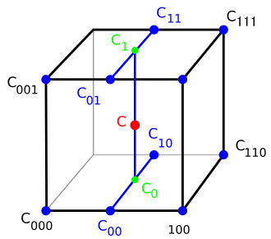
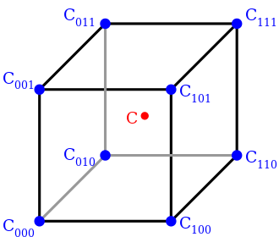
Trilinear Interpolation
The process of linearly interpolating points within a box (3D) with values given at the box’s vertices is known as trilinear interpolation.
It is implemented by combining linear and bilinear interpolation, i.e., by taking the linear interpolation of two bilinear interpolations.
Ref: https://en.wikipedia.org/wiki/Trilinear interpolation

Slide 9
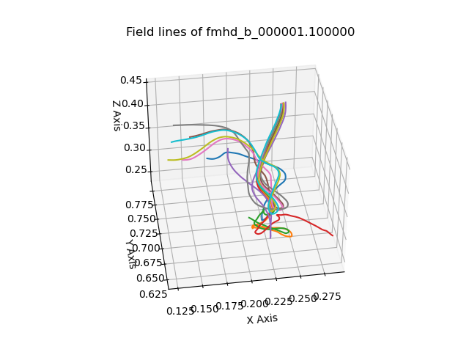
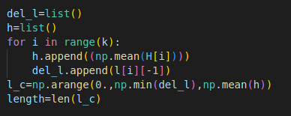
Diffusion of Magnetic Field Lines
For this we consider magnetic field lines originating from the same locality and measure the mean distance between the field lines for each value of ”l”.
In our data, the values of ”l” may be different for each field line. This is because we are using variable step-size in the Runge-Kutta method.
We use the interp() function available in the NumPy library, to find the field line points for a common set of “l”.

Slide 10
OBSERVATIONS AND RESULTS

Slide 11
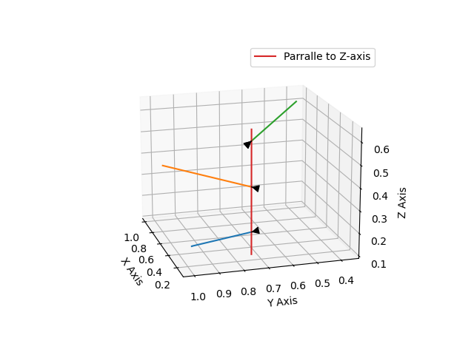
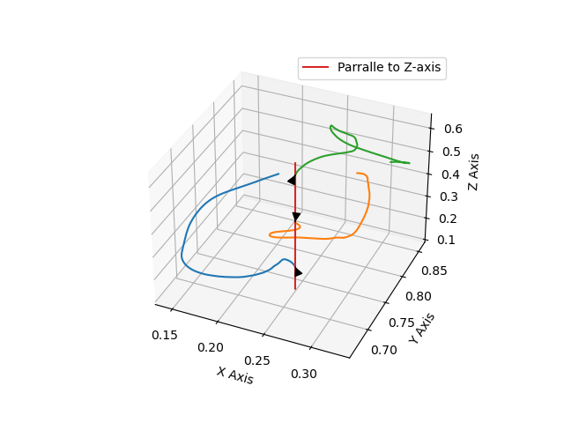
Field lines at a Seperation
The images given below show the form of the field lines at ’t=0’ and ’t=100000’ with initial points in a straight line parrallel to z-axis(x=0.2 and y= 0.7) at a seperation.

Slide 12
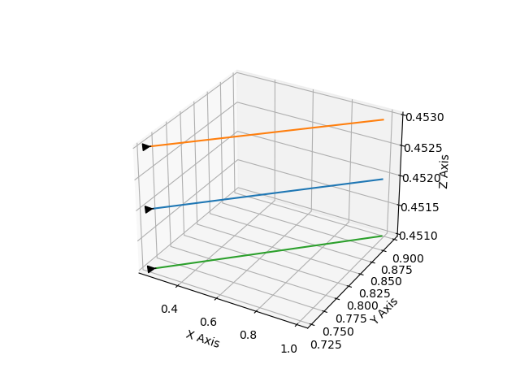
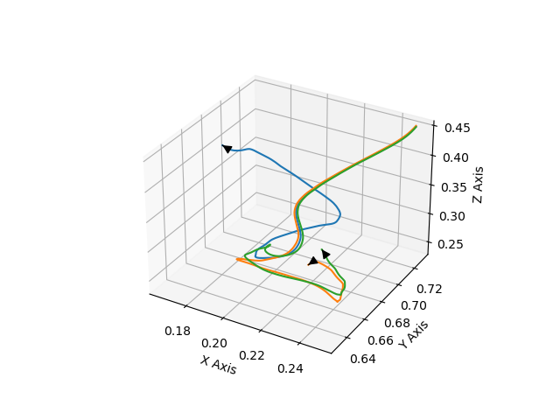
Adjoining Field lines
The images given below show the form of the field lines at ’t=0’ and ’t=100000’ with adjoined initial points.

Slide 13
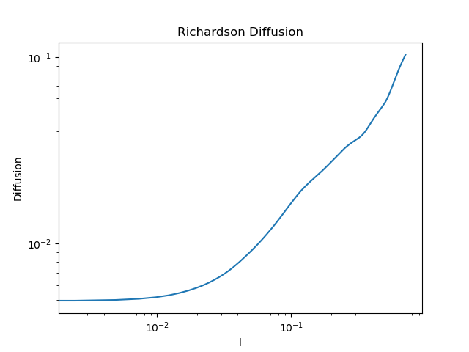
Diffusion of the Field lines
To find the diffusion we take 3 different localities with 10 magnetic field lines each.
”log(Diffusion)” vs ”log(l)”

Slide 14
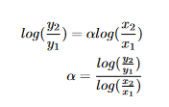

The straight line is of the form log(r) = αlog(l)+c, where α is the slope and c is the y-intercept.
We consider two end points (x1, y1) and (x2, y2).

Slide 15
Results
We take (x1=0.0494441, y1=0.00927756) and (x2=0.200011, y2=0.351961)
Calculating we get α= 0.954066858.
Diffusion r ∝ l^{0.954066858}.
Since we get α > 1/2 , it means that the field lines show Superdiffusion.

Slide 16
References
1. William H. Press, Saul A. Teukolsky, ”Adaptive Stepsize Runge-Kutta Integration”, Published by the American Institute of Physics in 1992.
2. Snehanshu Maiti, Kirit D. Makwana, Heshou Zhang, and Huirong Yan, ”Cosmic-ray Transport in Magnetohydrodynamic Turbulence”, Published in the The Astrophysical Journal by the American Astronomical Society on February 2022.
3. Peera Pongkitiwanichakul, Kirit D. Makwana, and David Ruffolo, ”Driving reconnection in sheared magnetic configurations with forced fluctuations”, Published in Physics of Plasmas on February 2018.
4. Abhinav Poddar, Engineering Physics, Department of Physics, Indian Institute of Technology Hyderabad, ”Tracing of field lines from MHD dataset”, April 2022

Slide 17
5. ”https://en.wikipedia.org/wiki/Magnetic reconnection”,”https://en.wikipedia.org/wiki/Plasma (physics)”
6. ”https://royalsocietypublishing.org/doi/10.1098/rsta.2014.0144”
7. ”https://numpy.org/doc/stable/reference/generated/numpy.interp.html”
8.”https://www.nature.com/articles/nature10827.pdf?pdf=reference”
9.”https://link.springer.com/article/10.1007/s41116-022-00032-9”
10.”https://www.compadre.org/nexusph/course/Diffusion and random walks”

