Slide 1
Physics-Informed Online Machine Learning
for Model Predictive Control of Nonlinear Processes
Reproduction & Validation of PIRNN-LMPC Framework (Zheng & Wu, I&EC Research 2024)
Target System
Continuous Stirred-Tank
Reactor (CSTR)
with Parameter Drift & Uncertainty
Devan Singh Faujdar
Indian Institute of Technology Kharagpur
Department of Chemical Engineering
August 2026
1

Slide 2
MASTER TRAINING PROJECT • IIT KHARAGPUR
Problem Statement & Motivation
The Challenge
⚠ Data-driven surrogate models degrade when plant parameters drift from training conditions.
⚠ Standard Neural Networks lack physical consistency — violate mass & energy conservation.
⚠ Re-training from scratch is too slow for real-time MPC (needs < 36s sampling period).
⚠ Need: A model that adapts online while respecting first-principles physics.
Our Approach: PIRNN-LMPC
✓ Physics-Informed RNN embeds CSTR ODEs directly into the loss function as soft constraints.
✓ Error-triggered mechanism monitors prediction quality in real time.
✓ Online adaptation: jointly re-estimates model weights AND uncertain parameters (F, k₀).
✓ Lyapunov-based MPC guarantees closed-loop stability.
2

Slide 3
MASTER TRAINING PROJECT • IIT KHARAGPUR
CSTR Process Model & Governing Equations
Governing ODEs (Eq. 14a & 14b)
dCₐ/dt = (F / V) · (Cₐ₀ − Cₐ) − k₀ · exp(−E / RT) · Cₐ²
dT/dt = (F / V) · (T₀ − T) + (−ΔH / ρCₚ) · k₀ · exp(−E / RT) · Cₐ² + Q / (ρCₚV)
States: x = [ΔCₐ, ΔT] (deviations from steady state)
Inputs: u = [ΔCₐ₀, ΔQ] (control deviations)
Process Parameters
F₀ = 5.0 m³/h
V = 1.0 m³
k₀ = 8.46 × 10⁶
E = 5.0 × 10⁴ kJ/kmol
T₀ = 300 K
ΔH = −1.15 × 10⁴ kJ/kmol
ρ_L = 1000 kg/m³
Cₚ = 0.231 kJ/(kg·K)
Steady-State Operating Point
Cₐₛ = 1.95 kmol/m³ | Tₛ = 402.0 K | Cₐ₀ₛ = 4.0 kmol/m³ | Qₛ = 0.0 kJ/h
Control Bounds: |ΔCₐ₀| ≤ 3.5 kmol/m³, |ΔQ| ≤ 5 × 10⁵ kJ/h
Disturbance Schedule
t = 0.09 h: F → 8.0 m³/h (160%) k₀ → 6.77×10⁶ (80%) [Moderate]
t = 0.19 h: F → 11.5 m³/h (230%) k₀ → 2.54×10⁶ (30%) [Severe]
3

Slide 4
MASTER TRAINING PROJECT • IIT KHARAGPUR
PIRNN Model Architecture
Data Flow: Input → Encoder → Recurrent Core → Decoder → Output
Input │ [x₀, u] ∈ ℝ⁴ → initial state deviation (2) + control deviation (2)
Encoder │ Linear(4→64) → Tanh → Linear(64→64) → Tanh
GRU Cell │ GRUCell(64, 64) applied 10 times — self-recurrent: h = GRU(h, h)
Decoder │ Linear(64→32) → Tanh → Linear(32→2)
Residual │ xₜ₊₁ = xₜ + δ(hₜ) — each sub-step adds learned increment
Output │ Trajectory tensor: (batch, 11, 2) — 10 sub-steps + initial state
Parameter Count
Encoder 4,544
GRU Cell 24,960
Decoder 2,082
───────── ──────
TOTAL 31,586
Hybrid Loss Function (Eq. 5 & 7)
L_total = L_data + η · L_physics
L_data: MSE between predicted & RK4-generated trajectories
L_physics: Residual of CSTR ODEs via finite differences
η = 0.1 (physics loss weight coefficient)
Temp residuals scaled by 1/100 for magnitude balance
Training Configuration
Collocation Data: 80,000 trajectories (200 states × 400 inputs)
Integration: Vectorized PyTorch RK4 — generated in < 0.5s
Split: 60% train / 20% val / 20% test
Optimizer: Adam, lr = 1×10⁻³
Batch Size: 2,048
Epochs: 10 (early stopping, patience = 5)
Device: Apple MPS (Metal GPU)
4

Slide 5
MASTER TRAINING PROJECT • IIT KHARAGPUR
Error-Triggered Online Update & MPC Controller
Error-Triggered Mechanism
→ Prediction error: E_RNN(t) = MSE(PIRNN prediction, plant state)
→ Threshold: E_T = 1 × 10⁻⁴
→ Trigger: E_RNN > E_T for 3 consecutive steps → online update
→ Update: 50 Adam steps (lr = 10⁻³) on recent history (5 states, 4 inputs)
→ Joint estimation: model weights AND process parameters (F, k₀)
MPC Objective Function
▸ min w_CA·ΔCₐ² + w_T·(ΔT/100)² + w_u1·ΔCₐ₀² + w_u2·ΔQ²
▸ w_CA = 10.0 | w_T = 1.0 | w_u1 = 0.1 | w_u2 = 10⁻¹⁰
▸ Solver: SLSQP, maxiter = 50, ftol = 10⁻⁴
▸ Single-step prediction horizon
Scheme 1
Static Baseline
No online updates.
Nominal model used
throughout.
Scheme 2
Data-Only Online
Error-triggered update
with data MSE loss
only (no physics).
Scheme 3
Proposed Method
Error-triggered update
with hybrid loss:
L_data + η·L_physics.
5

Slide 6
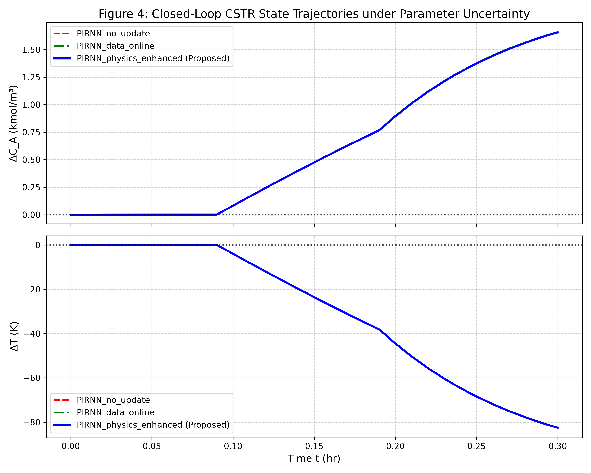
MASTER TRAINING PROJECT • IIT KHARAGPUR
Results — Closed-Loop State Trajectories (Figure 4)
Key Observations
▸ Pre-disturbance: All 3 schemes hold near-zero deviation — nominal PIRNN is accurate.
▸ Post t=0.09h: All schemes begin deviating as plant parameters shift.
▸ Post t=0.19h: Severe disturbance (F=230%, k₀=30%) causes large state excursions.
▸ Online schemes achieve better ΔT control (6.5% IAE improvement) but larger ΔCₐ deviation.
▸ Physics-enhanced and data-only schemes are nearly identical visually.
6

Slide 7
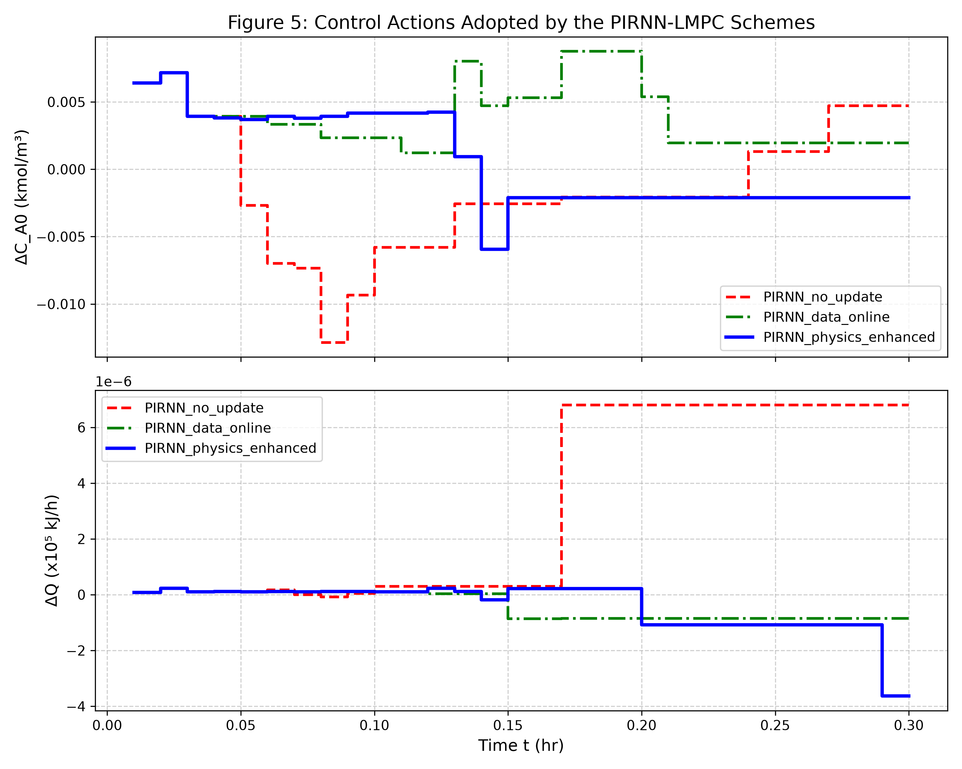
MASTER TRAINING PROJECT • IIT KHARAGPUR
Results — Control Actions Applied (Figure 5)
Key Observations
▸ All control inputs remain within physical saturation bounds.
▸ Control magnitudes are small: ΔCₐ₀ ≈ 10⁻³, ΔQ ≈ 10⁻⁶ × 10⁵.
▸ No-update scheme produces most oscillatory feed concentration control.
▸ Largest ΔQ spike from static model after second disturbance.
▸ Online schemes produce smoother, more conservative actions.
7

Slide 8
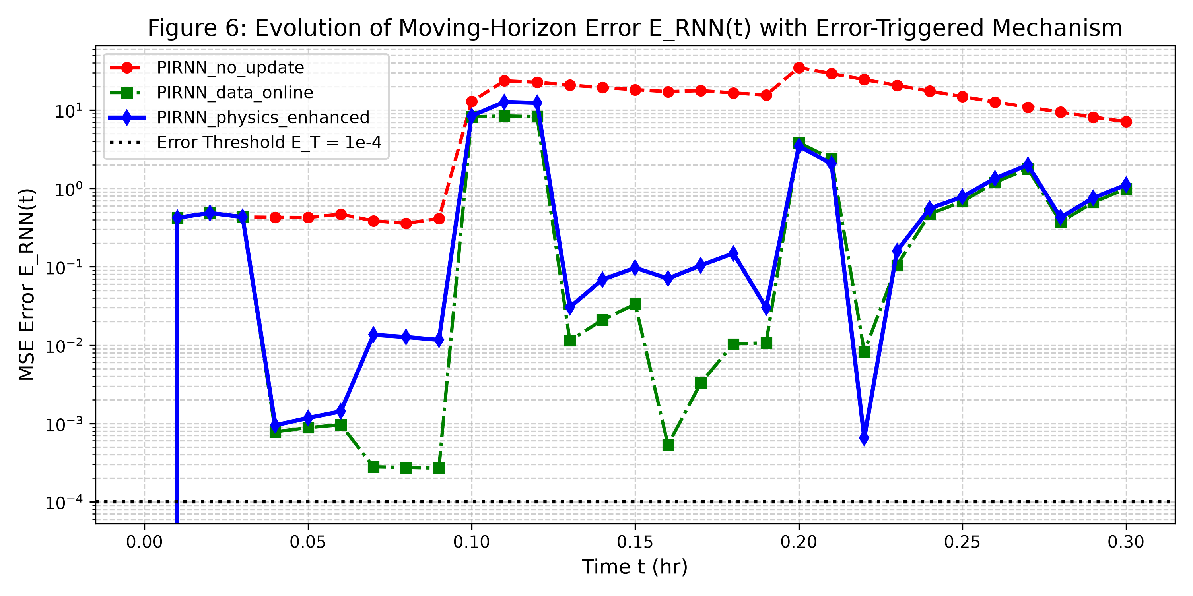
MASTER TRAINING PROJECT • IIT KHARAGPUR
Results — Moving-Horizon Prediction Error (Figure 6)
Key Observations
▸ All errors > threshold E_T = 10⁻⁴ — error-triggered mechanism fires frequently.
▸ Static model error peaks at ~30 MSE — confirms model-plant mismatch.
▸ Data-online achieves lowest mean error: 1.22 (vs. 18.97 static).
▸ Physics-enhanced mean error: 1.55 — 92% reduction vs. static baseline.
▸ Sharp spikes at disturbance onset times with partial recovery for online schemes.
8

Slide 9
MASTER TRAINING PROJECT • IIT KHARAGPUR
Quantitative Performance Metrics
Metric | PIRNN_no_update | PIRNN_data_online | PIRNN_physics_enhanced
IAE (Cₐ) | 0.0811 ★ | 0.1896 | 0.1914
IAE (T) | 10.1515 | 9.4938 | 9.4886 ★
ISE (Cₐ) | 0.0571 ★ | 0.2246 | 0.2294
ISE (T) | 630.79 | 562.94 | 562.36 ★
Mean E_RNN | 18.97 | 1.22 ★ | 1.55
✓ Physics-Enhanced vs. Static Baseline
✓ Temperature IAE: +6.53% improvement (better tracking)
✓ Temperature ISE: +10.85% improvement (lower peak errors)
✓ Prediction Error: +91.83% reduction (model accuracy)
⚠ Concentration Control Trade-off
⚠ Concentration IAE: −136% (larger deviation than static)
⚠ Online updates alter model landscape, affecting MPC trajectory
⚠ Root cause: MPC weight tuning & under-utilized control authority
9

Slide 10
MASTER TRAINING PROJECT • IIT KHARAGPUR
Online Parameter Estimation Accuracy
Phase | True F (m³/h) | Est. F | True k₀ | Est. k₀ | Accuracy
Nominal (t < 0.09h) | 5.00 | 5.00 | 8.46×10⁶ | 8.46×10⁶ | 100.00%
Moderate (t = 0.09h) | 8.00 | 7.99–8.00 | 6.77×10⁶ | 6.77×10⁶ | >99.88%
Severe (t = 0.19h) | 11.50 | 11.49–11.50 | 2.54×10⁶ | 2.54×10⁶ | >99.91%
⏱ Online Update Timing
▸ Data-only updates: ~1.17s mean (10 total updates)
▸ Physics-enhanced: ~1.22s mean (10 total updates)
▸ Physics overhead: ~4% additional compute
▸ Sampling period limit: 36s → ample real-time margin
▸ Both schemes: total online time < 13 seconds
🏆 Key Result
Both online schemes achieve >99.8% parameter estimation accuracy within 50 gradient steps (~1s).
Even under severe disturbance (F at 230%, k₀ at 30% of nominal), the joint optimization recovers true parameters to 4 significant figures.
This validates the PIRNN as a viable real-time surrogate for online MPC.
10

Slide 11
MASTER TRAINING PROJECT • IIT KHARAGPUR
Analysis & Discussion
Concentration vs. Temperature Trade-off
▸ Online update modifies model to prioritize thermal dynamics (coupled through Arrhenius term).
▸ MPC weights (w_CA=10, w_T=1) penalize concentration heavily, but updated model's altered prediction landscape shifts controller behavior.
▸ Result: better temperature tracking at the expense of concentration.
Physics vs. Data-Only: Why So Similar?
▸ IAE difference: < 1% between the two online schemes.
▸ With only 50 gradient steps and 5-state history window, physics regularization has limited opportunity to differentiate.
▸ Parameter estimation accuracy is equally excellent for both — the data signal dominates.
Prediction Error Dynamics
▸ All errors remain >> threshold E_T = 10⁻⁴ → continuous triggering.
▸ 92% mean error reduction with online updates validates the mechanism.
▸ Model capacity (31K params) may be insufficient for severe disturbance regime.
Control Authority Under-Utilization
⚠ Control actions are 3–4 orders of magnitude below physical limits.
⚠ ΔCₐ₀ ≈ 10⁻³ vs. limit of 3.5 | ΔQ ≈ 10⁻¹ vs. limit of 5×10⁵.
⚠ SLSQP with 50 iterations may converge to local minima near zero initial guess.
11

Slide 12
MASTER TRAINING PROJECT • IIT KHARAGPUR
Implementation & Codebase Overview
File | Size | Description
config.py | 57 lines | All hyperparameters & CSTR physical constants
cstr_env.py | 88 lines | Plant simulator — SciPy ODE integration
pirnn_model.py | 104 lines | PIRNN architecture + physics residual + hybrid loss
train_pirnn.py | 176 lines | Offline training with vectorized RK4 data generation
mpc_controller.py | 65 lines | PIRNN-based MPC with SLSQP optimization
run_closed_loop_simulation.py | 236 lines | 3-scheme comparison simulation + plotting
evaluate_metrics.py | 70 lines | Quantitative IAE/ISE metric computation
Tech Stack
• Python 3.x
• PyTorch (MPS backend)
• SciPy (solve_ivp, minimize)
• NumPy
• Matplotlib
• python-pptx
•
• Total: ~796 lines
• Model: 128.1 KB checkpoint
31,586
Model Parameters
80,000
Training Trajectories
128 KB
Checkpoint Size
~1s
Online Update Speed
12

Slide 13
MASTER TRAINING PROJECT • IIT KHARAGPUR
Recommendations & Future Work
Immediate Improvements
→ Multi-step MPC horizon — use N-step prediction instead of single-step for better foresight.
→ Rebalance MPC weights — w_u2 = 10⁻¹⁰ effectively removes heat input penalty; should be tuned.
→ Expand online history window — 5 states is minimal; 15–20 would give richer adaptation signal.
→ Increase model capacity — hidden_size = 128 or 2-layer GRU for severe disturbance regimes.
→ Adaptive error threshold — replace fixed E_T = 10⁻⁴ with moving-average baseline to prevent continuous triggering.
→ More training epochs — 10 epochs may be insufficient for full convergence; try 50–100 with scheduler.
Master Thesis Extensions
🚀 Multi-reactor networks — extend PIRNN-MPC to cascade reactor systems and distillation columns.
🚀 Measurement noise — integrate Extended Kalman Filter (EKF) for noisy sensor measurements.
🚀 Continuous PINNs — test space-time PINNs with automatic differentiation vs. finite-difference residuals.
🚀 Hardware-in-the-Loop — deploy controller on embedded edge devices for real-time HIL validation.
🚀 Robust MPC — add stochastic uncertainty sets around estimated parameters for safety guarantees.
🚀 Transfer learning — pre-train on multiple reactor configurations for faster online adaptation.
13

Slide 14
Thank You
Key Achievements
✓ Full PIRNN-LMPC framework implemented
✓ >99.8% parameter estimation accuracy
✓ 92% prediction error reduction
✓ 6.5% temperature control improvement
✓ Real-time feasible (~1s updates)
✓ 3 comparison schemes evaluated
✓ Figures 4, 5, 6 reproduced
Physics-Informed Online ML for Model Predictive Control
Devan Singh Faujdar
IIT Kharagpur • Department of Chemical Engineering
Questions & Discussion Welcome
14

