Slide 1
King County House Prices Prediction Model Instructor- Ebrahim Nasrabadi Submitted by- Sayali Walke

Slide 2
SUMMARY
Overview:
This dataset contains house sale prices for King County including homes sold between May 2014 and May 2015.
Purpose:
The goal is to predict the sales price for each house based on the given features.
Objectives:
1] Data Analysis
2] Data Visualization
3] Data Preprocessing
4] Feature Selection
5] Model Implementation
6] Future Improvements
7] Learning Outcomes

Slide 3
Overview of Dataset
This dataset has 18
Features.
Id to denote the house
Date on which the house was sold
Column Name | Description
id | a notation for a house
date | Date house was sold
price | Price is prediction target
bedrooms | Number of Bedrooms/House
bathrooms | Number of bathrooms/House
sqft_living | square footage of the home
sqft_lot | square footage of the lot
floors | Total floors (levels) in house
waterfront | House which has a view to a waterfront
view | Has been viewed
condition | How good the condition is ( Overall )
grade | overall grade given to the housing unit, based on King County grading system
sqft_above | square footage of house apart from basement
sqft_basement | square footage of the basement
yr_built | Built Year
yr_renovated | Year when house was renovated
Zipcode | zip
Lat | Latitude coordinate
Long | Longitude coordinate
sqft_living15 | Living room area in 2015
sqft_lot15 | lotSize area in 2015

Slide 4
Data Analysis and Data Cleaning
Simple checkpoints:
Missing values- checked for missing values in dataset
Unique values- checked for unique values of house id
Statistical Analysis:
Average price of house sold in King County is $538926.
Very few houses which have some features and price appear far from others like 33 bedrooms or price
$7700000
There will always be some outliers as some luxury house prices in this dataset. I have addressed this
problem in next step to reduce the effect of outliers
The sqft_living column has maximum value of 12050 sqft, which is 3 standard deviations above mean.
Avg no. of 3 bedrooms and 2 bathrooms per house were sold in King County
Avg area of house is 2071 Sqft with one house having 12050 Sqft. Area
The dataset contains houses built from year 1900 to 2015

Slide 5
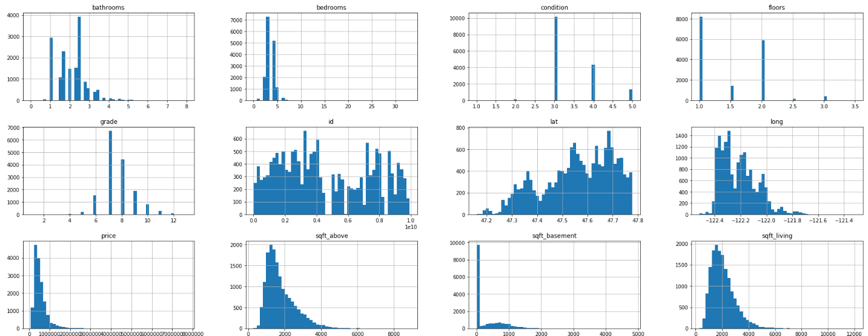
Data Visualization
Observations:
Most of the houses in the dataset have 3 bedrooms and have only 1 floor
Most of the houses have more than average condition(3)
For most of the houses overall grade is 7
The histograms of Price is right-skewed.

Slide 6
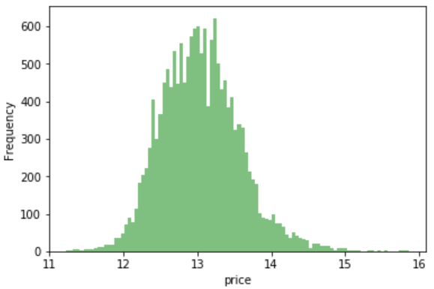
Data Preprocessing
Log transformation:
According to visualization in previous slide
histogram of price of the houses
was right-skewed
If the data is skewed, then the mean
may not provide a good estimate for
the center of the data and represent
where most of the data fall
The price of house varies from 75K to 7.7M
By normalizing price variable I made value of
this numeric column common scale,
without distorting differences in the ranges
of values.
Log transformed Histogram of price

Slide 7
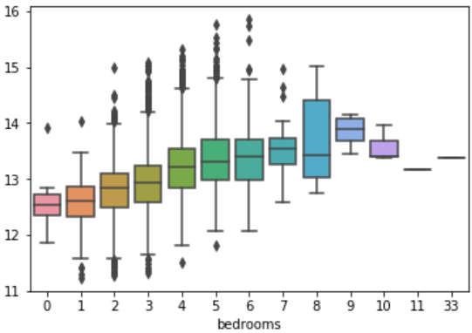
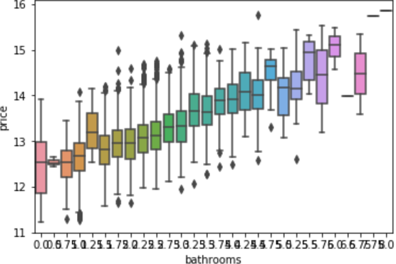
Box plots
Outliers:
From the statistical analysis I found that the features sqft_living, sqft_lot, bedrooms, bathrooms have maximum value above two standard deviations that means, these features have outliers
From above box plots we can say the outliers for price variable correspond to outliers in these features and outliers in these features corresponds to outliers in grade, condition
So after considering these dependencies I have decided to keep these outliers

Slide 8
Data Preprocessing
Computed Columns:
While traversing through dataset I found that some of the columns are not much significant. So, In order to provide us with better understanding of the data, I computed new columns.
Age of house = year_sold (extracted from date column) – yr_built
Is_renovated (0 or 1) = 0 if yr_renovated is not present
1 if yr_renovated is present
Encoding high cardinality features:
High-cardinality refers to columns with values that are very uncommon or unique
For this dataset feature zip code with many distinct value could be very predictive as it could be telling prices of house according to area
I have encoded zip code into dummy numerical value and later investigated its relationship with price.

Slide 9
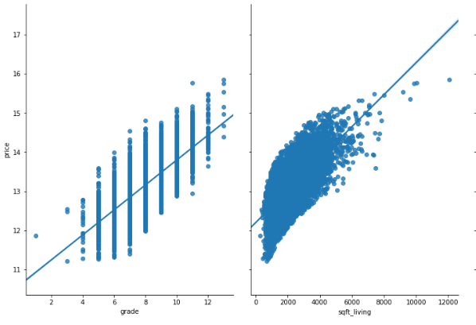
Feature Selection
1] Filter Method using correlation:
Correlation refers to some statistical relationships involving dependencies between variables
For better understanding of relationships between features, I have used heatmap
But as we are more interested in finding out relationship between features and response,
I have calculated correlation coefficients of all the features with respect to price
These are the pair plots of grade and sqft_living with
respect to price. The price of houses is more if the
grade and sqft area is more. The correlation
coefficient >0.5 and visualization makes it clear that
price of houses is highly dependent on grade and
Sqft area.
Grade= 0.705
Sqft_living= 0.698

Slide 10
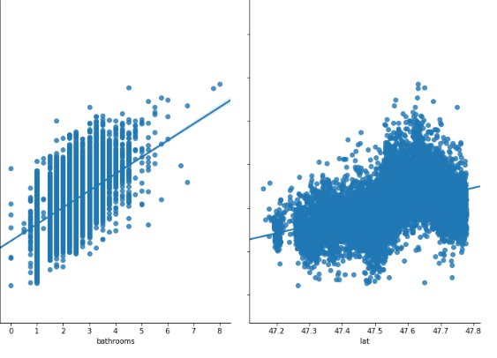
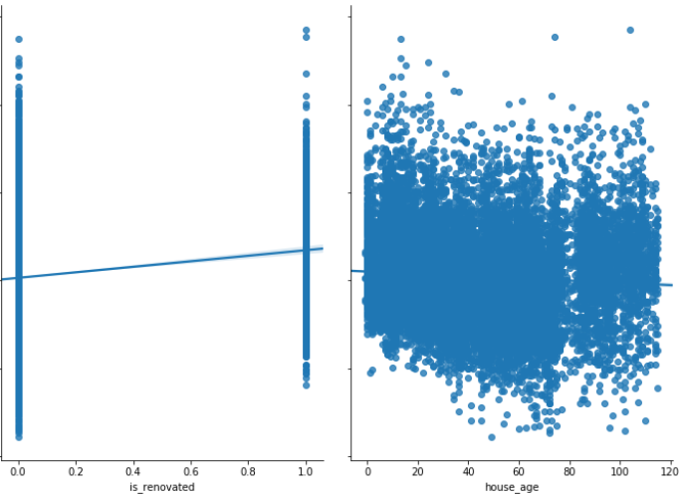
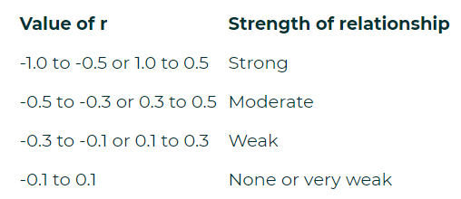
Bathrooms= 0.552
Lat=0.495
Is_renovated=0.125
House_age=-0.03
From the above pair plot it is clear that as correlation coefficient decreases, the dependency of price on that feature also decreases.
This table shows the interpretation of
Correlation Coefficients.
Using this I have selected different
features for my model

Slide 11
Feature Selection
Recursive feature elimination:
Method works by recursively removing attributes and building a model on those attributes that
remain. It uses accuracy metric to rank the feature according to their importance.
Backward Feature elimination:
Method works by feeding all the possible features to the model at first. We check the performance
of the model and then iteratively remove the worst performing features one by one till the overall
performance of the model comes in acceptable range
The performance metric used here to evaluate feature performance is pvalue. If the pvalue is above
0.05 then we remove the feature, else we keep it
Using these different techniques the various feature subsets were found and later used in
model implementation.

Slide 12
Model Implementation
1. Simple Linear regression:
Selected features whose correlation coefficient with price is more than 0.5.
One of the assumptions of linear regression is that the independent variables need to be uncorrelated with each other so, I discarded those features which were highly correlated to each other
R squared for this model was low because number of features were less.
2. Complex Linear regression:
Selected features whose correlation coefficient with price is more than 0.2
Out of 13 features found, selected best possible 11 features using Recursive elimination technique
R squared for this model showed much improvement compared to previous model
3. Ridge regression:
In ridge regression, the cost function is altered by adding a penalty equivalent to square of the magnitude of the coefficients.
Ridge was implemented by using same set of features in previous model and R squared value increased slightly

Slide 13
Simple Linear regression:
Complex Linear regression:
Ridge regression: In ridge regression, the cost function is altered by adding a penalty equivalent to square of the magnitude of the coefficients.
4. Polynomial regression:
The given equation represents how polynomial regression model calculates response
This model was built using the same feature subset in previous model.
Model gives highest R squared value i.e 77% and least RMSLE.
5. Ridge regression with more features:
Selected all the features in datasets including the computed columns
Using Backward elimination technique created the feature subset of 84 features
Model gave R squared value i.e. 81% with alpha value 1
But I have not selected this model because it has more features.
6. Lasso regression with more features:
In Lasso model instead of taking the square of the coefficients, magnitudes are taken into account. This regularization leads to zero coefficients which reduces overfitting
This model with 84 features and alpha value 0.01 gave R squared value 74.7%

Slide 14
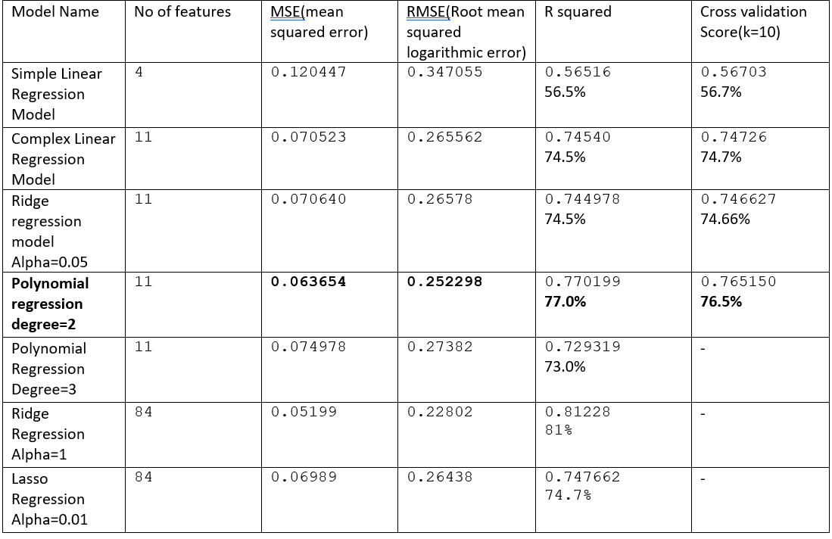
Summary of models

Slide 15
Future Improvements
More techniques can be used for data cleaning, preprocessing
Feature selection process can be done more precisely
Embedded method can be used to decide feature importance
Explore different machine learning algorithms like Random Forest
The model can be made more precise by using techniques Gradient boosting, XGBoost
Evaluate model performance using different accuracy metrics

Slide 16
Learning Outcomes
Dealing with high cardinality columns
Computed useful columns
Learned analyzing and processing large dataset
Implemented and interpreted some good visualizations
Learned different techniques of feature selection
Implemented various machine learning algorithm and evaluated their performances

Slide 17
Thank you!

