Slide 1
Credit Card Fraud Detection Model Instructor- Ebrahim Nasrabadi Submitted by- Sayali Walke

Slide 2
Summary
Overview:
This dataset contains credit card transactions in September 2013 by European cardholders.
Purpose:
The goal is to detect fraudulent and non fraudulent transactions.
Objectives:
1] Data Analysis
2] Data Visualization
3] Data Preprocessing
4] Model Implementation
5] Future Improvements
6] Learning Outcomes

Slide 3
Overview of Dataset
This dataset has 28 numerical input variables as the result of a PCA transformation.
The other inputs that have not been transformed are 'Time' and 'Amount’.
The variable 'Time' contains the seconds elapsed between each transaction and the first transaction in the dataset.
The variable ‘Amount' is the transaction Amount.
The variable 'Class' is the response variable and it takes value 1 in case of fraud and 0 otherwise.

Slide 4
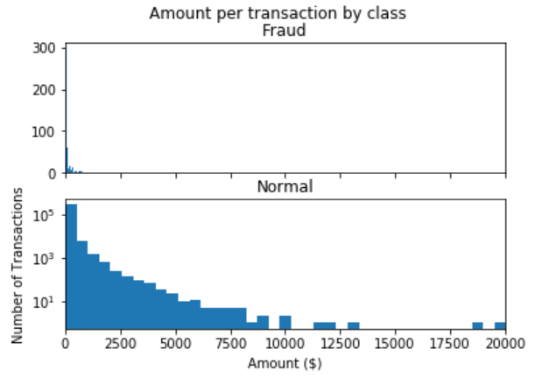
Data Analysis and Data Cleaning
Simple checkpoints:
Missing values- checked for missing values in dataset
Unique values- checked for unique values of transaction id
Statistical Analysis:
There is no metadata about the original
features provided, so pre-analysis or
feature study could not be done.
The transaction amount is relatively small.
The mean of all the amounts made is
approximately USD 88.
The maximum transaction amount is
USD 25691.

Slide 5
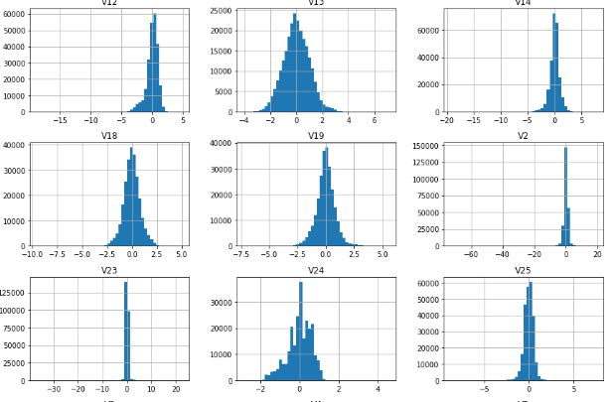
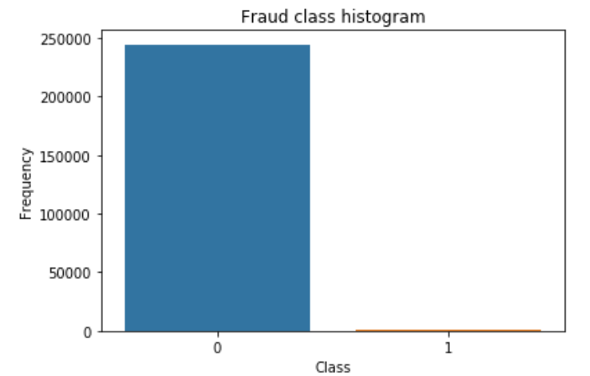
Data Visualization
Observations:
All the PCA transformed features are scaled
Amount and Time input are not scaled
In fig 2. we can see that most of the transactions(99.9%) are non –fraud and very few(0.172%) are fraud

Slide 6
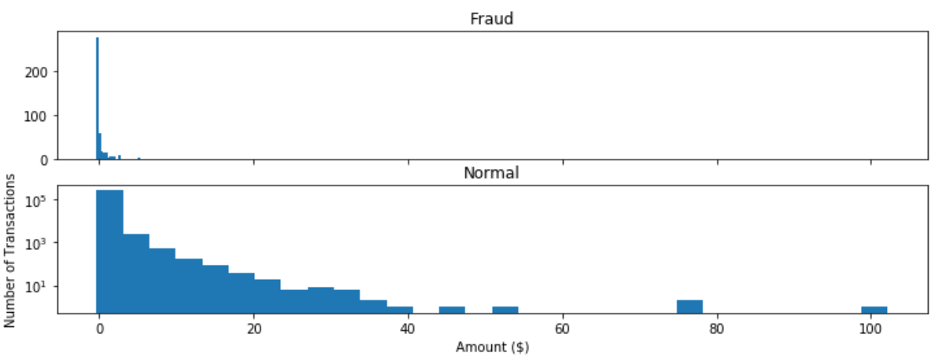
Data Preprocessing
Scaling:
As observed from histograms most of the features are scaled except Amount and Time
I have scaled the Amount column and created new column norm_amount
Dropped Time, Amount, ID columns
In the fig. we can see number of transactions v/s for Fraud and Non- Fraud Categories

Slide 7
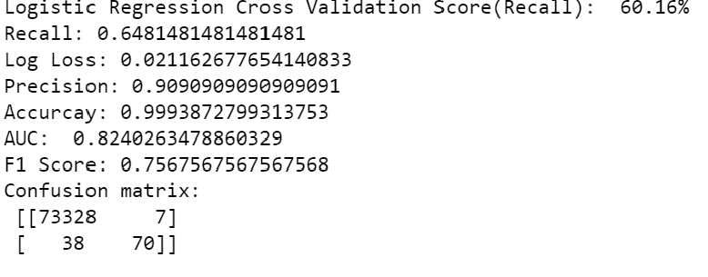
Data Preprocessing
Need of sampling :
Fit logistic regression on imbalanced dataset
Got accuracy of 99.9% But it’s not true.
As most of the labels 0, even random guess
gives 99% accuracy.
So use Recall as a accuracy measure which
measures the ability of model to predict right
for a given label.
Recall is very Low 64.814%

Slide 8
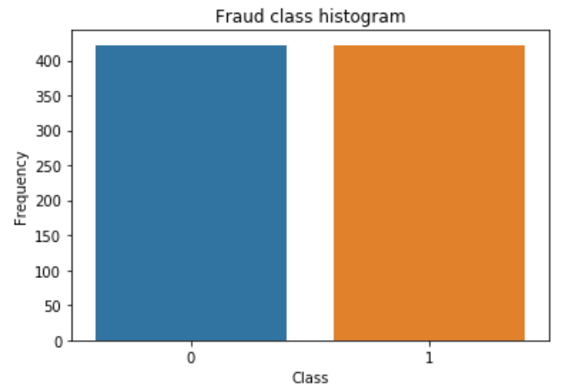
Data Preprocessing
Under sampling:
Under sampling is one of the techniques used for handling class imbalance.
In this technique, we under sample majority class to match the minority class and make sure that the training data has equal amount of fraud and non-fraud samples.
In the fig we can see that training dataset has equal number of fraud and non-fraud
Transactions.

Slide 9
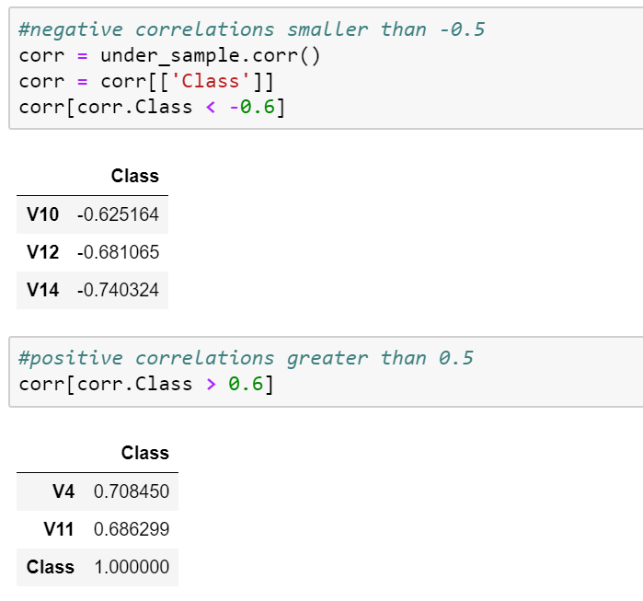
Feature Selection
Filter Method using correlation:
If we try to correlate class and features
on imbalanced dataset then it will be of no
use because we will not see true correlations
of features with result.
Try correlating class and features on under
sampled dataset
Fitted the model with best possible features
But it resulted in poor performance

Slide 10
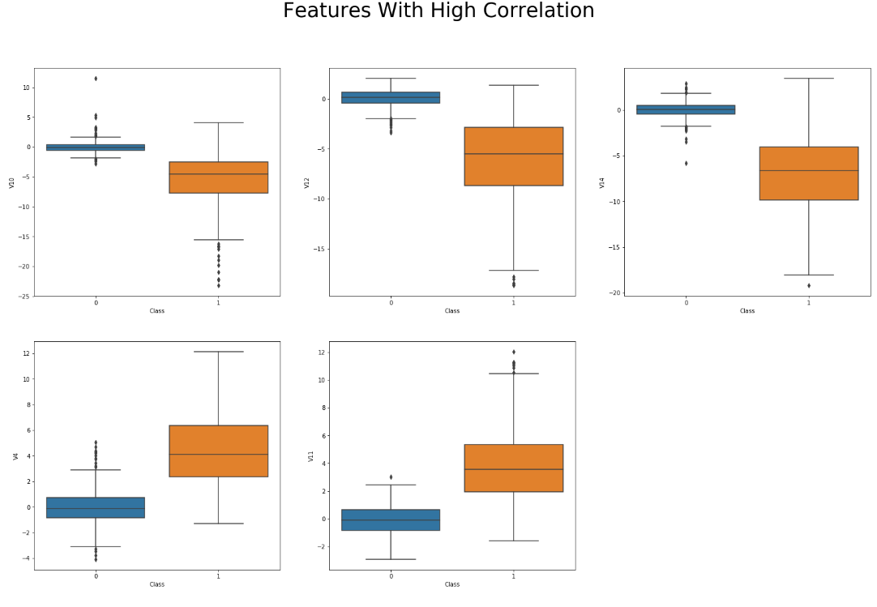
Box plots

Slide 11
Outliers
Removed the extreme outliers which were outside of 2.5 times IQR
Fitted models with and without outliers
Got better result before removing outliers
Before even thinking of removing outliers there should be enough evidence that these observations are actual outliers
It should be done by in depth statistical analysis to make sure that these observations are actual outliers because different ML methods used for detecting fraud, are based on anomaly detection and they treat such extreme outliers as frauds.
So, by removing them we delete the most important observations, that have higher probability of being frauds

Slide 12
Model Implementation
1] Logistic regression on imbalanced dataset
2] Logistic regression using class_weight: scikit-learn logistic regression has a option named class_weight when specified does class imbalance handling implicitly.
3] Logistic regression with tuning parameters[0.001, 0.1,1,10]
4] Decision Tree Classifier

Slide 13
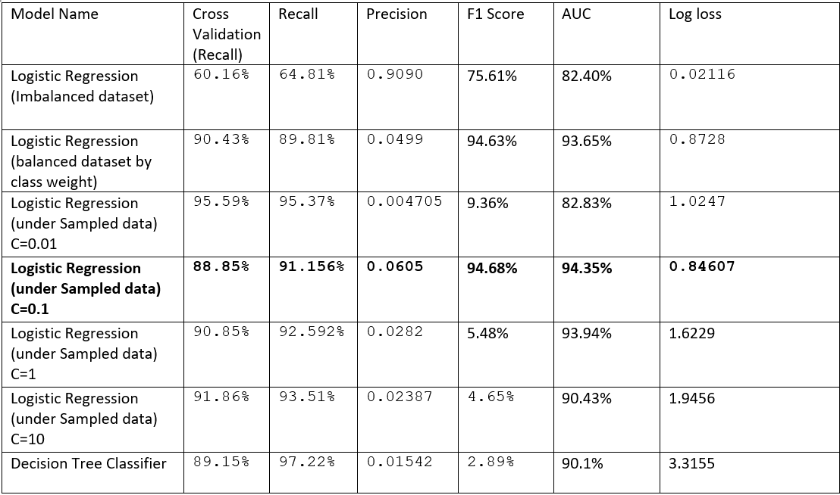
Summary of models

Slide 14
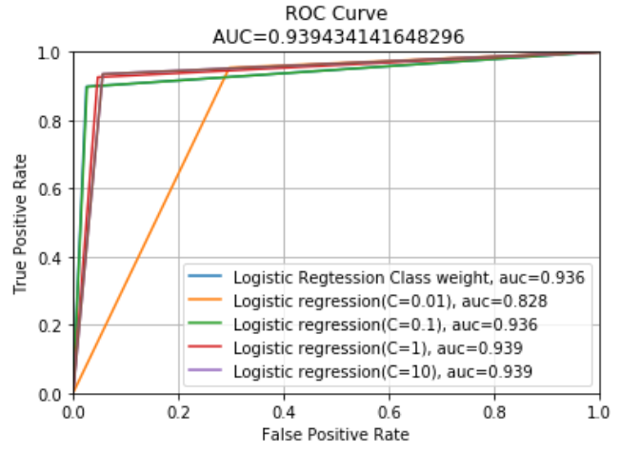
Summary of models

Slide 15
Future Improvements
More techniques can be explored for sampling like Over sampling, SMOTE
In depth analysis for outlier detection
Explore different techniques for feature selection
Explore different machine learning algorithms like Random Forest Classifier, Support Vector etc
Explore classification by changing threshold

Slide 16
Learning Outcomes
Dealing with imbalanced dataset
Learned analyzing and processing large dataset
Implemented and interpreted some good visualizations
Implemented various machine learning algorithm and evaluated their performances based on various accuracy metrics

Slide 17
Thank you!

