Slide 1
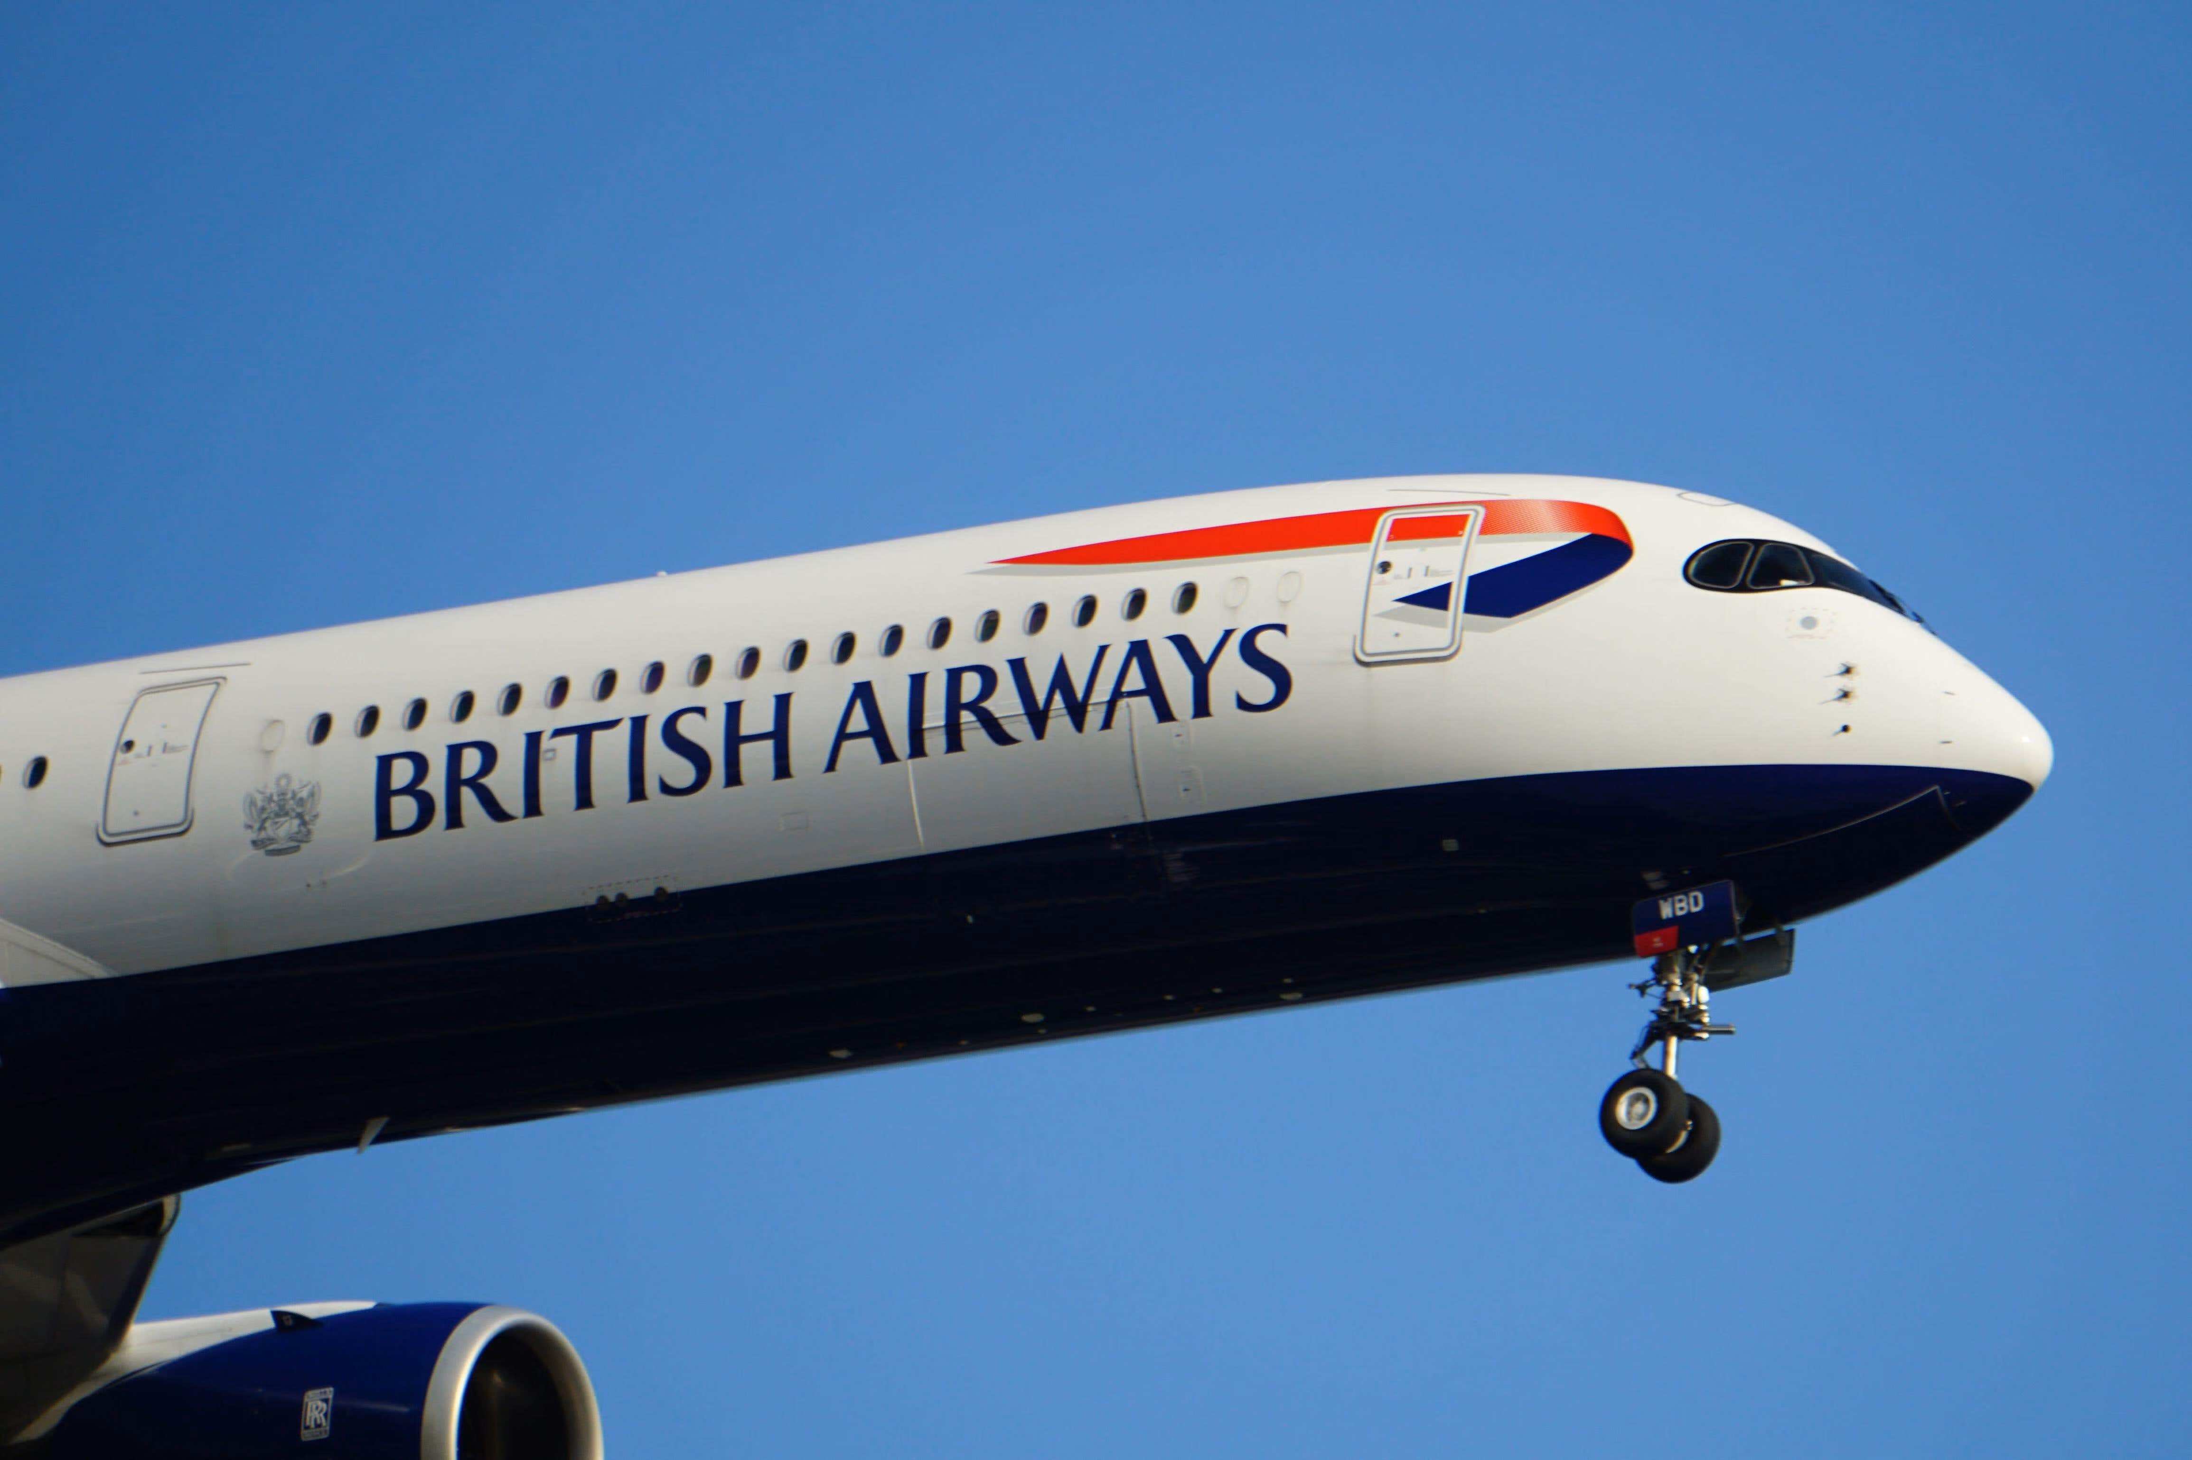
BRITISH AIRWAYS
CUSTOMER RATING ANALYSIS

Slide 2
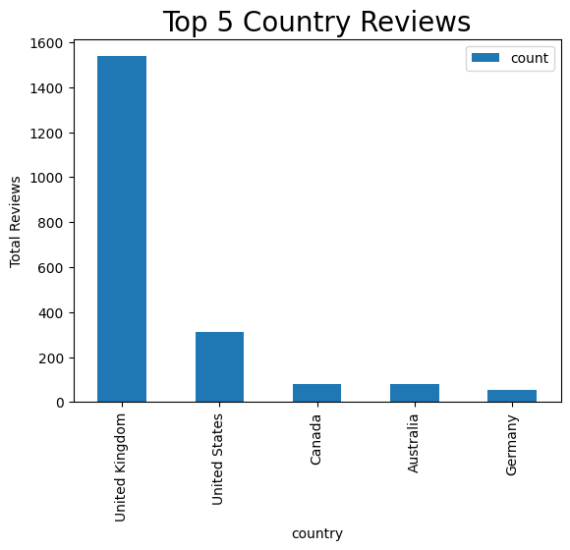
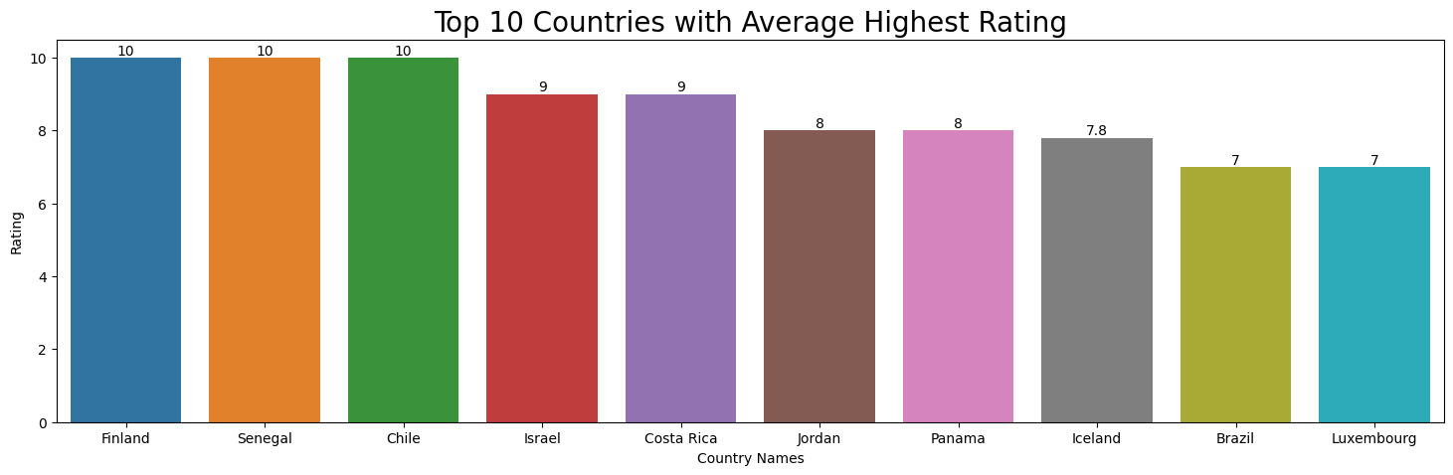
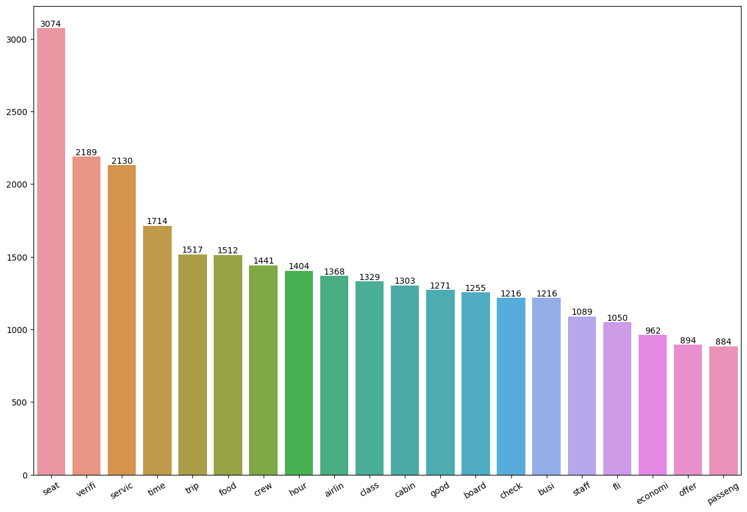

Average Overall Rating
4.29 /10
Total Reviews Collected
2500
Reviews From
68 Countries
Finland, Senegal, Chile are the countries with highest average rating.
United Kingdom has given maximum rating.
There were 1370 people who has not verified trip and only 1170 people has verified trip.
All customers like seating arrangement, crew, food, service.
Focus on economic and business class services and entertainment experience and delays

