Slide 1
DATA DETECTIVE CHALLENGE
Ecomstore's Expansion Strategy

Slide 2
Overview
The Ecomstore is a large company that sells various products under various categories to customers around the globe. The company now wants to expand their horizons and make more profits and become a global behemoth.
This data analysis includes the results of the statistical techniques used to identify correlations, trends, or patterns observed in the dataset containing various information about various orders received by the company over the last three years. The report aims to provide solutions for the company's goals of expanding its business and maximizing profits.

Slide 3
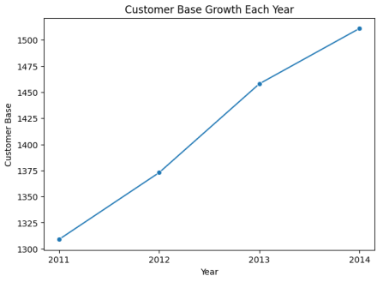
Customer Base
Over the last four years, the company has seen a slow but steady growth of its customer base, gaining almost 95 unique customers each year over the timeframe of three years. The company currently has 1590 customers with different demographic backgrounds.

Slide 4
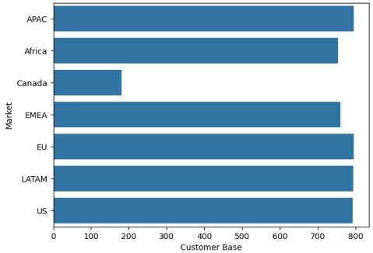
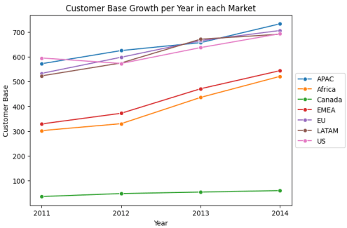
Customer Base of Markets
Customer Base Growth in each Market
The company has an almost equal customer base in different markets. However, The Canada Market as an exception has a significantly low customer base. The consumer base in the Canadian market has remained low and stagnant over the past three years, whereas a positive trend can be seen in the markets of Africa, EMEA, US, EU, and APAC. However, an unsteady trend is observed for the LATAM market.

Slide 5
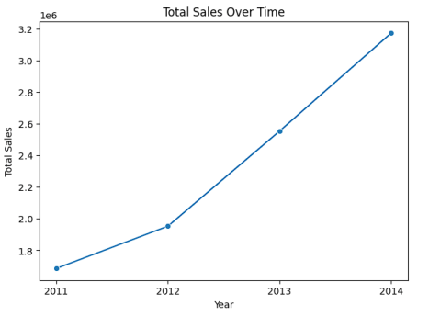
Sales Analysis
The company has experienced significant growth in its sales over the past three years. The growth has remained steady and constant and possibly results from a similar trend in its customer base.

Slide 6
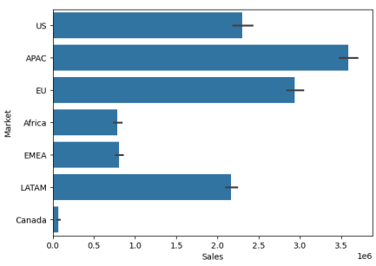
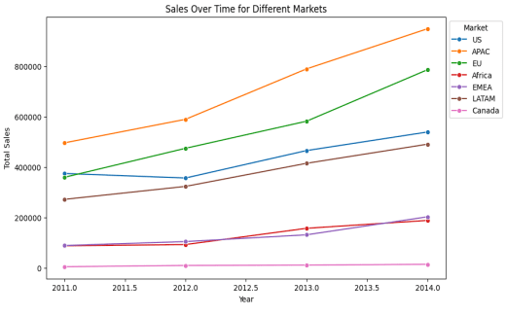
High Sales in US, APAC, and LATAM and low sales in Africa, Canada and EMEA Markets
The company has its highest sale in APAC followed by EU, US and LATAM. Also, these markets have shown a positive increase in sales over years. However, sales in Africa, EMEA and Canada are significantly low, where Canada is the lowest. The sales in Canada is also stagnant over the years but slight increasing for Africa and EMEA.
Total Sales of Markets
Total Sales of Markets per Year

Slide 7
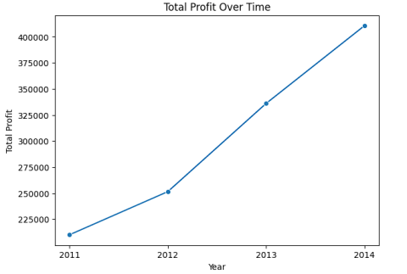
Profit Analysis
The company has been generating increasing profits over the last three years. The steady growth in profits is an indication of the excellent financial performance of the company, which also provides the basis for taking further risks of expansion into markets with low customer base

Slide 8
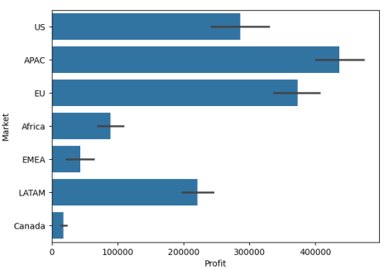
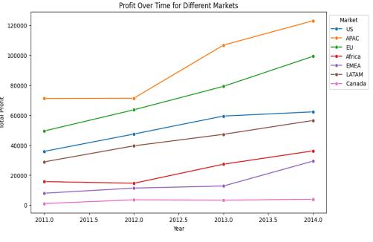
Similar Trend as for Sales but relatively low Profit in EMEA than Africa even with same sales
The company follows a similar trend in profits as in sales, it has its highest sale in APAC followed by EU, US and LATAM and very less for Africa, EMEA and Canada. However, it has very less profit from EMEA than Africa despite of having equal sales.
Total Profits of Markets
Total Profits of Markets per year

Slide 9
US equivalent Customer Base of EMEA and Africa but less profits and sales
The African and EMEA markets have almost the same customer base as the European and US markets, but its profit and sales are significantly lower.
Total Customer Base of Markets
Total Sales of Markets per year

Slide 10
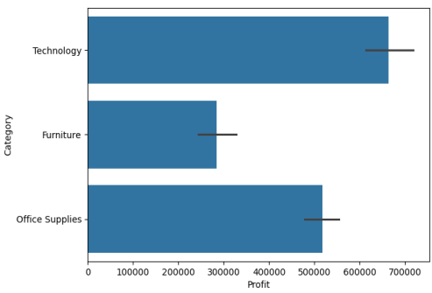
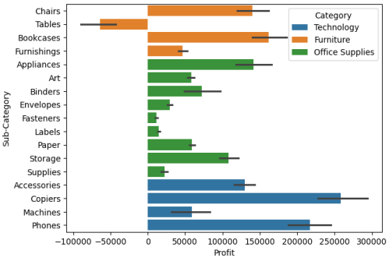
Significant losses in Tables Category
The category of office supplies comes in second with the highest profit, while the category of furniture has the lowest profit. The losses resulting from the sale of tables can be to blame for this.
Total Profits of Categories
Total Profits of Sub-Categories

Slide 11
Financial Ratio Analysis
The financial ratios being used for analysis are GPR, NPR, PPQ and SCR.
GPR: Gross Profit Ratio
NPR: Net Profit Ratio
PPQ: Profit per Quantity

Slide 12
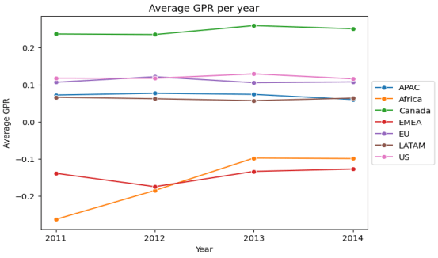
Market GPR Trends: Highest in Canada, Sharp Increase in Africa
The average GPR is maximum for the Canada market in the span of four years which represents the scope of expansion in Canada Market. Also, it is able to maintain almost constant GPR over time. The market of Africa has shown a good increase in average GPR over years.
Average GPR per year of Markets

Slide 13
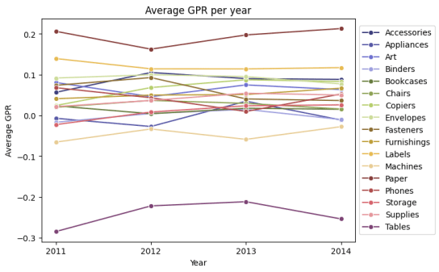
Negative GPR for Tables and Machines and stagnant for other sub-categories
All of the sub-categories have almost maintained the same average GPR with time, while tables and machines have maintained the negative GPR.
Average GPR per year of Sub-Categories

Slide 14
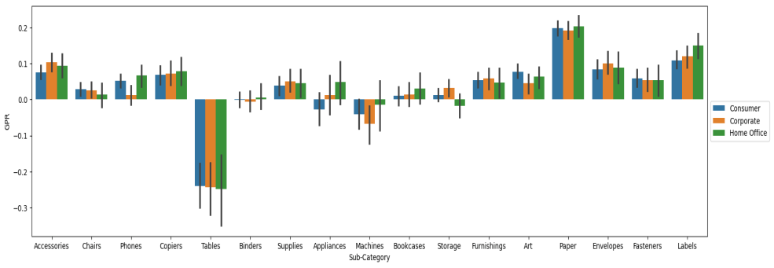
Negative GPR of Tables in all three segments and Machines
Tables and Machines has the negative GPR for all of the segments.
Average GPR of Categories in different Segments

Slide 15
Strategies For Expansion and for Maximizing Profits

Slide 16
Expansion in Canada:
The low sales and profit figures in the Canadian market can be attributed to the significantly low customer base.
Customer Base of Markets
Sales of Markets
Profits of Markets

Slide 17
Expansion in Canada:
The mean GPR is maximum for the Canadian market in the span of three years. Also, it is able to maintain almost constant GPR over time.
Average GPR per year of Markets

Slide 18
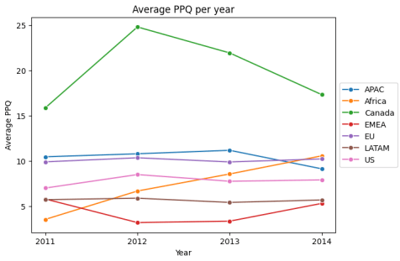
Expansion in Canada:
The average PPQ has been the highest for the Canadian market in the consumer and corporate segments in the span of three years.
Average PPQ per year of Markets

Slide 19
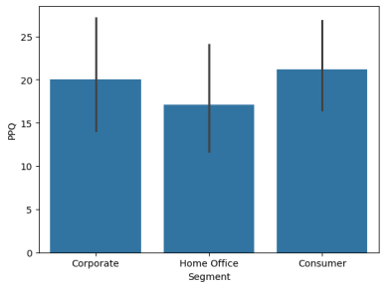
Expansion in Canada:
All these show that there is a very high potential for expansion in the Canadian market. The trend also shows that there is scope for expansion in almost all customer segments and product categories.
PPQ from each Segment in Canada Market

Slide 20
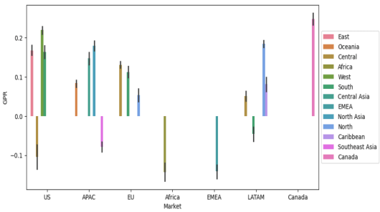
Better focus on African market:
The African market has almost the same customer base as the European and US markets, but its profits and sales are significantly lower. The gross profit ratio (GPR) has remained low and negative for the market. This shows that the Africa is currently very inefficient for company operations. This is also true for EMEA market
Customer Base of Markets
Average GPR of Markets

Slide 21
Better focus on African market:
However, the mean GPR and PPQ for African markets have increased over the span of three years, while they have remained constant or slightly increased in other markets, including EMEA.
Average GPR per year of Markets
Average PPQ per year of Markets

Slide 22
This shows that the African market, though currently inefficient, may have potential for growth and higher profits, similar to present day EU and US markets. Engaging the customer base and increasing the sales of product subcategories with high GPR and PPQ values will help achieve this.
But EMEA is expected to remain inefficient, despite still generating profits for the company. The company should remain vigilant regarding the EMEA market.

Slide 23
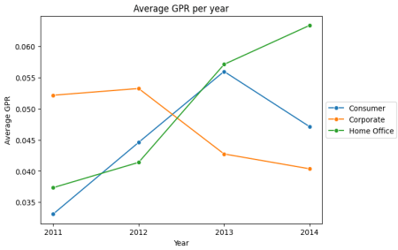
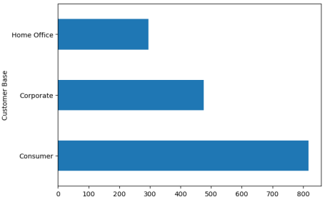
Segment-wise focus on certain categories of products:
The mean GPR, NPR and PPQ of the Home Office segment have shown a significant increase over the past three years. As there is a lower consumer base in this segment, these stats show this segment offers a good scope of expansion in all the markets.
Average GPR per year of Segments
Customer Base of Segments

Slide 24
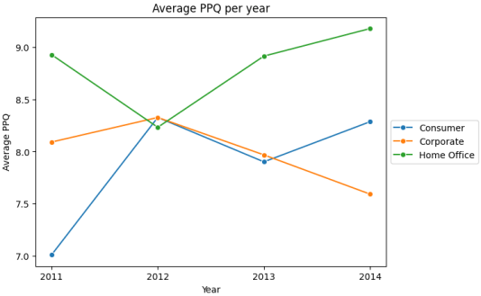
The PPQ and GPR have shown a declining trend over the last three years for the corporate segment. This may lead to reduced profits and even losses in the future. Thus there is a need to be vigilant here and try expanding in other two segments.
Average PPQ per year of Segments

Slide 25
The company is advised not to sell Tables, or to sell only those brands where they don't encounter losses, especially in the markets of the US, APAC and EU, where losses are considerably high.
Average PPQ of Sub-Categories
The company is advised not to sell tables, or to sell only those brands where they don't encounter losses, especially in the markets of the US, APAC and EU, where losses are considerably high.

Slide 26



Team:
DATA DETECTIVES
Devanand
Vikas
Gouri

Slide 27
Thank you.

