Slide 1

A Secure Web-Based Editorial Services Management System
Devananda Rajan
24MCA28
Under the Supervision of
Dr. Fousia M Shamsudeen
TKM College of Engineering, Kollam
MCA
Department of Computer Applications
March 16, 2026

Slide 2
Presentation Outline
Introduction
Problem Statement
Existing Systems
Objectives
Literature Review
Research Gap
Methodology
Project Status
Screenshots
Conclusion

Slide 3
Introduction
The Secure Web-Based Editorial Services Management System is a web application designed to manage editorial services through a centralized platform.
The system allows users to submit documents and provide editing instructions in a structured manner.
Users can track the progress of their editorial requests through the application.
Editors and administrators can efficiently manage documents, communication, and workflows within the system.

Slide 4
Problem statement
No centralized system for managing clients.
Files shared through common communication channels.
Difficult to track:
Risk of data loss and data breach.
Time-consuming manual coordination.
Payment Status
Project Progress
Client Communication

Slide 5
Existing Systems
Editorial services are managed using emails, messaging apps, or generic web platforms.
Limited workflow tracking and Communication.
Lack of a centralized and structured workflow.
Limited security for document sharing and communication.
Manual processes cause delays and inefficiency.

Slide 6
Literature Review
Sl.No | Journal Details | Techniques used | Pros | Cons
1. | Samuel M. Alade “Design and Implementation of a Web-Based Document Management System”, International Journal of Information Technology and Computer Science (IJITCS), 2023 | Web-based document management, role-based access, upload/retrieval | Foundation for web document systems | Does not include advanced security, automation, or payments
2 | Suprakash Sudarsanan Nair, Karuppasamy Mariappan “A Secure Framework for Communication in Web Applications”, Engineering Proceedings, 2023 | SSL/TLS, encryption | Improves secure communication | Does not address workflow or payment
3 | Anrie Suryaningrat et al “File Upload Security: Essential Practices for Programmers”, CCIT Journal, 2024 | Input sanitization, secure upload validation | Reduces file-upload vulnerabilities | Limited Storage Security concepts.

Slide 7
Research Gap
Existing systems provide only basic document management without complete editorial workflows.
Security features are limited.
Users cannot initiate editor revisions, restricting the document management process.
Secure online payment integration is not included with document management systems.

Slide 8
Objectives
Develop a secure web-based platform.
Provide secure file upload and communication system.
Enable structured editing instructions submission.
Enable secure online payment transactions.
Improve data management and workflow efficiency.

Slide 9
Methodology – System Architecture
Clientt
Admin/Editors
Editorial Service Management System
Document Handling
Document and Upload Management
Communication
Structured Instructions and Messaging
Quote and Payment Processing
Inquiry, Quotes and Secure Payments
Database Storage
Payment Gatewayt

Slide 10
Methodology- Workflow
Account Creation & Login
-User registers and logs into the system.
Service Request Submission
- User submits a request specify required services.
- Admin reviews the request
3. Quote Preparation & Response
- Admin prepares a quote based on the request.
- User receives details about payment.
Client Decision & Document Upload
- client agrees on payment and uploads the document
- Payment is made through the secure gateway
Editorial Work
- Admin assigns work and uploads edited files once completed.
6. Revision & Final Delivery
- if revisions are needed, the client requests them.
- Final edited document is delivered to the client.

Slide 11
Methodology
Technologies Used:
Front-End : HTML, CSS, Bootstrap(v5.3)
Back-End : PHP Laravel
Database : MySQL

Slide 12
Project Status
Works | Status
Front-End: Form Pages Informational Pages Client Portal: Dashboard Project Submission Portal Review and Reset Password | Completed

Slide 13
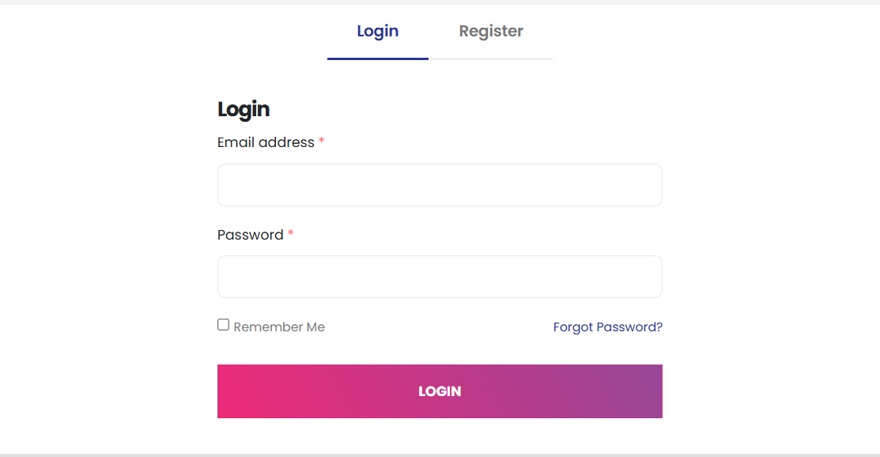
Screenshots
Login Form

Slide 14
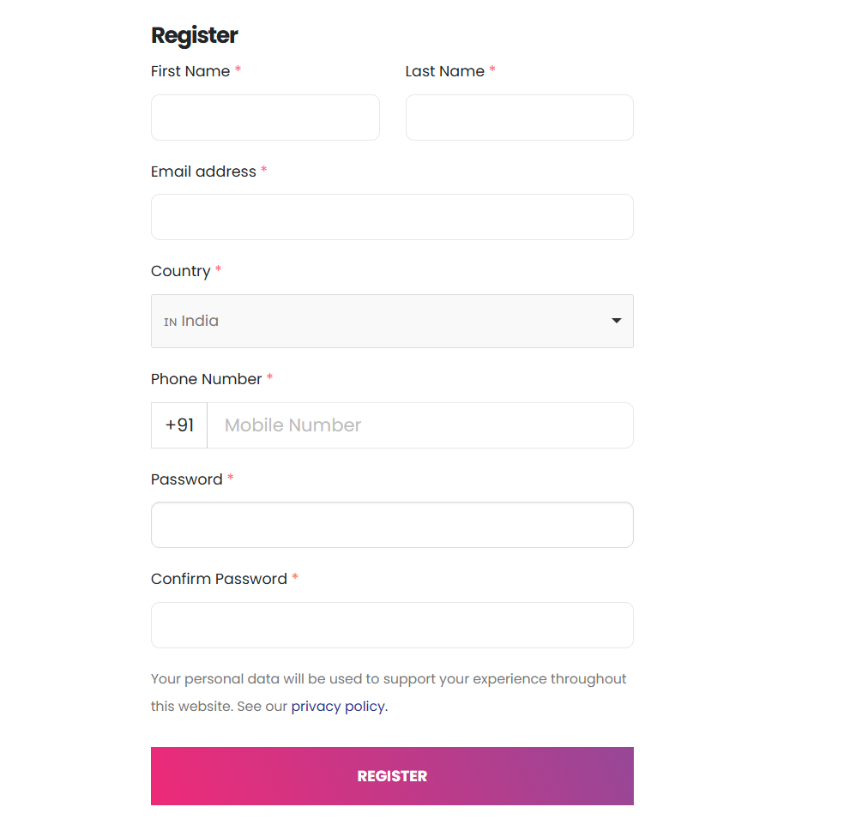
Register Form

Slide 15
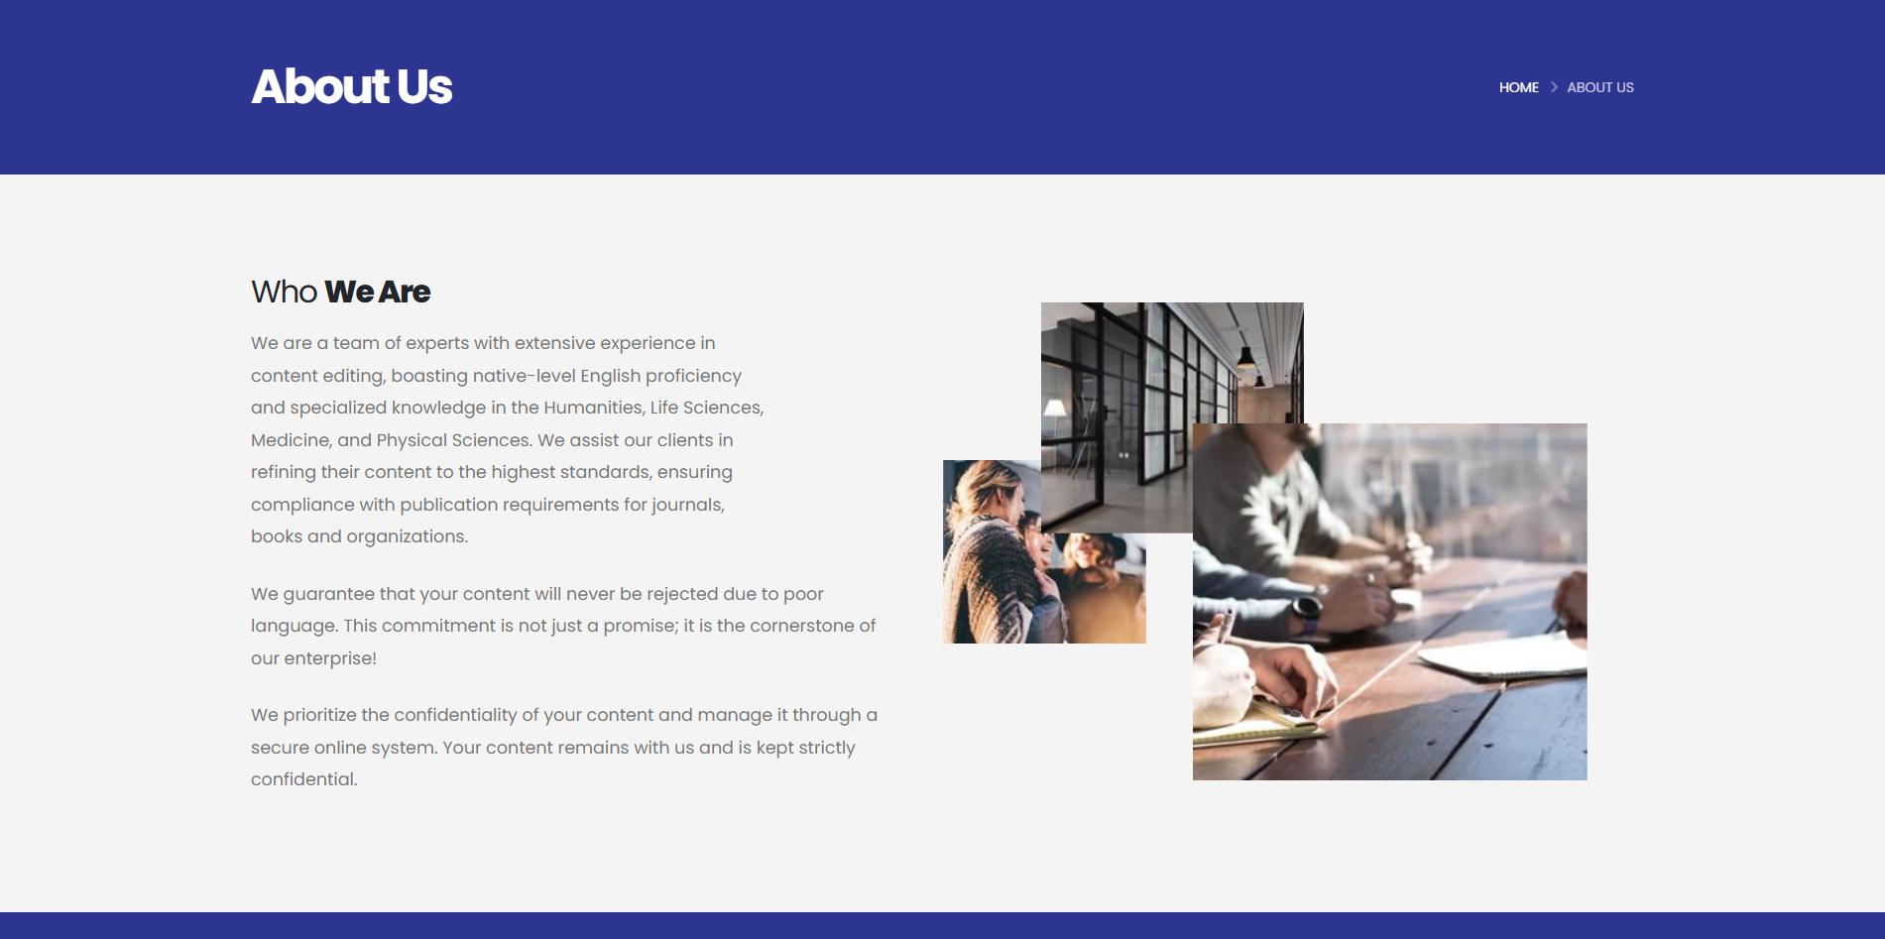
Informational Page-1

Slide 16
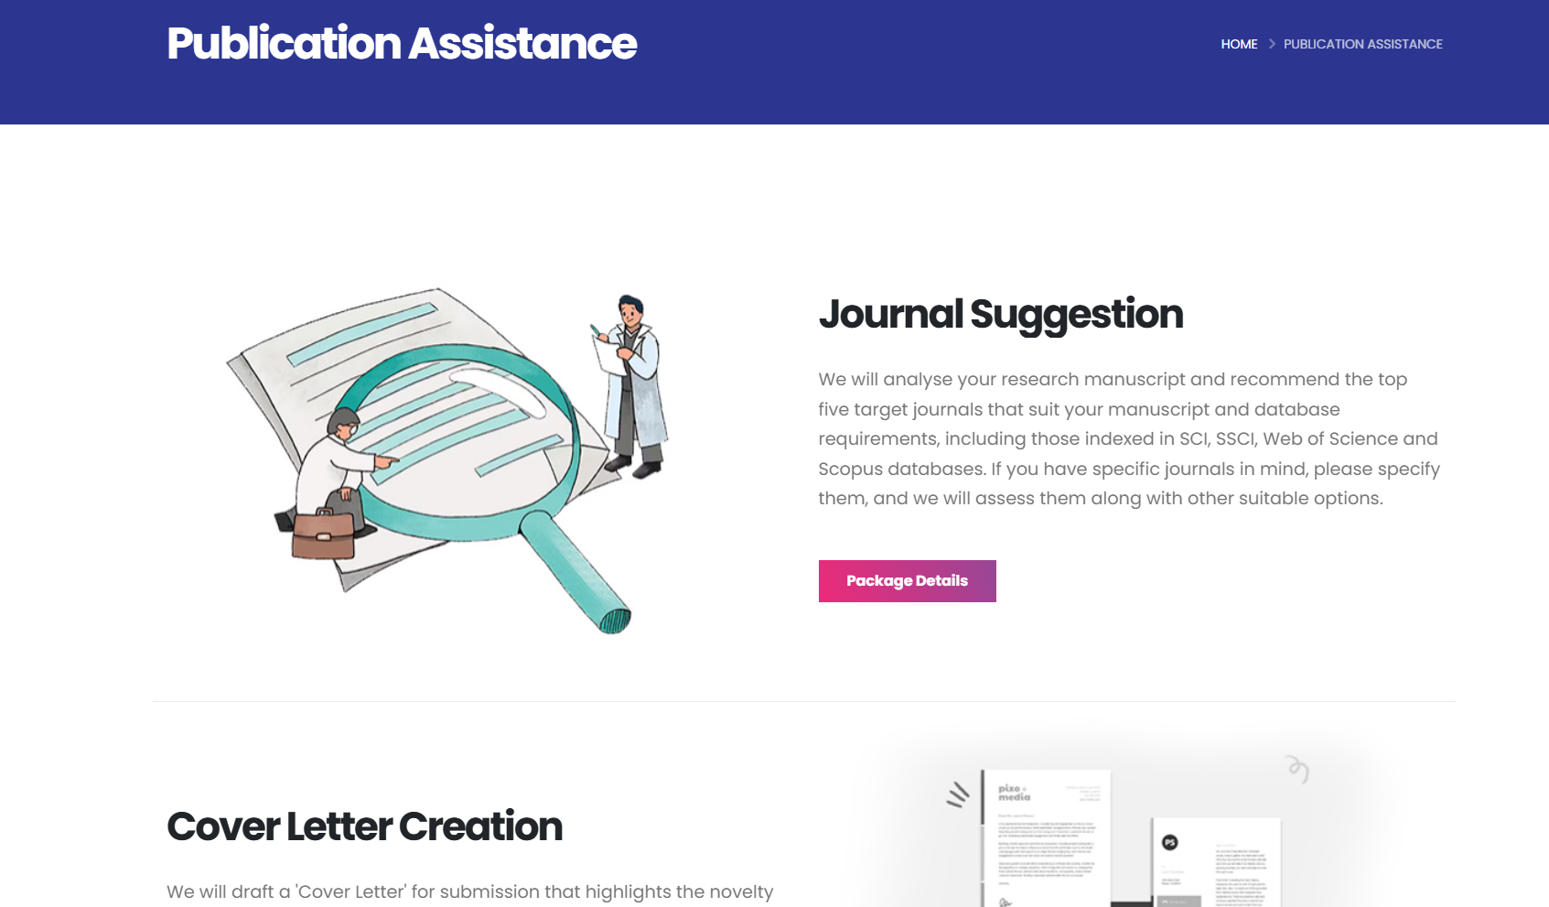
Informational Page-2

Slide 17
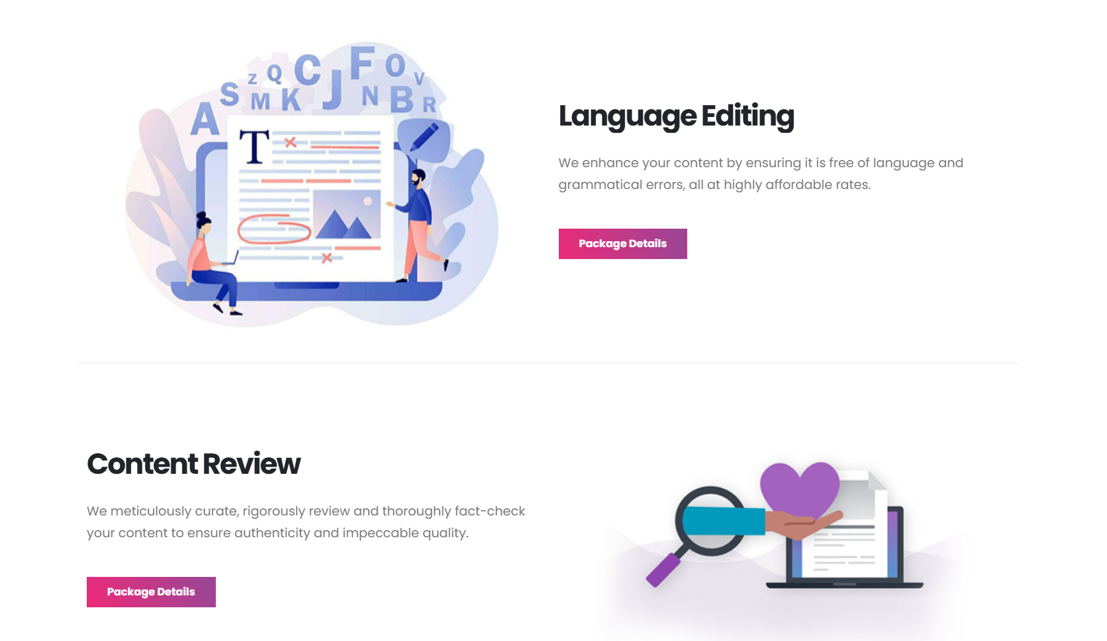
Informational Page-3

Slide 18
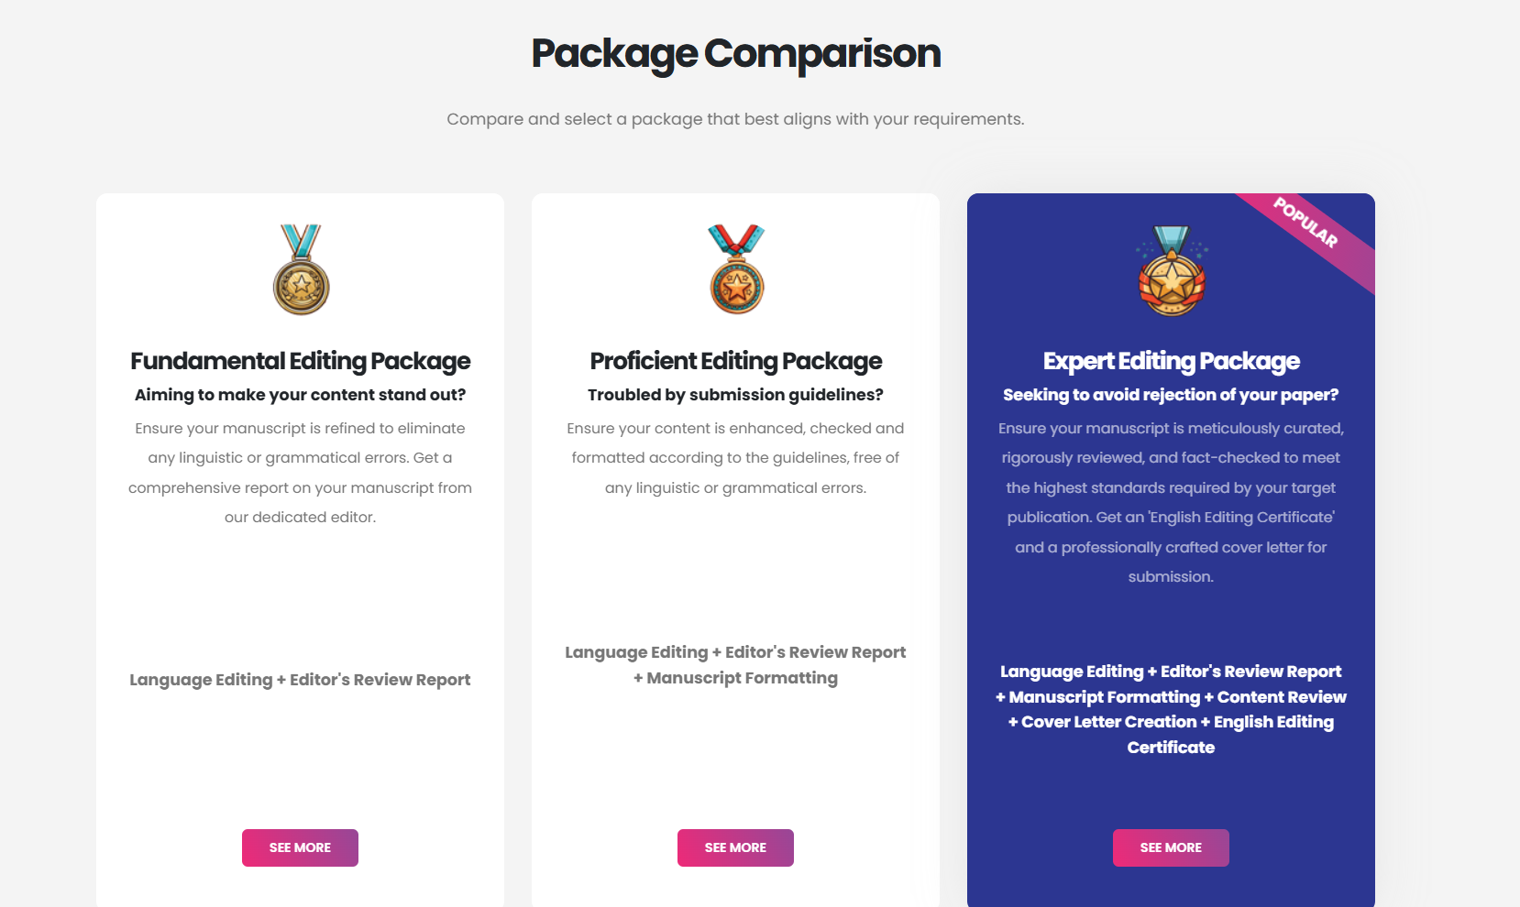
Informational Page-4

Slide 19
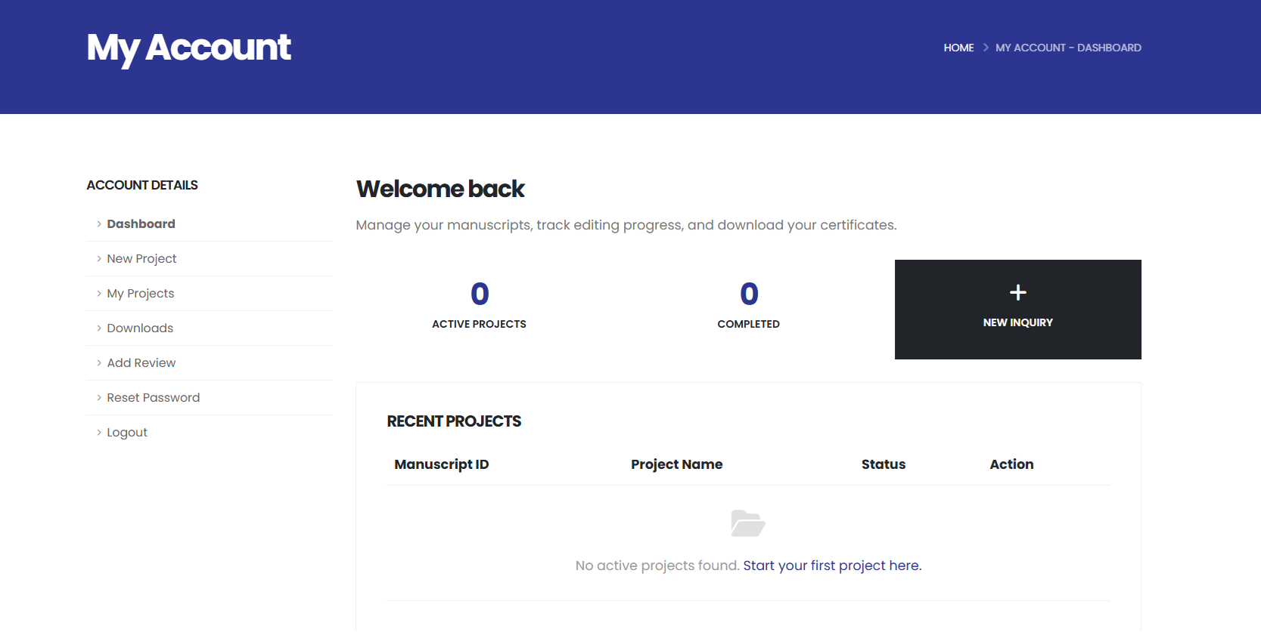
User Dashboard

Slide 20
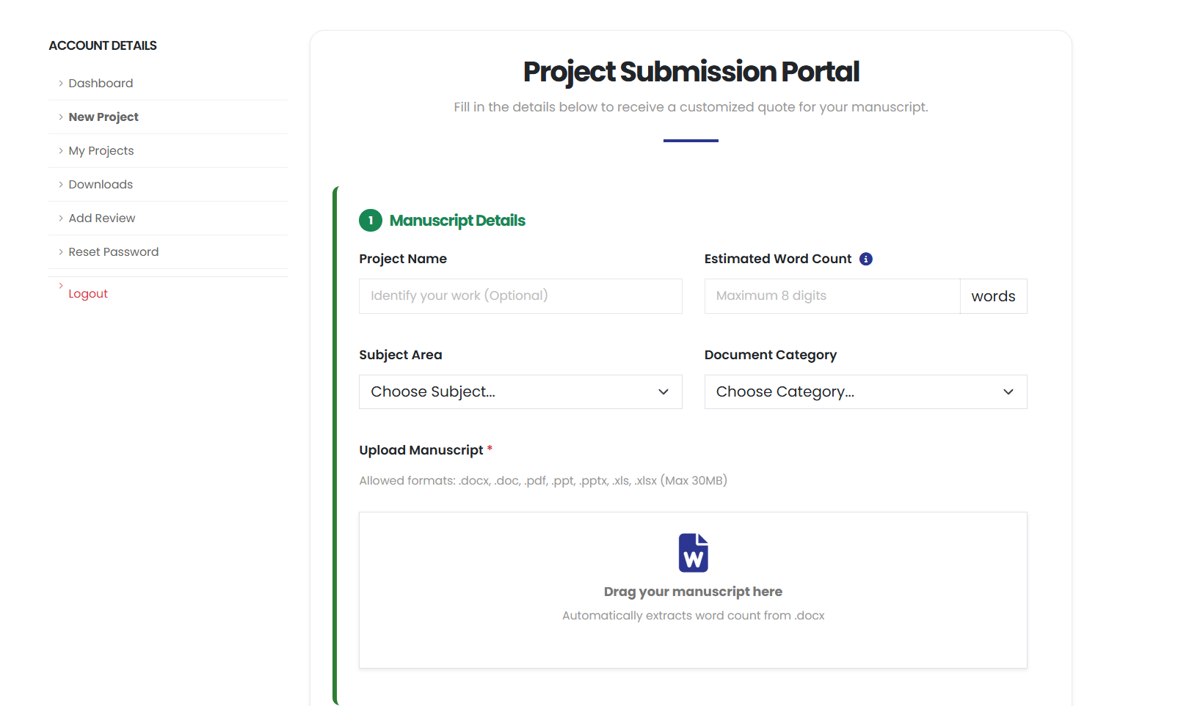
Project Submission portal

Slide 21
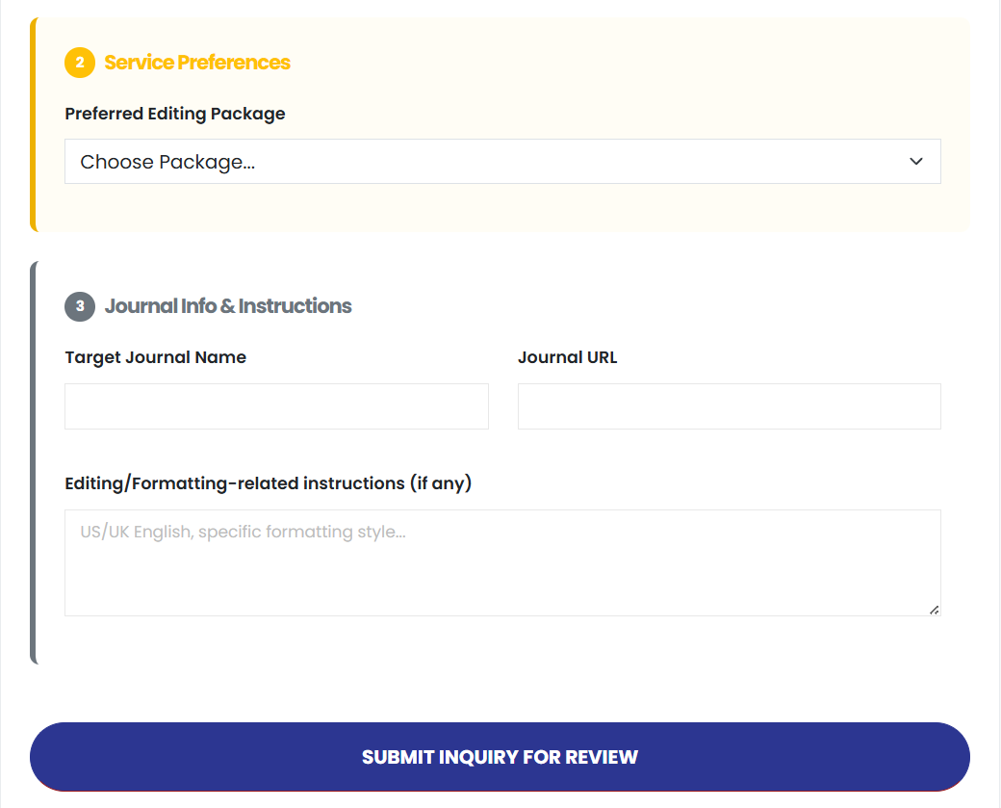
Project Submission portal

Slide 22
Conclusion
The proposed system provides a centralized platform for managing documents, communication, and editorial workflows.
Secure file upload and structured editing instruction submission are integrated into the system.
Secure online payment transactions ensure safe and reliable payments.
User‑friendly interface makes the system easy to adopt and operate.

Slide 23
References
S. M. Alade, “Design and Implementation of a Web-Based Document Management System,” International Journal of Information Technology and Computer Science (IJITCS), vol. 15, no. 2, pp. 45–52, 2023, doi: 10.5815/ijitcs.2023.02.04.
S. S. Nair and K. Mariappan, “A Secure Framework for Communication in Web Applications,” Engineering Proceedings, vol. 45, no. 1, pp. 1–6, 2023.
A. Suryaningrat et al., “File Upload Security: Essential Practices for Programmers,” CCIT Journal, vol. 7, no. 2, pp. 34–40, 2024.

Slide 24
Thank you

