Slide 1


Energy Efficiency in Smart Buildings
Acharya institute of graduate studies
DEVANANDANA VR
ABHIJITH ANIL
ARJUNKRISHNA KS
JITHIN JAN

Slide 2
Problem statement
Buildings account for nearly 40% of global energy consumption. Improving energy efficiency in buildings is essential for meeting sustainability targets. AI-powered systems can analyze energy consumption patterns, optimize heating and cooling systems, and provide recommendations for reducing energy use. These solutions are particularly effective in commercial buildings with high energy demands
Key objectives
Reduce energy consumption
Enhance Occupant Comfort
Lower Occupant Comfort
Increase Sustainability
Improve Building Performance
Source : www.Kaggle.com/

Slide 3
Dataset Overview
Dataset Name: Building Energy Consumption Dataset
Source: Kaggle / UCI Machine Learning Repository
Size: 10,000+ records from multiple smart buildings
Features:
Energy consumption (kWh)
Temperature & humidity levels
Occupancy data
HVAC system usage
Weather conditions (outdoor temperature, sunlight, etc.)
Time-series data for energy trends
Use Case: Used for analyzing energy patterns, predicting consumption, and optimizing building energy efficiency with AI models.
Source :
www.Kaggle.com/

Slide 4
.
.
Methodology
Approach:
.
Data Acquisition
Data Ingestion & Processing
Data Filtering & Selection
Data Analysis & Summarization
Visualization & Trend Analysis
User Interaction & Insights
Algorithms
Descriptive Statistics – Used .describe() to summarize key metrics (mean, min, max, standard deviation).
Filtering Algorithm – Implemented rule-based filtering to select relevant data based on categorical variables.
Visualization Algorithms – Applied:
Line Chart (Time-series trend analysis of energy consumption).
Scatter Plot (Identifies correlations between building parameters and energy use).
Histogram (Analyzes frequency distribution of energy consumption).
Source :
www.Kaggle.com/

Slide 5

Conclusion
Summary:
This Streamlit-based Energy Efficiency Dashboard allows users to upload a CSV dataset related to smart building energy usage. It provides:
Data Ingestion & Filtering –.
Data Analysis & Visualization.
User-Friendly Interface
Future Work:
Advanced Machine Learning Models – Implement predictive analytics for energy consumption forecasting.
Real-time Data Integration – Connect with IoT sensors for live monitoring of smart buildings.
Automated Energy Optimization – Use AI-driven recommendations to reduce energy waste.
Expanded Visualization Options – Add heatmaps, bar charts, and anomaly detection for deeper insights.
Source :
www.Kaggle.com/

Slide 6
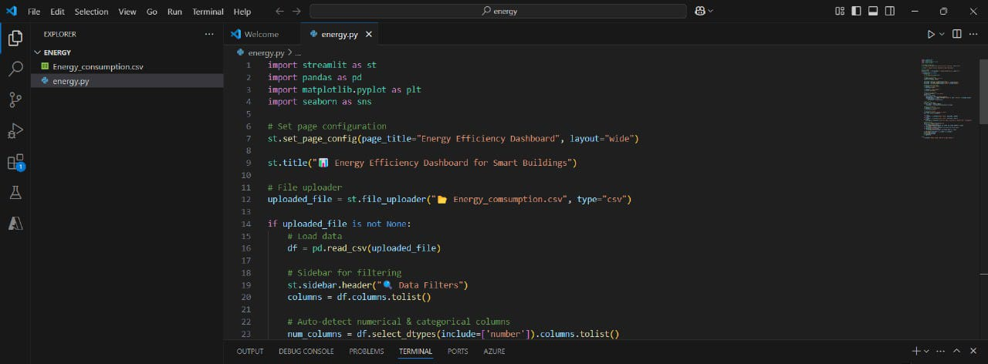
References
www.Sciencedirect.com/
Source code for energy efficiency in smart buildingslinks =

Slide 7
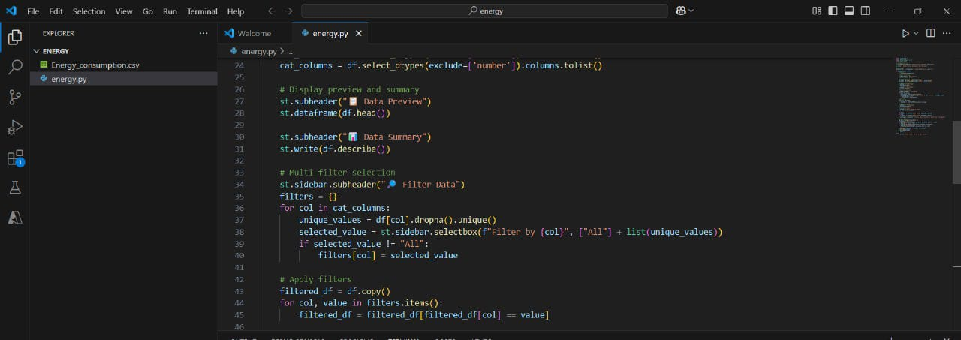

Slide 8
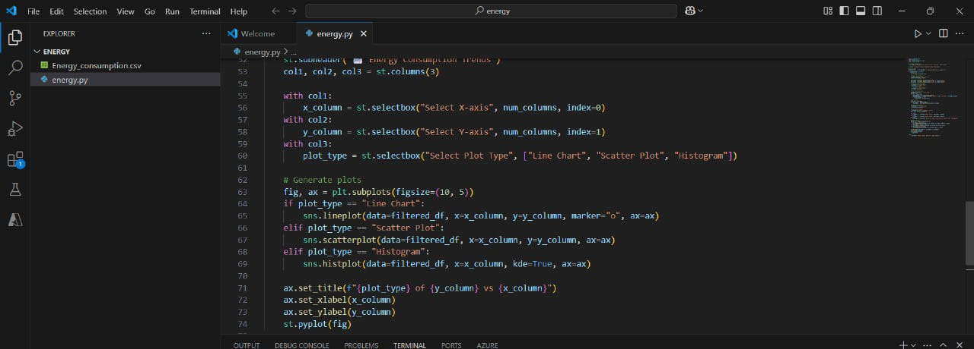

Slide 9
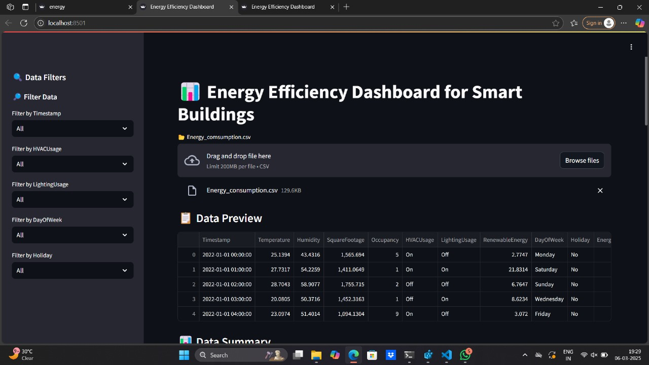

Slide 10
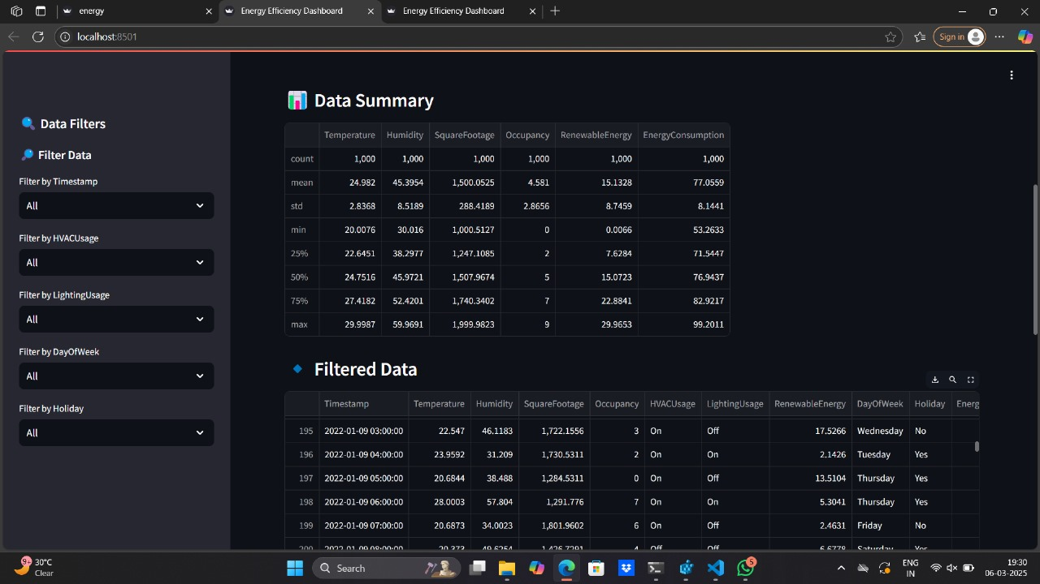

Slide 11
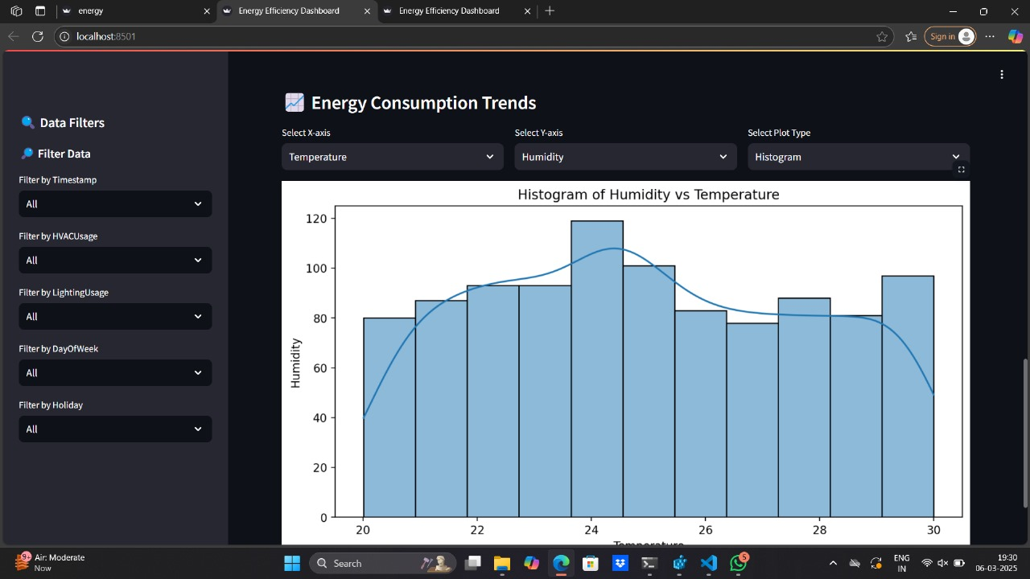

Slide 12
Thank You
Notes:
Thank You !!

