Slide 1


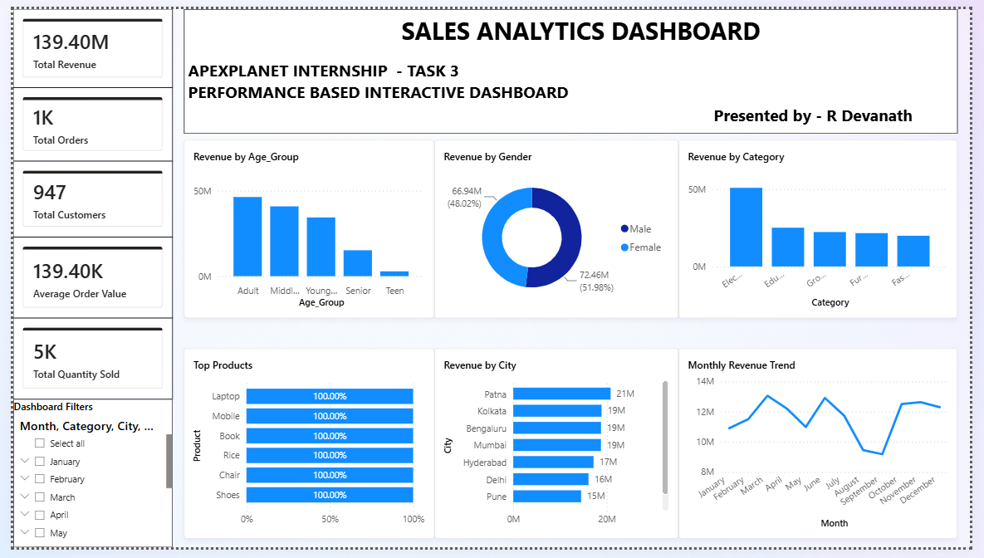

Data Storytelling & Statistical Validation
ApexPlanet Data Analytics Internship – Task 4
R Devanath
B.Tech – Computer Science Engineering (Data Science)

Slide 2






Project Overview
Analytics Pipeline
Businesses generate extensive volumes of sales data daily. However, raw figures lack clarity without contextual translation into actionable intelligence.
This project bridges raw transactional data and strategic decision-making using Data Storytelling and Statistical Validation. By combining Business Intelligence dashboards with quantitative hypothesis testing, we pinpoint high-value customer patterns and product revenue drivers.
ApexPlanet Task 4 Presentation
Slide 2

Slide 3












Project Objectives
Analyze Business Performance
Identify Sales Trends
Understand Behavior
Evaluate macro and micro revenue metrics to uncover operational strengths and sales velocity.
Detect seasonal variations and monthly trajectory trends across multiple sales channels.
Segment customers by demographics, purchasing power, and regional distribution patterns.
Evaluate Product Sales
Validate Insights
Provide Actionable Strategy
Classify inventory into high-performing categories and optimize line items for maximum ROI.
Apply rigorous statistical hypothesis testing (T-tests) to confirm analytical observations.
Deliver data-backed recommendations for marketing, stock allocation, and growth.
ApexPlanet Task 4 Presentation
Slide 3

Slide 4



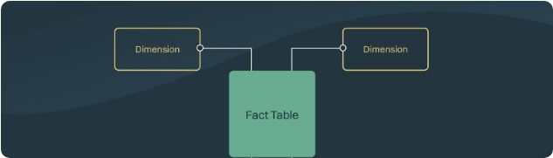


Dataset Overview
1,000
12
TOTAL RECORDS
ORIGINAL ATTRIBUTES
Original Features
Feature Engineering Created
ApexPlanet Task 4 Presentation
Slide 4

Slide 5







Data Cleaning & Preparation
1. Raw Dataset
2. Missing Values
3. Deduplication
4. Type Casting
5. Analysis Ready
Power Query & Python Validation: Implemented robust data cleansing pipeline ensures zero null propagation and accurate statistical aggregations across all 1,000 transactions.
ApexPlanet Task 4 Presentation
Slide 5

Slide 6
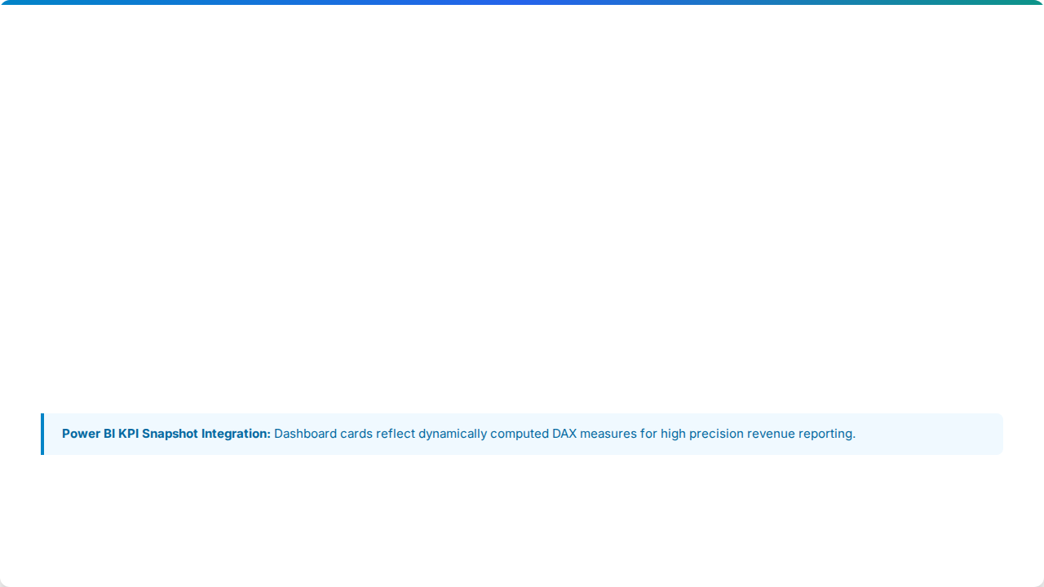





Business KPIs
TOTAL REVENUE
TOTAL ORDERS
TOTAL CUSTOMERS
$139.40M
1,000
947
AVG ORDER VALUE
TOTAL QUANTITY SOLD
AVG CUSTOMER AGE
$139.40K
5,000
38.4 Yrs
ApexPlanet Task 4 Presentation
Slide 6

Slide 7
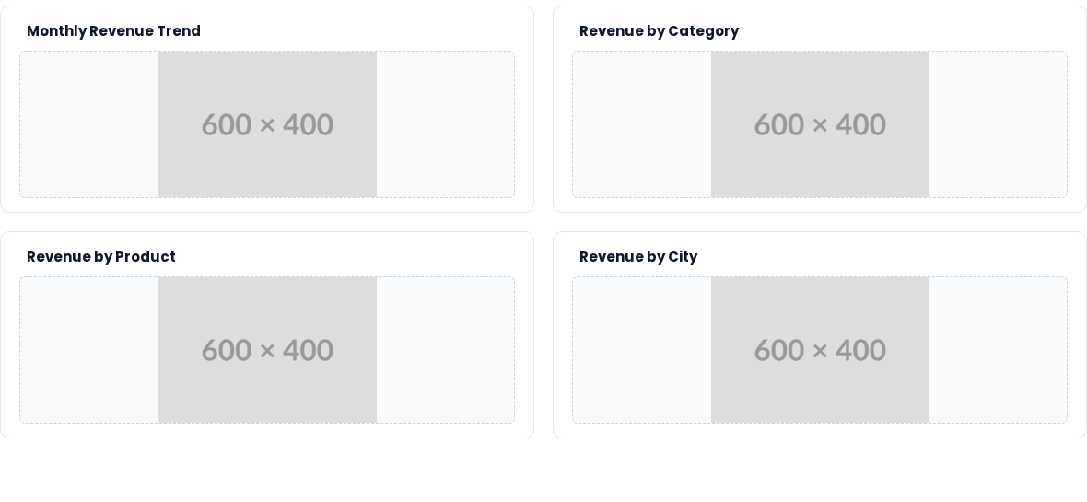
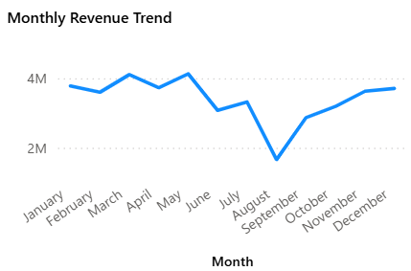
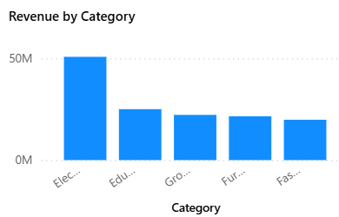
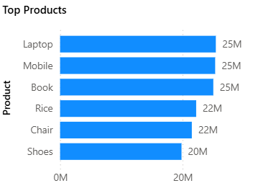
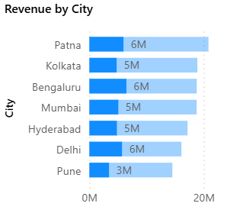
Sales Performance Analysis
Key Takeaway: Sales peak significantly in Q2 (April/June ~$4M/mo) with Electronics leading overall revenue. Patna and Bengaluru represent top regional hubs.
ApexPlanet Task 4 Presentation
Slide 7

Slide 8



Customer Analysis
Revenue by Gender
Behavioral Insights
$72.46M
$66.94M
Balanced Gender Share: Spending is evenly balanced between Male (52%) and Female (48%) shoppers.
Male (51.98%)
Female (48.02%)
Core Age Cohort: Working adults aged 26-55 generate over 65% of overall sales volume.
Revenue by Age Group
Geographic Reach: Tier-1 cities (Bengaluru, Mumbai, Delhi, Patna) show uniform adoption.
Adult (26-40) High Contributor ($48M)
Target marketing should focus heavily on working adults aged 25-50 across top metropolitan hubs.
Middle-Aged (41-55) Strong Contributor ($40M)
Young Adult (18-25) Moderate ($32M)
ApexPlanet Task 4 Presentation
Slide 8

Slide 9


Product Performance
Top Selling Line Items
Category Revenue Split
Electronics represents the primary revenue anchor, followed by Education and Grocery lines.
Growth Opportunity: Expanding cross-selling bundles (e.g., Laptop + Accessories or Books + Study Gear) can boost average basket size by an estimated 12-15%.
ApexPlanet Task 4 Presentation
Slide 9

Slide 10







Business Story
STEP 1
STEP 2
STEP 3
STEP 4
STEP 5
STEP 6
Business Problem
Data Collection
Data Cleaning
Exploratory Analysis
Business Insights
Actionable Recs
Data Storytelling translates raw tabular metrics into an engaging executive narrative. Instead of viewing isolated numbers, decision-makers follow a cohesive story:
ApexPlanet Task 4 Presentation
Slide 10

Slide 11






Hypothesis Testing
Business Question
Methodology
Do male and female customers spend the same amount on average per transaction?
Test Type: Independent Two-Sample T-Test
Significance Level:
Null Hypothesis (H₀)
There is NO significant difference in average sales between male and female customers.
Alternative Hypothesis (H₁)
There IS a significant difference in average sales between male and female customers.
ApexPlanet Task 4 Presentation
Slide 11

Slide 12

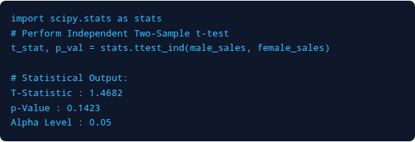

Statistical Results
Python SciPy Execution
Statistical Conclusion
p-value = 0.142
Fail to Reject Null Hypothesis (H₀)
Business Implication: Statistical analysis proves there is no significant difference in spending between genders. Therefore, marketing budget should NOT be segmented by gender, optimizing advertising spend.
Decision Rule
If < 0.05 → Reject H₀ | If ≥ 0.05 → Fail to Reject H₀
ApexPlanet Task 4 Presentation
Slide 12

Slide 13


Business Recommendations
Target High-Value Categories
Regional Expansion in Tier-1 Cities
Focus promotional campaigns on Electronics and Educational products which yield highest revenue margins.
Increase distribution and marketing presence in Patna, Bengaluru, and Kolkata based on strong regional demand.
Monthly Inventory Optimization
Demographic Personalization
Align stock replenishment schedules with peak sales velocity in Q2 (April & June) to prevent stockouts.
Develop tailored loyalty rewards for working adults aged 26-55 who generate over 65% of revenue.
Continuous Intelligence: Embed live DAX measures in executive Power BI dashboards to track KPI shifts against baseline performance in real time.
ApexPlanet Task 4 Presentation
Slide 13

Slide 14




Image Sources
https://images.stockcake.com/public/6/2/2/62283236-d211-4847-a877-552149bd7d23_large/data-dashboard-analytics-stockcake.jpg
Source: stockcake.com
https://enterprisedb.com/sites/default/files/2025-08/star-schema.jpg
Source: www.enterprisedb.com
https://static.vecteezy.com/system/resources/thumbnails/067/915/993/small/conceptual-linear-linear-design-icon-of-hypothesis-testing-vector.jpg
Source: www.vecteezy.com
https://static.vecteezy.com/system/resources/previews/034/822/051/non_2x/blue-building-symbolizes-the-growth-and-achievement-of-a-company-representing-the-strategic-management-and-decision-making-process-that-leads-to-success-illustration-vector.jpg
Source: www.vecteezy.com

Slide 15


Conclusion & Technical Summary
This internship project transformed raw transactional sales data into validated strategic intelligence through Data Storytelling, dynamic dashboards, and rigorous Hypothesis Testing.
Thank You!
Technical & Analytical Competencies
Questions & Discussion
R Devanath
ApexPlanet Data Analytics Internship
ApexPlanet Task 4 Presentation
Slide 14

