Slide 1
Inference Economics
Engineering LLMs for Cost, Latency, and Scale
Devang Sharma
Senior AI Engineer, Meta
LLM Day San Francisco 2026 | Track 2 | Harness HQ, 55 Stockton St
Notes:
Welcome. One sentence on who I am, then straight in: this talk is about the engineering decisions that decide whether your AI product makes money. Thirty minutes, a live demo in the middle, and a framework you can use on Monday.

Slide 2
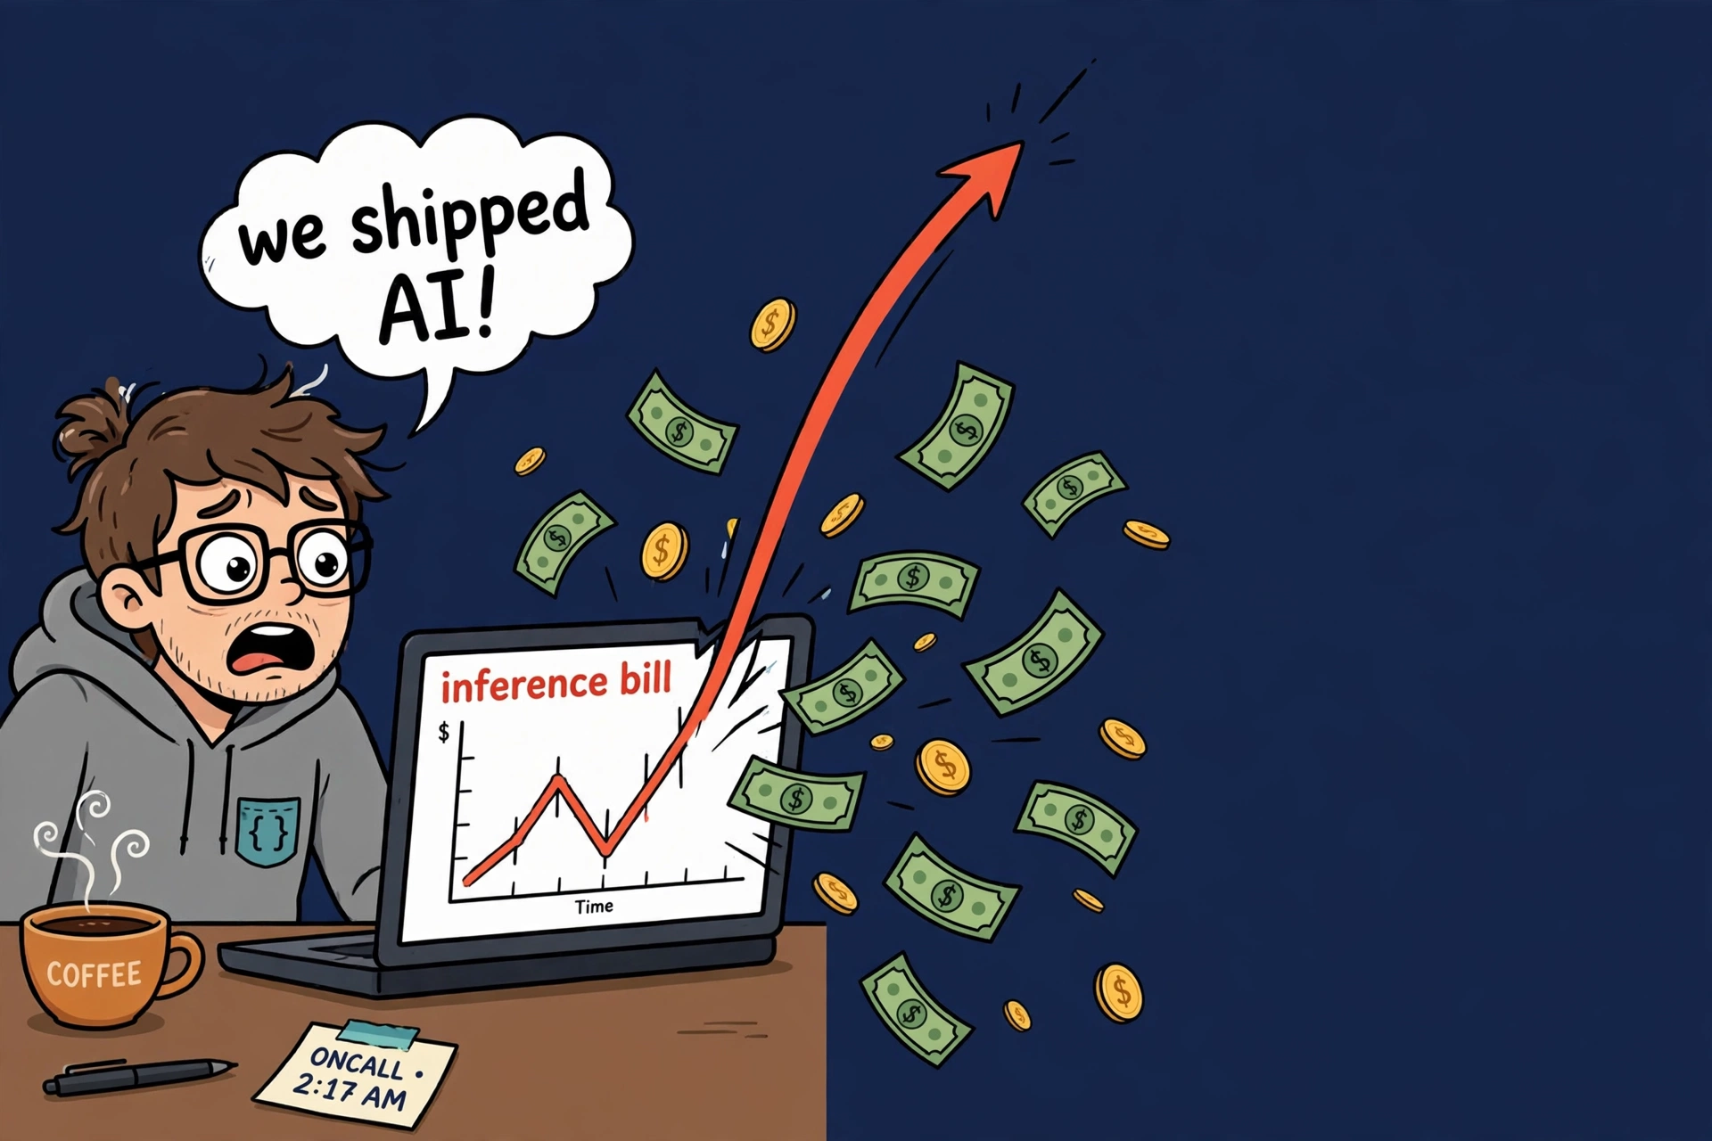
THE INDUSTRY
Everyone shipped AI. Then the bill arrived.
The 2026 mood, in one meme.
Inference quietly became the biggest cost line in most AI products.
Models got bigger. Traffic grew. Bills scaled linearly while margins collapsed.
The teams that win will not have the biggest models. They will be the ones serving them 10x cheaper without losing quality.
Inference Economics | LLM Day San Francisco 2026
2
Notes:
Open with the laugh, then land the point: per-token prices fell every year, but tokens per user grew faster. Volume won. Serving is now the main cost of an AI product, and almost nobody engineered for it.

Slide 3
THE INDUSTRY
Where the money moved
Training was the bill. Then serving took over.
2023
The capability race
GPT-4, everyone ships a demo.
Money: training.
2024
The reasoning turn
Models think before answering.
Context windows explode.
Money: still training.
2025
Agents reach production
One user request becomes
a dozen model calls.
2026
Serving dominates
Reasoning x agents x context.
The budget moved to inference.
Training is capex: you pay once. Inference is opex: it arrives on every request, every day, forever.
Three multipliers stacked on the same bill: reasoning emits many more tokens per question, agents multiply calls per request, and context windows went from 4K to a million. None were mistakes. All were capability wins that cost tokens.
Inference Economics | LLM Day San Francisco 2026
3
Notes:
Walk the timeline fast. The punchline: per-token prices fell every single year and it did not matter, because tokens per user grew faster. Training is capex, inference is opex, and opex is forever.

Slide 4
FOUNDATIONS
What is inference, really?
The simplest definition you will hear today.
Inference is running a trained model to answer a question.
No training. No learning. Just answering, live, over and over, as fast as possible.
You ask
a question,
a prompt
The model thinks
billions of tiny
math operations
Answer streams back
one word
at a time
Every chatbot reply, every agent step, every autocomplete: that is inference. And you pay for each one.
Inference Economics | LLM Day San Francisco 2026
4
Notes:
Keep this dead simple for the non-technical half of the room: inference is just the model answering. Training happened months ago. This is the part that runs every time someone hits enter, and the part that shows up on the bill.

Slide 5
FOUNDATIONS
Two halves, two speed limits
This is the one mental model the whole talk depends on.
It has two halves:
reading your prompt (fast, math-heavy)
and writing the answer one word at a time (slow, because the GPU re-reads the whole model from memory for every single word).
1 Reading your prompt
2 Writing the answer
write
me
a
poem
roses
...
...
...
whole prompt, all at once | math-heavy, fast
one word at a time | re-reads the model per word
“If the GPU has to read the entire model to write one word for one user, it may as well write a word for a hundred users in that same read.”
Inference Economics | LLM Day San Francisco 2026
5
Notes:
Read the callout exactly as written, slowly. The diagram shows it: the prompt goes in whole, the answer comes out word by word with a full model re-read each time. The quoted sentence explains batching, caching, quantization, and why one lever fails later. If they remember one thing, make it this.

Slide 6
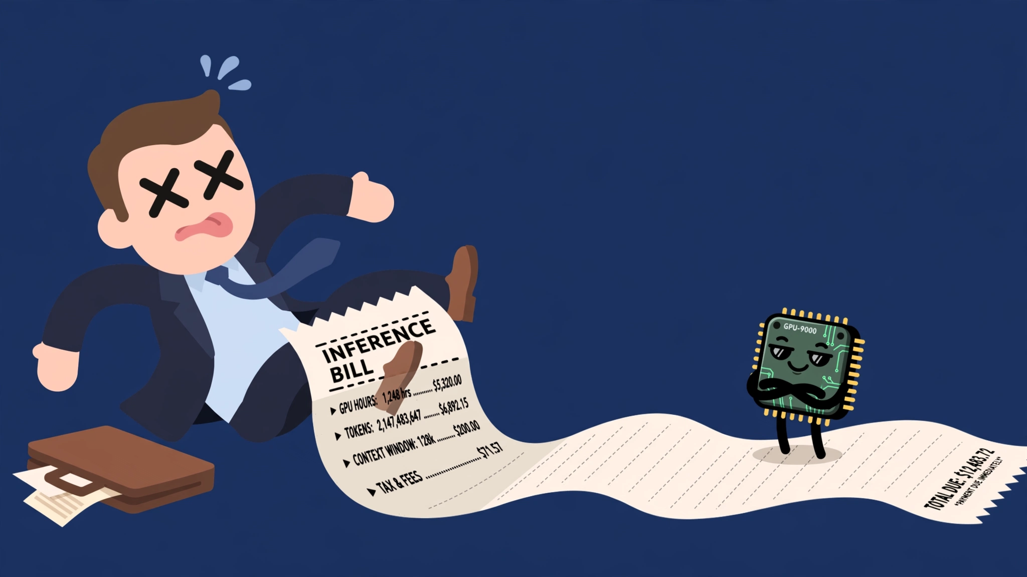
WHY IT MATTERS
Why should you care?
Because this is where your margin goes.
$57,600 a month
to answer 35 questions a second. One model. Not a hyperscaler, a mid-size product.
• You pay per answer, not per user. More users means thinner margins.
• Speed and cost fight each other. Every saving trades against waiting time.
• The out-of-the-box setup is the expensive one. Nobody ships a tuned fleet by accident.
The winners will serve AI ten times cheaper at the same quality. That is engineering, not luck.
Inference Economics | LLM Day San Francisco 2026
6
Notes:
Translate everything into money for the non-technical half. The meme is the CFO watching the GPU eat the margin. Three plain points, then the optimistic close: this is controllable.

Slide 7
AGENDA
The plan
Problem, approach, live demo, then the playbook.
1
The problem
The exact question, stated precisely
2
The approach
A flight simulator for your GPU bill
3
Live demo
A real run, real metrics, no code tour
4
Results + playbook
What moved, what failed, what to steal
5
Q&A
Bring your worst inference bill
Inference Economics | LLM Day San Francisco 2026
7
Notes:
Twenty seconds. Signpost and move. Promise the demo and the take-home playbook.

Slide 8
THE PROBLEM
The question nobody can answer
“How many tokens per second can we do?”
That number is cherry-pickable. Quietly let replies get slower, and it improves. Teams end up arguing about benchmarks that were never comparable.
The question that has an answer:
How many GPUs, to hold this latency, at this traffic?
Fix the traffic. Fix the latency promise. Then the only thing left to vary is the engineering.
Latency is an output, never an input. Queueing and contention produce it. Assume it, and the model can only tell you what you already believed.
Inference Economics | LLM Day San Francisco 2026
8
Notes:
This reframes the whole talk: not tokens per second, but GPUs to hold a latency promise at a traffic level. Not gameable, comparable across setups, and it is the unit on the invoice.

Slide 9
THE APPROACH
A flight simulator for your GPU bill
Capacity planning before you rent a single GPU.
1
Give it your traffic shape
and your latency SLO.
2
It searches replica counts
until both targets hold.
3
Flip a lever, re-run,
read the new GPU count.
Why trust it
• Mechanisms are actually implemented, not fudge factors.
• Hardware math from published specs.
• Checked against 11 published reference points: 11 of 11 reproduced, worst error 6.5%.
Answers it on a laptop in about 20 seconds. No GPU, no network, no API key.
Inference Economics | LLM Day San Francisco 2026
9
Notes:
Three steps, then the trust case: real mechanisms, published hardware math, 11 of 11 reference points reproduced. The kicker: this runs on a laptop, offline, before you spend anything. Do not say simulation equals measurement; say calibrated, here is the error bar, here is the one command that checks it.

Slide 10
THE APPROACH
What we built
A capacity-planning tool, in one picture.
Your traffic
shape + volume
The simulator
tries fleet sizes
until the promise holds
Smallest fleet
that keeps
latency + quality
Then we flip the five levers on, one by one, and watch the GPU count fall:
32
Start
20
Prefix caching
8
INT8
8
Spec decoding
5
Routing + cache
→
→
→
→
Same traffic, same promise. The only thing that changes is the engineering.
Inference Economics | LLM Day San Francisco 2026
10
Notes:
This is the whole project in one picture for the non-technical audience: traffic goes in, the smallest working fleet comes out. Then we stack the five levers and the GPU number drops from 32 to 5. Point at the flat 8 to 8: that is the teaser for the results.

Slide 11
THE APPROACH
Five levers, five different bottlenecks
Which is exactly why the order matters.
Prefix caching
Stop recomputing the same system prompt and retrieved context on every request.
Quantization (INT8)
Make the model physically smaller in memory, so every read is cheaper.
Speculative decoding
A small model guesses ahead; the big one checks several words at once.
Routing + response cache
Easy questions go to a smaller model. Repeats skip the GPU entirely.
Survival
What happens when traffic doubles with no warning.
Watch the GPU column in the demo. One of these five is going to disappoint us.
That will be the most useful slide in the deck.
Inference Economics | LLM Day San Francisco 2026
11
Notes:
Name the five, one line each, and set the hook: one lever fails. Do not reveal which. Each attacks a different bottleneck, which is why the stacking order matters.

Slide 12
LIVE DEMO
What we are about to run
Five configurations, one traffic shape, one promise that never moves.
The traffic
3,000 requests over 86 seconds = 34.8 req/s
40% chat | 30% RAG | 18% agent | 12% code
The promise (never moves)
p95 first token ≤ 1 second
per-token ≤ 50 ms
The fleet search must hold both, every run.
The hardware
H100 SXM, 3.35 TB/s memory bandwidth
Llama-70B | $2.50 per GPU-hour
KV cache: 320 KiB per token
Runs: stock vLLM → + prefix cache → + INT8 → + speculative decoding → + routing & cache → spike test (2x traffic)
Inference Economics | LLM Day San Francisco 2026
12
Notes:
Set the table before switching to the terminal: same traffic, same promise, five runs plus a spike test. Everything runs offline on this laptop. The pauses are the fleet search doing real work.

Slide 13
LIVE DEMO
python demo.py
github.com/Devang-25/inference-economics
Five minutes. I will not tour the code. I will run it, show the metrics, and the repo is yours afterwards.
Inference Economics | LLM Day San Francisco 2026
13
Notes:
Switch to terminal. Keep RUNBOOK.md open for exact keystrokes. Narrate only the GPU column and whether the latency promise holds. If anything fails, fall back to the results slide: every number on it came from this exact run.

Slide 14
RESULTS
32 GPUs → 5. $57,600 → $9,000 a month.
Same traffic. Same latency promise, kept at every step. Quality cost: 0.31%.
Stage | GPUs | $ / month | Key number
Stock vLLM defaults | 32 | $57,600 | 39 requests in flight
+ Prefix caching | 20 | $36,000 | 64% of prompt tokens not recomputed
+ INT8 quantization | 8 | $14,400 | 98 requests in flight
+ Speculative decoding | 8 | $14,400 | 63% accepted, no gain
+ Routing + response cache | 5 | $9,000 | 68% to small model, 26% skip GPU
Final: p95 first token 60 ms, per-token 17.8 ms. $48,600 a month saved.
Inference Economics | LLM Day San Francisco 2026
14
Notes:
Read the GPU column top to bottom: 32, 20, 8, 8, 5. Point at the flat one: speculative decoding bought nothing, and that is deliberate. The promise held at every step. Quality cost is a third of one percent, almost all from INT8, a published average, not my eval.

Slide 15
RESULTS
What surprised us
The two slides most teams get wrong.
The lever that failed
Speculative decoding: 8 GPUs → 8. Per-token latency slightly worse.
It worked as designed: 63% of guesses accepted.
Why: the trick is free only while memory-bound. At 98 requests in flight we are compute-bound, and the extra guesses compete with real work.
A latency tool for low batch. First thing to switch off for cheap volume.
The spike test: traffic doubles
Serve everyone: first token 34.9 s. Nobody turned away, nobody served. A capacity problem becomes a total outage.
Protect the promise: cap concurrency, turn away at the door. 0.9 s, 645 served properly, the rest get a fast honest no.
Autoscaling cannot save you: loading a 70B onto cold GPUs takes minutes. The spike is now.
Inference Economics | LLM Day San Francisco 2026
15
Notes:
Two lessons. One: spec decoding fails exactly where the mental model from slide 4 says it must, at high batch. If a benchmark quotes a spec-decoding speedup without batch size, it told you nothing. Two: you cannot serve 2x traffic on the same fleet, so decide in advance how you degrade, or the default decides for you.

Slide 16
WRAP UP
The 10x Inference Playbook
Steal this playbook.
0 Measure
Cost per million tokens, per route. You cannot manage what you never measured.
1 Find your ratio
Prompt tokens vs answer tokens. That one number tells you which bottleneck you have.
2 Turn on what is free
Caching and batching. No quality cost.
3 Shrink the model
Quantization. The biggest single technical win.
4 Route
The largest remaining lever is architectural, not kernel-level.
5 Clever tricks last
Measured on your own batch sizes. See slide 15.
Where this goes next: capacity planning before you buy GPUs | a cost gate in CI | build-vs-buy with your own numbers | MoE | disaggregated prefill and decode
Inference Economics | LLM Day San Francisco 2026
16
Notes:
Close with the playbook and the invitation: swap in your traffic, your model, your GPU price. Future use cases on screen. Final line: 32 to 5, same promise, forty-eight thousand a month, every number reproducible on a laptop.

Slide 17
Questions?
Bring your worst inference bill.
github.com/Devang-25/inference-economics
Devang Sharma | Senior AI Engineer, Meta
linkedin.com/in/idevangsharma
Inference Economics | LLM Day San Francisco 2026
17
Notes:
Invite the hard questions. The brief has ten prepared answers: trust in the simulator, why spec decoding failed, the 6.4x math, quality cost, routing design, autoscaling vs admission control, and what is not modeled (MoE, disaggregation).

