Slide 1


Introduction to Web and HTML
Unit-1
Web Technology/01CE1401
Prepared By: Kajal Tanchak
Department of Computer Engineering

Slide 2
Topics Covered
Introduction to Web Servers,
HTTP request and Response Model,
Structure of HTML,
Doctypes in HTML,
HTML Tags, Elements and attributes
HTML 5
                HTML 5 Layout and syntax,
                Attributes,
                Events,
                Web forms and validations,
                Audio & Video,
                SVG.

Slide 3
CO Mapping
CO1:Design and develop interactive web pages using HTML5, identifying the correct use of attributes, incorporating multimedia elements and form validations. (Apply)

Slide 4
Introduction to WWW
The World Wide Web (WWW) is a network of online content that is formatted in HTML and accessed via HTTP.
The term refers to all the interlinked HTML pages that can be accessed over the Internet.
A properly designed hypertext document can help users to locate desired type of information rapidly.
Hypertext documents enable this by using a series of link.
A link is a special type of item in a hypertext document connecting the document to another document.
Hypertext documents on internet are known as Web Pages.
The World Wide Web was originally designed in 1991 by Tim Berners-Lee .

Slide 5
Internet vs. www
It is all the Web pages, pictures, videos and other online content that can be accessed via a Web browser.
The Internet, in contrast, is the underlying network connection that allows us to send email and access the World Wide Web.
Internet
Global system of interconnected computer networks to share information
Use the standard Internet Protocol suite (TCP/IP)
network of networks

Slide 6
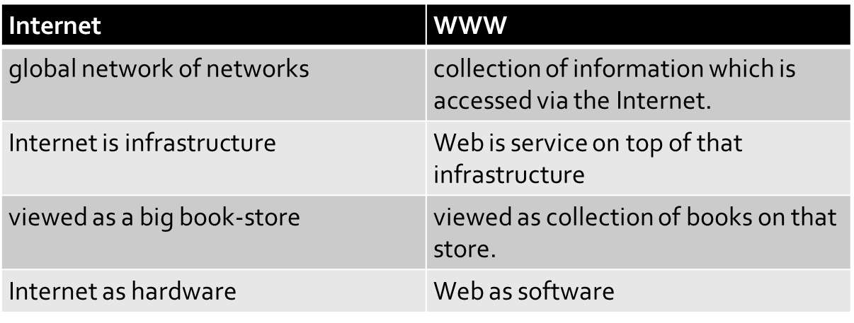
Internet vs. www

Slide 7
Introduction to Web Servers
Web server is a computer where the web content is stored. Basically web server is used to host the web sites but there exists other web servers also such as gaming, storage, FTP, email etc.
Web site is collection of web pages while web server is a software that respond to the request for web resources.
Web Server Working
Web server respond to the client request in either of the following two ways:
Sending the file to the client associated with the requested URL.
Generating response by invoking a script and communicating with database

Slide 8
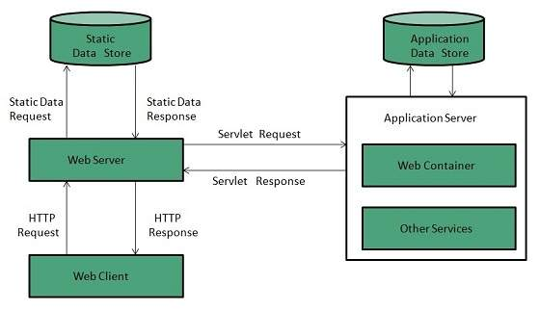

Slide 9
Introduction to Web Servers
Key Points
When client sends request for a web page, the web server search for the requested page if requested page is found then it will send it to client with an HTTP response.
If the requested web page is not found, web server will the send an HTTP response:Error 404 Not found.
If client has requested for some other resources then the web server will contact to the application server and data store to construct the HTTP response.
Architecture
Web Server Architecture follows the following two approaches:
Concurrent Approach
Single-Process-Event-Driven Approach.

Slide 10
Introduction to Web Servers
Concurrent Approach
Concurrent approach allows the web server to handle multiple client requests at the same time. It can be achieved by following methods:
Multi-process
Multi-threaded
Hybrid method.
Multi-processing
In this a single process (parent process) initiates several child processes and distribute incoming requests to these child processes. Each of the child processes are responsible for handling single request.
It is the responsibility of parent process to monitor the load and decide if processes should be killed or forked.

Slide 11
Introduction to Web Servers
Multi-threaded
Unlike Multi-process, it creates multiple single-threaded process.
Hybrid
It is combination of above two approaches. In this approach multiple process are created and each process initiates multiple threads. Each of the threads handles one connection. Using multiple threads in single process results in less load on system resources.

Slide 12
Example
Apache HTTP Server
This is the most popular web server in the world developed by the Apache Software Foundation. Apache web server is an open source software and can be installed on almost all operating systems including Linux, UNIX, Windows, FreeBSD, Mac OS X and more. About 60% of the web server machines run the Apache Web Server.
Internet Information Services (IIS)
The Internet Information Server (IIS) is a high performance Web Server from Microsoft. This web server runs on Windows NT/2000 and 2003 platforms (and may be on upcoming new Windows version also). IIS comes bundled with Windows NT/2000 and 2003; Because IIS is tightly integrated with the operating system so it is relatively easy to administer it.

Slide 13
Example
Lighttpd
The lighttpd, pronounced lighty is also a free web server that is distributed with the FreeBSD operating system. This open source web server is fast, secure and consumes much less CPU power. Lighttpd can also run on Windows, Mac OS X, Linux and Solaris operating systems.
Sun Java System Web Server
This web server from Sun Microsystems is suited for medium and large web sites. Though the server is free it is not open source. It however, runs on Windows, Linux and UNIX platforms. The Sun Java System web server supports various languages, scripts and technologies required for Web 2.0 such as JSP, Java Servlets, PHP, Perl, Python, and Ruby on Rails, ASP and Coldfusion etc.

Slide 14
Example
Jigsaw Server
Jigsaw (W3C's Server) comes from the World Wide Web Consortium. It is open source and free and can run on various platforms like Linux, UNIX, Windows, and Mac OS X Free BSD etc. Jigsaw has been written in Java and can run CGI scripts and PHP programs.

Slide 15
Introduction to Web Browser
A browser is a software program that is used to explore, retrieve, and display the information available on the World Wide Web.
This information may be in the form of pictures, web pages, videos, and other files that all are connected via hyperlinks and categorized with the help of URLs (Uniform Resource Identifiers).
A browser is a client program as it runs on a user computer or mobile device and contacts the webserver for the information requested by the user.
The web server sends the data back to the browser that displays the results on internet supported devices. On behalf of the users, the browser sends requests to web servers all over the internet by using HTTP (Hypertext Transfer Protocol).

Slide 16
Introduction to Web Browser
A browser requires a smartphone, computer, or tablet and internet to work.
Features of Web Browser
Most Web browsers offer common features such as:
Refresh button: Refresh button allows the website to reload the contents of the web pages. Most of the web browsers store local copies of visited pages to enhance the performance by using a caching mechanism. Sometimes, it stops you from seeing the updated information; in this case, by clicking on the refresh button, you can see the updated information.
Stop button: It is used to cancel the communication of the web browser with the server and stops loading the page content. For example, if any malicious site enters the browser accidentally, it helps to save from it by clicking on the stop button.

Slide 17
Introduction to Web Browser
Home button: It provides users the option to bring up the predefined home page of the website.
Web address bar: It allows the users to enter a web address in the address bar and visit the website.
Tabbed browsing: It provides users the option to open multiple websites on a single window. It helps users to read different websites at the same time. For example, when you search for anything on the browser, it provides you a list of search results for your query. You can open all the results by right-clicking on each link, staying on the same page.
Bookmarks: It allows the users to select particular website to save it for the later retrieval of information, which is predefined by the users.

Slide 18
Introduction to Web Browser
What is the URL (Uniform Resource Locator)?
A uniform resource locator is the address of a resource on the internet or the World Wide Web.
It is also known as a web address or uniform resource identifier (URI).
A URL represents the address of a resource, including the protocol used to access it.
A URL includes the following information:
It uses the protocol to access the resource.
It defines the location of a server by IP address or the domain name.
It includes a fragment identifier, which is optional.
It contains the location of the resource in the directory of the server.

Slide 19
Introduction to Web Browser
A URL forwards user to a particular online resource, such as a video, webpage, or other resources.
For example, when you search information on Google, the search results display the URL of the relevant resources in response to your search query. The title which appears in the search results is a hyperlink of the URL of the webpage.
It is a Uniform Resource Identifier, which refers to all kinds of names and addresses of the resources on the webservers. URL's first part is known as a protocol identifier, and it specifies the protocol to use, and the second part, which is known as a resource name, represents the IP address or the domain name of a resource.
Both parts are differentiated by a colon and two forward slashes like http://www.javatpoint.com.

Slide 20
Component of a Web browser
User Interface: The user interface is an area where the user can use several options like address bar, back and forward button, menu, bookmarking, and many other options to interact with the browser.
Browser Engine: It connects the UI (User Interface) and the rendering engine as a bridge. It queries and manipulates the rendering engine based on inputs from several user interfaces.
Rendering Engine: It is responsible for displaying the requested content on the browser screen. It translates the HTML, XML files, and images, which are formatted by using the CSS. It generates the layout of the content and displays it on the browser screen.

Slide 21
Component of a Web browser
Although it can also display the other types of content by using different types of plugins or extensions. such as:
Internet Explorer uses Trident
Chrome & Opera 15+ use Blink
Chrome (iPhone) & Safari use Webkit
Firefox & other Mozilla browsers use Gecko
Networking: It retrieves the URLs by using internet protocols like HTTP or FTP. It is responsible for maintaining all aspects of Internet communication and security. Furthermore, it may be used to cache a retrieved document to reduce network traffic.
JavaScript Interpreter: As the name suggests, JavaScript Interpreter translates and executes the JavaScript code, which is included in a website. The translated results are sent to the rendering engine to display results on the device screen.

Slide 22
Component of a Web browser
UI Backend: It is used to draw basic combo boxes and Windows (widgets). It specifies a generic interface, which is not platform-specific.
Data Storage: The data storage is a persistence layer that is used by the browser to store all sorts of information locally, like cookies. A browser also supports different storage mechanisms such as IndexedDB, WebSQL, localStorage, and FileSystem. It is a database stored on the local drive of your computer where the browser is installed. It handles user data like cache, bookmarks, cookies, and preferences.

Slide 23
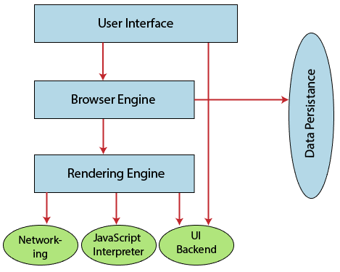

Slide 24
How does a browser work?
When a user enters a web address or URL in the search bar like javatpoint.com, the request is passed to a domain name servers (DNS). All of these requests are routed via several routers and switches.
The domain name servers hold a list of system names and their corresponding IP addresses. Thus, when you type something in the browser search bar, it gets converted into a number that determines the computers to which the search results are to be displayed.
The browser acts as a part of the client-server model. A browser is a client program that sends the request to the server in response to the user search queries by using Hypertext Transfer Protocol or HTTP.

Slide 25
How does a browser work?
When the server receives the request, it collects information about the requested document and forwards the information back to the browser.
Thereafter, the browser translates and displays the information on the user device.

Slide 26
HTTP request and Response Model
HTTP means HyperText Transfer Protocol.
HTTP is used by the World Wide Web and this protocol defines how messages are formatted and transmitted, and what actions Web servers and browsers should take in response to various commands.
when you enter a URL in your browser, this actually sends an HTTP command to the Web server directing it to fetch and transmit the requested Web page.
stateless protocol

Slide 27
HTTP request and Response Model
There are three basic features that make HTTP a simple but powerful protocol:
HTTP is connectionless: The HTTP client, i.e., a browser initiates an HTTP request and after a request is made, the client waits for the response. The server processes the request and sends a response back after which client disconnect the connection. So client and server knows about each other during current request and response only. Further requests are made on new connection like client and server are new to each other.
HTTP is media independent: It means, any type of data can be sent by HTTP as long as both the client and the server know how to handle the data content. It is required for the client as well as the server to specify the content type using appropriate MIME-type.

Slide 28
HTTP request and Response Model
HTTP is stateless: As mentioned above, HTTP is connectionless and it is a direct result of HTTP being a stateless protocol. The server and client are aware of each other only during a current request. Afterwards, both of them forget about each other. Due to this nature of the protocol, neither the client nor the browser can retain information between different requests across the web pages.

Slide 29
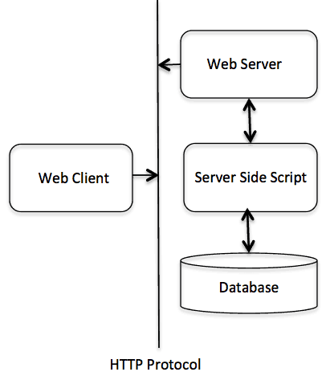
Architecture
HTTP/1.0 uses a new connection for each request/response exchange, where as HTTP/1.1 connection may be used for one or more request/response exchanges.

Slide 30
HTTP Request Method
The HTTP protocol is a request/response protocol based on the client/server based architecture where web browsers, robots and search engines, etc. act like HTTP clients, and the Web server acts as a server.
Request message:
GET /guide/index.html HTTP/1.1
Host: www.xxxx.com
Accept: image/gif, image/jpeg, */*
Accept-Language: en-us
Accept-Encoding: gzip, deflate
User-Agent: Mozilla/4.0 (compatible; MSIE 6.0; Windows NT 5.1)
(blank line)

Slide 31
HTTP Request Methods
GET
POST
PUT
HEAD
DELETE
OPTIONS

Slide 32
HTTP Request Methods
GET
Purpose: Retrieve data from a specified resource.
Characteristics:
  Safe and idempotent (does not change server state).
  Parameters can be passed in the URL as query strings.
Notes
  GET requests can be cached
  GET requests remain in the browser history
  GET requests can be bookmarked
  GET requests should never be used when dealing with sensitive data
  GET requests have length restrictions
  Example:
  GET /students?id=101 HTTP/1.1Host: www.example.com
  Returns details of the student with ID 101.

Slide 33
HTTP Request Methods
POST
Purpose: Send data to the server to create a new resource.
Characteristics:
  Not idempotent (repeating the request may create duplicates).
  Data is sent in the request body (not URL).
Example:
POST /students HTTP/1.1Host: www.example.com
Content-Type: application/json{ "name": "John", "age": 21}
Adds a new student record to the database.
Notes
  POST requests are never cached
  POST requests do not remain in the browser history
  POST requests cannot be bookmarked
  POST requests have no restrictions on data length based o server configuration.

Slide 34
HTTP Request Methods
PUT
Purpose: Update an existing resource or create a new one if it doesn’t exist.
Characteristics:
  Idempotent (repeating the request results in the same outcome).
Example:
PUT /students/101 HTTP/1.1Host: www.example.comContent-Type: application/json{ "name": "John Updated", "age": 22}
Updates the student record with ID 101.

Slide 35
HTTP Request Methods
DELETE
Purpose: Remove a specified resource.
Characteristics:
  Idempotent (deleting the same resource again has no further effect).
Example:
DELETE /students/101 HTTP/1.1Host: www.example.com
Deletes the student with ID 101.
PATCH
Purpose: Partially update a resource (only specific fields).
Characteristics:
  Not always idempotent.

Slide 36
HTTP Request Methods
Example:
PATCH /students/101 HTTP/1.1Host: www.example.comContent-Type: application/json{ "age": 23}
Only updates the age of the student with ID 101.
HEAD
Purpose: Similar to GET but fetches only the headers, not the body.
Use Case: Check if a resource exists or to get metadata.
Example:
HEAD /students/101 HTTP/1.1Host: www.example.com

Slide 37
HTTP Request Methods
OPTIONS
Purpose: Returns allowed HTTP methods for a specific resource.
Use Case: Useful in CORS (Cross-Origin Resource Sharing).
Example:
OPTIONS /students HTTP/1.1Host: www.example.com

Slide 38
HTTP Response Message
HTTP/1.1 200 OK
Date: Sun, 18 Oct 2015 08:56:53 GMT
Server: Apache/2.2.14 (Win32)
Last-Modified: Sat, 20 Nov 2015 07:16:26 GMT
Accept-Ranges: bytes
Content-Length: 44
Connection: close
Content-Type: text/html
X-Pad: avoid browser bug
<html><body><h1>Guide</h1><p>This is guide
on HTTP protocol</p></body></html>

Slide 39
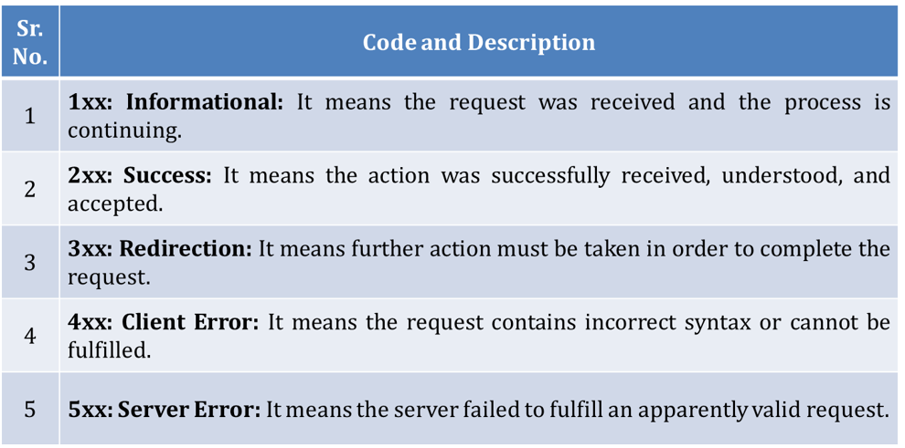
HTTP Response Message

Slide 40
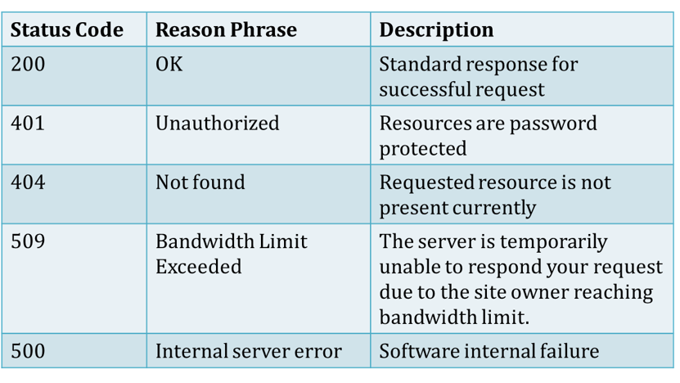
HTTP Response Message

Slide 41
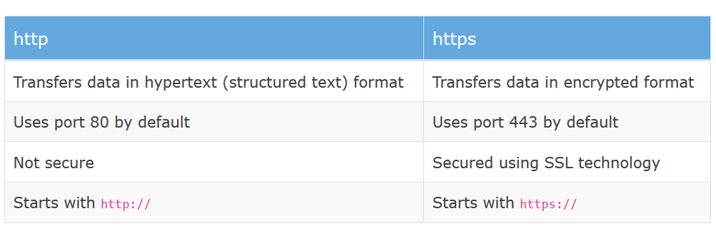
Difference between http and https

Slide 42
Structure of HTML
HTML is the standard markup language for creating Web pages
stands for Hyper Text Markup Language
describes the structure of a Web page
consists of a series of elements
HTML elements tell the browser how to display the content
HTML elements are represented by tags
HTML tags label pieces of content such as "heading", "paragraph", "table", and so on
Browsers do not display the HTML tags, but use them to render the content of the page
HTML is not case sensitive
<html>
  A little bit of html
  </html>

Slide 43
Structure of HTML
  Anything written in triangular bracket is known as tag.
  <html> defines that it is HTML.
  First and last line is same except / it denotes closing tag is matching with opening tag.
  Note:
  Html tags are in lower case.
  Html is not case sensitive

Slide 44
Structure of HTML
<!DOCTYPE html>
<html>
<head>
<title>Page Title</title>
</head>
<body>
<h1>My First Heading</h1>
<p>My first paragraph.</p>
</body>
</html>
The <!DOCTYPE html> declaration defines this document to be HTML5
The <html> element is the root element of an HTML page
The <head> element contains meta information about the document
The <title> element specifies a title for the document
The <body> element contains the visible page content
The <h1> element defines a large heading

Slide 45
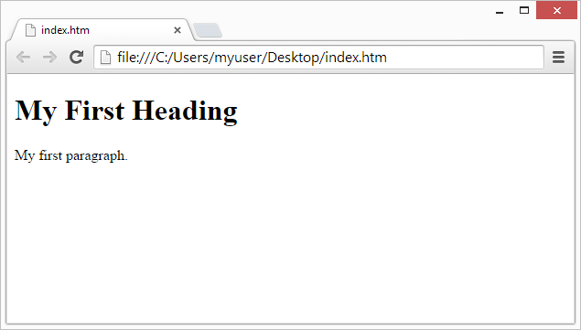
Structure of HTML
The purpose of a web browser (Chrome, Edge, Firefox, Safari) is to read HTML documents and display them.
The browser does not display the HTML tags, but uses them to determine how to display the document:

Slide 46
Doctype in HTML
The <!DOCTYPE> declaration must be the very first thing in your HTML document, before the <html> tag.
The <!DOCTYPE> declaration is not an HTML tag.
It is an instruction to the web browser about what version of HTML the page is written in.
The DTD specifies the rules for the mark up language, so that the browsers render and display the content correctly.
There are different document types on the web.
To display a document correctly, the browser must know both type and version.
The doctype declaration is not case sensitive. All cases are acceptable:
<!DOCTYPE html>
<!DOCTYPE HTML>
<!doctype html>
<!Doctype Html>

Slide 47
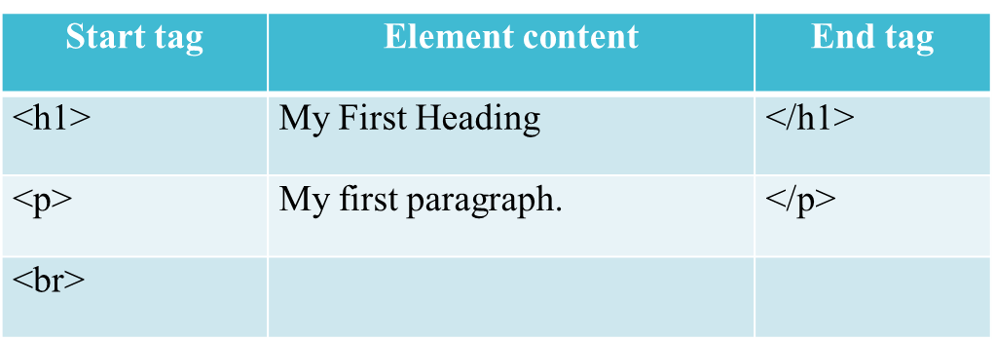
HTML Elements, tags and attributes
HTML Elements:
An HTML element usually consists of a start tag and an end tag, with the content inserted in between:
<tagname>Content goes here...</tagname>
The HTML element is everything from the start tag to the end tag:
<p>My first paragraph.</p>

Slide 48
HTML Elements, tags and attributes
Empty element:
HTML elements with no content are called empty elements.
Empty elements do not have an end tag, such as the <br> element (which indicates a line break).
Nested HTML Elements:
HTML elements can be nested (elements can contain elements).
All HTML documents consist of nested HTML elements.

Slide 49
HTML Elements, tags and attributes
This example contains four HTML elements:
<!DOCTYPE html>
<html>
<body>
<h1>My First Heading</h1>
<p>My first paragraph.</p>
</body>
</html>

Slide 50
HTML Attributes
All HTML elements can have attributes
Attributes provide additional information about an HTML element
Attributes are always specified in the start tag
Attributes usually come in name/value pairs like: name="value"
The href Attribute:
HTML links are defined with the anchor <a> tag. The link address is specified in the href attribute:
<a href="https://www.w3schools.com">This is a link</a>

Slide 51
HTML Attributes
The src Attribute:
HTML images are defined with the <img> tag.
The filename of the image source is specified in the src attribute:
<img src="img_girl.jpg">
The width and height Attributes
HTML images also have width and height attributes, which specifies the width and height of the image:
<img src="img_girl.jpg" width="500" height=“500">
The width and height are specified in pixels by default; so width="500" means 500 pixels wide.

Slide 52
HTML Attributes
The alt Attribute:
The alt attribute specifies an alternative text to be used, if an image cannot be displayed.
The value of the alt attribute can be read by screen readers. This way, someone "listening" to the webpage, e.g. a vision impaired person, can "hear" the element.
<img src="img_girl.jpg" alt="Girl with a jacket">
The style Attribute
The style attribute is used to specify the styling of an element, like color, font, size etc.
<p style="color:red">This is a paragraph.</p>
The lang Attribute:
The language of the document can be declared in the <html> tag.
The language is declared with the lang attribute.

Slide 53
Declaring a language is important for accessibility applications (screen readers) and search engines:
<!DOCTYPE html>
<html lang="en-US">
<body>
...
</body>
</html>
The first two letters specify the language (en) If there is a dialect, add two more letters (US).
The title Attribute
Here, a title attribute is added to the <p> element. The value of the title attribute will be displayed as a tooltip when you mouse over the paragraph:
<p title="I'm a tooltip">
This is a paragraph.
</p>

Slide 54
Formatting and Fonts
HTML Headings
Headings are defined with the <h1> to <h6> tags.
<h1> defines the most important heading. <h6> defines the least important heading.
Note: Browsers automatically add some white space (a margin) before and after a heading.
Headings Are Important for Search engines to index the structure and content of your web pages.
Users often skim a page by its headings. It is important to use headings to show the document structure.

Slide 55
Example
<html>
<body>
      <h1>Heading 1</h1>
      <h2>Heading 2</h2>
      <h3>Heading 3</h3>
      <h4>Heading 4</h4>
      <h5>Heading 5</h5>
      <h6>Heading 6</h6>
</body>
</html>

Slide 56
Bigger Headings
Each HTML heading has a default size. However, you can specify the size for any heading with the style attribute, using the CSS font-size property:
<html>
<body>
<h1 style="font-size:60px;">Heading 1</h1>
<p>You can change the size of a heading with the style attribute, using the font-size property.</p>
</body>
</html>

Slide 57
HTML Horizontal Rules
HTML Horizontal Rules:
The <hr> tag defines a thematic break in an HTML page, and is most often displayed as a horizontal rule.
The <hr> element is used to separate content (or define a change) in an HTML page
<html>
<head>
<title>1st webpage</title>
</head>
<body>
<h1>My First Heading</h1>
<hr/>
<p>My first paragraph.</p>
</body>
</html>

Slide 58
HTML Paragraphs
The HTML <p> element defines a paragraph.
Note: Browsers automatically add some white space (a margin) before and after a paragraph.
You cannot be sure how HTML will be displayed. Large or small screens, and resized windows will create different results.
With HTML, you cannot change the output by adding extra spaces or extra lines in your HTML code.
The browser will remove any extra spaces and extra lines when the page is displayed:

Slide 59
<html>
<body>
<p>
          This paragraph
          contains a lot of lines
          in the source code,
          but the browser
          ignores it.
</p>
  <p>
    This paragraph
    contains a lot of spaces
    in the source code,
    but the browser
    ignores it.
  </p>
  <p>
  The number of lines in a paragraph depends on the size of the browser window. If you resize the browser window, the number of lines in this paragraph will change.
  </p>
  </body>
  </html>

Slide 60
PRE tag
The Poem Problem:
<html>
<body>
<p>
          My Bonnie lies over the ocean.
          My Bonnie lies over the sea.
          My Bonnie lies over the ocean.
          Oh, bring back my Bonnie to me.
</p>
</body>
</html>

Slide 61
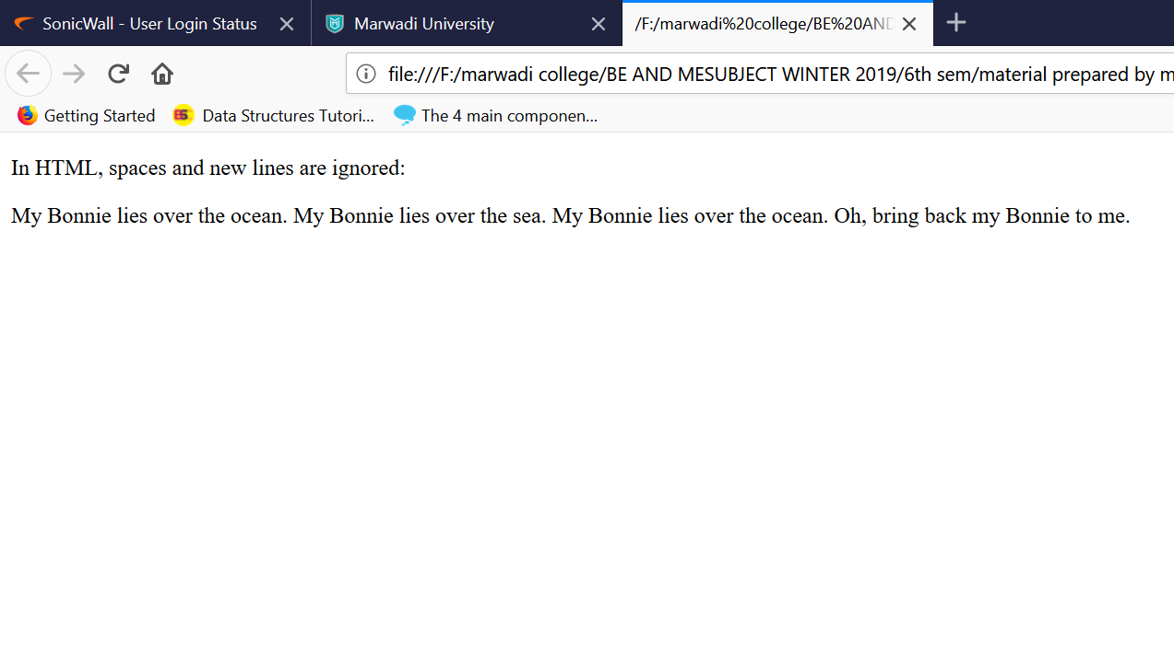
Pre Tag
This poem will display on a single line.

Slide 62
Pre Tag
The HTML <pre> element defines preformatted text.
The text inside a <pre> element is displayed in a fixed-width font (usually Courier), and it preserves both spaces and line breaks
<html>
<body>
<pre>
          My Bonnie lies over the ocean.
          My Bonnie lies over the sea.
          My Bonnie lies over the ocean.
          Oh, bring back my Bonnie to me.
</pre>
</body>
</html>

Slide 63
Pre Tag
This poem will have formatting

Slide 64
Break Tag
Br tag:
The HTML <br> element defines a line break.
Use <br> if you want a line break (a new line) without starting a new paragraph.
The <br> tag is an empty tag, which means that it has no end tag.
<html>
<body>
<p>This is<br>a paragraph<br>with line breaks</p>
</body>
</html>

Slide 65
HTML Styles
Setting the style of an HTML element, can be done with the style attribute.
<tagname style="property:value;">
The property is a CSS property. The value is a CSS value.
style attribute: for styling HTML elements
background-color: for background color
color : for text colors
font-family: for text fonts
font-size: for text sizes
text-align: for text alignment

Slide 66
Background Color
The CSS background-color property defines the background color for an HTML element.
<body style="background-color:powderblue;">
<h1>This is a heading</h1>
<p>This is a paragraph.</p>
</body>
Font family
The CSS font-family property defines the font to be used for an HTML element
<body>
<h1 style="font-family:verdana;">This is a heading</h1>
<p style="font-family:courier;">This is a paragraph.</p>
</body>

Slide 67
Font color
The CSS color property defines the font to be used for an HTML element.
<body>
<h1 style=“color:red;">This is a heading</h1>
<p style="font-family:courier;">This is a paragraph.</p>
</body>
Text Size
The CSS font-size property defines the text size for an HTML element.
<body>
<h1 style="font-size:300%;">This is a heading</h1>
<p style="font-size:160%;">This is a paragraph.</p>
</body>

Slide 68


