Slide 1
Data Frames in Python
Unit-4

Slide 2
Data Frame
Data frame is an object that is useful in representing data in the form of rows and columns
Data may come from an excel file(spreadsheet), a .csv file, a Python sequence like a dictionary, list or tuple
Python contains pandas which is a useful package for data analysis and manipulation
To create a dataframe, import pandas and then use its methods like: pandas.read_excel(), pandas.read_csv(), pandas.DataFrame()
Example.

Slide 3
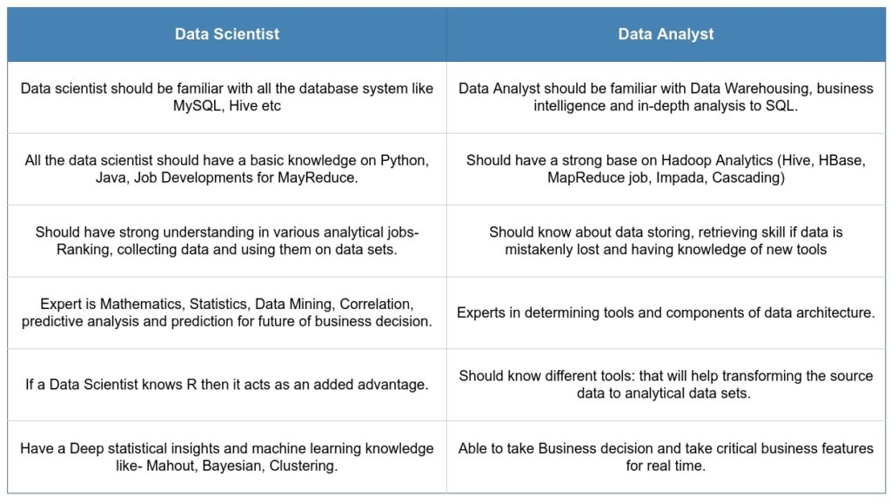

Slide 4
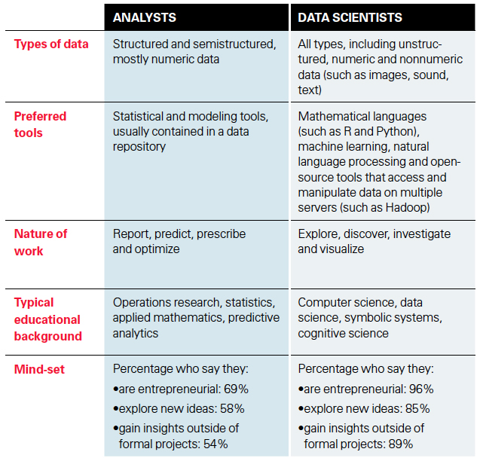

Slide 5
Operations on Data Frames
Knowing number of Rows and Columns:
  df.shape -> will return a tuple of rows and columns
  eg. Print(df.shape) will print (5,4) means 5 rows and 4 columns
  r, c = df.shape and print(r) will just print no. of rows
Retrieving Rows from Data Frame
  head() method returns 1st 5 and tail() returns last 5 rows by default
  If we provide an integer parameter in it will return that many rows
Retrieving a Range of Rows
  Can treat data frame as an object and rows can be retrieved using slicing
  df[2:5] -> will return rows 2 to 5 (will use row id- starting from 0)
  df[1::3] ->will return 1st row and 3rd row after 1st row i.e. 4th row, then 7th row and so on…
  df[5:0:-1]

Slide 6
Operations on Data Frames
Retrieve Column Names:
  df.columns will return list of columns with their index name.
  Output: Index(['Emp ID', 'EmpName', 'Salary', 'Joining Date'], dtype='object')
Retrieve column Data
  To retrieve column data, use column name as subscript
  eg. print(df.EmpName) will give o/p as list of all Employee Names
  2 ways: df.empid OR df[‘empid’]
Retrieving data from Multiple Columns
  Provide the list of column names as a subscript to dataframe object
  eg. df [[’empid’ , ’empname’]]
Finding Maximum and Minimum Values
  Use max() and min() method on columns containing numerical data
  eg. df [‘sal’].max()

Slide 7
Operations on Data Frames
Displaying Statistical Information
  describe() method displays information like: no. of values, average, standard deviation, minimum, maximum, 25%, 50% and 75% of total value.
  It is highly useful for statistical analysis. eg. df.describe()
Performing Queries on Data
  We can retrieve rows based on a query
  Query should be given as subscript in the data frame object
  To show data from some columns based on a query, mention the list of columns and then the query
  eg. 1 df[df.sal>1000]] eg2: df[[ ‘id’, ’name’]] [df.sal>1000]

Slide 8
Operations on Data Frames
Knowing the Index Range
  df.index will return for eg. RangeIndex(start=0, stop=5, step=1)
Setting Column as Index
  eg. df1 = df.set_index(‘empid’) OR df.set_index(‘empid’,inplace=True)
  Using df.loc[1004] can access a specific row with the defined index value
Resetting the Index
  df.reset_index(inplace=True)
Sorting the Data
  df.sort_values(‘doj’) OR df.sort_values(‘sal’, ascending=False)
Handling Missing Data
  df1 = df.fillna(0) or df1 = df.dropna()

