Slide 1

Group Members with Student ID
Om Panchal - 22106025
Sumant Bhise - 22106095
Sidra Khan - 22106028
Devang Dhuri - 22106036
Project Guide
Prof. Shraddha Dalvi

Slide 2
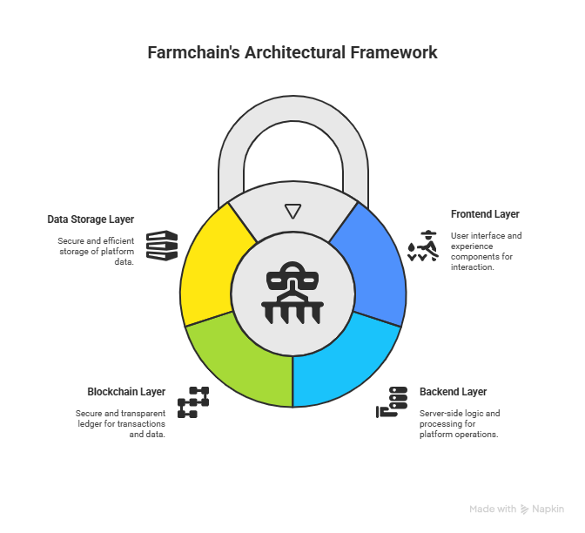
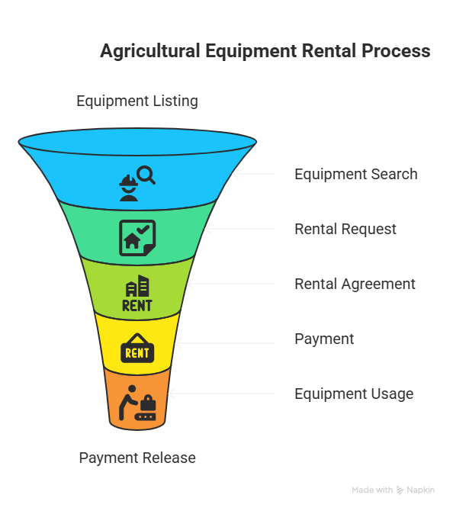
1. Farm chain - P2P Agricultural Equipment Rental Platform Using Blockchain Technology
About:
Farm Chain offers a blockchain-based P2P platform for renting agricultural equipment securely and transparently. Smart contracts automate rental agreements, payments, and dispute resolution without intermediaries. The system ensures trust, reduces costs, and provides real-time access to equipment availability and history.
Architecture:

Slide 3
Sr. No | TITLE | SOURCE | LINK
1. | Implementation of Smart Agricultural Equipment Rental System | International Journal of Advanced Scientific Research & Engineering Trends | 1474_Implementation_of_Smart_Agricultural_Equipment_Rental_System.pdf
2. | Metaheuristic and Machine Learning-Based Smart Engine for Renting and Sharing of Agriculture Equipment | Manik Rakhra, Ramandeep Singh, Tarun Kumar Lohani, Mohammad Shabaz | Metaheuristic and Machine Learning‐Based Smart Engine for Renting and Sharing of Agriculture Equipment - Rakhra - 2021 - Mathematical Problems in Engineering - Wiley Online Library
3. | A new location verification protocol and blockchain-based drone rental mechanism in smart farming | Computers and Electronics in Agriculture Volume 214, November 2023, 108267 | A new location verification protocol and blockchain-based drone rental mechanism in smart farming - ScienceDirect
4. | Blockchain Technology in Current Agricultural Systems: From Techniques to Applications | IEEE | Blockchain Technology in Current Agricultural Systems: From Techniques to Applications | IEEE Journals & Magazine | IEEE Xplore

Slide 4
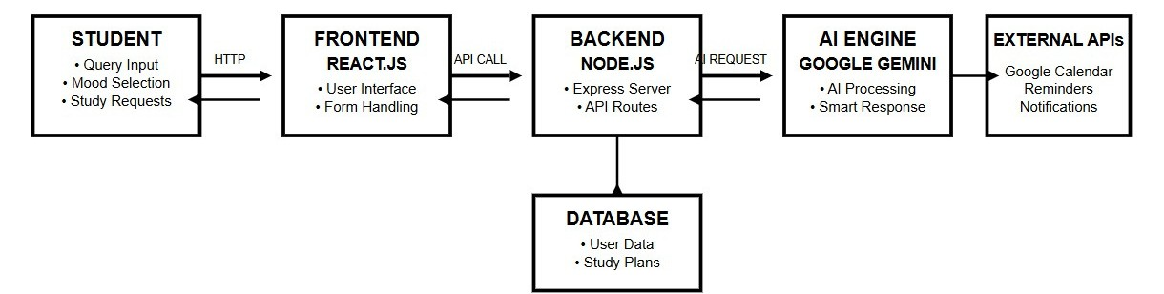
2. StudyGenie: Your AI-Powered Study Companion
Problem Statement:
Students waste valuable time searching for study help online, often finding resources that are too complex, irrelevant, or generic. This inefficiency frustrates learners and hampers effective study habits.
Objectives:
-To automate generation of study aids
-To make study smarter,faster and more engaging
-To assist learners in retraining information more effectively
Architecture:

Slide 5
Uniqueness
AI-generated quiz questions with explanations for incorrect answers.
Retention tracking (e.g., "You’re on track to remember this for X days").
Customizable decks based on uploaded documents/pdf content.
Time saving + dynamic engagement vs manual tools or static flashcard apps.
System Overview
-upload document
-AI extracts key concepts
-User engagement
-Quiz and Flash Card generation
-Mood based AI response
-calendar based reminders
Goal Alignment
Build a working MVP that automates quiz/flashcard creation.
Implement study-tracking features.
Demonstrate real retention gains through user testing.
Tie these goals to project rubric: complexity, usability, innovation.

Slide 6

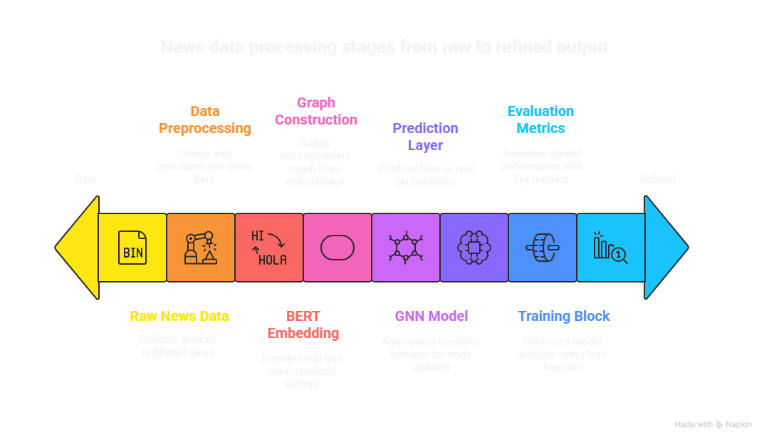
3. Fake News Detection with BERT + GNN
About:
This project presents a powerful fake news detection system that combines BERT for deep language understanding with Graph Neural Networks (GNNs) to analyze how news spreads on social media. By integrating NLP and Graph AI, the model evaluates both the content and its contextual trustworthiness.
Architecture:

Slide 8
THANK YOU

