Slide 1

Navigating the Future of Online Shopping
Made By - Devang Magare

Slide 2

Project Overview
This project analyzes an e-commerce dataset to understand sales performance and customer behavior. SQL is used to extract and compute insights from structured data, while Python is used to visualize the same results for better interpretation. Using both tools together helps validate the analysis and ensures consistency in results across different approaches.

Slide 3
Deciphering the Digital Marketplace: Dataset Overview
Customers Table
Orders Table
Order Items Table
Comprehensive details of individual customers, including geographical locations, providing a foundational layer for demographic analysis.
Records of order dates and their current statuses, crucial for tracking purchasing timelines and operational efficiency.
Detailed breakdown of product-level sales and pricing, offering granular insight into individual transaction values.
Products Table
Payments Table
Categorization of various products, enabling analysis of popular segments and inventory management.
Information on payment values and methods, essential for understanding revenue streams and financial flows.
This dataset offers a realistic snapshot of online shopping activities, allowing for in-depth analysis of consumer trends and business performance.

Slide 4




Analytical Arsenal: Tools & Methodology
SQL (MySQL Workbench)
Python (Pandas & Matplotlib)
Efficient data extraction using advanced join operations.
Robust data manipulation capabilities with Pandas.
Powerful aggregations and grouping for summarized insights.
Dynamic visualization of trends using Matplotlib.
Complex queries for in-depth retention analysis.
Critical cross-validation of SQL-derived results for accuracy.

Slide 5
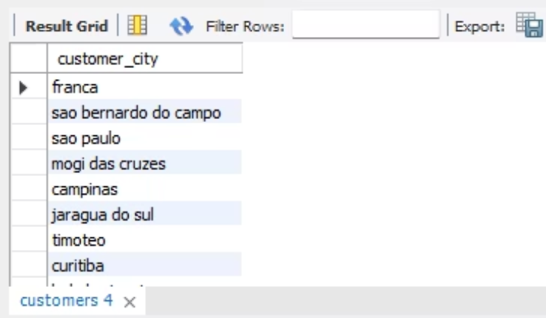
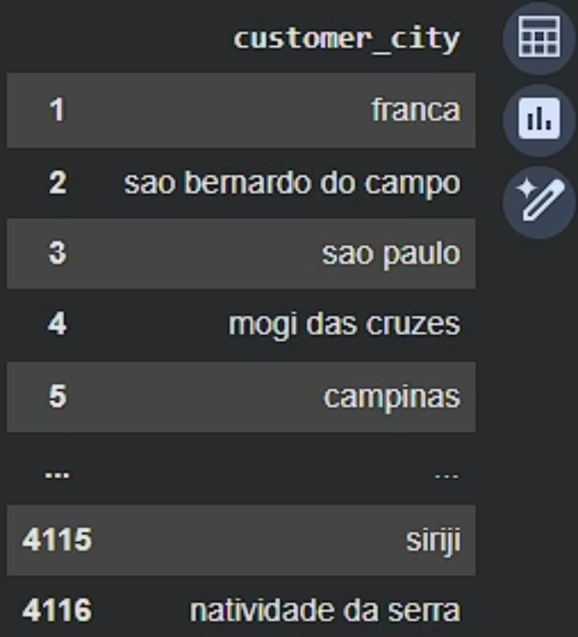
BASIC PROBLEM
SQL + PYTHON
Q1 .List all unique cities where customers are located
SQL Query
select distinct customer_city
from customers ;
Python Query
unique_cities = customers['customer_city'].unique()
unique_cities = customers[['customer_city']].drop_duplicates()
unique_cities.index = range(1, len(unique_cities) + 1)
unique_cities

Slide 6
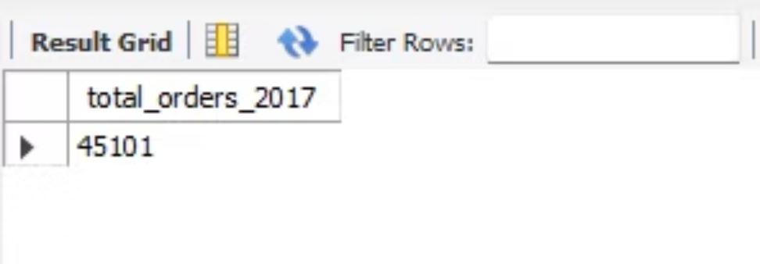
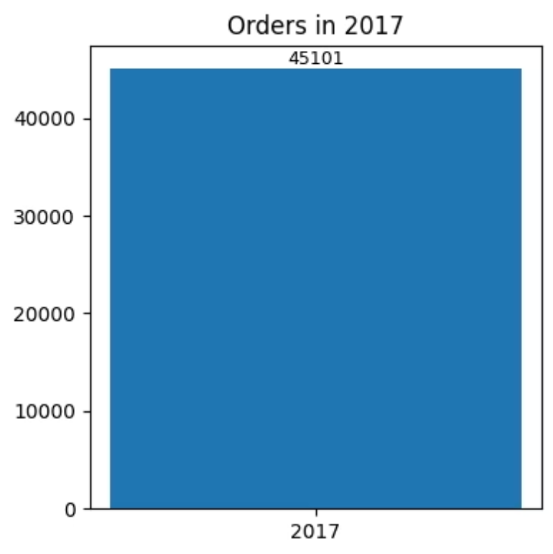
SQL + PYTHON
Q2. Count the number of orders placed in 2017
SQL Query
SELECT COUNT(*) AS total_orders_2017 FROM orders
WHERE YEAR(order_purchase_timestamp) = 2017;
Python Query
plt.figure(figsize=(4,4))
bars = plt.bar(['2017'], [count_2017])
plt.title('Orders in 2017’)
plt.bar_label(bars, labels=[count_2017], fontsize=9)
plt.tight_layout()
plt.show()

Slide 7
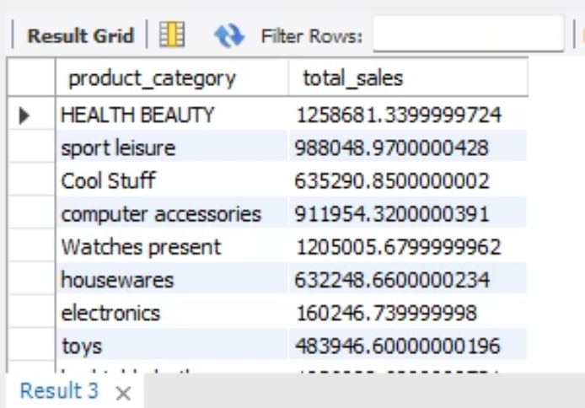
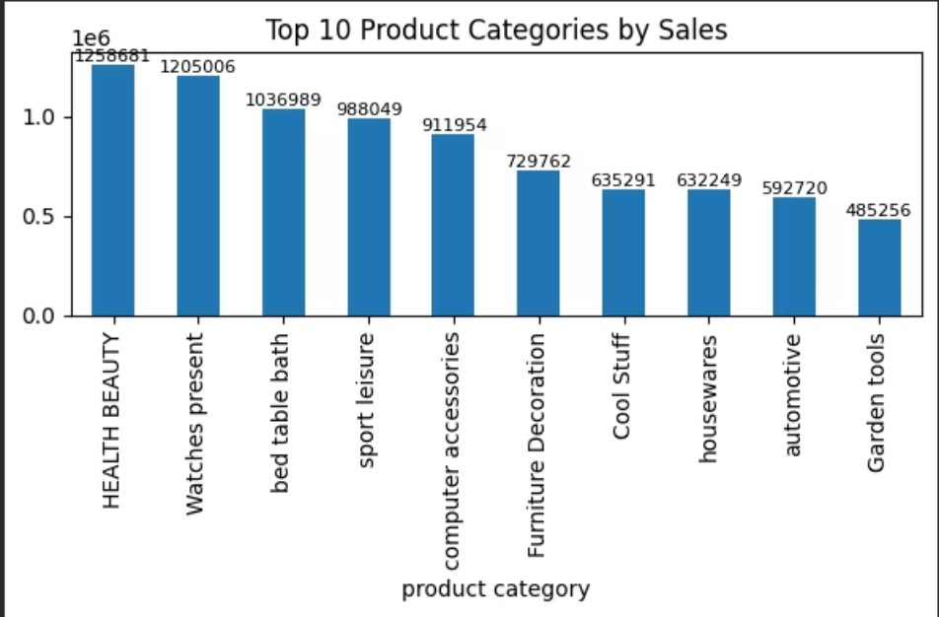
SQL + PYTHON
Q3. Find the total sales per category
SQL Query
SELECT products.product_category, SUM(order_items.price)
AS total_sales FROM order_items JOIN products ON
order_items.product_id = products.product_id GROUP BY products.product_category;
Python Query
plt.figure(figsize=(6,4))
bars = sales_cat.plot(kind='bar’)
plt.title('Top 10 Product Categories by Sales’)
plt.bar_label(bars.containers[0], fmt='%.0f', fontsize=8)
plt.tight_layout()
plt.show()

Slide 8
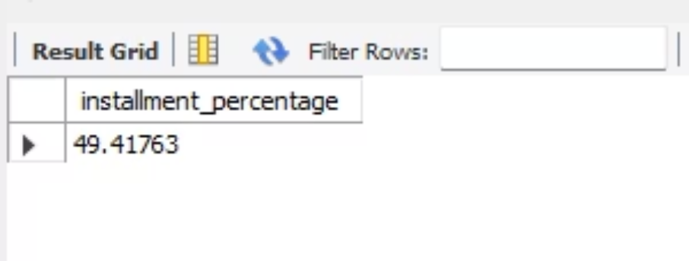
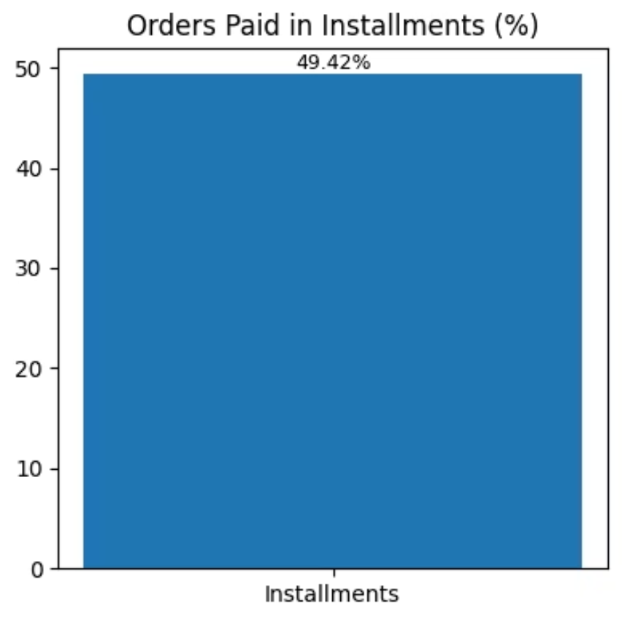
SQL + PYTHON
Q4. Calculate the percentage of orders that were paid in installments.
SQL Query
SELECT (COUNT(CASE WHEN payment_installments > 1
THEN 1 END) * 100.0 / COUNT(*)) AS
installment_percentage FROM payments;
Python Query
plt.figure(figsize=(4,4))
bars = plt.bar(['Installments'], [installment_pct])
plt.title('Orders Paid in Installments (%)’)
plt.bar_label(bars, fmt='%.2f%%', fontsize=9)
plt.tight_layout()
plt.show()

Slide 9
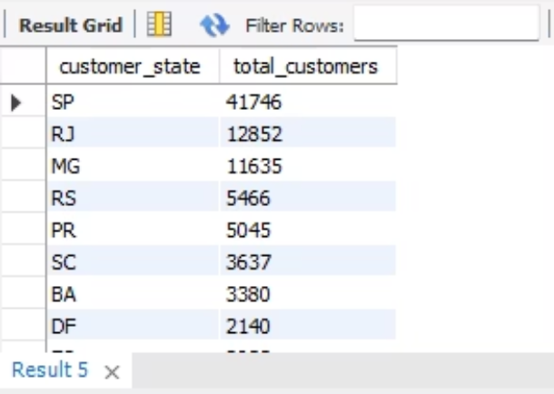
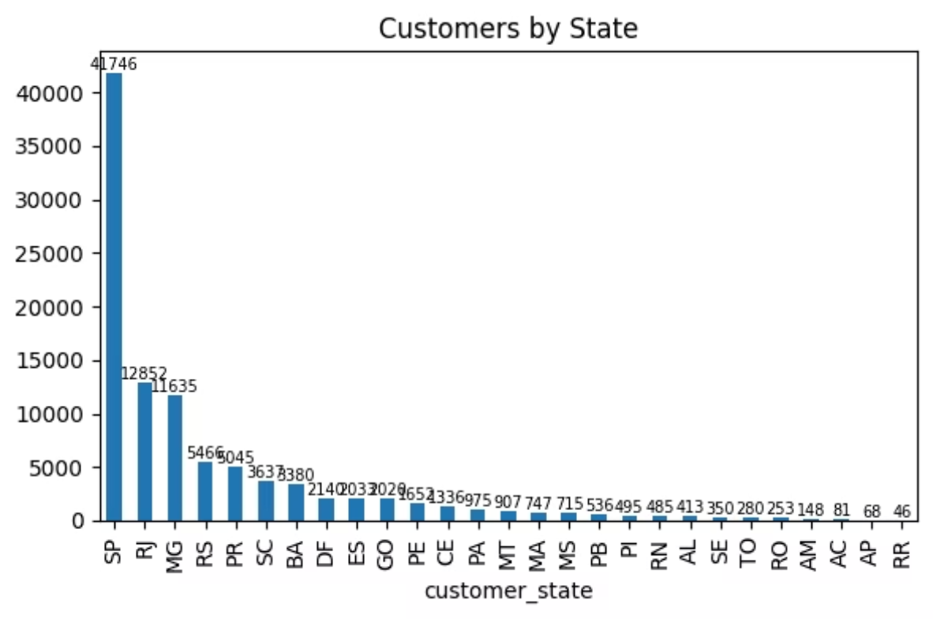
SQL + PYTHON
Q5. Count the number of customers from each state.
SQL Query
SELECT customer_state, COUNT(*) AS total_customers
FROM customers GROUP BY customer_state ORDER BY total_customers DESC;
Python Query
plt.figure(figsize=(6,4))
bars = state_counts.plot(kind='bar’)
plt.title('Customers by State’)
plt.bar_label(bars.containers[0], fontsize=7)
plt.tight_layout()
plt.show()

Slide 10
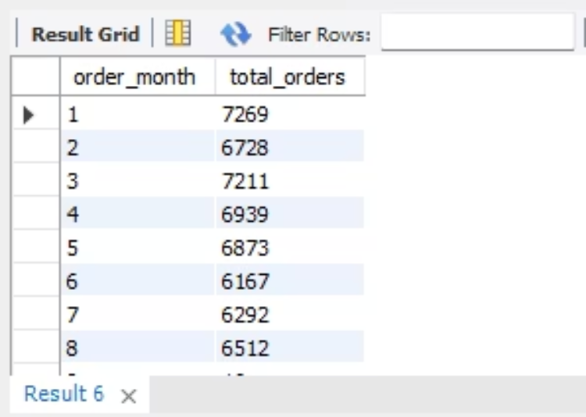
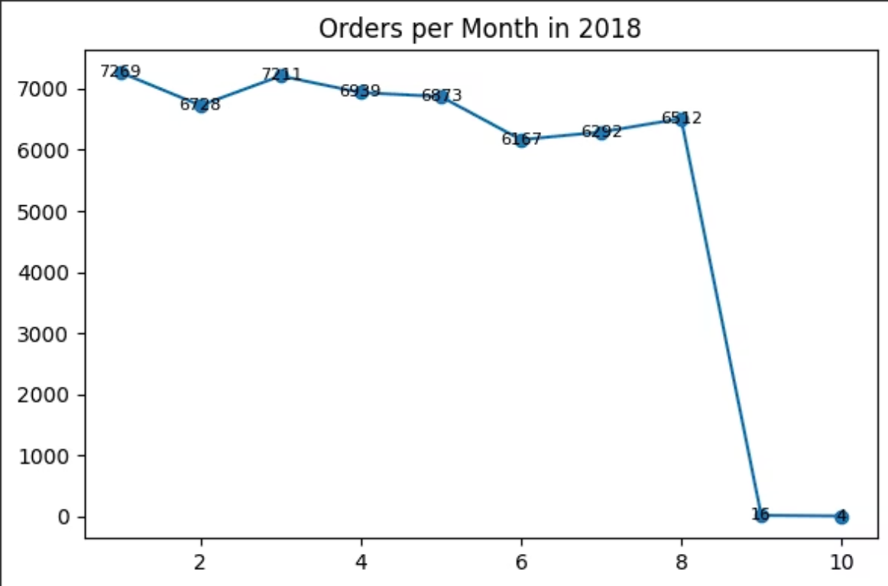
SQL + PYTHON
INTERMEDIATE PROBLEM
Q1. Calculate the number of orders per month in 2018.
SQL Query
SELECT MONTH(order_purchase_timestamp) AS order_month, COUNT(order_id) AS total_orders FROM orders
WHERE YEAR(order_purchase_timestamp) = 2018 GROUP BY MONTH(order_purchase_timestamp) ORDER BY order_month;
Python Query
plt.figure(figsize=(6,4))
plt.plot(monthly_orders.index, monthly_orders.values, marker='o’)
plt.title('Orders per Month in 2018’)
for x, y in zip(monthly_orders.index, monthly_orders.values):
plt.text(x, y, y, ha='center', va='center', fontsize=8)
plt.tight_layout()
plt.show()

Slide 11
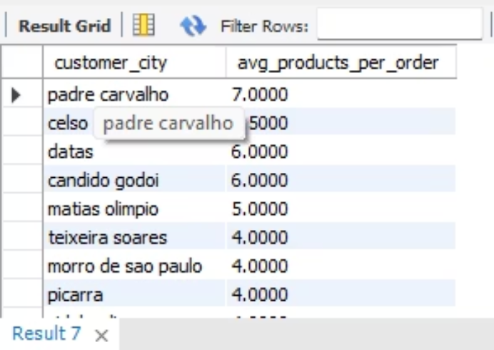
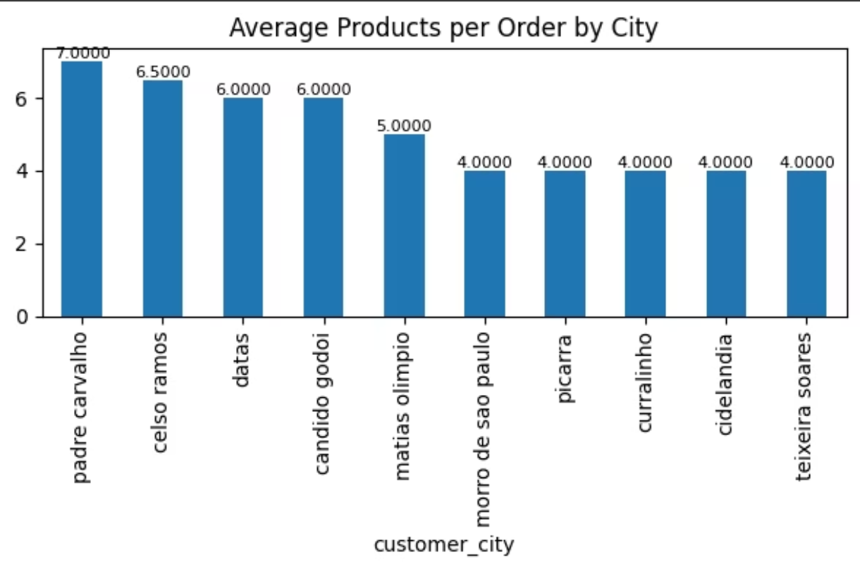
SQL + PYTHON
Q2. Find the average number of products per order, grouped by customer city.
SQL Query
SELECT c.customer_city, COUNT(oi.product_id) / COUNT(DISTINCT o.order_id) AS avg_products_per_order FROM orders o JOIN
order_items oi ON o.order_id = oi.order_id JOIN customers c ON
o.customer_id = c.customer_id GROUP BY c.customer_city ORDER BY
avg_products_per_order DESC LIMIT 10;
Python Query
plt.figure(figsize=(6,4))
bars = city_avg.head(10).plot(kind='bar’)
plt.title('Average Products per Order by City’)
plt.bar_label(bars.containers[0], fmt='%.4f', fontsize=8)
plt.tight_layout()
plt.show()

Slide 12
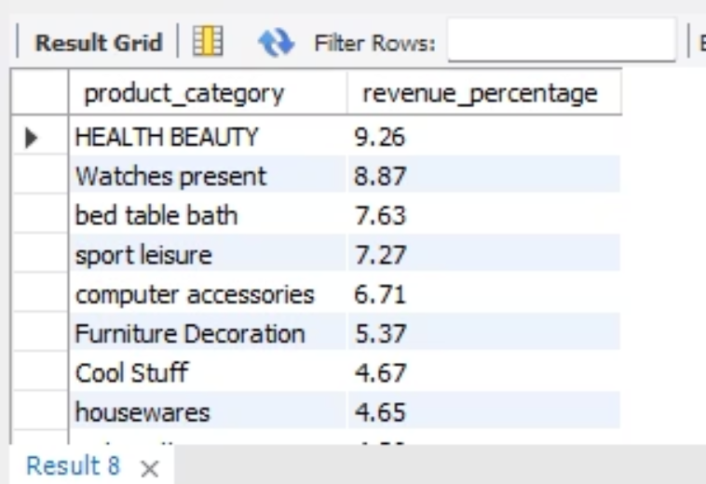
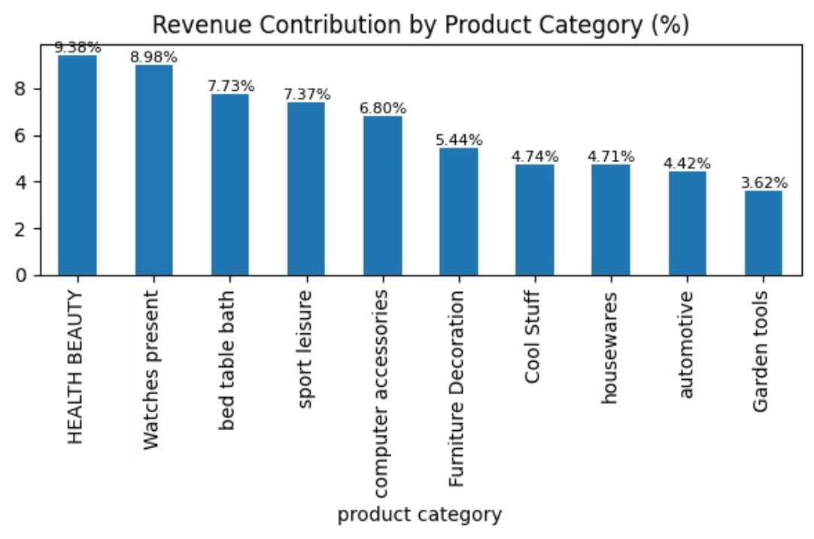
SQL + PYTHON
Q3. Calculate the percentage of total revenue contributed by each product category.
SQL Query
SELECT p.product_category, ROUND( SUM(oi.price) * 100.0 /
(SELECT SUM(price) FROM order_items), 2 ) AS revenue_percentage
FROM order_items oi JOIN products p ON oi.product_id = p.product_id GROUP BY p.product_category
ORDER BYrevenue_percentage DESC;
Python Query
plt.figure(figsize=(6,4))
bars = percent_revenue.plot(kind='bar’)
plt.title('Revenue Contribution by Product Category (%)’)
plt.bar_label(bars.containers[0], fmt='%.2f%%', fontsize=8)
plt.tight_layout()
plt.show()

Slide 13
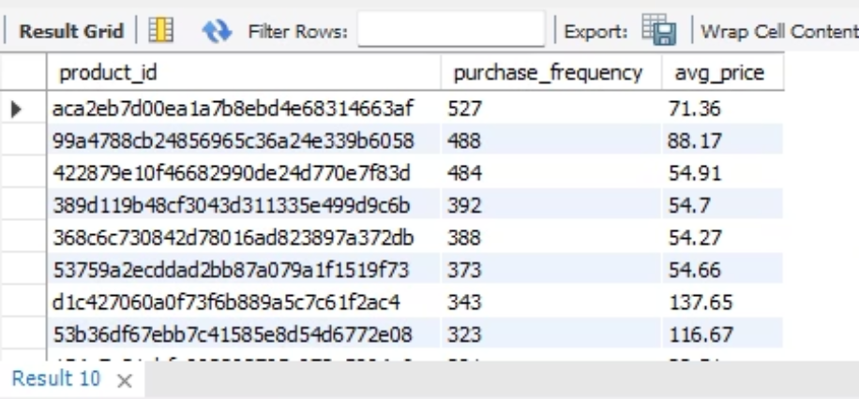
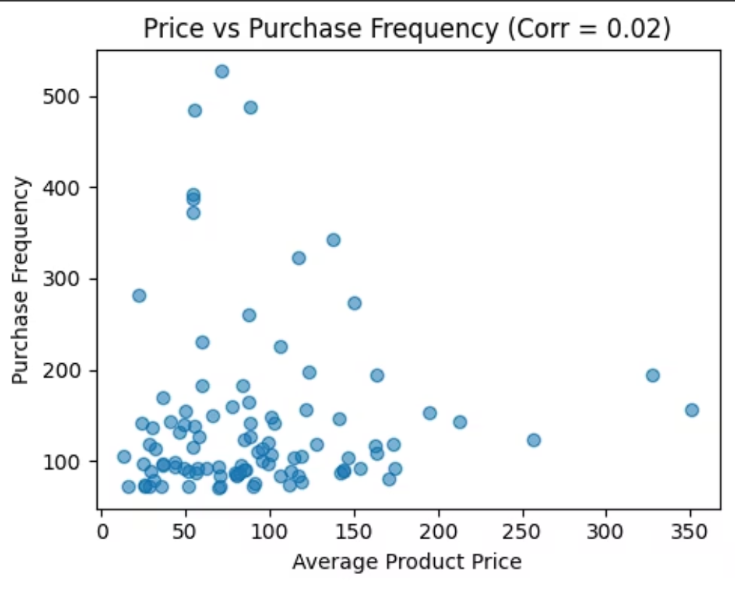
SQL + PYTHON
Q4. Identify the correlation between product price and the number of times a product has been purchased.
SQL Query
SELECT product_id, COUNT(*) AS purchase_frequency,
ROUND(AVG(price), 2) AS avg_price FROM order_items GROUP BY
product_id ORDER BY purchase_frequency DESC;
Python Query
plt.figure(figsize=(5,4))
plt.scatter(
top_products['avg_price'],
top_products['purchase_frequency'],
alpha=0.6)
plt.title(f'Price vs Purchase Frequency (Corr = {corr_value:.2f})’)
plt.xlabel('Average Product Price’)
plt.ylabel('Purchase Frequency')
plt.tight_layout()
plt.show()

Slide 14
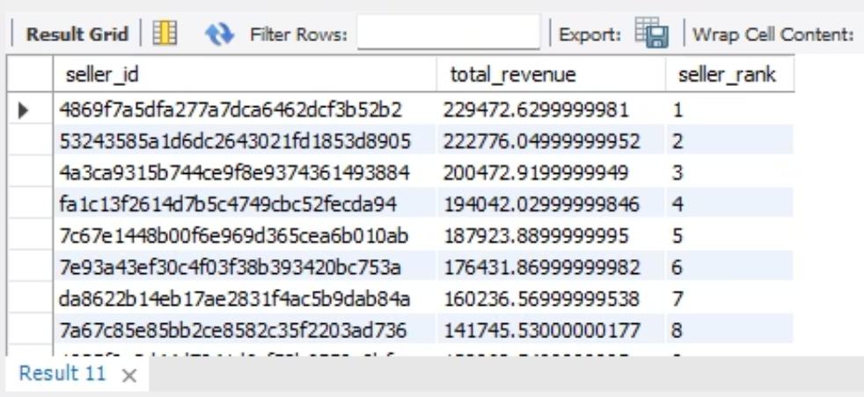
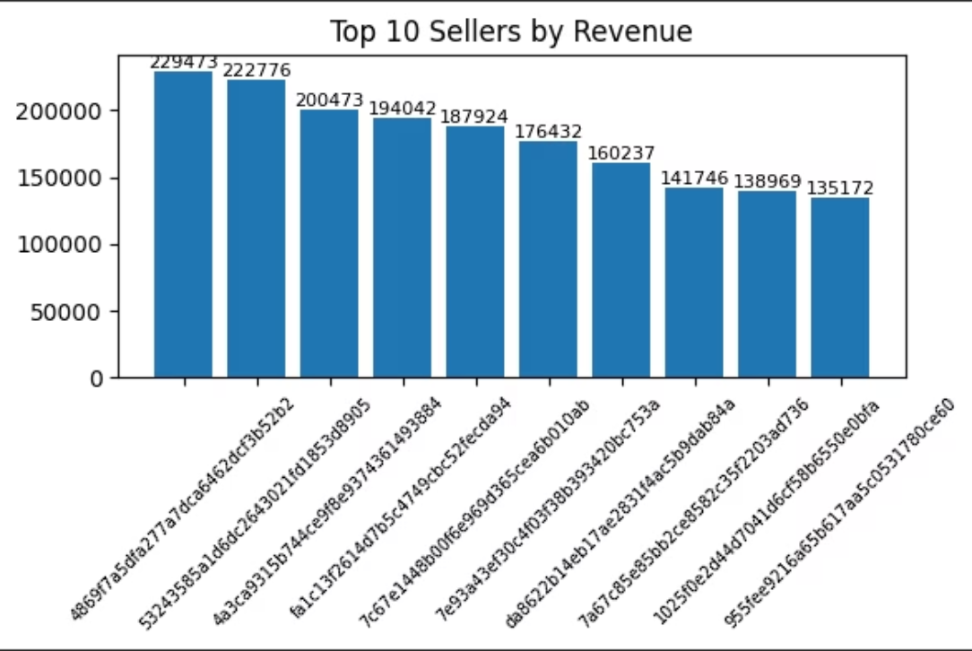
SQL + PYTHON
Q5. Calculate the total revenue generated by each seller, and rank them by revenue.
SQL Query
SELECT seller_id, SUM(price) AS total_revenue, RANK() OVER
(ORDER BY SUM(price) DESC) AS seller_rank FROM
order_items GROUP BY seller_id;
Python Query
plt.figure(figsize=(6,4))
bars = plt.bar(top_sellers['seller_id’],
top_sellers['total_revenue’])
plt.title('Top 10 Sellers by Revenue’)
plt.xticks(rotation=45, fontsize=7)
plt.bar_label(bars, fmt='%.0f', fontsize=8)
plt.tight_layout()
plt.show()

Slide 15
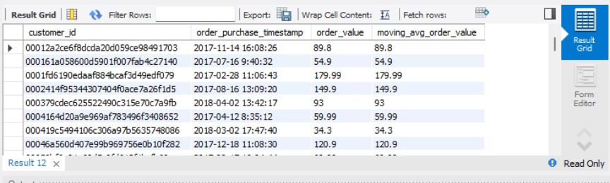
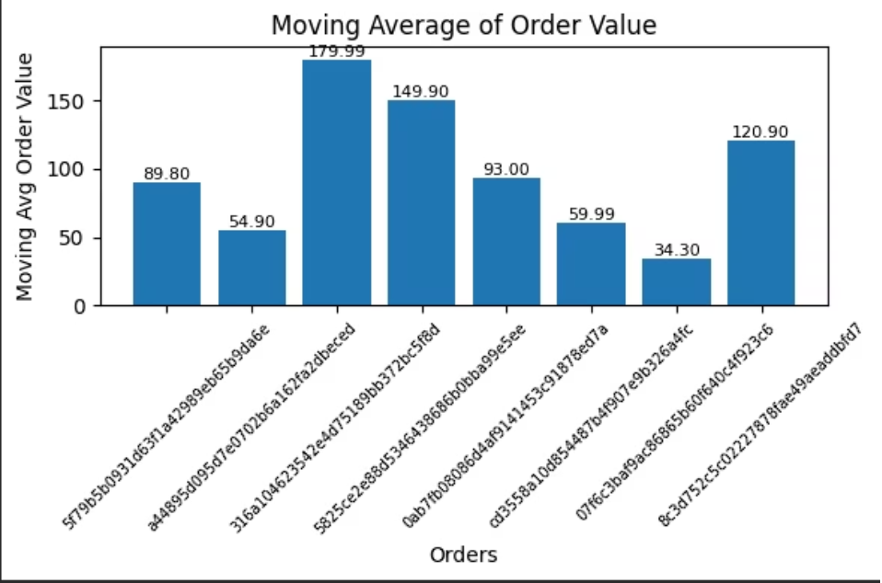
SQL + PYTHON
ADVANCED PROBLEM
Q1. Calculate the moving average of order values for each customer over their order history.
SQL Query
SELECT o.customer_id, o.order_purchase_timestamp, SUM(oi.price)
AS order_value, AVG(SUM(oi.price)) OVER ( PARTITION BY o.customer_id ORDER BY o.order_purchase_timestamp ROWS
BETWEEN UNBOUNDED PRECEDING AND CURRENT ROW ) AS
moving_avg_order_value FROM orders o JOIN order_items oi ON o.order_id =
oi.order_id GROUP BY o.customer_id, o.order_id, o.order_purchase_timestamp ORDER BY o.customer_id, o.order_purchase_timestamp;
Python Query
plt.figure(figsize=(6,4))
bars = plt.bar(range(len(sample)),sample['moving_avg_order_value'])plt.title('Moving Average of Order Value') plt.xlabel('Orders’)
plt.ylabel('Moving Avg Order Value')
plt.xticks(range(len(sample)), sample['order_id'], rotation=45, fontsize=7)
for bar in bars:
height = bar.get_height()
plt.text(bar.get_x() + bar.get_width()/2,
height,f'{height:.2f}',ha='center',va='bottom',fontsize=8)
plt.tight_layout()
plt.show()

Slide 16
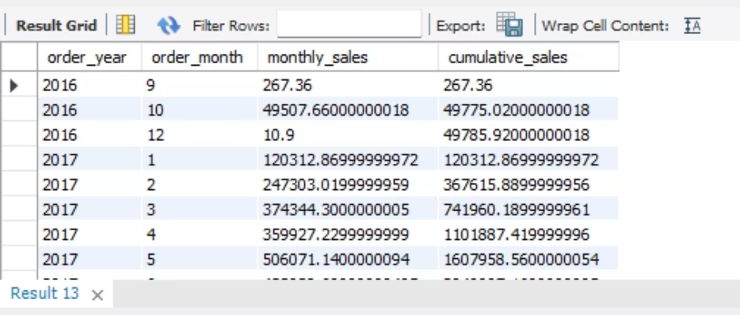
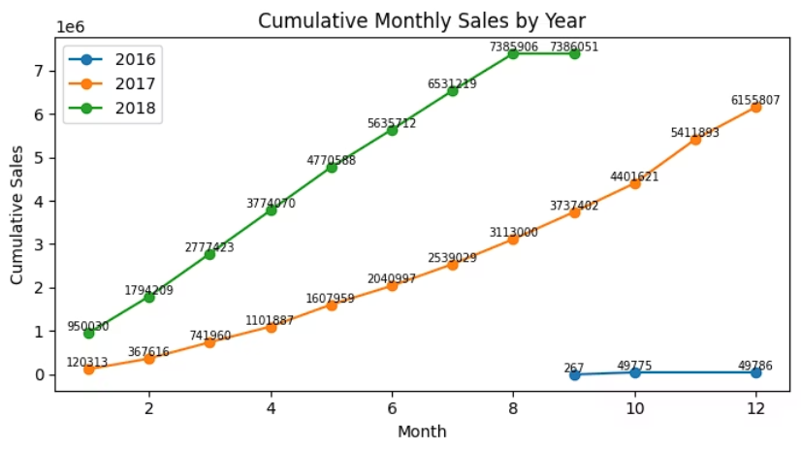
SQL + PYTHON
Q2. Calculate the cumulative sales per month for each year.
SQL Query
SELECT order_year, order_month, monthly_sales, SUM(monthly_sales) OVER
( PARTITION BY order_year ORDER BY order_month ) AS cumulative_sales FROM ( SELECT YEAR(o.order_purchase_timestamp) AS order_year,
MONTH(o.order_purchase_timestamp) AS order_month, SUM(oi.price) AS monthly_sales FROM orders o JOIN order_items oi ON o.order_id =
oi.order_id GROUP BY YEAR(o.order_purchase_timestamp), MONTH(o.order_purchase_timestamp) ) t ORDER BY order_year, order_month;
Python Query
plt.figure(figsize=(7,4))
for y in sorted(monthly_sales['year'].unique()):data = monthly_sales[monthly_sales['year'] == y]
plt.plot(data[‘month'],data['cumulative_sales'], marker='o',label=str(y))
for x, v in zip(data['month'],data['cumulative_sales']):
plt.text(x, v, f'{v:.0f}', fontsize=7, ha='center', va='bottom')
plt.title('Cumulative Monthly Sales by Year')
plt.xlabel('Month’)
plt.ylabel('Cumulative Sales’)
plt.legend()
plt.tight_layout()
plt.show()

Slide 17
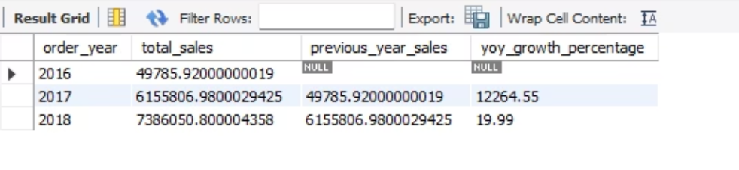
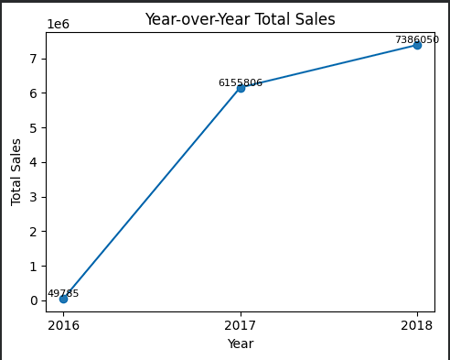
SQL + PYTHON
Q3. Calculate the year-over-year growth rate of total sales.
SQL Query
SELECT order_year, total_sales, LAG(total_sales) OVER (ORDER BY order_year) AS previous_year_sales, ROUND( (total_sales - LAG(total_sales)
OVER (ORDER BY order_year)) * 100.0 / LAG(total_sales) OVER (ORDER BY order_year), 2 ) AS yoy_growth_percentage
FROM ( SELECT YEAR(o.order_purchase_timestamp) AS order_year, SUM(oi.price) AS
total_sales FROM orders o JOIN order_items oi ON o.order_id = oi.order_id GROUP BY YEAR(o.order_purchase_timestamp) ) yearly_sales ORDER BY order_year;
Python Query
plt.figure(figsize=(5,4))
plt.plot(yearly_sales['order_year'],
yearly_sales['price'],
marker='o')
for x, y in zip(yearly_sales['order_year'], yearly_sales['price’]):
plt.text(x, y, f"{int(y)}", ha='center', va='bottom', fontsize=8)
plt.xticks(yearly_sales['order_year'])
plt.xlabel('Year')
plt.ylabel('Total Sales')
plt.title('Year-over-Year Total Sales')
plt.tight_layout()
plt.show()
yearly_sales

Slide 18
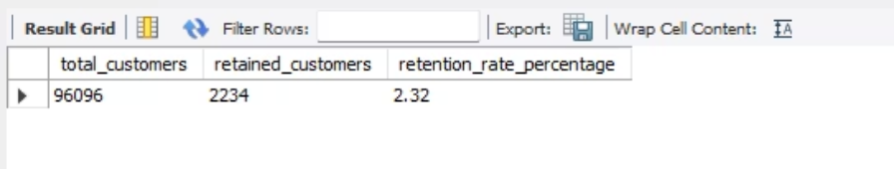
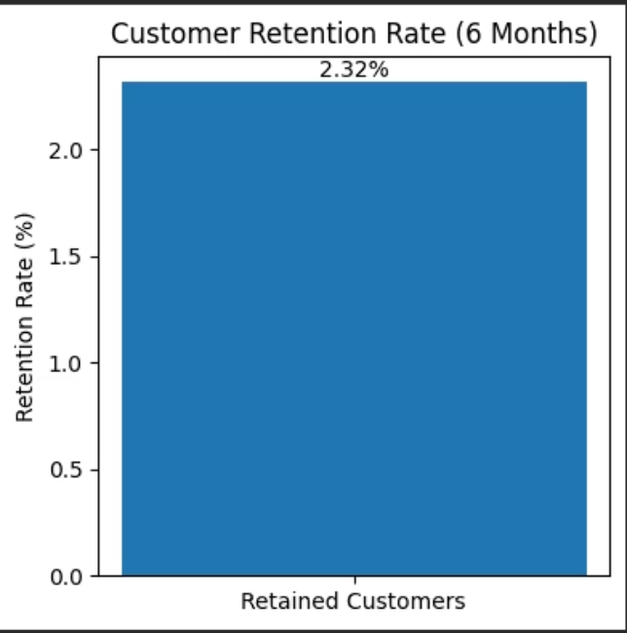
SQL + PYTHON
Q4. Calculate the retention rate of customers,defined as the percentage of customer who make another purcahse within 6 month of their purchase.
SQL Query
SELECT COUNT(DISTINCT customer_unique_id) AS total_customers, COUNT(DISTINCT CASE WHEN
order_purchase_timestamp > first_order_date AND
order_purchase_timestamp <= DATE_ADD(first_order_date,
INTERVAL 6 MONTH) THEN customer_unique_id END) AS retained_customers, ROUND( COUNT(DISTINCT CASE WHEN order_purchase_timestamp > first_order_date AND
order_purchase_timestamp <= DATE_ADD(first_order_date, INTERVAL 6 MONTH) THEN customer_unique_id END) * 100.0 / COUNT(DISTINCT customer_unique_id), 2 ) AS retention_rate_percentage
FROM ( SELECT c.customer_unique_id, o.order_purchase_timestamp, MIN(o.order_purchase_timestamp) OVER (PARTITION BY c.customer_unique_id) AS first_order_date FROM orders o JOIN customers c ON o.customer_id = c.customer_id ) t;
Python Query
plt.figure(figsize=(4,4))
plt.bar(['Retained Customers'], [retention_rate])
plt.ylabel('Retention Rate (%)’)
plt.title('Customer Retention Rate (6 Months)')
plt.text(0, retention_rate, f'{retention_rate}%', ha='center', va='bottom’)
plt.tight_layout()
plt.show()

Slide 19
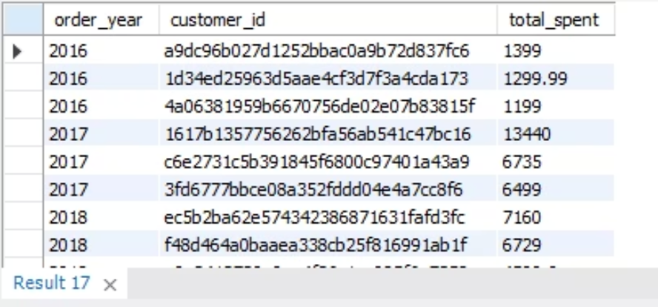
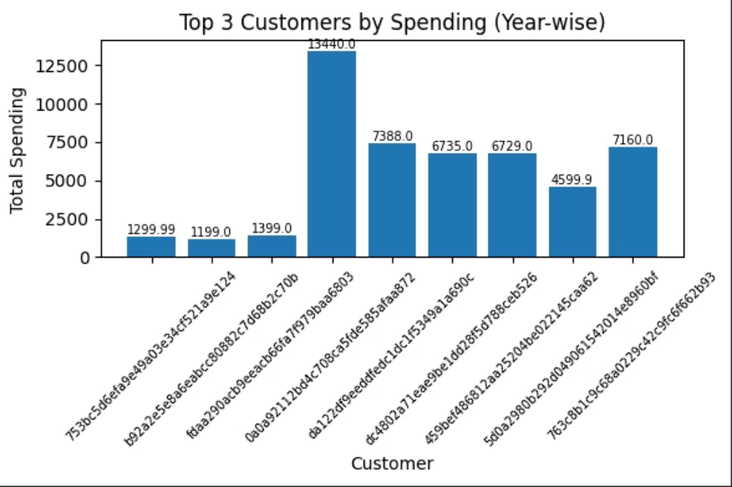
SQL + PYTHON
Q5. Identify the top 3 customers who spent the most money in each year.
SQL Query
SELECT order_year, customer_id, total_spent FROM ( SELECT YEAR(o.order_purchase_timestamp) AS order_year, o.customer_id,
SUM(oi.price) AS total_spent, DENSE_RANK() OVER ( PARTITION BY YEAR(o.order_purchase_timestamp) ORDER BY SUM(oi.price) DESC ) AS
rank_in_year FROM orders o JOIN order_items oi ON o.order_id = oi.order_id GROUP BY YEAR(o.order_purchase_timestamp), o.customer_id ) ranked_customers WHERE rank_in_year <= 3 ORDER BY order_year, rank_in_year;
Python Query
plt.figure(figsize=(6,4))
plt.bar(top3_customers['customer_unique_id'].astype(str),top3_customers['price’])
plt.xlabel('Customer')
plt.ylabel('Total Spending’)
plt.title('Top 3 Customers by Spending (Year-wise)')
plt.xticks(rotation=45, fontsize=7)
for i, v in enumerate(top3_customers['price']):
plt.text(i, v, round(v, 2), ha='center', va='bottom', fontsize=7)
plt.tight_layout()
plt.show()

Slide 20

Conclusion: Powering Decisions with Data
Structured Analysis
Visual Storytelling
SQL provided the backbone for structured and accurate data extraction, essential for reliable insights.
Python, through Pandas and Matplotlib, transformed raw data into compelling visualizations, revealing intricate trends.
Enhanced Decision-Making
Real-World Application
The combined approach of SQL and Python fortified our decision-making process with validated and clear data.
This project showcases practical, real-world data analytics skills, preparing for future challenges in e-commerce.

Slide 21
Thank You
Linkedin-https://www.linkedin.com/in/devang-magare-7b266b258/
Github-https://github.com/DevangMagare?tab=repositories
Email- devangmagare@gmail.com

