Slide 1

Exploring Music Recommendation through Facial Expressions
A python project

Slide 2

TEAM MEMBERS:
ANSH SEMWAL (RA2211027010071)
MOHAMMED ZAID (RA2211027010072)
DEVANG CHAUHAN (RA2211027010102)

Slide 3



Introduction
Welcome to the world of music recommendation! In this presentation, we will
delve into the fascinating realm of
and their connection to harmonious melodies. Discover how emotions can guide
personalized music suggestions, enhancing our listening experience. Join us on this journey of exploring the intricate relationship between music and emotions.

Slide 4

Background/ Problem Statement
Music has always been known to change people's moods. Capturing and recognizing a person's emotion and displaying appropriate songs matching the person's mood can gradually calm their mind and end up giving a pleasing effect.
People express their emotions primarily through their facial expressions. Our system aims to capture a person's emotion through facial expressions. The user's current emotion is used to generate an automatic music playlist. When compared to the algorithm in the existing literature, it performs better in terms of computational time.

Slide 5
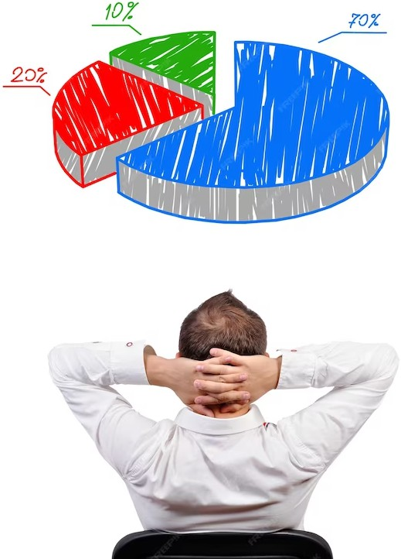
Working of the Project
In this system, the emotion will be detected and the music player will start recommending particular music. The person should be in the area containing light so that the detection is clear. The main objective of our music recommendation system based on users’ facial emotions is to provide users with suggestions that match their preferences.
The front-end involves XML , CSS, and JavaScript and the back-end involves Python. The framework used is FLASK and the database is MySQL. The libraries are OpenCV, NUMPY, and TensorFlow. The algorithm implemented is CNN (CONVOLUTIONAL NEURAL NETWORKS).

Slide 6

Enhancing the Listening Experience
Through the integration of facial expression analysis, we can enhance the listening experience. By recommending music that aligns with the listener's emotional state, we create a harmonious connection between music and emotions. This personalized approach fosters a deeper emotional engagement with the music, resulting in a more fulfilling and enriching listening journey.
Advantages
It’s easy to maintain.
It’s user-friendly.
Emotions are detected using the facial expression of users.
Instant music recommendation.

Slide 7
Conclusion
In conclusion, the exploration of music recommendation through facial expressions opens up exciting possibilities for a more personalized and emotionally resonant listening experience. By leveraging the power of facial expressions, we can create music recommendations that truly reflect the listener's emotional landscape. Let us embrace this harmonious blend of technology and emotions to unlock the full potential of music in our lives.

