Slide 1



Weather Trend Forecasting and Climate Analysis
PM Accelerator Data Scientist Internship Technical Assessment
Devangi Bhalala
BCA Graduate
Aspiring AI/ML Engineer & Data Scientist
Rajkot, Gujarat, India
May 2026

Slide 2

PM Accelerator Mission
PM Accelerator empowers future AI professionals through hands-on product development and real-world AI collaboration.
This project was completed as part of the PM Accelerator Data Scientist Internship Technical Assessment program.

Slide 3

Project Objectives
Analyze global weather trends and climate patterns
Forecast temperature using machine learning models
Compare forecasting model performance
Detect anomalous weather conditions
Study environmental impact using air quality indicators
Visualize geographical weather patterns worldwide
Tools & Technologies:
Python • Pandas • Scikit-learn • XGBoost • Matplotlib • Seaborn

Slide 4
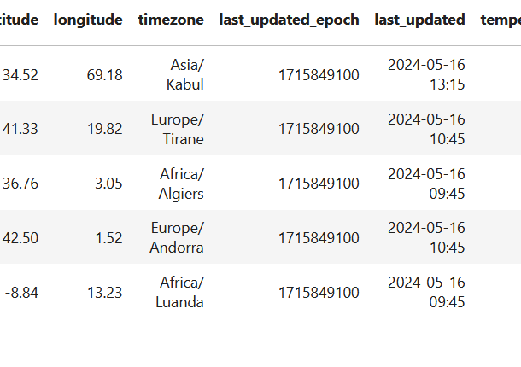
Dataset Overview
• Dataset: Global Weather Repository
• Source: Kaggle
• Records: 142,000+ weather observations
• Features: 40+ weather and environmental variables
• Coverage: Global city-level weather information
• Includes temperature, humidity, wind, precipitation, AQI, and atmospheric conditions
Dataset Size: ~46 MB
Rows: 142,873
Columns: 44

Slide 5

Data Cleaning & Preprocessing
• Checked and verified missing values
• Removed duplicate records
• Converted last_updated into datetime format
• Created time-series features:
- Year
- Month
- Day
• Selected important forecasting features
• Applied feature scaling using StandardScale
Missing Values Found: 0
Duplicate Records Removed Successfully

Slide 6
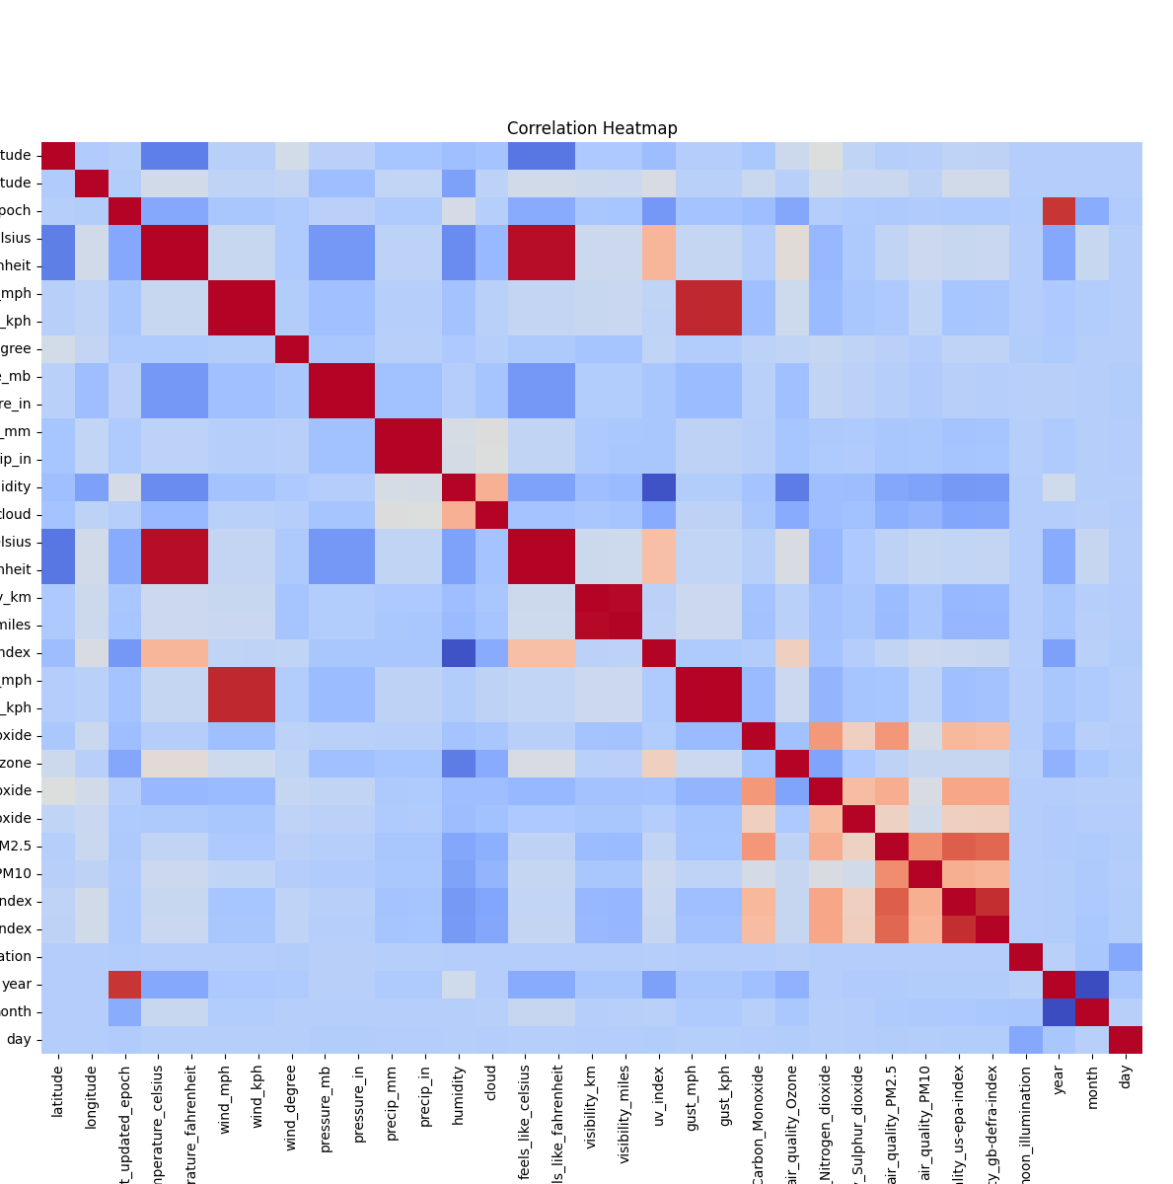
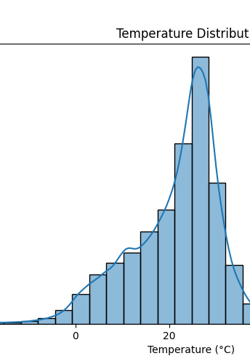
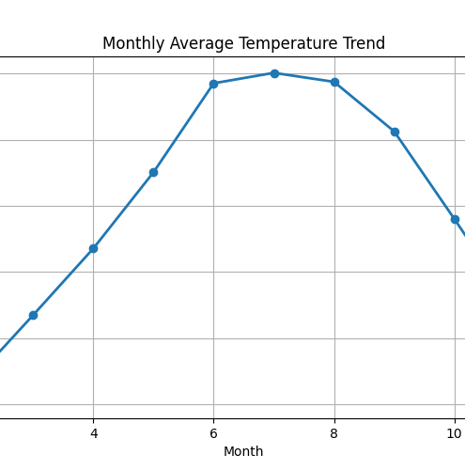
Exploratory Data Analysis (EDA)
Strong correlations exist between weather variables
Seasonal temperature variations are visible across months
Temperature and humidity show noticeable relationships
Environmental variables influence weather conditions

Slide 7
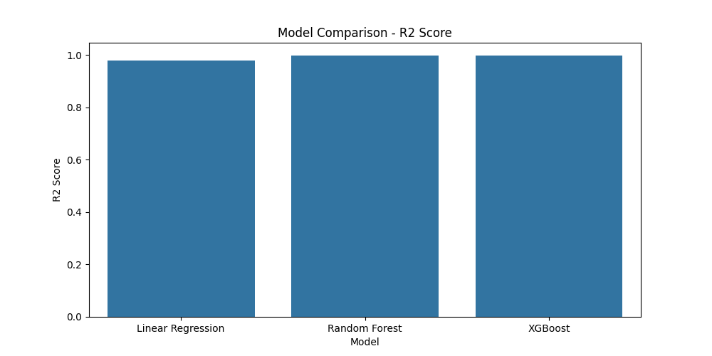
Forecasting Models & Performance
Implemented Models:
• Linear Regression
• Random Forest Regressor
• XGBoost Regressor
Best Model: Random Forest Regressor
R² Score: 0.9969
Model | MAE | RMSE | R² Score
Linear Regression | ~1.10 | ~1.70 | ~0.978
Random Forest | 0.281 | 0.531 | 0.997
XGBoost | 0.295 | 0.552 | 0.997

Slide 8
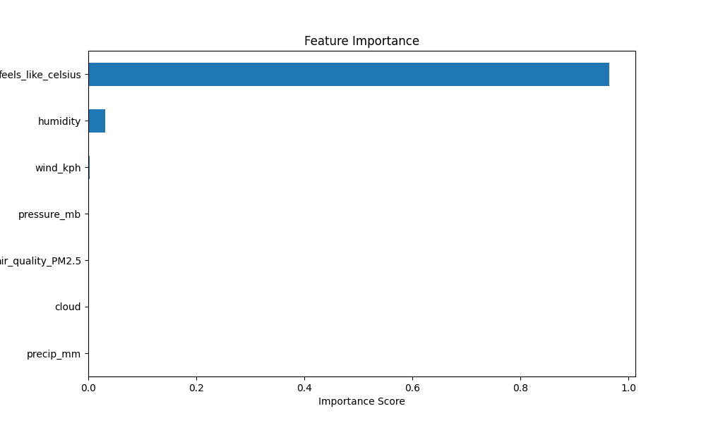
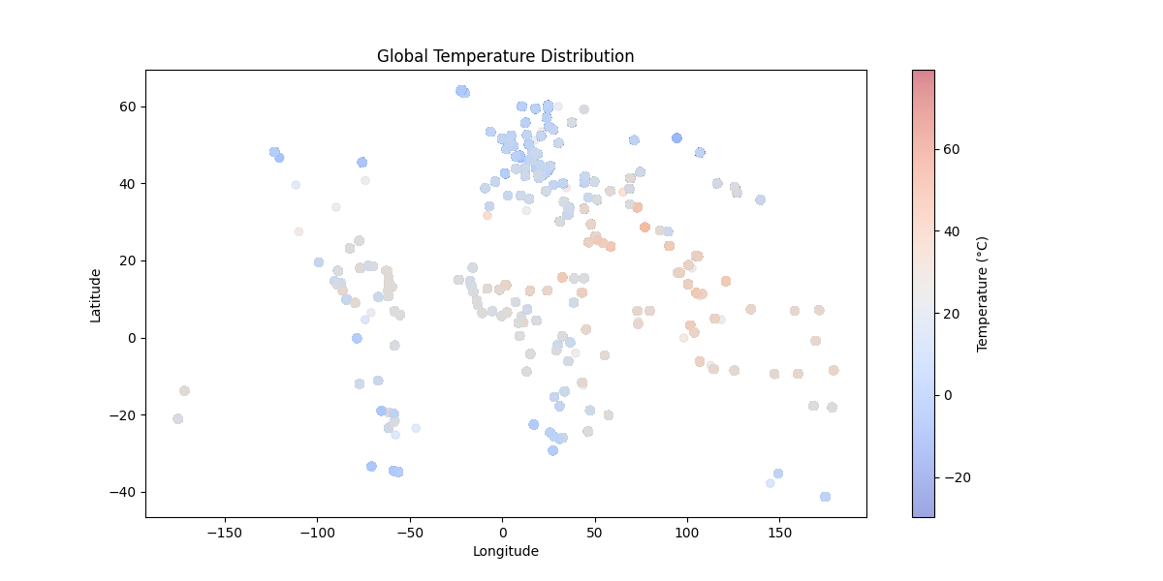
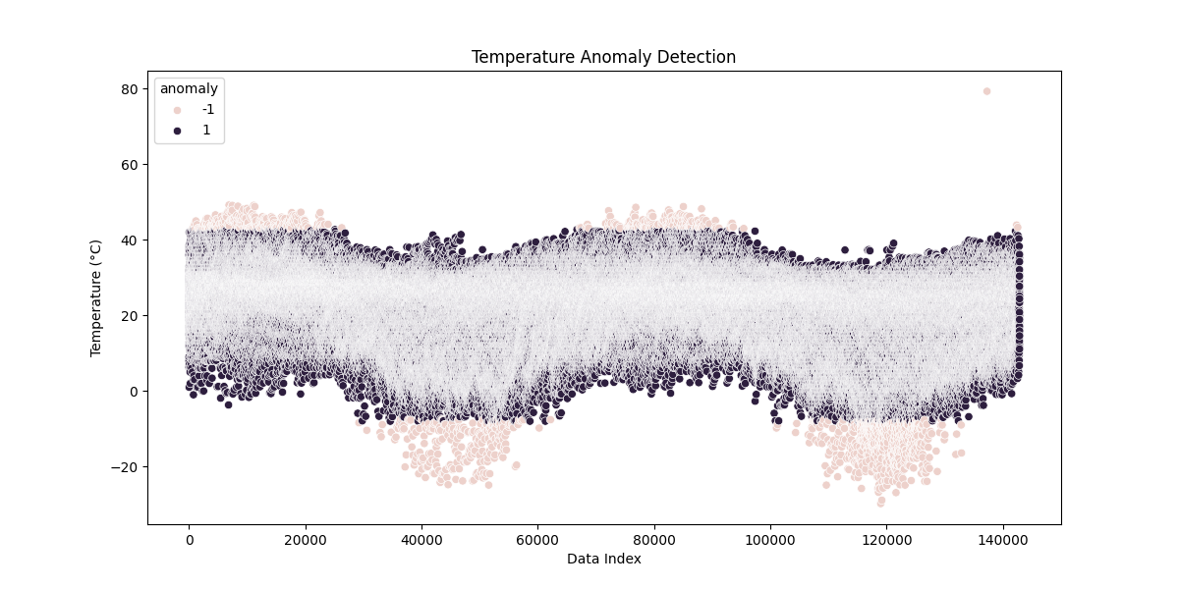
Advanced Analysis
Key Findings: • Isolation Forest detected unusual weather patterns • Feels-like temperature was the strongest predictor • Spatial analysis revealed global temperature trends

Slide 9
Key Insights
• Random Forest achieved the best forecasting performance with an R² score of approximately 0.997
• Weather variables such as humidity and feels_like_celsius showed strong predictive relationships
• Environmental indicators such as PM2.5 demonstrated correlations with temperature patterns
• Isolation Forest successfully identified anomalous weather observations
• Spatial analysis revealed noticeable geographical variations in global weather conditions
• Machine learning models proved highly effective for weather trend forecasting
Project Outcome:
Successfully developed a machine learning-based weather forecasting and climate analysis system using global weather data.

Slide 10
Conclusion
This project demonstrated the successful application of machine learning and data science techniques for weather forecasting, climate analysis, anomaly detection, and environmental impact analysis using global weather data.
Key Achievements:
• Built multiple forecasting models
• Achieved high prediction accuracy
• Performed advanced climate analysis
• Developed professional data science workflow
Thank You
Questions & Discussion
linkedin.com/in/devangibhalala
github.com/DevangiBhalala

