Slide 1
TaxMax AI
The average Indian taxpayer leaves
₹18,000+ on the table every year.
Why? Complexity, lack of awareness, and no personalised guidance.
⚠️ Discovery Gap
⏱️ Time Crunch
🔮 No Foresight
Most users don't know all 30+ deduction sections
Last-minute filing = missed optimization opportunities
Tools show past taxes, not future tax-saving potential
User Need: One AI-powered tool that (1) finds all missed deductions NOW and (2) plans tax-efficient investments for NEXT year.

Slide 2
AI-Powered Discovery: Prompts & Tool Stack
PERSONA GENERATION PROMPT
USER FLOW GENERATION PROMPT
"Act as a UX researcher. Create 3 detailed Indian taxpayer personas for a tax optimisation app. For each: name, age, occupation, annual income (₹8L–₹30L), key pain points with tax filing, tech savviness, and their top 2 tax-saving goals. Format as structured JSON."
"Design a 6-step onboarding flow for a tax deduction finder app targeting Indian salaried users. Each step: screen name, key inputs, validation rules, and error states. Output as a numbered list with UX rationale. Prioritise reducing cognitive load."
→ Claude
→ Claude
Task | Tool | Rationale
Persona & flows | Claude Sonnet 4 | Nuanced reasoning for user research
UI prototype | Lovable / Cursor | React code from natural language
Copy variants | Claude (A/B) | Generate 5 CTA variants in <30s
Tax calc logic | Claude + Code | Deduction rules → working JS
OKR dashboard | Claude + Recharts | AI-generated KPI mockups

Slide 3
AI Validation Prompts & Rapid Build Workflow
CODE GENERATION
"Write a React function computeTax(salary, deductions) that calculates Indian income tax for FY2024-25 old regime. Include all slabs, cess, and surcharge. Return {taxableIncome, tax, effectiveRate}."
COPY GENERATION
"Write 5 A/B test variants of the headline for a tax deduction finder. Audience: Indian salaried professionals 25-40. Tone: trustworthy but urgent. Constraint: under 12 words each."
USER TESTING SCRIPT
"Create a 15-minute usability test script for a tax savings tool. Include 5 tasks, 3 probing questions per task, and a SUS questionnaire. Target: first-time users unfamiliar with Section 80C."
Validation: 5 user interviews via Respondent.io (2hrs) → Claude synthesises themes → Figma prototype A/B tested via Maze

Slide 4
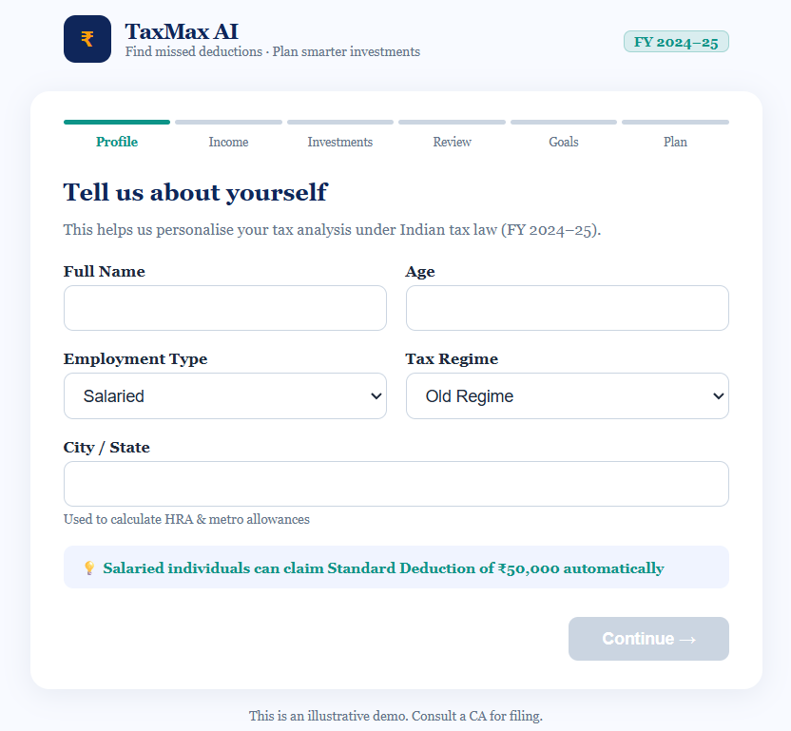
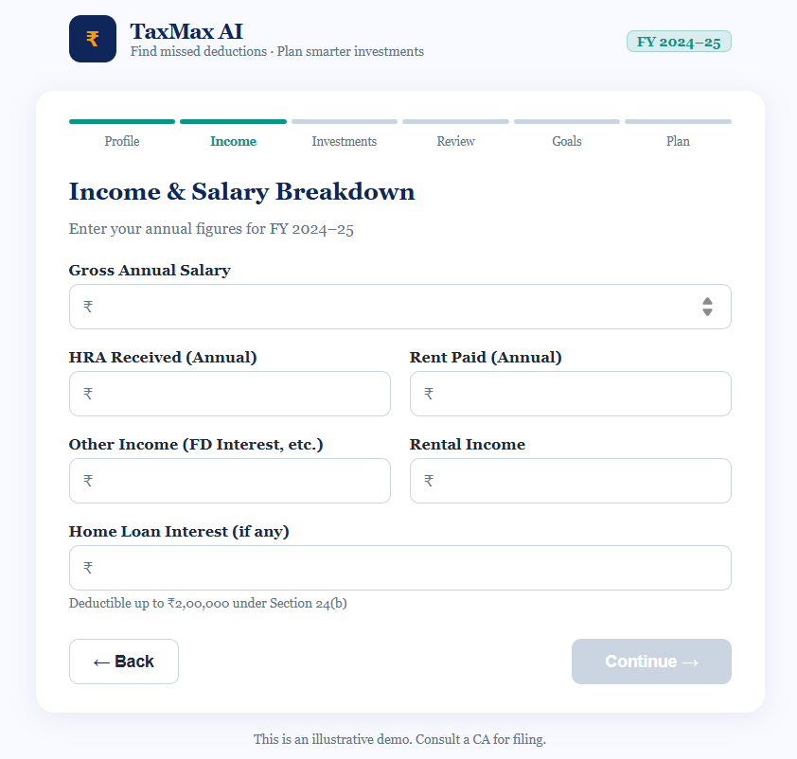
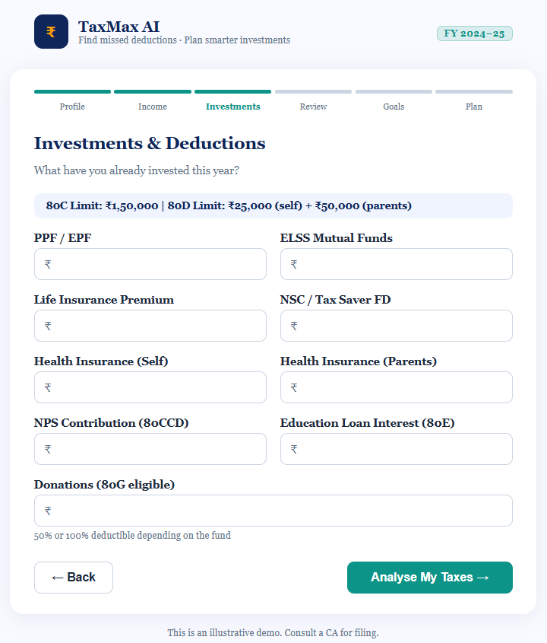
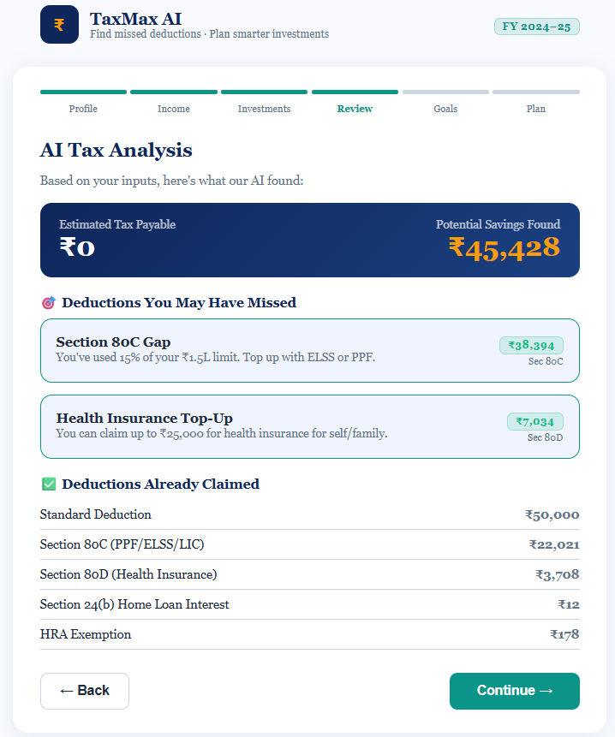
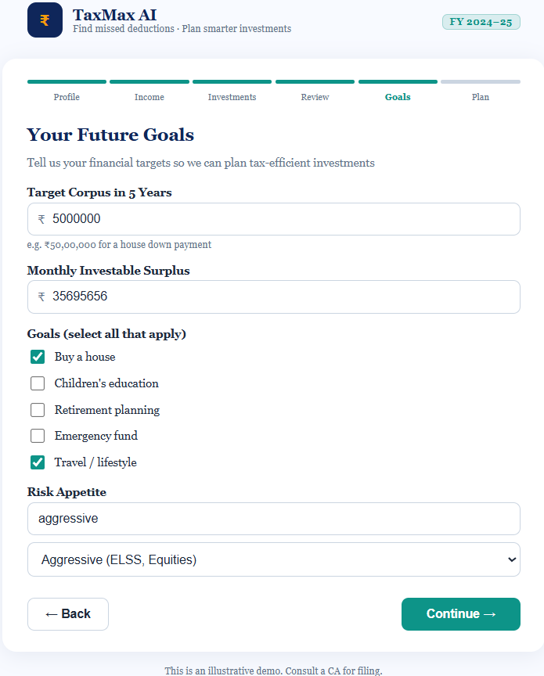
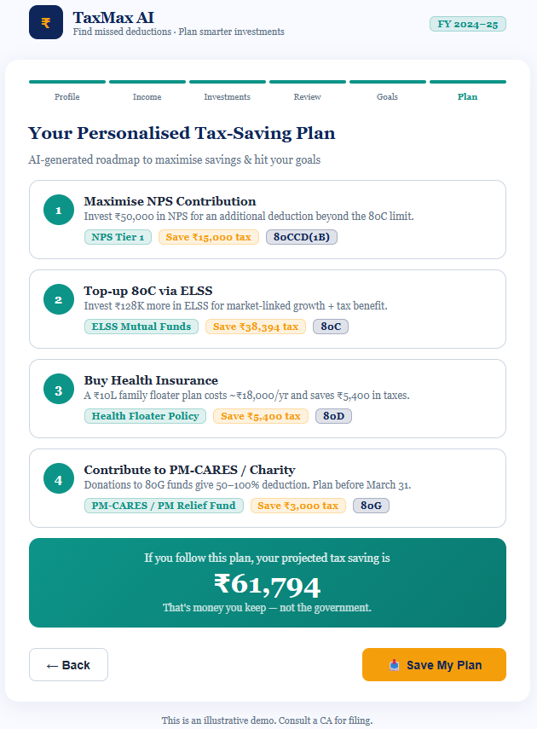
Working Prototype: TaxMax AI
Step 1 · Profile
Step 2 · Income
Step 3 · Investments
Name
Age
Employment Type
Tax Regime
City
Salary
HRA
Rent
FD Interest Home Loan
80C items
80D
NPS
80E
80G
Step 4 · AI Analysis
Step 5 · Goals
Step 6 · Tax Plan
Missed deductions
Tax payable
Savings found
Corpus target
Monthly surplus
Risk appetite
AI action plan
Instrument recs
Projected savings
Built with React (JSX) · Anthropic API · Recharts · Deployed: Claude Artifact | github.com/[repo]

Slide 5
Roll-out Plan & AI-Driven Feedback Loop
Week 1–2
Week 3–4
Month 2
Month 3
Alpha
Beta
A/B Tests
GA Launch
5 internal users · Usability test · Fix critical bugs
100 early adopters · NPS survey · Funnel analysis
3 CTA variants · 2 onboarding flows · Statistical significance
Feature flags · Segment rollout · PR & influencer seeding
Continuous AI-Driven Improvement Loop
1
Mixpanel captures step-drop events & deduction patterns
2
Claude weekly digest: 'Top 3 UX friction points from session logs'
3
AI auto-generates A/B test hypotheses from drop-off data
4
LaunchDarkly ships 50/50 variant; Claude monitors p-value daily
5
Winner promoted; loser archived. Cycle repeats every 2 weeks.

