Slide 1
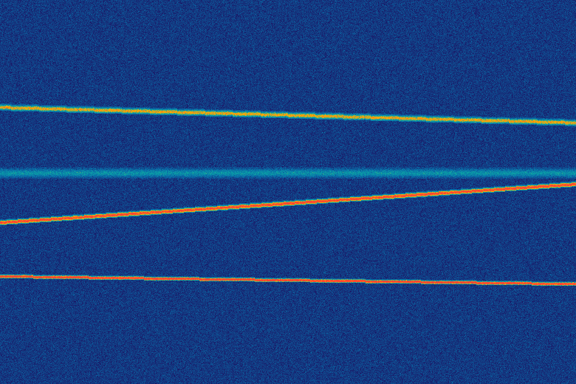
SMART INDIA HACKATHON · PROBLEM STATEMENT 26147
Autonomous RF Signal Analysis &
Parameter Extraction Platform
Confidence-aware .IQ / .WAV analysis — modulation ID, demodulation, de-interleaving,
FEC decoding, and bitstream correlation, fusing deterministic DSP with a trained classifier.
LIVE WATERFALL · SIGNATURE COLORMAP REUSED THROUGHOUT THE UI
ORGANISATION
CATEGORY
THEME
NTRO
Software
Miscellaneous
HONESTY-FIRST OUTPUT VOCABULARY
DETECTED
ESTIMATED
INFERRED
HYPOTHESIZED
UNKNOWN
Team: ________________________ Team Leader: ________________________
Notes:
Replace the team name / leader placeholders before submission. The waterfall swatch uses the exact 5-stop colormap implemented in the shipped React frontend (theme.css / Waterfall.tsx) -- this deck deliberately reuses the real product's visual identity rather than inventing a separate one.

Slide 2
THE IDEA
From Manual Guesswork to Confidence-Scored Intelligence
THE PROBLEM
OUR SOLUTION
1
Manual, one-signal-at-a-time analysis
1
One-click full pipeline
Analysts eyeball waterfalls and hand-tune demodulators per recording — slow, and not repeatable across sensors.
Ingest → detect → classify → demodulate → de-interleave → FEC-decode → correlate bitstream → report.
2
Metadata can't be trusted
2
DSP + AI confidence fusion
Sample rate, format, and center frequency vary by sensor/location and are often incomplete or wrong.
A deterministic DSP classifier and a trained CNN vote independently; agreement boosts confidence, disagreement surfaces both hypotheses honestly.
3
Fine-grain parameters go unextracted
3
SigMF-native, format-honest ingestion
FEC family, interleaving, symbol rate, and framing structure are rarely recovered at all today.
Auto-pairs .sigmf-data/.sigmf-meta, parses the full datatype vocabulary, and never fabricates a sample rate when metadata is missing.
4
No confidence, no evidence trail
4
Analyst-in-the-loop, reproducible
A single guessed label with no uncertainty and no way to reproduce how it was reached.
Override any value and re-run just the affected stages; every result exports as JSON / CSV / PDF / SigMF annotations.
RF SIGNAL ANALYSIS PLATFORM · SIH 26147 · NTRO
2

Slide 3
TECHNICAL APPROACH
17-Stage Pipeline, Hybrid DSP + AI at the Core
Ingest
(SigMF/IQ/WAV)
→
Detect &
Segment
→
DSP
Classifier
→
AI
Classifier
→
Confidence
Fusion
→
Demod +
De-interleave
→
FEC
Decode
→
Bitstream
Correlate
→
Report
Export
DSP and AI classifiers run independently on every recording and are combined by a dedicated fusion engine — not a single black-box model.
TECHNOLOGY STACK
SIGNAL CAPABILITIES
WHY IT'S DIFFERENT
FastAPI backend + React/TypeScript GUI
NumPy / SciPy / scikit-commpy (BSD) DSP core
PyTorch CNN classifier, temperature-calibrated
reedsolo (RS) + custom Viterbi FEC hypothesis search
reportlab PDF, SigMF-native everywhere
Modulation: BPSK/QPSK/8PSK/16&64QAM/2&4FSK
De-interleaving: block, convolutional, diagonal, PRN
FEC: convolutional (Viterbi) + Reed–Solomon
Bitstream: sync-word, framing, entropy, byte-align
Chunked full-file scan — bounded memory, any file size
Confidence fusion, not a single guessed label
Five-state honesty vocabulary end-to-end
Analyst overrides trigger a scoped re-run, not a redo
Every export is reproducible: model + params + hash
Built to extend — registries for demod/FEC/interleave
RF SIGNAL ANALYSIS PLATFORM · SIH 26147 · NTRO
3

Slide 4
FEASIBILITY & VIABILITY
Not a Concept Slide — A Working, Tested System
142 / 142
~50K
4
17
AUTOMATED TESTS PASSING
PARAMETER CNN CLASSIFIER
EXPORT FORMATS: PDF/JSON/CSV/SIGMF
PIPELINE STAGES, END TO END
MEASURED: MODULATION-CLASSIFIER ACCURACY vs. SNR
HONEST CHALLENGES — AND HOW WE'VE ADDRESSED THEM
⚠ PSK/QAM order confusion in the AI classifier
✓ Resolved by fusion: DSP's M-th-power method is independently reliable here
⚠ Multi-hundred-GB recordings
✓ Chunked, memory-mapped scan — never loads a full file into RAM
⚠ Blind FEC / interleaver identification is not fully solvable
✓ Reported as a ranked, evidenced hypothesis — never a false certainty
⚠ LDPC decoding, closed-loop timing recovery
✓ Documented roadmap; registries already support adding them
RF SIGNAL ANALYSIS PLATFORM · SIH 26147 · NTRO
4

Slide 5
IMPACT & BENEFITS
More Signal Intelligence, Less Analyst Time per Recording
WHO BENEFITS
HOW WE COMPARE
SIGINT / RF analysts
inspectrum
IQEngine
FISSURE
Ours
Go from raw capture to a structured, evidenced parameter set in one click instead of manual per-signal tuning.
Automatic signal detection
–
–
~
✓
Confidence-fused AI + DSP
–
–
–
✓
Sensor operations teams
Consistent, format-honest ingestion across sensors with different metadata quality — nothing silently guessed.
FEC + de-interleave hypotheses
–
–
–
✓
Analyst override → scoped re-run
–
–
–
✓
Downstream processing systems
SigMF-native, honest metadata
✓
✓
~
✓
Richer, machine-readable output (JSON / SigMF annotations) feeds directly into sensor tasking and cataloguing.
Comparison reflects each tool's default/native capability, based on our own architecture research (see References).
Training & knowledge transfer
Every result is reproducible and evidence-annotated — junior analysts see the reasoning, not just the label.
RF SIGNAL ANALYSIS PLATFORM · SIH 26147 · NTRO
5

Slide 6
RESEARCH, REFERENCES & ROADMAP
Grounded in Prior Art, Honest About What's Next
RESEARCH CORPUS REVIEWED
ROADMAP FROM HERE
IQEngine (MIT)
LDPC + concatenated-code decoding
SigMF data model + chunked-access UX pattern, referenced
inspectrum / SNAIL
Closed-loop Costas / Gardner timing recovery
mmap-backed large-file viewing pattern, referenced
Multi-signal-per-file separation (time-freq clustering)
GNU Radio (GPL-3.0)
algorithm reference only — not linked, license-isolated
ONNX export for lightweight, no-PyTorch deployment
scikit-commpy (BSD-3)
PSK/QAM modems + Viterbi — directly integrated
Constellation plot + comparison mode in the GUI
RadioML / DeepSig (CC BY-NC-SA)
Security hardening: fuzzing, process isolation
taxonomy reference only — not used to train our model
FISSURE
closest prior art; scoped against for genuine differentiation
This deck reports only what has been built and tested — 142/142 automated tests, run against synthetic ground truth, not just “does it import.”
Full licensing + reuse-strategy analysis (reuse / wrap / reimplement / reference, per component) documented in our architecture report.
RF SIGNAL ANALYSIS PLATFORM · SIH 26147 · NTRO
6

