Slide 1
Membrane
Useful context.
Selective memory.
A policy layer for AI memory.
OPS INCIDENT DEMO
Notes:
An incident chat contains two kinds of information: what the agent needs right now, and what the company should keep. Those are different decisions. Membrane keeps the authorized context available for the current task, then applies company rules and employee preferences before memory or training. This is a synthetic ops demo.

Slide 2
PRODUCT PIPELINE
A policy hook before persistent memory
The current task keeps its context. The persistent copy follows the rules.
company.md
employee.md
Agent
Membrane
Cleaned output
GBrain
Memory writes
Agent trajectories
Listen, classify,
and redact
Useful facts
Sanitized trajectory
Memory for future tasks
Handoff simulated
Jev decisions
Training export
Simulated classifier
Separate permission
Membrane
Deterministic local rules run today. Jev and GBrain are integration points.
02
Notes:
The agent produces memory writes and execution trajectories. A listener intercepts them before persistence. Company policy and an employee Markdown file determine what can survive. Jev is the intended typed classifier; our code applies those decisions and assembles the cleaned output. For this demo, deterministic local rules perform that work. GBrain is the intended memory destination, and training export has its own consent gate. The UI replays traces; Jev calls and the GBrain handoff are simulated. Hosted classification would also have to respect data-egress policy. Source for Jev capability: https://typesafe.ai/blog/introducing-system-one-models-and-jev

Slide 3
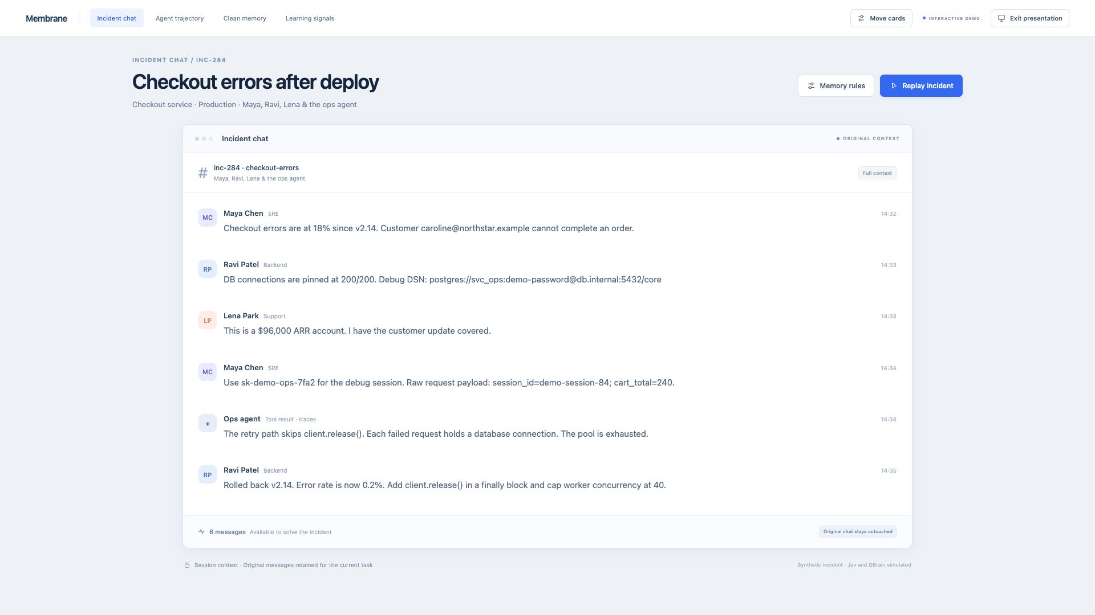
Notes:
Here is the incident. Checkout errors jumped to 18 percent after a deploy. Maya, Ravi and Lena share useful debugging context, but also a customer email, revenue, a connection credential and a raw request. The ops agent traces the failure to a connection leak. The team rolls back and identifies a fix. The original conversation remains available for this task. All names, incidents and credentials in this screen are synthetic.

Slide 4
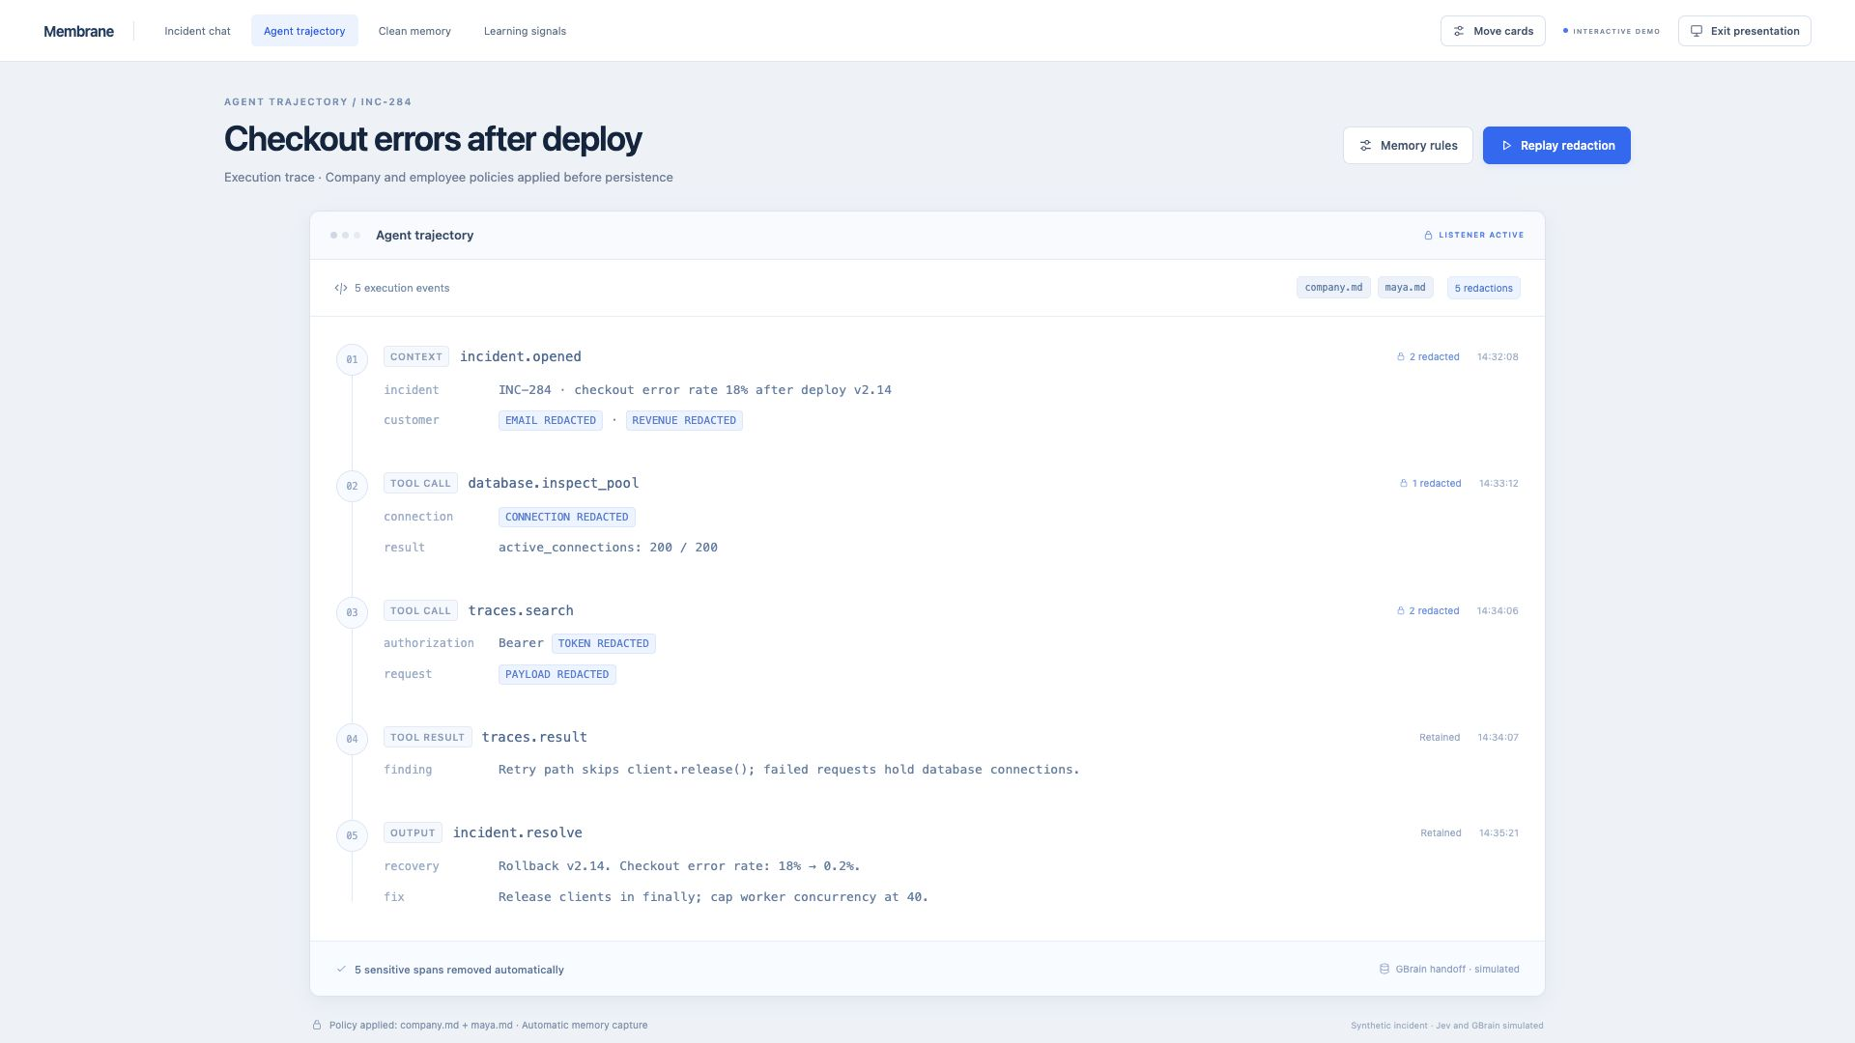
Notes:
Now look at the persistent copy of the execution trace. The hook removes five sensitive spans automatically: customer email, revenue, connection credential, API token and raw request payload. It keeps the useful tool result, diagnosis and resolution. There is no review queue or save button. The cleaning runs locally; the displayed GBrain handoff is simulated. In a live demo, Replay redaction reveals the transformation step by step.

Slide 5
RULES AND PERSONALIZATION
Two files decide what survives
Company restrictions and personal preferences meet at the same hook.
company.md
maya.md
# Company memory policy
- Never store: credentials,
customer emails, customer revenue
- Allow training: sanitized
operational procedures
- Minimum repeated runs: 3
# Maya Chen
- Never store: raw request payloads
- Allow training: yes
Keep the diagnosis and reusable fix.
A preference change applies on the next replay and training export.
Membrane
Prototype policy parser. Previously stored data and trained models are separate concerns.
05
Notes:
The rules fit into two Markdown files. The company excludes credentials, customer emails and revenue. Maya adds raw request payloads and grants permission for sanitized operational training examples. We retain the diagnosis and reusable fix. The demo uses a small local parser and known sensitive patterns, so these files are easy to edit and replay. A rule change affects the next generated output; this is not a claim that previously stored records or trained weights have been erased.

Slide 6
REPEATED WORK
Nine incidents. Two recurring procedures.
Repeated steps and token usage identify candidates for a training experiment.
103,974
tokens across nine runs
7
eligible example records
Minimum repeat count: 3. One run lacks consent; one procedure has only one run.
Membrane
Synthetic incident history and token counts. No training performance is claimed.
06
Notes:
The same small set of procedures appears repeatedly in our synthetic history. There are five pool-exhaustion incidents, three retry storms and one disk issue. The seeded telemetry totals 103,974 input and output tokens. At a repeat threshold of three, and after checking consent, 7 example records are eligible: four pool examples and three retry examples. One pool run lacks consent; the disk issue has not repeated enough. These are fixtures grouped by a known pattern label, not a live clustering model. They signal an experiment, not proof that fine-tuning will work. Data source: public/ops-data.js, library(true), grouped(), totalTokens() and trainingRows().

Slide 7
WHEN TO LEARN
Permission comes before a training pilot
Token count alone cannot tell you whether a model needs training.
Keep in retrieval
Test a training pilot
Facts that change
Procedures that repeat
Current incidents, customers
and company knowledge.
Retrieve permitted information
when the task needs it.
Clean examples with consent.
Compare a custom model with
the RAG baseline on new incidents
before deciding to train further.
Allow training: no 7 eligible examples become 0 on the next export.
Membrane
The demo exports JSONL. Training and its expected benefits are simulated.
07
Notes:
When and what are separate questions. Changing company facts belong in governed retrieval. A stable, repeated procedure may justify a training pilot, provided the examples are permitted and useful. The pilot needs held-out incidents and a comparison against the current RAG baseline. Our seven demo records are synthetic and repeat templates; they are not a validated training dataset. The concrete control is permission: changing Allow training from yes to no makes the next export contain zero eligible examples. That does not untrain an existing model. River or another training service is a proposed downstream connection; no model is trained here.

Slide 8
Membrane: a policy layer for AI memory
The fix survives.
The sensitive details don’t.
RUNNING IN THE DEMO
NEXT CONNECTIONS
Markdown rules
Automatic trace redaction
Consent-filtered JSONL export
Jev classification
Live writes into GBrain
A custom-model training pilot
Synthetic ops data. Jev, GBrain handoff and training are simulated.
Notes:
The product promise is simple: remember the fix without retaining the sensitive details that happened to be nearby. Today the demo runs Markdown rules, automatic redaction and a consent-filtered JSONL export. Local GBrain has been set up and verified separately, but the UI handoff is simulated. Jev classification and a custom-model training pilot are the next connections. This is the policy layer between useful work now, useful memory later and deliberate learning.

