Slide 1
Project Title : Guess The Word
Name: Devansh Bhagania
Roll No: 2210990259

Slide 2
Index
Objective
Introduction
Methodology, Approach & Techniques
Algorithm
Result
Source Code (screenshots)
Conclusion
Reference

Slide 3
Objective
The objective of Guess The Word Game is to decipher a secret word letter by letter before your chances run out. You'll be presented with a series of dashes, representing the hidden word's length. Each guess you make reveals a letter in the word, helping you build towards the solution. Choose your guesses strategically, as incorrect attempts will cost you a chance. With a limited number of tries, this game tests your vocabulary, spelling, and deduction skills in a race against the clock.

Slide 4
Introduction
Welcome to Guess the Word, a classic game where wit and deduction are your greatest weapons. A mysterious word is hidden behind a row of dashes, waiting to be unraveled. Can you guess the letters one by one to expose the full word before your chances run dry?
Are you ready to take on the challenge? Let the game begin!

Slide 5
Methodology, Approach & Techniques
Hidden Information: The core mechanic of Guess the Word relies on incomplete information. The player starts with a series of dashes representing the hidden word's length. They must progressively reveal the letters by making educated guesses.
Trial and Error with Limited Attempts: Guess the Word employs a trial and error approach. Players experiment with different letters to uncover the hidden word. However, there's a limited number of guesses allowed. This creates a sense of urgency and strategic decision-making.
Deductive Reasoning: As the game progresses, players use deductive reasoning to refine their guesses. They consider previously revealed letters, the word's length, and common letter combinations to make informed choices and maximize their chances of success.
Vocabulary and Spelling Reinforcement: Guess the Word inherently strengthens vocabulary and spelling skills. Players constantly encounter new words and practice spelling them letter by letter as they try to solve the puzzle.

Slide 6
Algorithm
Intialization:
Define a list of words (word_list).
Select a random word from the list (secret_word).
Initialize an empty string to store guessed letters (guessed_letters).
Set the maximum number of allowed guesses (max_guesses).
Game Loop:
While the player has remaining guesses (max_guesses > 0) and the word is not guessed (secret_word != guessed_letters):
Display the word with dashes representing unguessed letters and revealed letters based on guessed_letters.
Prompt the player to guess a letter.
Process the guess:
If the guess is in the secret word:
Update guessed_letters to include the guessed letter.
Otherwise:
Decrement the remaining guesses (max_guesses -= 1).
Inform the player the guess is incorrect.
Game End:
If the player has guessed all the letters correctly (secret_word == guessed_letters):
Declare victory.
Otherwise:
Reveal the secret word.
Declare defeat.

Slide 7
Result
Victory:
The player successfully guesses all the letters in the hidden word before running out of attempts.
The game congratulates the player on their keen wit and vocabulary skills.
2. Defeat:
The player exhausts all their allotted guesses before solving the word.
The game reveals the hidden word, showcasing the answer the player missed.
The game acknowledges the player's effort and encourages them to try again.

Slide 8
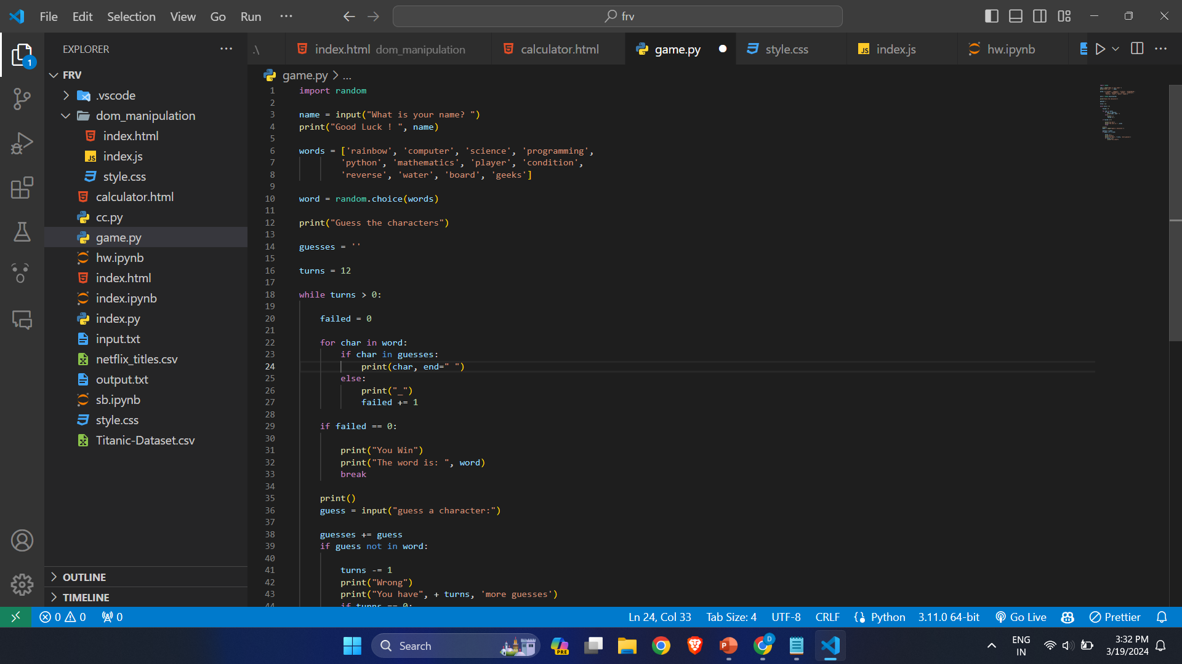
Source Code (screenshots)

Slide 10
Conclusion
Guess The Word Game is to decipher a secret word letter by letter before your chances run out. You'll be presented with a series of dashes, representing the hidden word's length. Each guess you make reveals a letter in the word, helping you build towards the solution.

Slide 11
Reference
GeeksForGeeks
Javapoint

Slide 12
The End

