Slide 1
JSS MAHAVIDYAPEETHA
JSS ACADEMY OF TECHNICAL EDUCATION, NOIDA
FindIt@Campus
Campus Lost & Found Directory
Mini Project / Internship Assessment • Subject Code: BCC-351
Department of Computer Science and Engineering (AI & ML) | B.Tech. Semester III
Submitted by: [Student Name] (Roll No: [Roll No.]) • Section: [Section]
Academic Year: 2025-26
Full-Stack Web App • Node.js v22 Express • SQLite Database • Identity Verification System

Slide 2
THE PROBLEM STATEMENT
Challenges with conventional campus lost and found practices
📋
🔍
🔒
📷
📁
Scattered & Ephemeral
Zero Searchability
No Identity Verification
Lack of Visual Proof
No Audit Ledger
Reports are posted across WhatsApp groups and paper notices -- quickly buried and impossible to search.
A student who finds an item has no central index to query whether the owner has reported it missing.
Anyone can pick up a found item without presenting credentials or proving genuine ownership.
Text descriptions alone fail to distinguish lookalike items (chargers, bottles, ID cards, bags).
No timestamped, permanent digital record of who claimed an item, when, and with what proof.
Result: Genuine owners rarely recover lost belongings; found items go unclaimed or are wrongfully taken.

Slide 3
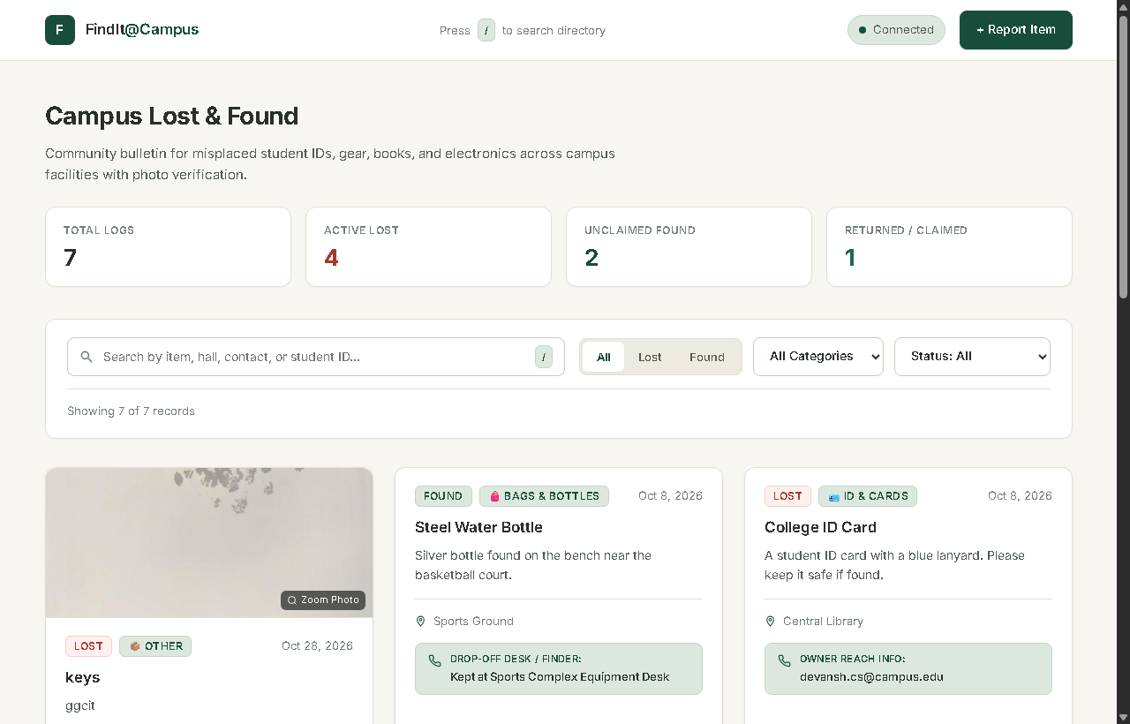
THE SOLUTION: FindIt@Campus
Centralised, photo-enabled, and identity-verified lost & found directory
System Highlights
http://localhost:3000 • FindIt@Campus
• Single web-based directory for the whole campus
• Filter instantly by Type (All / Lost / Found)
• Search across categories: Electronics, Bags, IDs, etc.
• Direct Contact field: Phone, room no., or drop-off desk
• Mandatory Claimant Verification before return
• Audit Ledger with claimant ID and proof note
• Optional Claimant Photo upload for forensic proof
• Automated Cross-Match engine for lost/found pairs
• Zero framework overhead -- instant loading
Figure 1: FindIt@Campus Live Production Interface (Cards, Filters & Status Bar)

Slide 4
TECHNOLOGY STACK
Lightweight, maintainable, and built with modern web standards
🌐
⚙️
🗃️
Frontend Layer
Backend Runtime
Database Layer
Vanilla HTML5, CSS3, JS
Node.js v22 + Express
SQLite (node:sqlite)
Semantic HTML, CSS custom properties, responsive grid, zero build tools or bundler overhead.
Non-blocking event loop, modular REST routing, multipart file upload via multer, clean JSON APIs.
Serverless, zero-config relational database built into Node 22.5+. ACID compliant single-file persistence.
🐍
🧪
🖼️
Alt. Backend
Automated Testing
Client Compression
Python 3 + Flask
Node Test Runner
HTML5 Canvas API
Complete drop-in Flask alternative (app.py) for environments preferring Python deployment.
Automated API test suite (test_api.js) validating all GET, POST, PATCH, and error cases.
Client-side JPEG compression (max 800px, 0.75 quality) before upload to save campus network bandwidth.

Slide 5
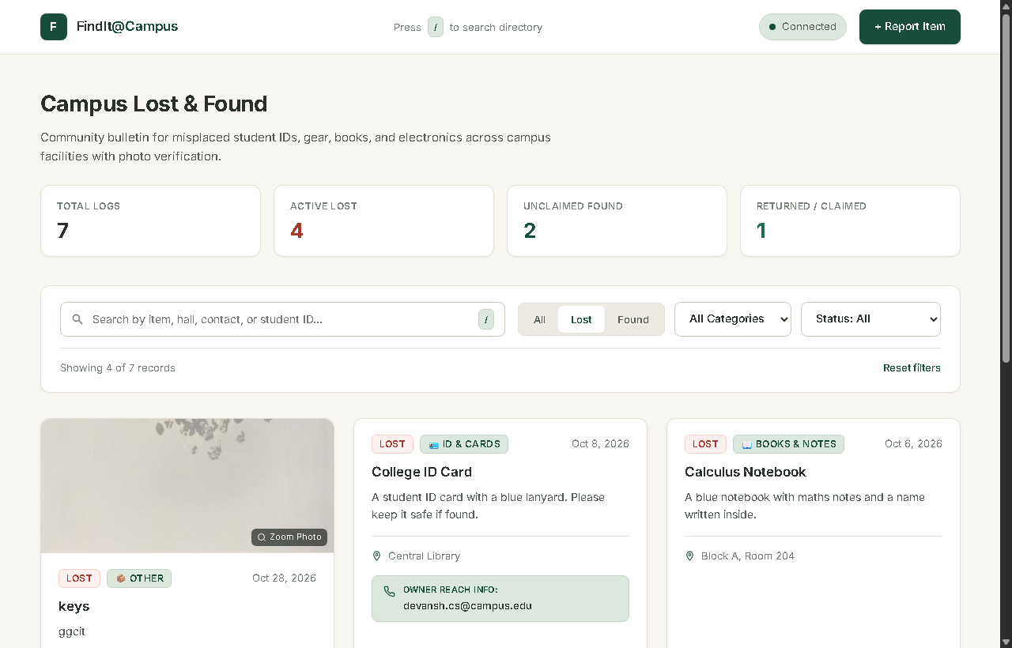
FEATURE 1: DIRECTORY, SEARCH & FILTERS
Instant item discovery with real-time reactive filtering
Directory Capabilities
http://localhost:3000 • FindIt@Campus
• Segmented Control: Toggle between All / Lost / Found
• Category Dropdown: Electronics, IDs, Books, Clothing, etc.
• Resolution Status: Open, Claimed, or Returned
• Live Search Bar: Debounced at 300ms for smooth typing
• Press '/' Shortcut: Automatically focuses search input
• Finder Contact Info: Each card displays drop-off desk / phone
• Image Lightbox: Click any photo to view full-resolution
• Status Pill: Real-time visual cue (Open vs. Returned)
Figure 2: Active Lost Items directory showing search filters & contact details

Slide 6
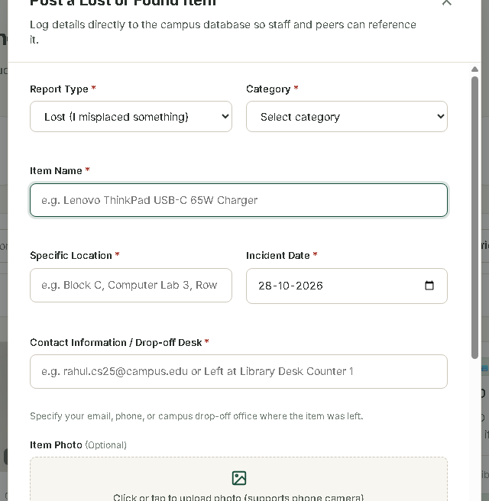
FEATURE 2: POST A NEW REPORT
Seamless submission with photo upload and drop-off contacts
Submission Architecture
http://localhost:3000 • FindIt@Campus
• Modal Form: Clean slide-up dialog with keyboard support (Esc)
• Type Selection: Choose Lost Report or Found Item
• Metadata Capture: Title, category, location, and date
• Finder Contact Field: Essential for peer-to-peer retrieval
(e.g., 'Hostel 3, Room 104' or 'Security Desk Block B')
• Canvas Image Compression: Automatically resizes photos to
max 800px at 0.75 JPEG quality before transmission
• Server Storage: Multipart upload stored in /uploads directory
• Instant Refresh: Card immediately appended to live grid
Figure 3: 'Post a Lost or Found Item' modal showing photo dropzone & contact field

Slide 7
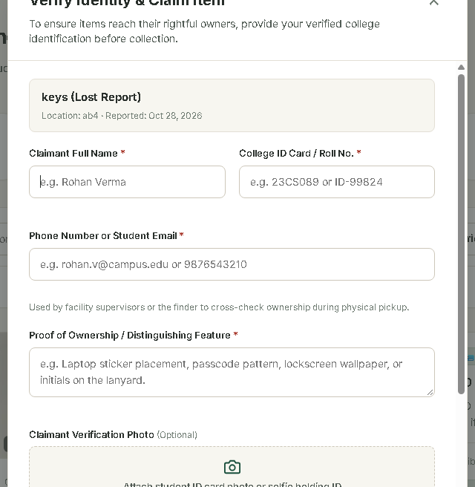
FEATURE 3: CLAIMANT IDENTITY VERIFICATION
Preventing wrongful claims through verified credentials
Required Verification Fields
http://localhost:3000 • FindIt@Campus
1. Full Name: Legal name of the claiming student / staff
2. College ID / Roll No: Permanent institutional identity
3. Contact Info: Verified phone number / official email
4. Ownership Proof: Mandatory description proving ownership
(e.g., wallpaper description, serial no., scratch mark)
5. Claimant Photo (Optional): Selfie holding college ID or
photograph of ID card for the digital audit log
🛡️ Security Outcome: Solves campus misappropriation.
Only genuine owners with demonstrable proof can claim.
Figure 4: 'Verify Identity & Claim Item' modal with College ID & Photo Upload

Slide 8
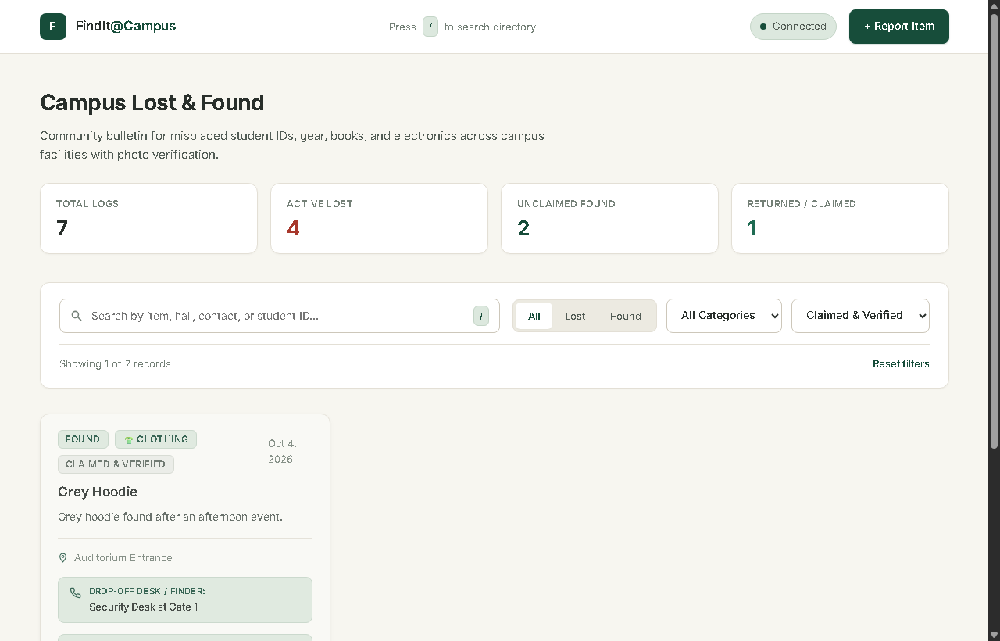
FEATURE 4: DIGITAL AUDIT LEDGER
Transparent record of recovered items with claimant photo evidence
Audit Trail Architecture
http://localhost:3000 • FindIt@Campus
• Status Transition: Moves from 'open' to 'returned'
• Permanent Record: claimant identity fields written to DB
• Audit Badge: Card displays 'Returned' status indicator
• Claimant Metadata: Shows Name, College ID, Proof Note
• Claimant Photo Thumbnail: Clickable thumbnail opens in
full-screen lightbox for verification inspection
• Timestamped Ledger: ISO 8601 claim timestamp recorded
• Accountability: Campus security can audit all recoveries
Figure 5: Returned Items view showing claimant verification details & audit ledger

Slide 9
SYSTEM ARCHITECTURE
Robust three-tier client-server architecture
PRESENTATION TIER
APPLICATION TIER
DATA TIER
Browser (Client)
Node.js Server (:3000)
Embedded Storage
index.html
style.css
script.js
server.js
(Express 4.x)
campus_reports.db
/uploads/ directory
• Vanilla DOM rendering
• Fetch API with AbortController
• HTML5 Canvas compression
• Toast notification queue
• Skeleton loading states
• RESTful API routing
• Multipart upload handling
• Cross-match scoring engine
• Defensive input validation
• JSON error responses
• SQLite relational database
• Zero-config node:sqlite
• 18-column schema with audit
• Static image file serving
• Atomic write transactions
JSON / HTTP REST ⟹
node:sqlite ⟹

Slide 10
DATABASE SCHEMA
Single-table relational architecture with comprehensive claimant audit fields
Item Core Metadata (Columns 1-10)
Claimant Identity & Audit Ledger (Columns 11-18)
id
INTEGER PK
Auto-increment primary key
claimedBy
TEXT
Claimant full legal name
type
TEXT
'lost' or 'found'
claimantId
TEXT
Verified College Roll No. / ID
category
TEXT
Electronics, Clothing, ID Cards, etc.
claimantContact
TEXT
Claimant phone number / email
name
TEXT
Item title / summary
claimProof
TEXT
Written proof of ownership
location
TEXT
Specific discovery/loss location
claimantPhoto
TEXT
File path to claimant ID / selfie photo
date
TEXT
Date of event (YYYY-MM-DD)
claimedAt
TEXT
ISO 8601 timestamp of resolution
description
TEXT
Detailed distinguishing notes
demo
INTEGER
1 = seeded demo record; 0 = user post
contact
TEXT
Finder contact / drop-off location
createdAt
TEXT
ISO 8601 creation timestamp
image
TEXT
File path to compressed item photo
status
TEXT
'open', 'claimed', 'returned'

Slide 11
REST API SPECIFICATION
Standardised HTTP endpoints with structured JSON responses
GET
/api/reports
List reports with query filters (?type=, ?category=, ?status=, ?q=)
POST
/api/reports
Submit new lost/found report (multipart/form-data with optional image)
GET
/api/reports/:id
Retrieve complete details of a single report by ID
PATCH
/api/reports/:id/claim
Submit verified claim: updates status to 'returned' with audit data & photo
DELETE
/api/reports/:id
Delete an existing report by ID
GET
/api/cross-match/:id
Compute similarity scores between a report and opposite-type open items
GET
/uploads/:filename
Serve uploaded item photos and claimant verification images

Slide 12
UX & DEFENSIVE ENGINEERING
Crafted micro-interactions and resilient error handling
🦴 Skeleton Loaders
🔔 Toast Notifications
Card skeletons animate during network requests -- eliminates jarring blank screens and layout shifts.
Queued non-blocking toast notifications auto-dismiss after 4s. No disruptive browser alert() popups.
⌨️ Keyboard Shortcuts
🌐 Live Health Dot
'/' key immediately focuses search; 'Escape' dismisses any modal. Full Tab-index navigation support.
Connection indicator in navbar polls server every 30s. Green = Live, Red = Connection Offline.
🖼️ Responsive Lightbox
🛡️ Defensive Networking
Clicking any item photo or claimant photo opens a distraction-free full-screen image viewer.
Fetch calls implement AbortController timeouts with fallback state for network interruptions.

Slide 13
DATA FLOW: CLAIM & VERIFICATION
End-to-end data lifecycle when an item is claimed
Step 1
Step 2
Step 3
Step 4
Step 5
Step 6
Claimant clicks
'I Found This'
Inputs Roll No,
Proof & Photo
Client validates
all required inputs
PATCH /api/reports
/:id/claim
Atomic DB write
(status: returned)
Card re-renders with
verified audit badge
➔
➔
➔
➔
➔
📦 Data Committed to Database Ledger Upon Claim Verification:
✓ claimedBy: Full Legal Name
✓ claimantId: College ID / Roll No
✓ claimantContact: Verified Phone / Email
✓ claimProof: Written proof statement
✓ claimantPhoto: Uploaded ID / selfie path
✓ claimedAt: ISO 8601 timestamp
✓ status: 'returned'
✓ auditStatus: permanently preserved

Slide 14
FUTURE SCOPE & ENHANCEMENTS
Planned extensions for production campus deployment
🔐
🔔
🤖
📱
Campus SSO Auth
Automated Push Alerts
AI Visual Matching
Dedicated Mobile App
Integrate LDAP / Google Workspace OAuth to bind reports to official campus email accounts.
Notify users via email / web push when an item matching their description is reported.
Deploy CNN-based image similarity to match uploaded photos regardless of wording.
React Native / Flutter app with camera barcode scanning and native push notifications.
📊
🌐
🔗
🏷️
Admin & Security Portal
Multilingual Support
Distributed Audit Trail
Campus QR Tags
Analytical dashboard tracking recovery rates, frequent loss hotspots, and department statistics.
Localisation in Hindi and regional languages for wider campus accessibility.
Tamper-proof cryptographic ledger recording claim events for institutional compliance.
Printable QR stickers for student laptops, ID lanyards, and backpacks linked directly to the portal.

Slide 15
CONCLUSION & COURSE OUTCOME MAPPING
Aligning project milestones with BCC-351 engineering outcomes
Key Accomplishments
Course Outcome (CO) Mapping
✅ Full-stack campus web app delivered and operational
✅ Solved real-world lost & found friction with verified claims
✅ Zero-dependency SQLite implementation via node:sqlite
✅ Client-side Canvas image optimization pipeline
✅ Production-grade UX: toasts, skeletons, keyboard shortcuts
✅ Complete REST API with automated test suite
✅ Forensic claimant audit trail preventing item misappropriation
C340.1: Developed full-stack technical artifact utilizing
Node.js, SQLite, Canvas API, and modern CSS
C340.2: Authored formal requirements, designed REST schema,
and created automated test cases
C340.3: Followed industry standards: semantic HTML, defensive
error handling, and RESTful conventions
C340.4: Strengthened problem-solving, UI design, and
technical report documentation
C340.5: Applied professional and ethical principles by building
an identity-verified audit mechanism for fair return

Slide 16
Thank You!
FindIt@Campus
Campus Lost & Found Directory
[Student Name] • Roll No: [Roll No.] • Section: [Section]
Department of Computer Science and Engineering (AI & ML)
JSS Academy of Technical Education, Noida
BCC-351 Mini Project Assessment • Academic Year 2025-26
Questions & Discussion

