Slide 1
COMP3011 Web Services
CineMatch API
A RESTful Web API with CRUD, token authentication, analytics,
content-based recommendations, and MCP server integration
Python / Django
SQLite
DRF
Token Auth
OpenAPI 3
MCP Server
Individual Coursework 1 |Devansh Singhal | devanshsinghal0109.pythonanywhere.com/api/

Slide 2
Project Overview
🎬 Full CRUD + Auth
📊 5 Analytics Endpoints
🤖 Recommendation Engine
Movies and Reviews with token-protected writes. PUT, PATCH, DELETE. Input validation with proper HTTP status codes.
Top-rated, most-reviewed, genre summary, decade trends, and advanced multi-parameter search.
Content-based filtering scoring on genre, director, era, and ratings. No external API — fully offline and explainable.
🔗 MCP Server
📦 Real Dataset
✅ 46 Passing Tests
All 15 endpoints exposed as AI tools. Claude Desktop can query the movie catalogue via natural language.
4,800 films from TMDB Kaggle dataset. 14,000+ synthetic reviews calibrated to real TMDB vote statistics.
8 test classes covering auth, CRUD, analytics, recommendations, serialiser structure, and edge cases.

Slide 3
Technology Stack & Justification
Layer
Choice
Evaluated Against
Key Reason
Language
Python 3.12
Node.js, Go
Ecosystem, readability, DRF support
Framework
Django 6 + DRF 3.16
FastAPI, Flask
Serialisers, ORM, permissions — no extra packages
Database
SQLite → PostgreSQL
MongoDB
ORM-only access; one settings change to migrate
Auth
Token Authentication
JWT, Session
Stateless, simple, no refresh token complexity
API Docs
drf-spectacular
drf-yasg
OpenAPI 3 (current standard); auto-generated
Recommender
Content-based filter
LLM API
No cost, offline, explainable with reasons array
AI Interface
MCP server
REST client only
Natural language tool calls via Claude Desktop
Deployment
PythonAnywhere
Heroku, Railway
Free tier, Python-native, simple WSGI config

Slide 4
Data Model & Dataset
Movie
Review
🔑 id (PK, auto)
🔑 id (PK, auto)
title (CharField)
🔗 movie (FK → Movie)
genre (e.g. Action/Adventure)
reviewer_name (CharField)
release_year (PositiveInt)
rating (1–5, validated)
director (CharField)
1
*
comment (TextField)
one-to-many
CASCADE delete
overview (TextField)
created_at (auto timestamp)
created_at (auto timestamp)
MovieSerializer computes average_rating and review_count on every GET — calculated via ORM aggregation, never stored as columns

Slide 5
API Endpoints (15 total)
Method
Endpoint
Description
Auth
POST
/api/auth/register/ | /api/auth/login/
Register or login — returns auth token
🌐
GET
/api/movies/
List all movies (paginated, PAGE_SIZE=20)
🌐
POST
/api/movies/
Create a movie
🔒
GET
/api/movies/<id>/
Retrieve with avg_rating and review_count
🌐
PUT / PATCH
/api/movies/<id>/
Full or partial update
🔒
DELETE
/api/movies/<id>/
Delete movie and all its reviews
🔒
GET
/api/movies/<id>/reviews/
List all reviews for a movie
🌐
POST
/api/movies/<id>/reviews/
Add review — rating validated 1–5
🔒
PATCH / DELETE
/api/movies/<id>/reviews/<rid>/
Update or delete a review
🔒
GET
/api/movies/search/
Filter: q, genre, year, min_rating (combinable)
🌐
GET
/api/movies/top-rated/ | most-reviewed/
Ranked by avg rating or review count (?limit=N)
🌐
GET
/api/movies/genre-summary/ | decade-summary/
Per-genre or per-decade aggregated stats
🌐
GET
/api/movies/<id>/recommendations/
5 similar films with match scores and reasons
🌐
🔒 Requires Authorization: Token <key> 🌐 Public — no auth needed

Slide 6
Authentication
1 POST /api/auth/register/
2 POST /api/auth/login/
Request:
Request:
{ "username": "alice", "password": "..." }
{ "username": "alice", "password": "..." }
Response:
{ "token": "abc123..." }
Response:
{ "token": "abc123..." }
3 Authenticated request
4 Unauthenticated write
Request:
Request:
Header: Authorization: Token abc123...
POST /api/movies/ (no token)
Response:
200 OK / 201 Created / 204 No Content
Response:
401 Unauthorized

Slide 7
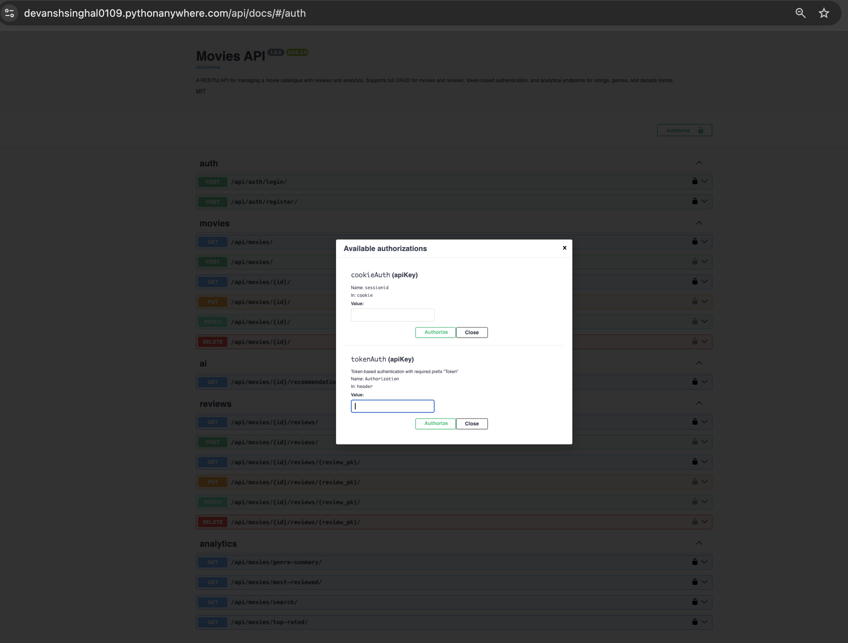

Slide 8
Analytics Endpoints
🔍
Advanced Search
Filter by keyword, genre, year, and min_rating — all combinable in a single request.
/api/movies/search/
🏆
Top Rated
Movies ranked by average review score. Supports ?limit=N. Only movies with reviews included.
/api/movies/top-rated/
📝
Most Reviewed
Movies ranked by total review count with title as tiebreaker — reflects dataset popularity.
/api/movies/most-reviewed/
🎭
Genre Summary
Per-genre aggregation: movie count and average rating across all 18 genres.
/api/movies/genre-summary/

Slide 9
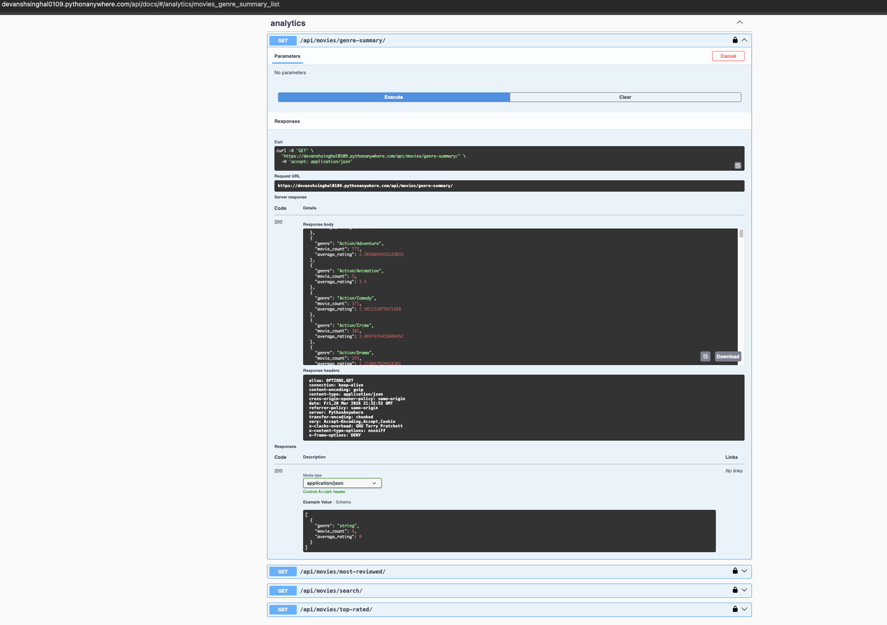

Slide 10
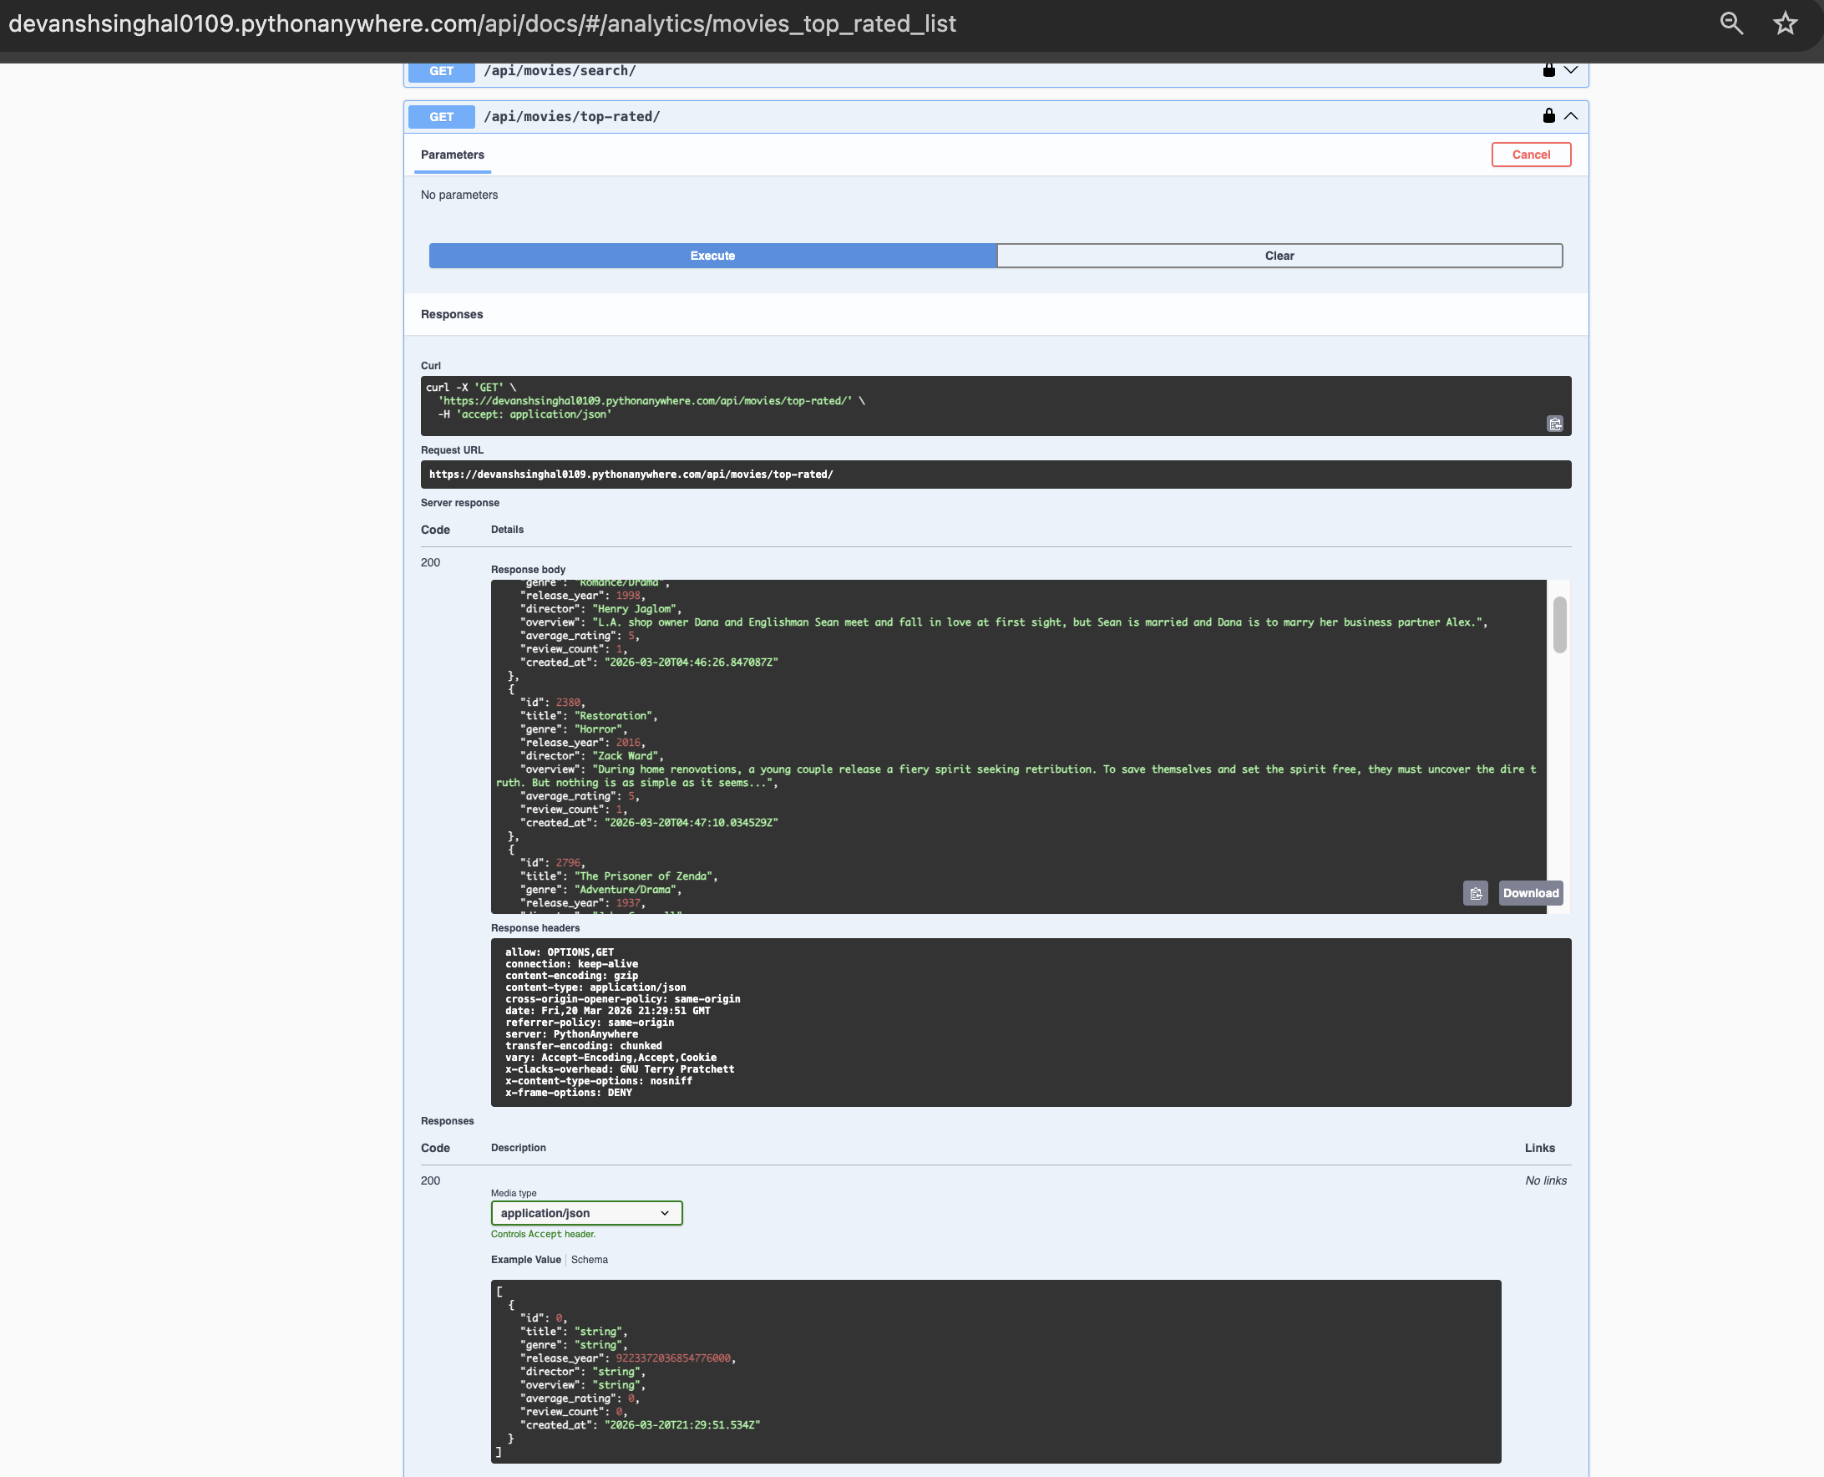

Slide 11
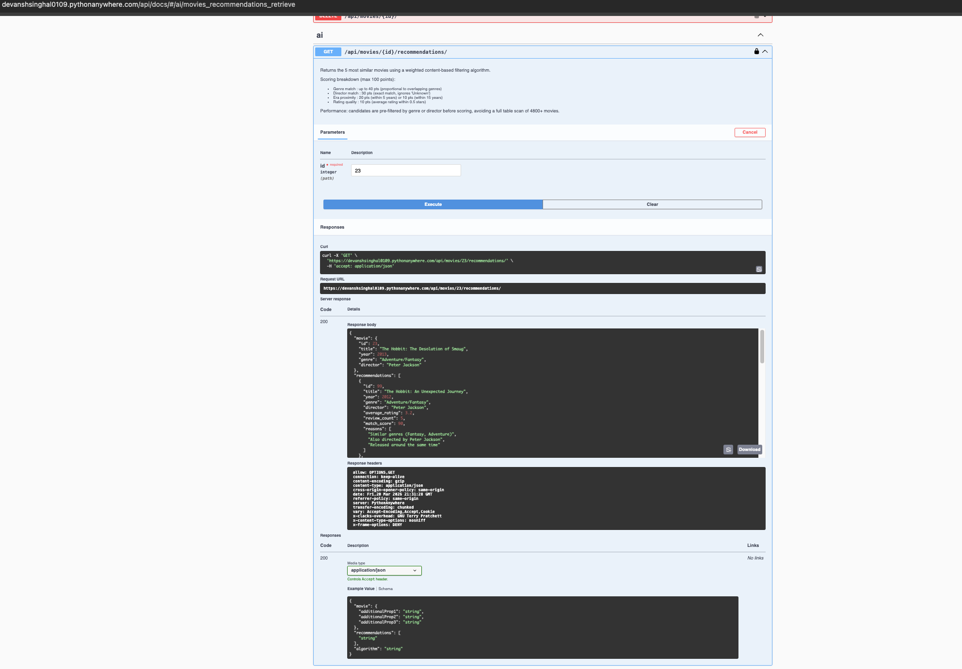
Content-Based Recommendation Engine
Scoring Algorithm (max 100 pts)
Genre overlap
0–40
Proportional to shared genres / source count
Director match
30
Exact match — ignores 'Unknown'
Era proximity
20/10
≤5 years = 20pts, ≤15 years = 10pts
Rating similarity
10
Average rating within 0.5 stars
Pre-filtered with Django Q objects — only genre/director matches loaded. No full table scan of 4,800 rows.

Slide 12
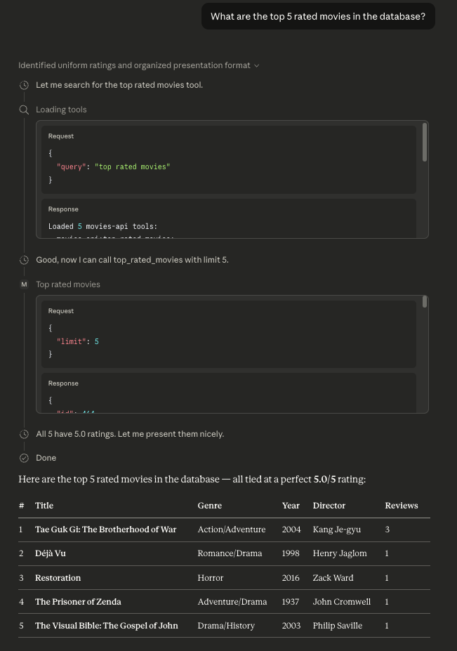
MCP Server — Claude Desktop Integration
What is MCP?
Claude Desktop — Live Demo
Model Context Protocol (MCP) is an open standard by Anthropic that lets AI assistants call external tools via a standardised interface.
The mcp_server.py wraps all 15 API endpoints as callable tools — Claude Desktop can query the movie catalogue using plain English, with no HTTP knowledge required.
📸 INSERT SCREENSHOT:
mcp-tool-call.png
Showing Claude Desktop with
hammer icon active and your
API returning real movie data
from a natural language query
How it works
You ask Claude Desktop in plain English
Claude calls mcp_server.py tools
Tools make HTTP requests to Django API
Django queries SQLite with 4,800 movies
Real data flows back to Claude
Claude formats a natural language answer

Slide 13
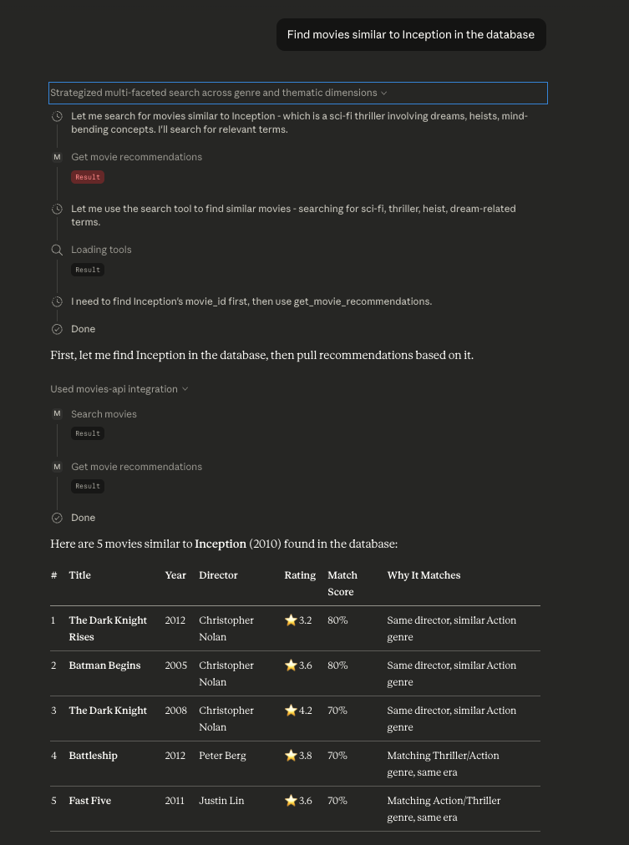

Slide 14
Testing — 47 Tests, All Passing
46
Auth (6)
✓
Register, login, duplicate username, missing fields, wrong password
✓
Movie CRUD (9)
List, create, retrieve, PUT, PATCH, DELETE — auth guard on every write
tests passing
✓
Review CRUD (8)
List, create, PATCH, DELETE — cross-movie 404 check included
✓
Analytics (10)
All 5 endpoints, limit param, invalid year, invalid min_rating
✓
Serialiser (3)
id field present, computed avg_rating correct, null when no reviews
✓
Recommendations (10)
Status, structure, source excluded, ≤5 results, director scoring, 404

Slide 15
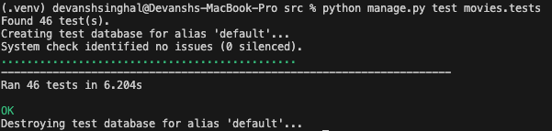

Slide 16
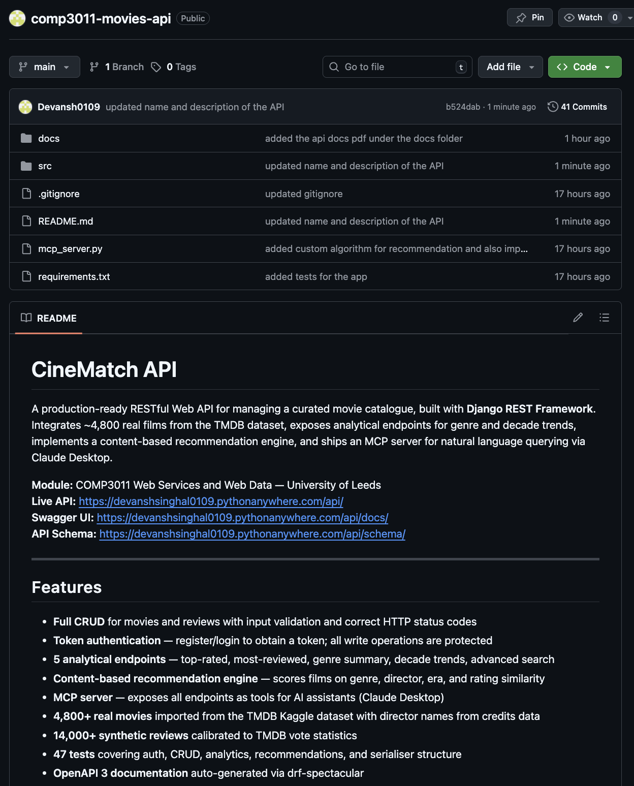
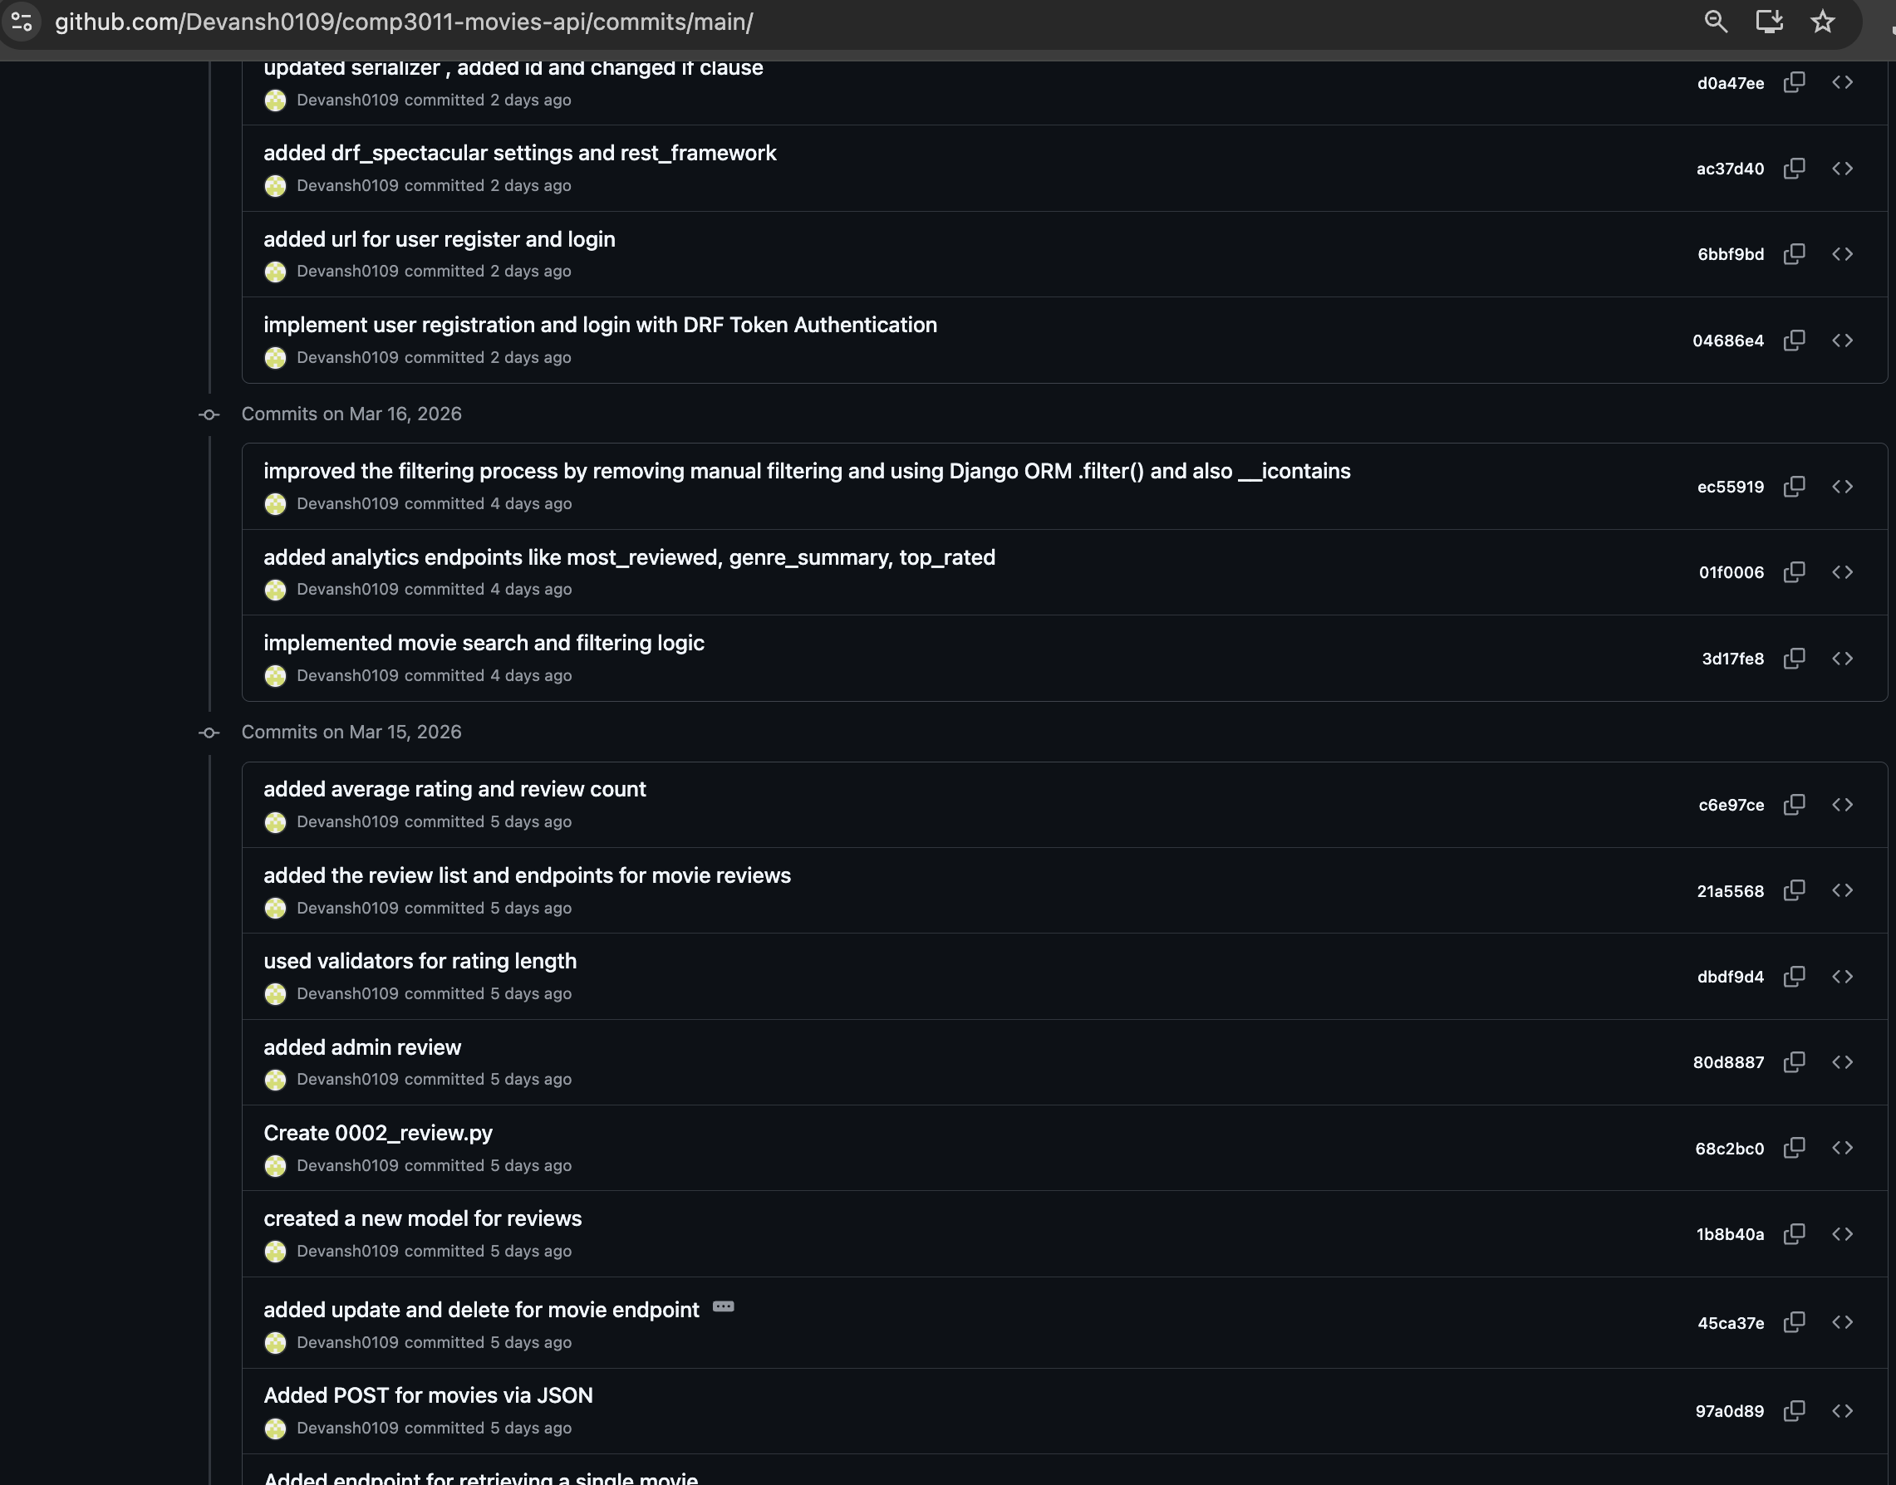
Version Control & Deployment
Live Deployment — PythonAnywhere
API: devanshsinghal0109.pythonanywhere.com/api/
Swagger: devanshsinghal0109.pythonanywhere.com/api/docs/
Server: PythonAnywhere Free Tier | Django WSGI

Slide 17
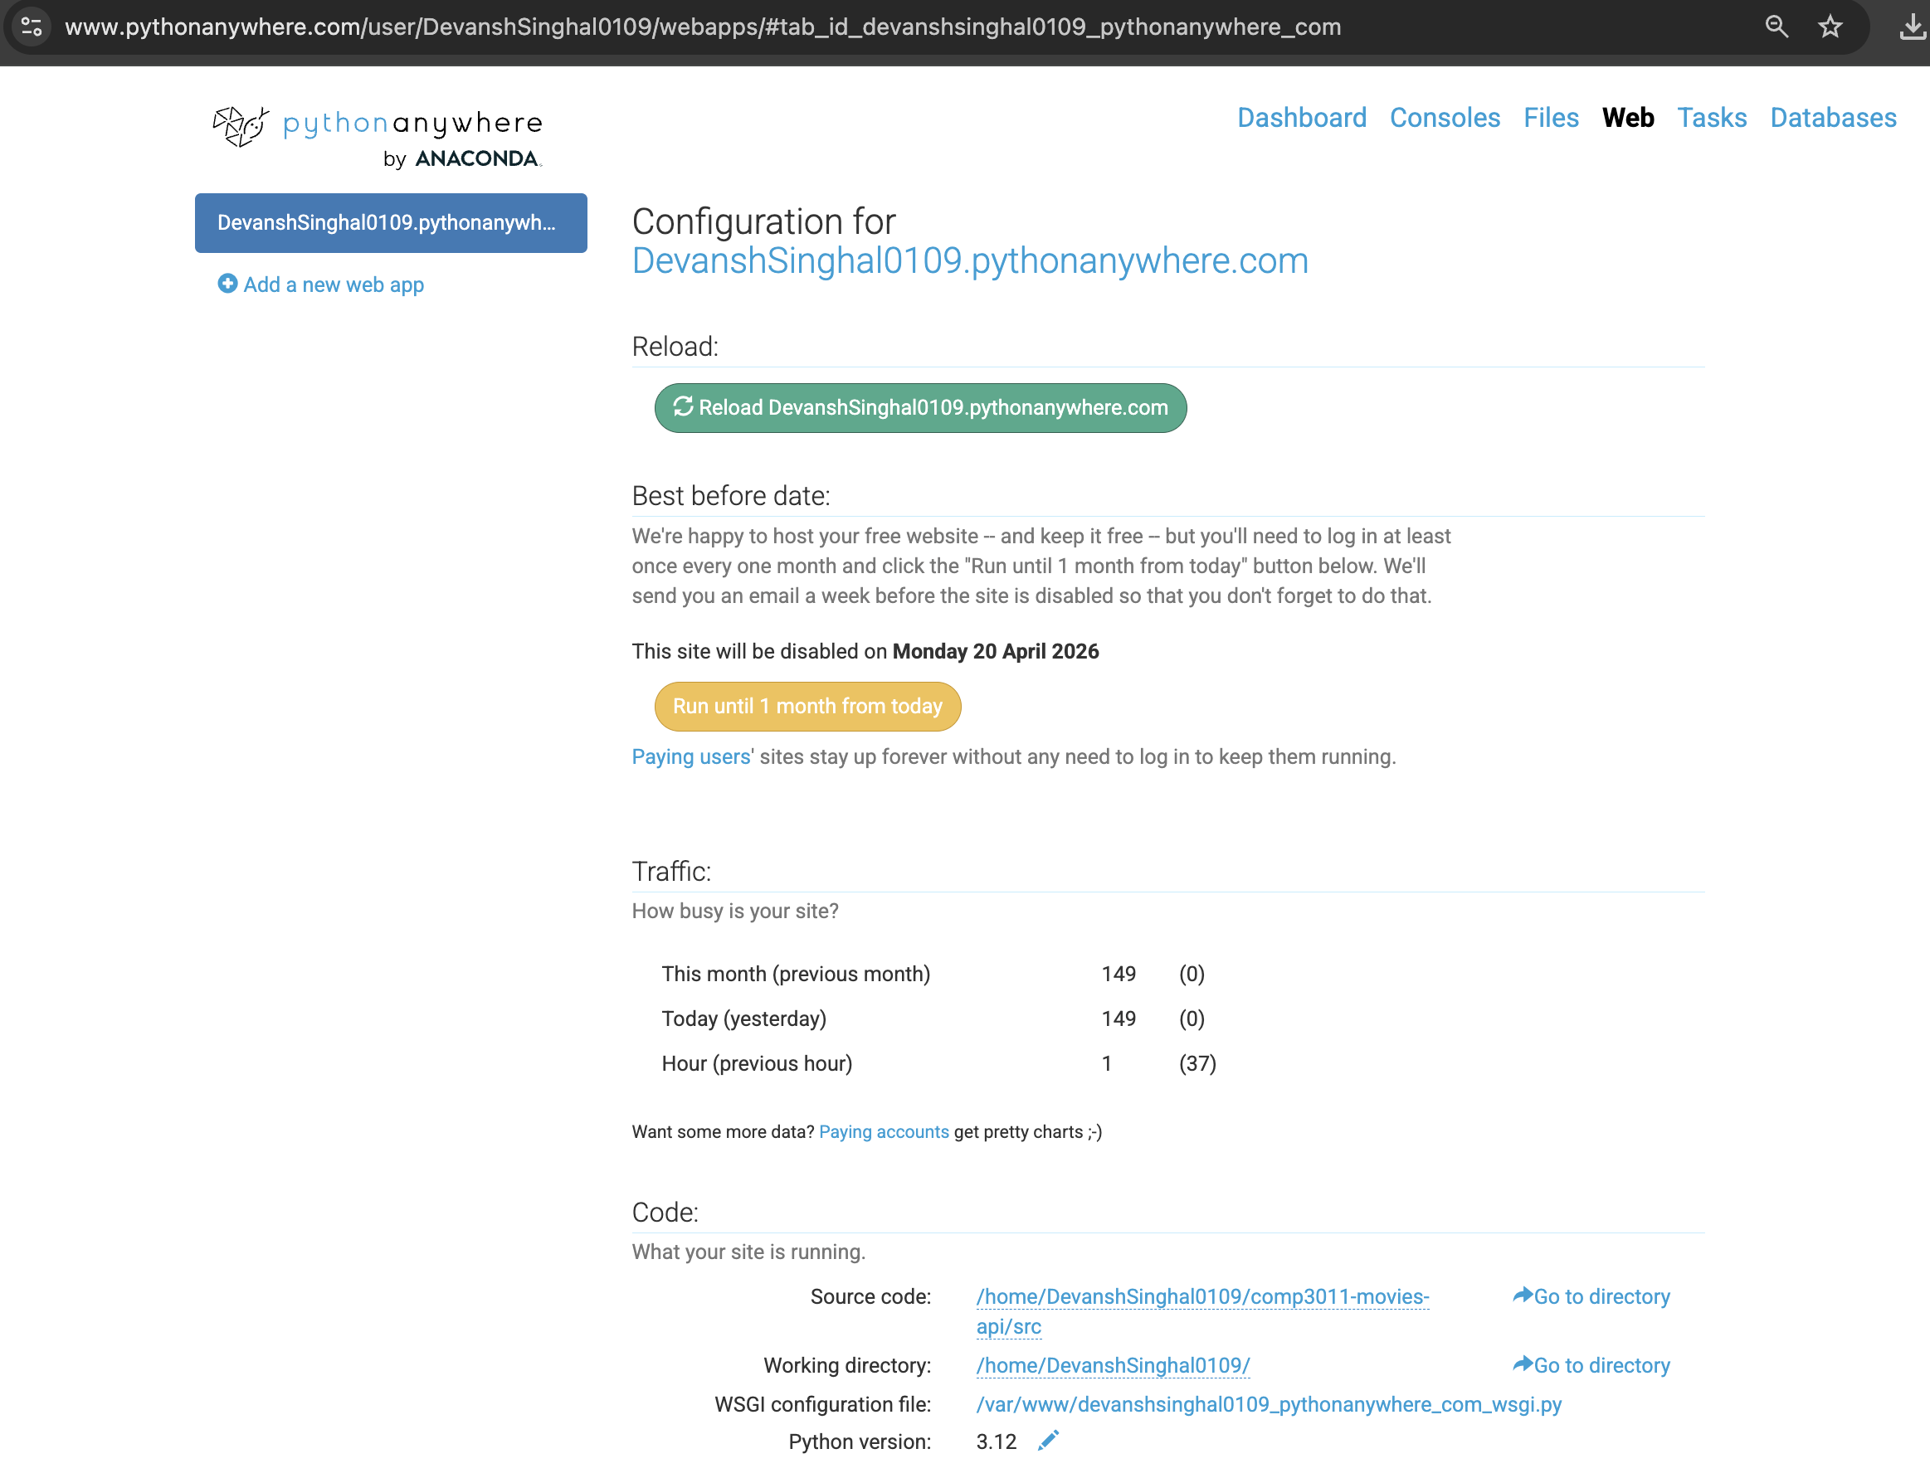

Slide 18
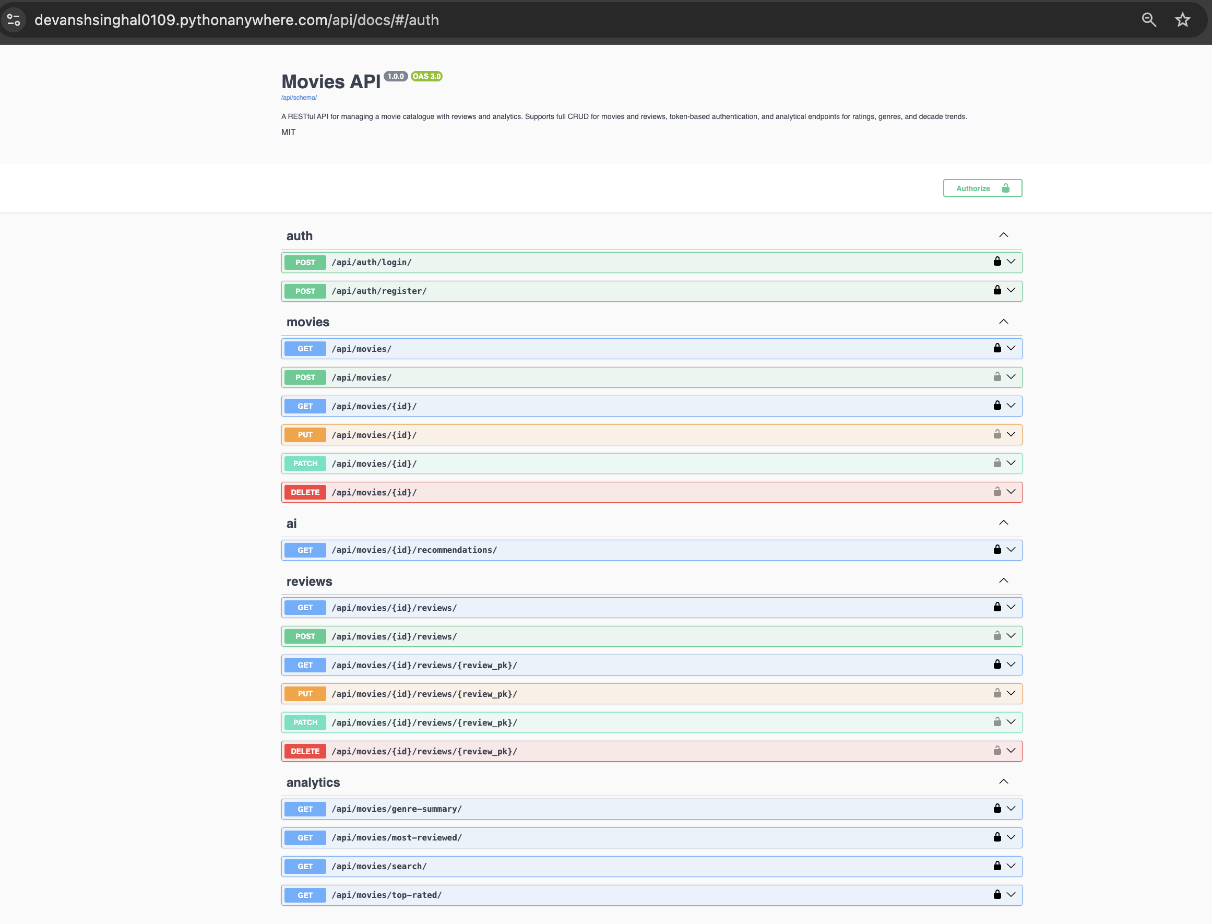
API Documentation
Documentation covers
All 15 endpoints with HTTP methods
Request body schemas per endpoint
Response format and field types
Query parameter definitions
Token authentication process
Error codes (400, 401, 404)
Live Try it out — executes against
the deployed PythonAnywhere API
Raw OpenAPI 3 schema at /api/schema/
PDF in docs/ folder in GitHub repo

Slide 19
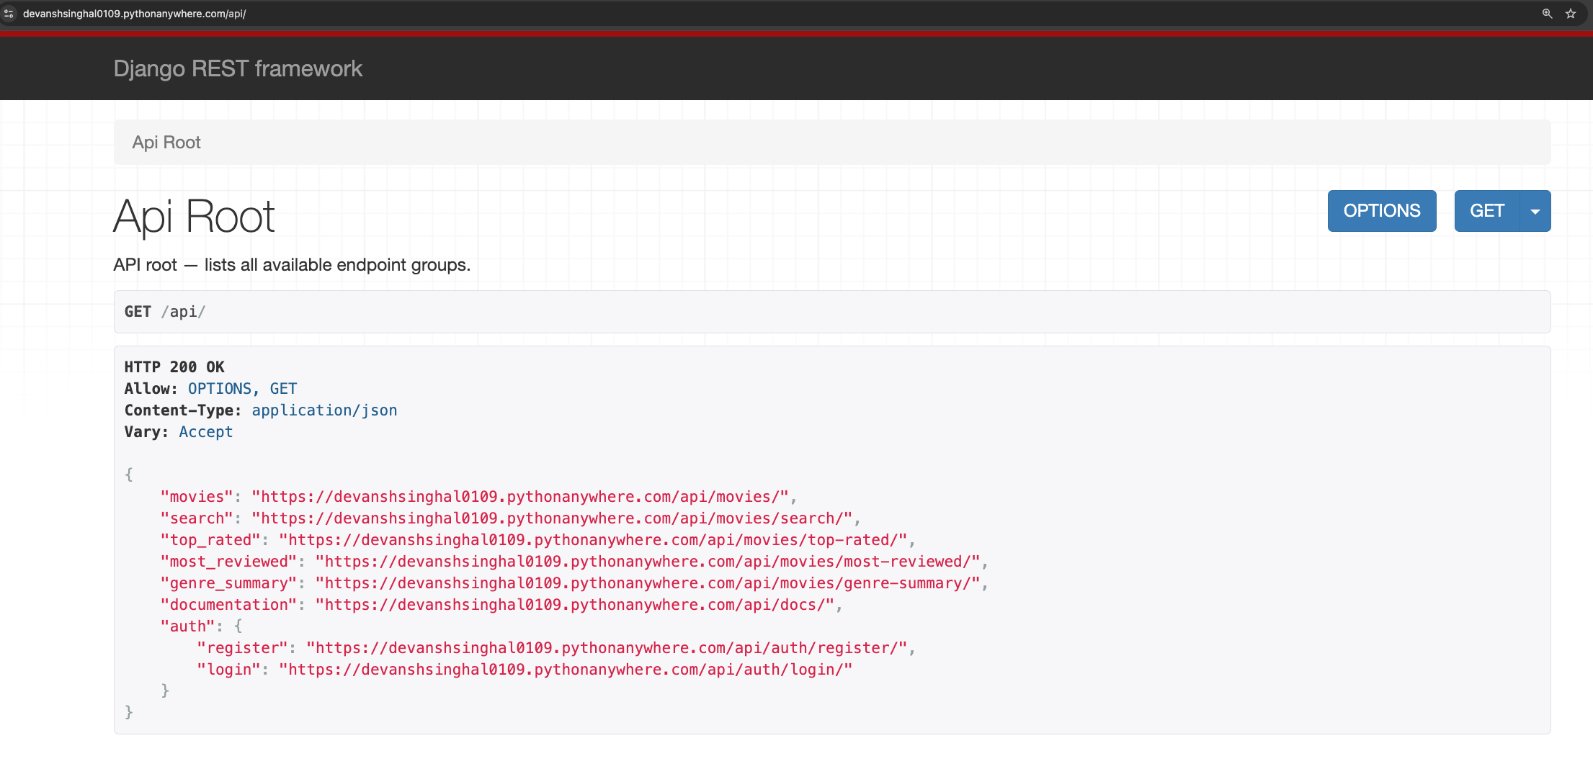

Slide 20
Generative AI Usage
Green Light Assessment — GenAI use is permitted and encouraged | Tool used: Claude (Anthropic) | Logs in genai-logs/
🏗️ Architecture design
📦 Dataset & import script
Evaluated REST vs GraphQL, Django vs FastAPI vs Flask, Token vs JWT. AI surfaced trade-offs; all decisions made independently.
AI suggested TMDB dataset, explained two-CSV structure, generated import_movies.py to merge files and extract directors from JSON.
⭐ Synthetic review design
🤖 Recommendation algorithm
Designed calibration: vote_average → 1–5 scale, log-scaled review counts from vote_count, normal distribution (σ=0.7) sampling.
Explored LLM-based (rejected — paid credits) vs in-house filtering. Designed Q-object pre-filter and weighted scoring formula.
🧪 Test strategy
🔗 MCP server design
AI suggested non-obvious edge cases: cross-movie 404, auth guard on writes, id field serialiser test, null avg_rating check.
AI explained Model Context Protocol specification and how FastMCP wraps Python functions as callable tools with env-var credentials.
All conversation logs exported and stored in genai-logs/ in the GitHub repository

Slide 21
All Deliverables
✅
Public GitHub Repo
✅
README.md
✅
API Documentation
Public repo with 15+ descriptive commits
Setup instructions, endpoints, live URL
Swagger PDF in docs/ — all 15 endpoints
✅
46 Passing Tests
✅
Token Authentication
✅
Technical Report
8 classes — auth, CRUD, analytics, recommendations
Register, login, protected write endpoints
5-page PDF — stack, data, testing, GenAI
✅
PythonAnywhere Deploy
✅
MCP Server
✅
GenAI Logs
devanshsinghal0109.pythonanywhere.com/api/
Claude Desktop integration — natural language queries
Exported conversations in genai-logs/

