Slide 1
DPCN Research Mapping · Group 29
Research output, citation and collaboration networks of four CSIR biology labs, 2016–2026
CSIR-CCMB Hyderabad · CSIR-IGIB New Delhi · CSIR-IMTECH Chandigarh · CSIR-CDRI Lucknow
6,063
144,139
274
66%
123
unique papers
citations
faculty with papers
Q1 share of ranked journal papers
institutional h-index
Source: OpenAlex snapshot 2026-10-13; Scimago SJR; CORE2023. Instructor: Chittaranjan Hens. 2026 is a partial year.

Slide 2
Data and method
A reproducible OpenAlex pipeline; every number here is regenerated from the submitted CSVs
1 Roster
2 Match
3 Filter
4 Enrich
294 scientists: lab websites plus PIs found from lab-affiliated authorship
Each scientist matched to one or more OpenAlex author IDs (ORCID, own publication list, name)
A paper counts only if the scientist's own authorship carries the lab; articles, reviews, letters, conference papers
SJR quartile of the publication year (coverage 93%–98%); OpenAlex topics; Indian citation flows
Lab | Faculty | Papers | Coverage of lab output
CCMB | 54 | 1,204 | 71%
IGIB | 55 | 1,417 | 74%
IMTECH | 49 | 817 | 72%
CDRI | 116 | 2,699 | 80%
Faculty = scientists/PIs; students and postdocs appear only as co-authors
h-index is computed within 2016–2026 from this dataset (lifetime h shown for context)
Indian partner = an Indian institution other than the paper's own lab (CSIR HQ, ministries, AcSIR excluded)
Limitations: OpenAlex author disambiguation; uncovered papers are mostly by students or unlisted staff
DPCN Group 29 · CSIR biology labs · 2

Slide 3
Publication trend 2016–2026
CDRI publishes most · peak years: CCMB 2021, IGIB 2021, IMTECH 2018, CDRI 2016 · 2026 is a partial year
CCMB
1,204 papers · 36,616 citations
CAGR 2016–2025: 0.2%
IGIB
1,417 papers · 36,787 citations
CAGR 2016–2025: -1.1%
IMTECH
817 papers · 22,901 citations
CAGR 2016–2025: -2.6%
CDRI
2,699 papers · 55,256 citations
CAGR 2016–2025: -1.4%
DPCN Group 29 · CSIR biology labs · 3

Slide 4
Journal quality: Q1 fraction and top journals
Q1 fraction = Q1 papers ÷ journal papers with a known SJR quartile
Top 3 journals per lab (top 5 in the dashboard)
Lab | Journal | Papers | Q
CCMB | Scientific Reports | 54 | Q1
 | eLife | 20 | Q1
 | Journal of Biosciences | 19 | Q1
IGIB | Scientific Reports | 54 | Q1
 | Indian Journal of Microbiology | 21 | Q3
 | Frontiers in Microbiology | 21 | Q1
IMTECH | Scientific Reports | 47 | Q1
 | International Journal Of Systematic And… | 38 | Q1
 | Frontiers in Microbiology | 33 | Q1
CDRI | European Journal of Medicinal Chemistry | 59 | Q1
 | Organic Letters | 55 | Q1
 | The Journal of Organic Chemistry | 46 | Q1
CCMB Q1 71% (coverage 93%) IGIB Q1 62% (coverage 95%) IMTECH Q1 76% (coverage 98%) CDRI Q1 63% (coverage 97%)
DPCN Group 29 · CSIR biology labs · 4

Slide 5
Faculty: h-index distribution and leaders
Window h-index from 2016–2026 dataset papers; department-level summary from the roster divisions
Faculty | Lab | Papers | Citations | h
Rajesh Pandey | IGIB | 137 | 4,853 | 32
Vinod Scaria | IGIB | 160 | 4,262 | 31
Naibedya Chattopadhyay | CDRI | 125 | 3,042 | 31
Jiaur R Gayen | CDRI | 132 | 2,950 | 31
Kalyan Mitra | CDRI | 85 | 1,832 | 29
Rajender Singh | CDRI | 97 | 2,711 | 28
Prabhat R Mishra | CDRI | 59 | 1,664 | 28
Sarika Singh | CDRI | 66 | 2,248 | 27
Sidharth Chopra | CDRI | 185 | 2,516 | 26
Muhammad Wahajuddin | CDRI | 66 | 2,088 | 26
108 departments/divisions; largest by output: Medicinal & Process Chemistry (CDRI, 487 papers)
IMTECH publishes no divisions: grouped by each scientist's main OpenAlex subfield
Median h: CCMB 9 · IGIB 11 · IMTECH 8 · CDRI 12 · all 10
DPCN Group 29 · CSIR biology labs · 5

Slide 6
Research areas and most-cited papers
OpenAlex primary topic → field; citation counts at collection date
# | Paper | Journal | Year | Cites | Lab
1 | Guidelines for the use and interpretation of assays for monitoring… | Autophagy | 2016 | 5,860 | CCMB
2 | Guidelines for the use and interpretation of assays for monitoring… | Autophagy | 2021 | 2,611 | IGIB; IMTECH
3 | Oxidative Stress: A Key Modulator in Neurodegenerative Diseases | Molecules | 2019 | 2,251 | IGIB
4 | The Simons Genome Diversity Project: 300 genomes from 142 diverse… | Nature | 2016 | 1,595 | CCMB
5 | Nanoemulsion: Concepts, development and applications in drug delivery | Journal of Controlled… | 2017 | 1,354 | CDRI
6 | SARS-CoV-2 B.1.617.2 Delta variant replication and immune evasion | Nature | 2021 | 1,337 | CCMB; IGIB
7 | Altered TMPRSS2 usage by SARS-CoV-2 Omicron impacts infectivity and… | Nature | 2022 | 1,148 | IGIB
8 | The genetic architecture of type 2 diabetes | Nature | 2016 | 1,049 | CCMB; IGIB
9 | The power of genetic diversity in genome-wide association studies of… | Nature | 2021 | 968 | CCMB; IGIB
10 | A saturated map of common genetic variants associated with human height | Nature | 2022 | 815 | CCMB
DPCN Group 29 · CSIR biology labs · 6

Slide 7
Citation network within the four labs
Directed graph: nodes = dataset papers, edges = paper A cites paper B (internal corpus)
6,063
9,634
56%
49%
PageRank top 10
Paper | Year | Lab | In-deg
Nitric oxide-mediated apoptosis of neutrophils through… | 2016 | CDRI | 12
Theophylline, a methylxanthine drug induces osteopenia and… | 2016 | CDRI | 23
Altered glucose and lipid homeostasis in liver and adipose… | 2017 | CDRI | 13
Computational Analysis and Phylogenetic Clustering of… | 2021 | IGIB | 6
The Simons Genome Diversity Project: 300 genomes from 142… | 2016 | CCMB | 12
High throughput detection and genetic epidemiology of… | 2021 | IGIB | 15
An F-type lectin domain directs the activity of… | 2018 | IMTECH | 9
Skp2 inhibits osteogenesis by promoting ubiquitin–proteasome… | 2016 | CDRI | 10
Drug Repurposing: A new Front in the War Against… | 2016 | CDRI | 4
Globular adiponectin reverses osteo-sarcopenia and altered… | 2017 | CDRI | 28
papers (nodes)
internal citations
in largest component
never cited internally
cites → | CCMB | IGIB | IMTECH | CDRI
CCMB | 1659 | 69 | 35 | 28
IGIB | 85 | 1542 | 27 | 31
IMTECH | 30 | 30 | 1192 | 30
CDRI | 47 | 46 | 50 | 5035
Mean in-degree 1.59; maximum 31; reciprocity 0.006
Heavy-tailed: the most-cited 10% of papers receive 51% of internal citations
95% of lab-to-lab citations stay inside the citing lab (matrix diagonal)
DPCN Group 29 · CSIR biology labs · 7

Slide 8
Indian citation flow
Citations received from (in) and given to (out) works carrying another Indian institution
Top Indian institutes citing each lab
Lab | Citing institute | Cites in
CCMB | Indian Institute of Chemical Technology | 318
 | NIPER (Hyderabad) | 221
 | National Chemical Laboratory | 192
IGIB | All India Institute of Medical Sciences | 711
 | University of Delhi | 505
 | Maharshi Dayanand University | 343
IMTECH | IIIT Delhi | 327
 | Panjab University | 260
 | NIPER (Mohali) | 167
CDRI | Jamia Hamdard | 545
 | SRM Institute of Science and Technology | 496
 | NIPER (Hyderabad) | 449
Citations received per citing year (2026* partial)
0.87
1.07
1.05
0.79
In = CCMB 5,400, IGIB 7,569, IMTECH 4,806, CDRI 13,127; out = CCMB 6,228, IGIB 7,046, IMTECH 4,567, CDRI 16,565
CCMB in/out ratio
IGIB in/out ratio
IMTECH in/out ratio
CDRI in/out ratio
DPCN Group 29 · CSIR biology labs · 8

Slide 9
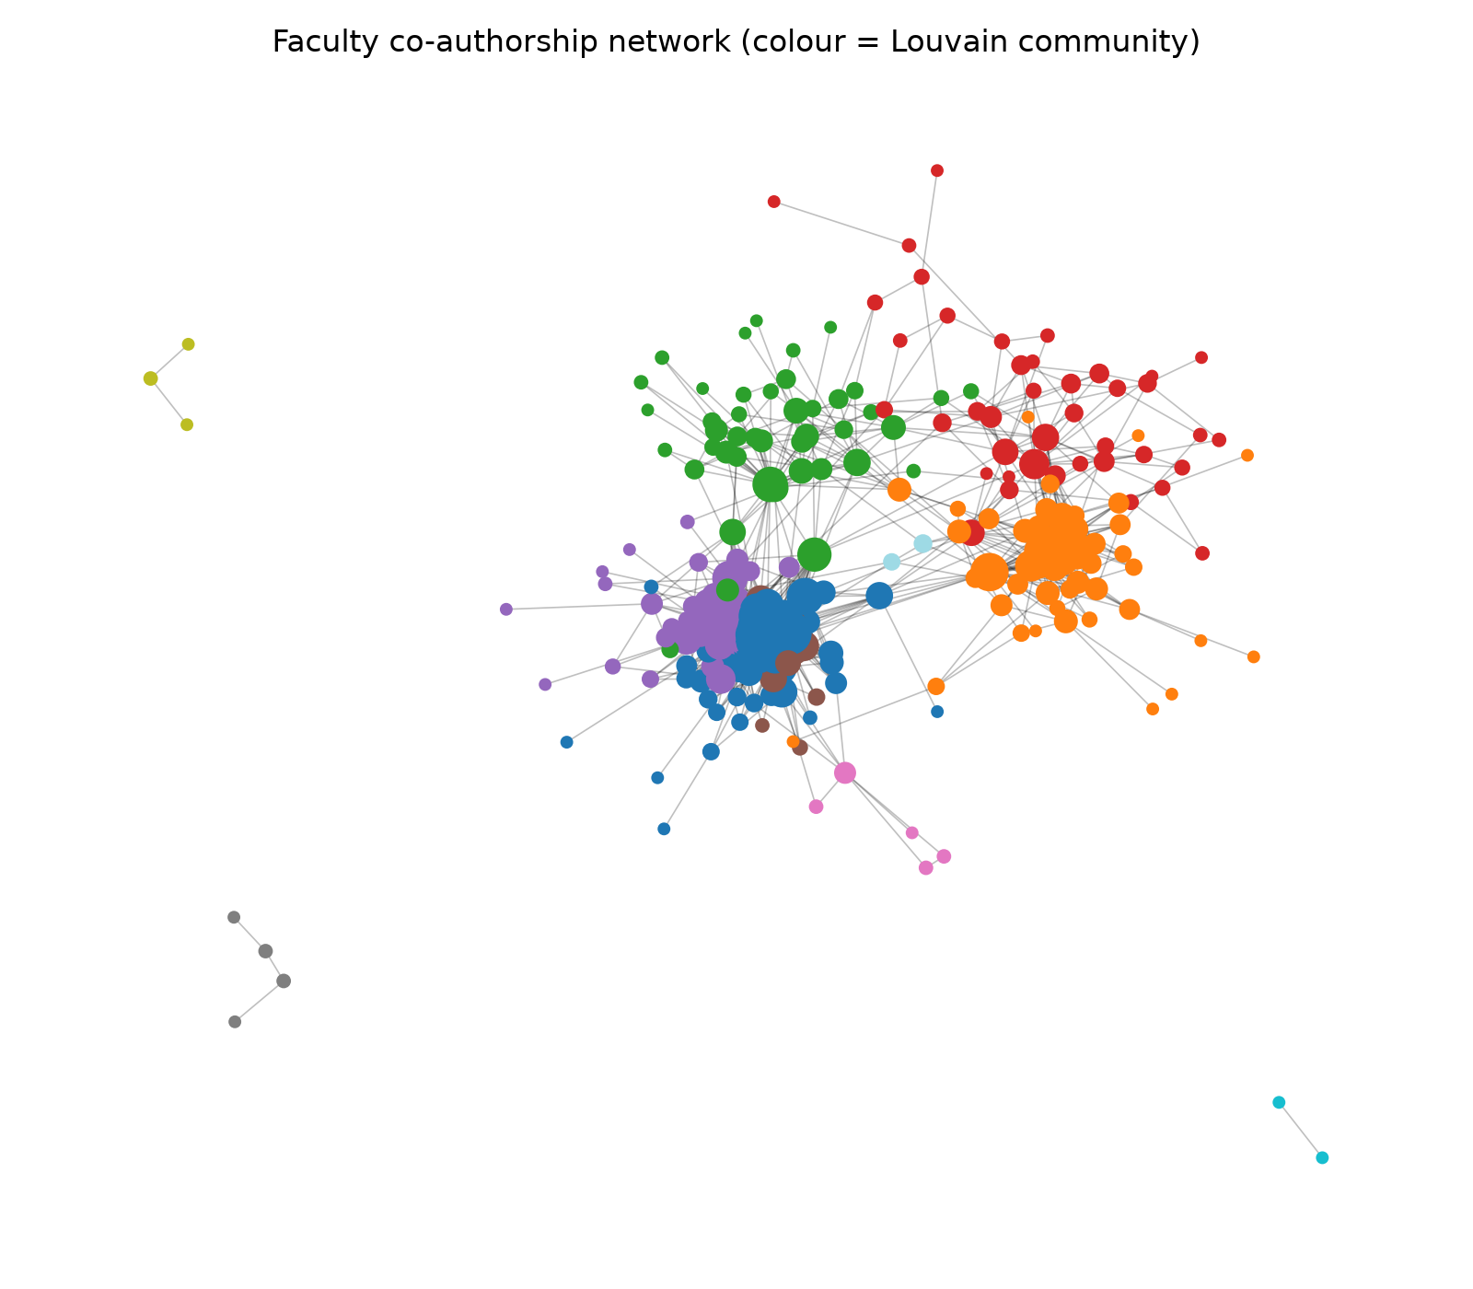
Authorship network: brokers and communities
Faculty co-authorship graph: 274 faculty, 1311 links, Louvain modularity Q = 0.54
Most collaborative (degree)
Bridges (betweenness)
Faculty | Lab | Deg
Kalyan Mitra | CDRI | 51
Jiaur R Gayen | CDRI | 47
Rabi S Bhatta | CDRI | 45
Mohammad I Siddiqi | CDRI | 44
Madhav N Mugale | CDRI | 43
Faculty | Lab | Betw
Rajesh Pandey | IGIB | 0.165
Deepak Sharma | IMTECH | 0.095
P. Anil Kumar | IMTECH | 0.089
Divya Tej Sowpati | CCMB | 0.068
Krishan Gopal | IMTECH | 0.052
31 communities; the largest have 54, 51 and 43 faculty; 44% of communities with 3+ members sit within a single lab
98 of 1311 faculty links join two labs; 20 faculty have no faculty co-author
Hub author: Shantanu Sengupta (IGIB) co-authors with 116 Indian partner institutions
All-author graph: 6,124 authors, Q = 0.76; 48 papers with > 50 authors excluded from pairs
DPCN Group 29 · CSIR biology labs · 9

Slide 10
Connectivity map and key findings
Who our labs co-author with across Indian science
Key findings
CDRI is the most productive lab (2,699 papers); IMTECH has the highest Q1 share (76%).
56% of papers have an Indian partner co-author and 21% a foreign one.
Strongest ties outside CSIR: University (other) (2,157 papers), Medical (1,053 papers), Central University (650 papers).
Indian citation in/out ratio 0.79–1.07: IGIB, IMTECH receive more than they give; CCMB, CDRI give more than they receive.
Collaboration is lab-bound: 98 of 1311 faculty links and 5% of lab-to-lab citations cross between the four labs.
Shared papers by partner cluster (all four labs)
Lab | Top partner | Papers | Jaccard
CCMB | CSIR-IICT | 106 | 0.08
IGIB | AIIMS | 250 | 0.10
IMTECH | Panjab University | 83 | 0.14
CDRI | King George's Medical University | 138 | 0.04
DPCN Group 29 · CSIR biology labs · 10

