Slide 1

Angular Is …
A JavaScript framework
For building client-side applications Using HTML, CSS and JavaScript

Slide 2


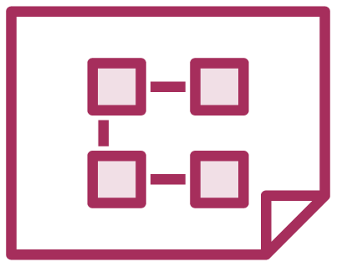

Why Angular?
Expressive HTML
Powerful Data Binding
Modular By Design
Built-in Back-End Integration

Slide 3

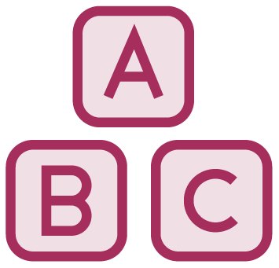


Why a New Angular?
Built for Speed
Modern
Simplified API
Enhances Productivity

Slide 4

Module Overview
Anatomy of an Angular Application
Getting the Most from This Course Sample Application
Course Outline

Slide 5
Anatomy of an Angular Application
Application
Component
Component
Component
…
=
+
+
Services

Slide 6
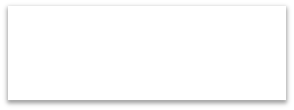


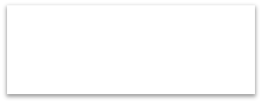

Component
Class
Component
=
Template
+
Properties
+
Metadata
Methods

Slide 7
Angular Modules
Root
Angular Module
Feature Angular Module
Component
Component
Component
Component
Component
Component
Component
Component

Slide 8
Prerequisites
Required
Helpful
Not Required
JavaScript
HTML
CSS
Object-oriented programming (OOP) concepts
C++, C#, Java, …
Prior knowledge of Angular
Prior knowledge of TypeScript

Slide 9
Sample Application Architecture
Welcome Component
index.html
App Component
Product List Component
Star Component
Product Detail Component
Product Data Service

Slide 10









Slide 11




Slide 12










Slide 13




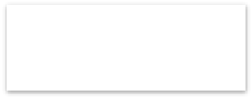





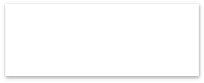

















•
•
•
•
•
•
•
•
•

Slide 14






import { Component } from '@angular/core';
@Component({
selector: 'pm-root', template: `
<div><h1>{{pageTitle}}</h1>
<div>My First Component</div>
</div>
`
})
export class AppComponent {
pageTitle: string = 'Acme Product Management';
}

Slide 15





export class AppComponent {
pageTitle: string = 'Acme Product Management';
}
class
export

Slide 16






export class AppComponent {
pageTitle: string = 'Acme Product Management';
}

Slide 17

@Component({
selector: 'pm-root',
template: `
<div><h1>{{pageTitle}}</h1>
<div>My First Component</div>
</div>
`
})
export class AppComponent {
pageTitle: string = 'Acme Product Management';
}

Slide 18








@Component()

Slide 19






@Component({
selector: 'pm-root',
template: `
<div><h1>{{pageTitle}}</h1>
<div>My First Component</div>
</div>
`
})
export class AppComponent {
pageTitle: string = 'Acme Product Management';
}

Slide 20








import
import

Slide 21


index.html

Slide 22


<body>
<pm-root></pm-root>
</body>
import { Component } from '@angular/core';
@Component({
selector: 'pm-root',
template: `
<div><h1>{{pageTitle}}</h1>
<div>My First Component</div>
</div>
`
})
export class AppComponent {
pageTitle: string = 'Acme Product Management';
}

Slide 23













Slide 24

import { NgModule } from '@angular/core';
import { BrowserModule } from '@angular/platform-browser'; import { AppComponent } from './app.component';
@NgModule({
imports: [ BrowserModule ], declarations: [ AppComponent ], bootstrap: [ AppComponent ]
})
export class AppModule { }

Slide 25





Slide 27
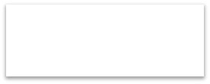

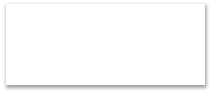

Class
Component
=
Template
+
Properties
+
Metadata
Methods

Slide 28
Module Overview
Building a Template
Using a Component as a Directive Binding with Interpolation Adding Logic with Directives

Slide 29
Defining a Template in a Component
Inline Template Inline Template Linked Template
template: "<h1>{{pageTitle}}</h1>"
template: `
<div>
<h1>{{pageTitle}}</h1>
<div>
My First Component
</div>
</div>
templateUrl:
'./product-list.component.html'
`
ES 2015
Back Ticks

Slide 30

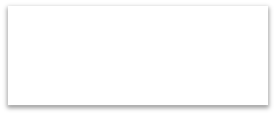

Binding
Coordinates communication between the component's class and its template and often involves passing data.
Class
Template
Properties
Methods

Slide 31
Interpolation
Template
Class
<h1>{{pageTitle}}</h1>
{{'Title: ' + pageTitle}}
{{2*20+1}}
{{'Title: ' + getTitle()}}
export class AppComponent { pageTitle: string =
'Acme Product Management';
}getTitle(): string {...};
}
<h1 innerText={{pageTitle}}></h1>

Slide 32
Directive
Custom HTML element or attribute used to power up and extend our HTML.
Custom
Built-In

Slide 33
Custom Directives
app.component.ts
product-list.component.ts
@Component({ selector: 'pm-root', template: `
<div><h1>{{pageTitle}}</h1>
<pm-products></pm-products>
</div>
`
})
export class AppComponent { }
@Component({
selector: 'pm-products',
templateURL:
'./product-list.component.html'
})
export class ProductListComponent { }

Slide 34
Angular Built-in Directives
•
•
*ngIf: If logic
*ngFor: For loops
Structural Directives

Slide 35
*ngIf Built-In Directive
<div class='table-responsive'>
<table class='table' *ngIf='products && products.length'>
<thead> ...
</thead>
<tbody> ...
</tbody>
</table>
</div>

Slide 36
AppModule
BrowserModule
AppComponent
ProductList - Component
Imports Exports Declarations Providers Bootstrap

Slide 37
*ngFor Built-In Directive
Template input variable
<tr *ngFor='let product of products'>
<td></td>
<td>{{ product.productName }}</td>
<td>{{ product.productCode }}</td>
<td>{{ product.releaseDate }}</td>
<td>{{ product.price }}</td>
<td>{{ product.starRating }}</td>
</tr>

Slide 38
for…of vs for…in
for…of
Iterates over iterable objects, such as an array.
Result: di, boo, punkeye
let nicknames= ['di', 'boo', 'punkeye'];
for (let nickname of nicknames) { console.log(nickname);
}
for…in
Iterates over the properties of an object.
Result: 0, 1, 2
let nicknames= ['di', 'boo', 'punkeye'];
for (let nickname in nicknames) { console.log(nickname);
}

Slide 39
*ngFor Built-In Directive
<tr *ngFor='let product of products'>
<td></td>
<td>{{ product.productName }}</td>
<td>{{ product.productCode }}</td>
<td>{{ product.releaseDate }}</td>
<td>{{ product.price }}</td>
<td>{{ product.starRating }}</td>
</tr>

Slide 40

Checklist: Template
Inline template
For short templates
Specify the template property
Use the ES 2015 back ticks for multiple lines
Watch syntax
Linked template
For longer templates
Specify the templateUrl property
Define the path to the HTML file

Slide 41
Checklist: Component as a Directive
product-list.component.ts
@Component({
selector: 'pm-products', templateURL:
'./product-list.component.html'
})
export class ProductListComponent { }
app.component.ts
app.module.ts
@Component({ selector: 'pm-root', template: `
<div><h1>{{pageTitle}}</h1>
<pm-products></pm-products>
</div>`
})
export class AppComponent { }
@NgModule({
imports: [ BrowserModule ], declarations: [
AppComponent, ProductListComponent ],
bootstrap: [ AppComponent ]
})
export class AppModule { }

Slide 42
Property Binding
<img [src]='product.imageUrl'>
<img src={{product.imageUrl}}>
Template Expression
Element Property
l ' '
Binding Source
<img src='http://o
ipart.org/{{produc
[ ]
Binding Target
penc
t.imageUrl}}'>

Slide 43
Event Binding
Template
Class
<h1>{{pageTitle}}</h1>
<img [src]='product.imageUrl'>
<button (click)='toggleImage()'>
export class ListComponent {
https://developer.mozilla.org/en-US/docs/Web/Events ;
pageTitle: string = 'Product List' products: any[] = […];
toggleImage(): void {…}
( )
Target Event
' '
}
Template
Statement

Slide 44
Two-way Binding
Template
Class
<input [(ngModel)]='listFilter'>
export class ListComponent { listFilter: string = 'cart';
}

Slide 45
Two-way Binding
Template
Class
<input [(ngModel)]='listFilter'>
export class ListComponent { listFilter: string = 'cart';
}

Slide 46
Two-way Binding
Template
Class
<input [(ngModel)]='listFilter'>
export class ListComponent { listFilter: string = 'cart';
}

Slide 47
Two-way Binding
Template
Class
<input [(ngModel)]='listFilter'>
export class ListComponent { listFilter: string = 'cart';
}
[()]
Banana in a Box

Slide 48
Transforming Data with Pipes
Built-in pipes
date
number, decimal, percent, currency
json, slice
etc
Transform bound properties before display
Custom pipes

Slide 49
Checklist: ngModel
product-list.component.html
app.module.ts
<div class='col-md-4'>
<input type='text' [(ngModel)]='listFilter' />
</div>
@NgModule({ imports: [
BrowserModule, FormsModule ],
declarations: [ AppComponent, ProductListComponent ],
bootstrap: [ AppComponent ]
})
export class AppModule { }

Slide 50
Interface
A specification identifying a related set of properties and methods.
A class commits to supporting the specification by implementing the interface.
Use the interface as a data type. Development time only!

Slide 51
Interface Is a Specification
export
keyword
export interface IProduct { productId: number; productName: string; productCode: string; releaseDate: Date; price: number; description: string; starRating: number; imageUrl: string;
Interface Name
interface
keyword
calculateDiscount(percent: number): number;
}

Slide 52

Component Lifecycle
Create and render children
Process changes
Create
Render
Destroy

Slide 53

Component Lifecycle Hooks
OnInit: Perform component initialization, retrieve data
OnChanges: Perform action after change to input properties
OnDestroy: Perform cleanup

Slide 54
Using a Lifecycle Hook
import { Component, OnInit } from '@angular/core';
export class ProductListComponent
implements OnInit { pageTitle: string = 'Product List'; showImage: boolean = false; listFilter: string = 'cart'; products: IProduct[] = […];
ngOnInit(): void {
console.log('In OnInit');
}
}

Slide 55
Building a Custom Pipe
import { Pipe, PipeTransform } from '@angular/core';
@Pipe({
name: 'convertToSpaces'
})
export class ConvertToSpacesPipe
implements PipeTransform {
transform(value: string,
character: string): string {
}
}

Slide 56
Using a Custom Pipe
Template
<td>{{ product.productCode | convertToSpaces:'-'}}</td>
Pipe
transform(value: string, character: string): string {
}

Slide 57

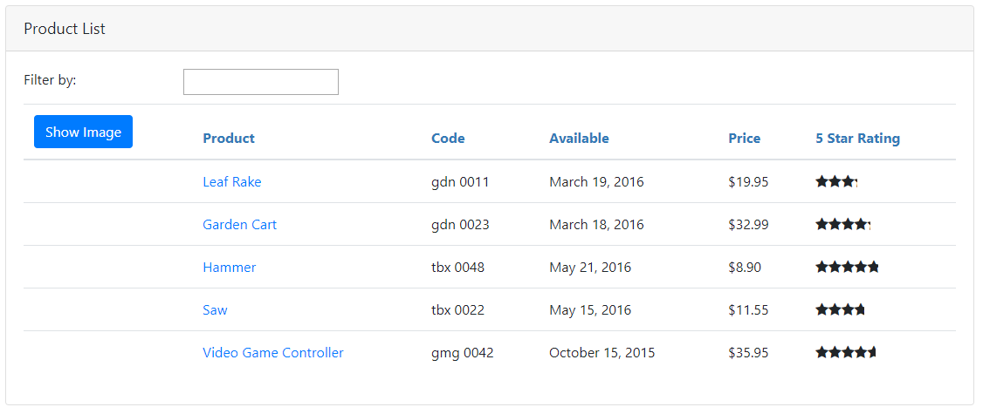
Using a Component
As a Directive
As a Routing target
App Component OR Nested Component
Full page style view
<body >
<pm - roo t >< /pm - roo t >
< / body >

Slide 58
Building a Nested Component
Container Component
Template
Nested Component
<pm-star> </pm-star>
Template
Class
Class

Slide 59
Building a Nested Component
Container Component
Template
Nested Component _{</pm-star>}
Template
<pm-star>
Input
Output
Class
Class

Slide 60
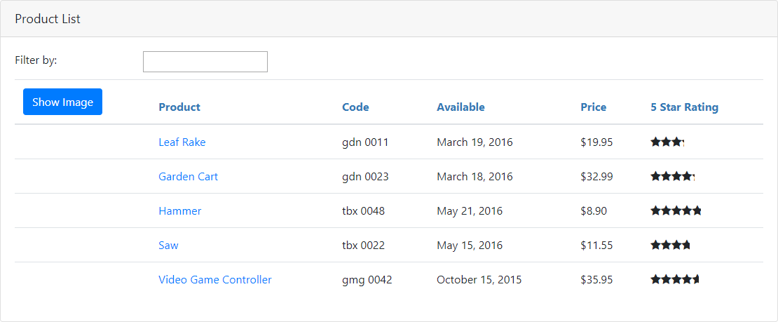
Product List View

Slide 61
Using a Nested Component as a Directive
product-list.component.ts
star.component.ts
@Component({
selector: 'pm-products',
templateURL: './product-list.component.html'
})
export class ProductListComponent { }
@Component({ selector: 'pm-star',
templateURL: './star.component.html'
})
export class StarComponent { rating: number;
starWidth: number;
}
product-list.component.html
<td>
{{ product.starRating | number }}
</td>

Slide 62
Using a Nested Component as a Directive
product-list.component.ts
star.component.ts
@Component({
selector: 'pm-products',
templateURL: './product-list.component.html'
})
export class ProductListComponent { }
@Component({ selector: 'pm-star',
templateURL: './star.component.html'
})
export class StarComponent { rating: number;
starWidth: number;
}
product-list.component.html
<td>
<pm-star></pm-star>
</td>

Slide 63
Passing Data to a Nested Component (@Input)
Container Component
Template
Nested Component _{</pm-star>}
Template
<pm-star>
Input @Input()
Class
Class

Slide 64
Application Architecture
Welcome Component
index.html
App Component
Product List Component
Star Component
Product Detail Component
Product Data Service

Slide 65
Service
A class with a focused purpose. Used for features that:
Are independent from any particular component
Provide shared data or logic across components
Encapsulate external interactions

Slide 66
Dependency Injection
A coding pattern in which a class receives the instances of objects it needs (called dependencies) from an external source rather than creating them itself.

Slide 67
Building a Service
product.service.ts
import { Injectable } from '@angular/core'
@Injectable()
export class ProductService {
getProducts(): IProduct[] {
}
}

Slide 68
Registering a Service - Root Application
product.service.ts
import { Injectable } from '@angular/core'
@Injectable({ providedIn: 'root'
})
export class ProductService {
getProducts(): IProduct[] {
}
}

Slide 69
Injecting the Service
product-list.component.ts
...
import { ProductService } from './product.service';
@Component({
selector: 'pm-products',
templateUrl: './product-list.component.html'
})
export class ProductListComponent {
constructor(private productService: ProductService) {
}
}

Slide 70



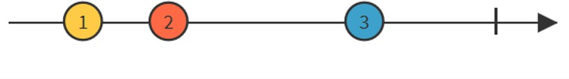
-

Slide 71





Slide 72










Slide 73

...
import { HttpClientModule } from '@angular/common/http';
@NgModule({ imports: [
BrowserModule, FormsModule, HttpClientModule ],
declarations: [ AppComponent, ProductListComponent, ConvertToSpacesPipe, StarComponent ],
bootstrap: [ AppComponent ]
})
export class AppModule { }

Slide 74
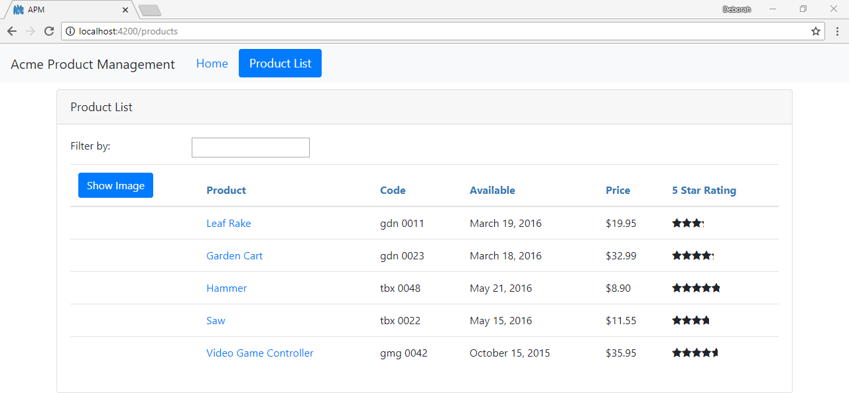
How Routing Works
<a r ou t e rL i nk=" / p r odu c ts">P roduc t L i s t < / a>
{ pa t h : 'p r oduc t s ' , c ompon e n t: P r oduc t L i s tCompon e n t }
product-list.component.ts
impo r t { Componen t } f rom '@angu la r /co re ' ;
< rou te r - ou t le t>< / r ou t e r - ou t le t >
@Componen t ({ temp la teUr l
} )
: ' . /p roduc t - l is t .componen t .h tm l '
expo r t c lass Produc tL is tComponen t { }

Slide 75
Configuring Routes
app.module.ts
...
import { RouterModule } from '@angular/router';
@NgModule({ imports: [
BrowserModule, FormsModule, HttpClientModule, RouterModule
],
declarations: [
...
],
bootstrap: [ AppComponent ]
})
export class AppModule { }

Slide 76
Configuring Routes
app.module.ts
...
import { RouterModule } from '@angular/router';
@NgModule({ imports: [
BrowserModule, FormsModule, HttpClientModule, RouterModule.forRoot([])
],
declarations: [
...
],
bootstrap: [ AppComponent ]
})
export class AppModule { }

Slide 77

 |  | Configuring Routes
[
{ | path: | 'products', component: ProductListComponent },
{ | path: | 'products/:id', component: ProductDetailComponent },
{ | path: | 'welcome', component: WelcomeComponent },
{ path: '', redirectTo: 'welcome', pathMatch: 'full' }, { path: '**', component: PageNotFoundComponent } ]

Slide 78
Tying Routes to Actions
app.component.ts
...
@Component({
selector: 'pm-root', template: `
<ul class='nav navbar-nav'>
<li><a>Home</a></li>
<li><a>Product List</a></li>
</ul>
`
})

Slide 79
Tying Routes to Actions
app.component.ts
...
@Component({
selector: 'pm-root', template: `
<ul class='nav navbar-nav'>
<li><a [routerLink]="['/welcome']">Home</a></li>
<li><a [routerLink]="['/products']">Product List</a></li>
</ul>
`
})

Slide 80
Placing the Views
app.component.ts
...
@Component({
selector: 'pm-root', template: `
<ul class='nav navbar-nav'>
<li><a [routerLink]="['/welcome']">Home</a></li>
<li><a [routerLink]="['/products']">Product List</a></li>
</ul>
<router-outlet></router-outlet>
`
})

Slide 81
Passing Parameters to a Route
app.module.ts
@NgModule({ imports: [
...,
RouterModule.forRoot([
{ path: 'products', component: ProductListComponent },
{ path: 'products/:id', component: ProductDetailComponent },
{ path: 'welcome', component: WelcomeComponent },
{ path: '', redirectTo: 'welcome', pathMatch: 'full' },
{ path: '**', redirectTo: 'welcome', pathMatch: 'full' }
])
],
declarations: [...], bootstrap: [ AppComponent ]
})
export class AppModule { }

Slide 82
Passing Parameters to a Route
product-list.component.html
<td>
<a [routerLink]="['/products', product.productId]">
{{product.productName}}
</a>
</td>
app.module.ts
{ path: 'products/:id', component: ProductDetailComponent }

Slide 83
Reading Parameters from a Route
product-detail.component.ts
import { ActivatedRoute } from '@angular/router';
constructor(private route: ActivatedRoute) { console.log(this.route.snapshot.paramMap.get('id'));
}
app.module.ts
{ path: 'products/:id', component: ProductDetailComponent }

Slide 84
Activating a Route with Code
product-detail.component.ts
import { Router } from '@angular/router';
...
constructor(private router: Router) { }
onBack(): void { this.router.navigate(['/products']);
}

Slide 85

Protecting Routes with Guards
CanActivate
Guard navigation to a route
CanDeactivate
Guard navigation from a route
Resolve
Pre-fetch data before activating a route
CanLoad
Prevent asynchronous routing

Slide 86
Building a Guard
product-detail.guard.ts
import { Injectable } from '@angular/core'; import { CanActivate } from '@angular/router';
@Injectable({ providedIn: 'root'
})
export class ProductDetailGuard implements CanActivate {
canActivate(): boolean {
...
}
}

Slide 87
Using a Guard
app.module.ts
@NgModule({ imports: [
...,
RouterModule.forRoot([
{ path: 'products', component: ProductListComponent },
{ path: 'products/:id',
canActivate: [ ProductDetailGuard ], component: ProductDetailComponent },
...])
],
declarations: [...], bootstrap: [ AppComponent ]
})
export class AppModule { }

Slide 88
Routing Checklist: Passing Parameters
app.module.ts
{ path: 'products/:id', component: ProductDetailComponent }
product-list.component.html
<a [routerLink]="['/products', product.productId]">
{{product.productName}}
</a>
product-detail.component.ts
import { ActivatedRoute } from '@angular/router';
constructor(private route: ActivatedRoute) { console.log(this.route.snapshot.paramMap.get('id'));
}

Slide 89
















Slide 90










-
-
-
-
-

Slide 91






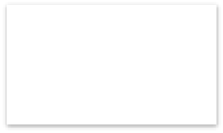


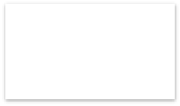



















Slide 92


...
<li><a [routerLink]="['/welcome']"> Home</a></li>
<li><a [routerLink]="['/products']"> Product List</a></li>
...
<router-outlet></router-outlet>
...

Slide 93

...
<input type='text'
[(ngModel)]='listFilter' />
...

Slide 94
...
<tr *ngFor='let product of products'>
<td>
<img *ngIf='showImage'
...

Slide 95
...
<td>{{ product.productCode |
convertToSpaces: '-' }}
</td>
...

Slide 96
...
<pm-star [rating]='product.starRating'
(ratingClicked)='onRatingClicked($event)'>
</pm-star>
...

Slide 98






Slide 99

...
bootstrap: [ AppComponent ]
...

Slide 100

...
declarations: [ AppComponent, WelcomeComponent, ProductListComponent, ProductDetailComponent, ConvertToSpacesPipe, StarComponent
]
...

Slide 101


import { NgModule } from '@angular/core';
import { RouterModule } from '@angular/router';
import { WelcomeComponent } from './home/welcome.component';
@NgModule({
imports: [ RouterModule.forRoot([
{ path: 'welcome', component: WelcomeComponent },
{ path: '', redirectTo: 'welcome', pathMatch: 'full'},
{ path: '**', redirectTo: 'welcome', pathMatch: 'full' }
])
],
exports: [ RouterModule ]
})
export class AppRoutingModule { };

Slide 102
@NgModule({
imports: [ BrowserModule, HttpClientModule, ProductModule, AppRoutingModule
],
declarations: [ AppComponent, WelcomeComponent ], bootstrap: [ AppComponent ]
})
export class AppModule { }

Slide 103
@NgModule({
imports: [ BrowserModule, HttpClientModule, AppRoutingModule, ProductModule
],
declarations: [ AppComponent, WelcomeComponent ], bootstrap: [ AppComponent ]
})
export class AppModule { }

Slide 104


import { NgModule } from '@angular/core';
import { RouterModule } from '@angular/router';
import { ProductListComponent } from './product-list.component'; import { ProductDetailComponent } from './product-detail.component'; import { ProductDetailGuard } from './product-detail.guard'; @NgModule({
imports: [
RouterModule.forChild([
{ path: 'products', component: ProductListComponent },
{ path: 'products/:id', canActivate: [ ProductDetailGuard],
component: ProductDetailComponent }
])
],
exports: [ RouterModule ]
})
export class ProductRoutingModule { };

Slide 105

@NgModule({
imports: [ SharedModule, ProductRoutingModule
],
declarations: [ ProductListComponent, ProductDetailComponent, ConvertToSpacesPipe
]
})
export class ProductModule {}

