Slide 1
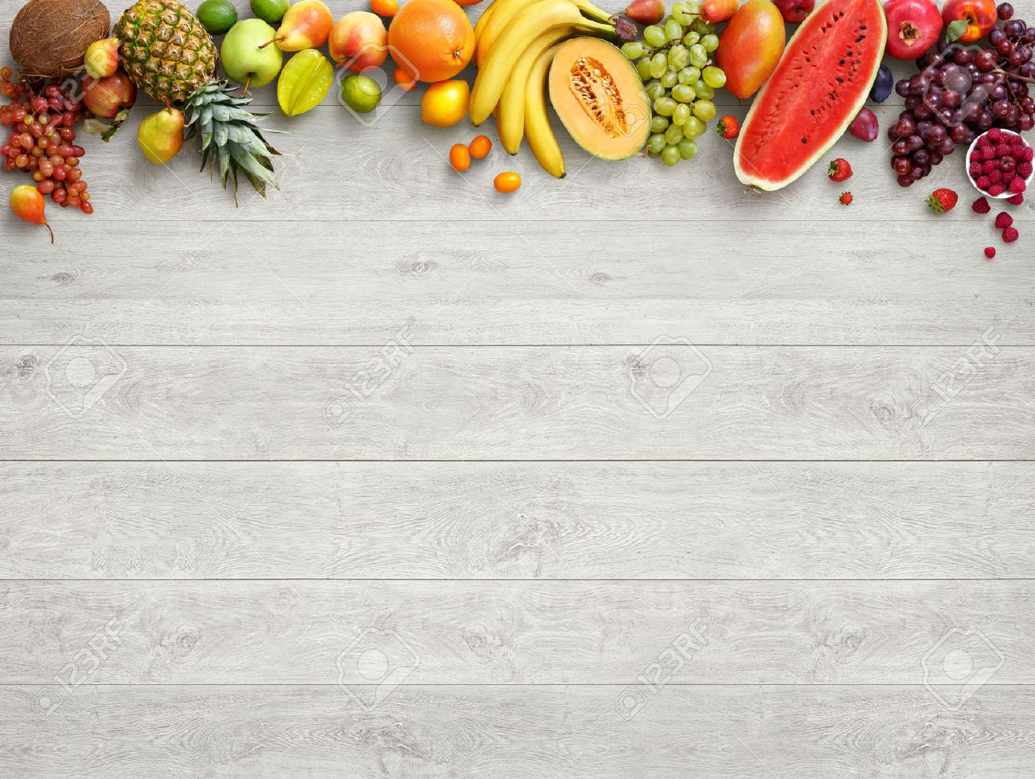
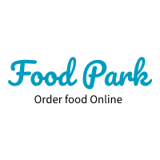

Slide 2
PROBLEM STATEMENT
Now-a-days it can be seen that world’s population is growing at an exponential rate, and as this population keeps growing, the amount of food required also increases. But according to a research done by an institute in America it has been come into site that the food produced is enough to meet people’s requirements, the problem lies in wastage and management of food. Major part of food wastage can be seen in high end restaurants and developed cities where people order more than they actually require.

Slide 3
SOCIAL IMPACT
As food gets wasted, all the ingredients required to produce that food also gets wasted, as a result cost of food production increases, which directly affects the society and a middle class person is the most affected along with poor people who already don’t get enough food everyday.
So today, we coding guys are here to provide this world with one of the best solutions ever.
So that the food wastage can be minimised and everyone gets enough food to eat.

Slide 4
SOLUTION
We have come up with an online food ordering system in which people can select a restaurant of their own choice, and order food according to their need.
This is not the only use of our platform, our website also helps the restaurants to keep a record of their daily usage of ingredients and food resources.
This gives them a rough idea about which food is most ordered from their restaurant and how much of it is being ordered.
This helps them to order food resources and ingredients accordingly, which reduces food wastage.

Slide 5
Technology used
We are trying to implement data analytics in our idea which keeps record of usage of food on daily basis which gives an idea of how much more resources are required in future.
Web development is also used to implement this idea in an attractive and user friendly way
Front end development is done using html, css.
Back end is developed using javascripts, sql for database management.

Slide 6
THANK YOU

