Slide 1
PREDICTIVE ANALYTICS
Company Bankruptcy Prediction
Using Machine Learning
An end-to-end classification project using the KDD process
Presented by: Devansh Gosewade
Department of Computer Science & Engineering
INDIVIDUAL PROJECT PRESENTATION

Slide 2
01 • PROBLEM
Problem Statement & Objectives
Can financial indicators help identify companies classified as bankrupt?
Why it matters
Early risk signals can support further financial investigation.
We train machine learning models to predict bankruptcy status from historical company financial data.
Prediction task
Binary classification: 1 = bankrupt; 0 = non-bankrupt.
• Explore and prepare financial data
• Compare three classification models
• Measure missed bankruptcies and false alarms
• Identify influential financial indicators
Project output
A tested model plus interpretable evaluation results.
COMPANY BANKRUPTCY PREDICTION • PREDICTIVE ANALYTICS
2

Slide 3
02 • DATASET
Dataset & Target Variable
Dataset
Dataset scale
Target
Taiwanese Company Bankruptcy Prediction
Common version: 6,819 records and 95 predictors
Bankrupt? • 1 = bankrupt; 0 = non-bankrupt
Financial indicators describe different aspects of company health:
Profitability
Liquidity
Leverage
Efficiency
Profit generation
Short-term obligations
Debt exposure
Use of assets
The target is imbalanced: bankrupt cases are much rarer than non-bankrupt cases. Confirm exact counts from the uploaded CSV.
COMPANY BANKRUPTCY PREDICTION • PREDICTIVE ANALYTICS
3

Slide 4
03 • WORKFLOW
End-to-End Workflow: KDD Process
1
2
3
4
5
6
7
Problem
identification
Data
understanding
Preprocessing
Transformation
Model training
Evaluation
Interpretation
Define target
Inspect data
Clean & split
Prepare features
Fit classifiers
Compare metrics
Discover patterns
The KDD process turns raw financial data into evaluated predictions and interpretable findings.
Reproducibility
Stratified 80:20 split • fixed random seed • preprocessing fitted on training data
COMPANY BANKRUPTCY PREDICTION • PREDICTIVE ANALYTICS
4

Slide 5
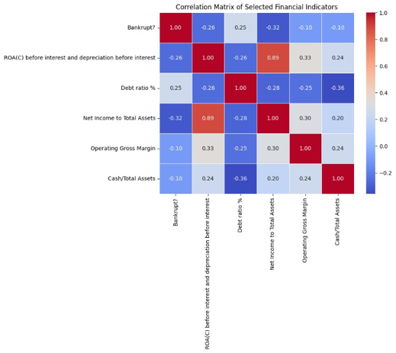
04 • EDA
Data Understanding: Correlation Heatmap
What it shows
Correlation values summarize linear relationships between selected variables.
Observed example
ROA(C) and Net Income to Total Assets have a strong positive correlation (about 0.89).
Interpretation
Correlation shows association, not cause and effect.
COMPANY BANKRUPTCY PREDICTION • PREDICTIVE ANALYTICS
5

Slide 6
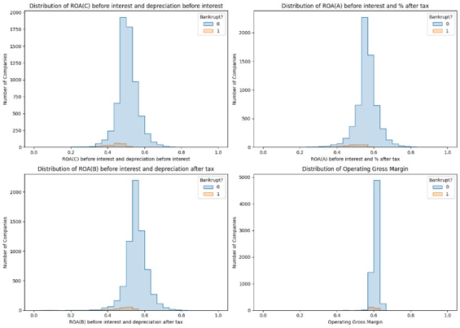
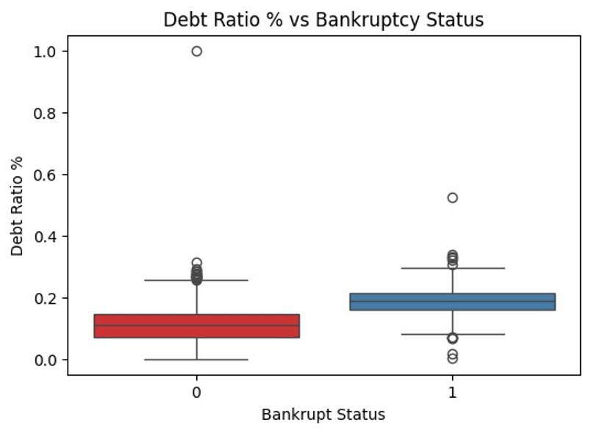
04 • EDA
Exploratory Data Analysis: Distributions
Figure: distributions of selected financial indicators
Figure: debt ratio by bankruptcy status
Histogram takeaway
Box-plot takeaway
The distributions overlap; one variable alone may not separate the classes.
The bankrupt group shows a higher median debt ratio in this sample.
COMPANY BANKRUPTCY PREDICTION • PREDICTIVE ANALYTICS
6

Slide 7
05 • MODELLING
Preprocessing & Model Development
Preprocessing
Models compared
• Check missing values and duplicates
• Separate X (features) and y (target)
• Stratified 80:20 train-test split
• Avoid fitting transformations on test data
1. Logistic Regression — baseline
2. Decision Tree — decision rules
3. Random Forest — ensemble of trees
Why compare models?
• Each model learns patterns differently.
• All models are evaluated on the same held-out test set.
• Class imbalance means recall and precision matter, not accuracy alone.
COMPANY BANKRUPTCY PREDICTION • PREDICTIVE ANALYTICS
7

Slide 8
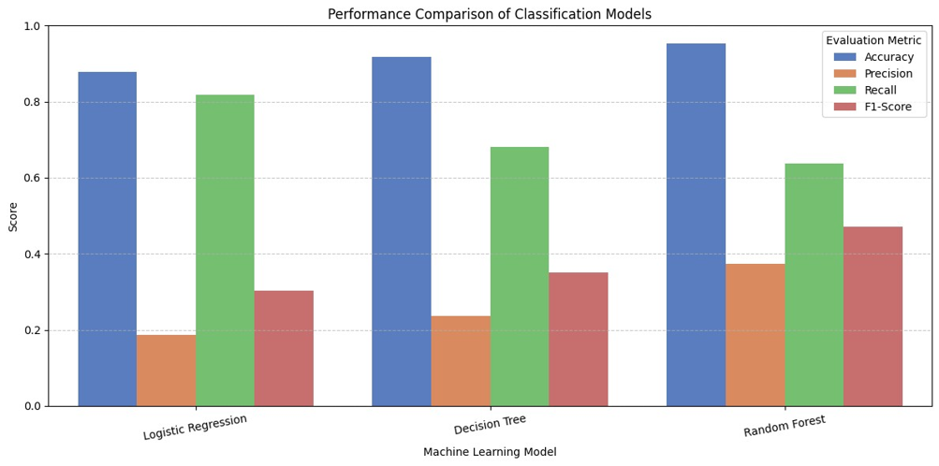
06 • EVALUATION
Model Comparison: What the Results Show
Random Forest accuracy
95.38% of test predictions were correct.
Recall: 63.64%
Detected 28 of 44 actual bankrupt companies.
F1-score: 0.4706
Balances precision (0.3733) and recall.
Accuracy is high, but precision and recall show that bankruptcy detection still has important errors.
COMPANY BANKRUPTCY PREDICTION • PREDICTIVE ANALYTICS
8

Slide 9
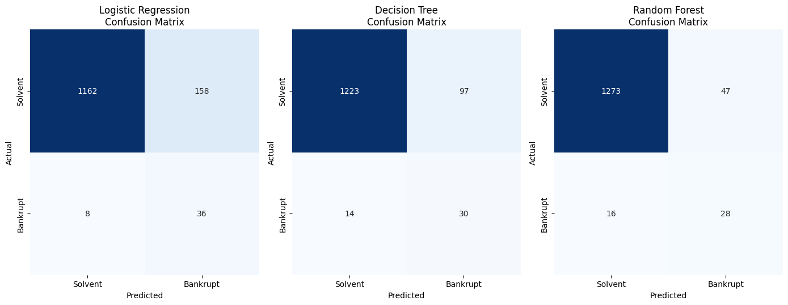
07 • EVALUATION
Confusion Matrices: Reading the Errors
True negatives: 1,273
Solvent companies correctly predicted solvent.
False positives: 47
Solvent companies incorrectly flagged bankrupt.
False negatives: 16
Bankrupt companies missed by the model.
True positives: 28
Bankrupt companies correctly detected.
For the Random Forest, 28 / (28 + 16) = 63.64% recall.
COMPANY BANKRUPTCY PREDICTION • PREDICTIVE ANALYTICS
9

Slide 10
08 • RESULTS
Selected Model: Random Forest
Accuracy
Precision
Recall
95.38%
37.33%
63.64%
F1-score
ROC-AUC
PR-AUC
47.06%
0.950
0.490
Interpretation: Random Forest separates the classes well overall (ROC-AUC ≈ 0.95), but its bankruptcy precision is 37.33%. Of 75 companies predicted bankrupt, 28 were actually bankrupt.
The selected model should be judged against the cost of missed bankruptcies and false alarms.
COMPANY BANKRUPTCY PREDICTION • PREDICTIVE ANALYTICS
10

Slide 11
09 • CONCLUSION
Conclusion & Future Improvements
Conclusion
Limitations
• Completed an end-to-end KDD workflow
• Compared three classification models
• Random Forest achieved 95.38% accuracy and 63.64% recall
• Confusion matrix revealed 16 missed bankruptcies
• Imbalanced historical dataset
• Precision is relatively low
• Financial patterns may change over time
• Prediction is not a guarantee of bankruptcy
Future improvements
• Tune classification threshold using training validation data.
• Test boosting models and probability calibration.
• Validate on newer data and use explainability methods.
Takeaway: use predictions as a financial risk signal, not as a standalone decision.
COMPANY BANKRUPTCY PREDICTION • PREDICTIVE ANALYTICS
11

Slide 12
10 • SOURCES
References
• Beaver, W. H. (1966). Financial ratios as predictors of failure. Journal of Accounting Research, 4, 71–111.
• Altman, E. I. (1968). Financial ratios, discriminant analysis and the prediction of corporate bankruptcy. The Journal of Finance, 23(4), 589–609.
• Ohlson, J. A. (1980). Financial ratios and the probabilistic prediction of bankruptcy. Journal of Accounting Research, 18(1), 109–131.
• Zięba, M., Tomczak, S. K., & Tomczak, J. M. (2016). Ensemble boosted trees with synthetic features generation in application to bankruptcy prediction. Expert Systems with Applications, 58, 93–101.
• Barboza, F., Kimura, H., & Altman, E. (2017). Machine learning models and bankruptcy prediction. Expert Systems with Applications, 83, 405–417.
• UCI Machine Learning Repository: Taiwanese Bankruptcy Prediction dataset. https://archive.ics.uci.edu/dataset/572/taiwanese+bankruptcy+prediction
• Scikit-learn documentation: https://scikit-learn.org/stable/
Check the dataset citation and bibliographic details before final submission.
COMPANY BANKRUPTCY PREDICTION • PREDICTIVE ANALYTICS
12

Slide 13
Thank You
Questions & Discussion
Company Bankruptcy Prediction Using Machine Learning

