Slide 1
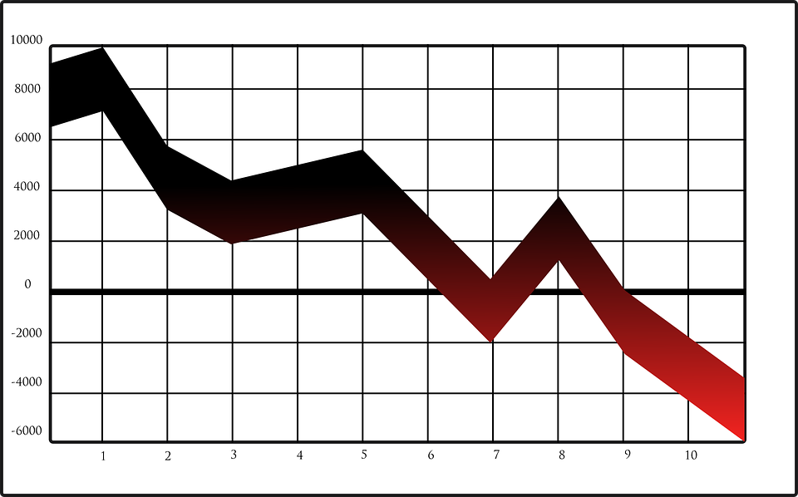
Stock Price Prediction
DEVANSH CHAUHAN 1510110119
KARTIK JAIN 1510110184

