Slide 1


KIET GROUP OF INSTITUTIONS, GHAZIABAD, UTTAR PRADESH
Affiliated to DR. A.P.J. ABDUL KALAM TECHNICAL UNIVERSITY, LUCKNOW, UTTAR PRADESH, INDIA
DEPARTMENT OF COMPUTER SCIENCE AND INFORMATION TECHNOLOGY
Photography Portfolio
Student Name : ARCHITA SINGH
University ID : 202401100500039
Library ID : 2428CSIT2132
DEVANSH PORWAL
202401100500061
2428CSIT1388

Slide 2

WELCOME TO MY PHOTOGRAPHY PORTFOLIO
Photography, to me, is more than just capturing moments; it’s about telling stories, evoking emotions, and seeing the world from unique perspectives. Through this portfolio, I invite you to explore a collection of my work that reflects my journey as a photographer. From intimate portraits to expansive landscapes, every image here is an expression of my passion for visual storytelling. I hope this portfolio resonates with you.

Slide 3
EMPATHIZE
My aim is to capture moments that not only showcase beauty but also provoke thought and inspire connection.
When I photograph people, I take the time to connect with them, ensuring they feel comfortable, seen, and respected. I believe that this connection leads to authentic, powerful imagery that resonates long after the photo is taken.
I approach every photo with empathy, seeking to understand the emotions and thoughts behind what I see through my lens.

Slide 4
DEFINE
My photography is defined by a deep appreciation for the interplay of light, emotion, and narrative.
I approach each project with a focus on authenticity, aiming to capture moments that feel real, raw, and unposed.
I aim to define not just what’s visible, but what’s felt-transforming the ordinary into extraordinary through the lens of my camera.
This portfolio is a reflection of my artistic journey-a blend of creative vision and technical expertise.

Slide 5
IDEATE
Every photograph begins with an idea-a spark of inspiration that drives me to explore and create.
The ideation process is both structured and spontaneous-sometimes it’s about carefully planning each shot, and other times it’s about letting the moment unfold naturally.

Slide 6
PROTOTYPE
In the prototyping stage, I embrace experimentation and exploration, testing out new ideas, techniques, and approaches to bring my concepts to life. I view this phase as an opportunity to step outside my comfort zone and push the boundaries of what I’ve done before.
This process is about trial and error, understanding what works and what doesn’t, and learning from each shot.
The prototype phase allows me to grow as a photographer, honing my technical skills and creative vision before capturing the perfect shot.

Slide 7
TEST
Testing is a critical part of my creative process. Once I’ve developed a concept and prototype, I put it into action by testing it in real-world conditions.
This stage allows me to evaluate my ideas, techniques, and settings to ensure that I’m achieving the desired effect.
During the test phase, I focus on how different elements work together.
Ultimately, the test phase helps me make informed decisions about what works and what doesn’t.

Slide 8
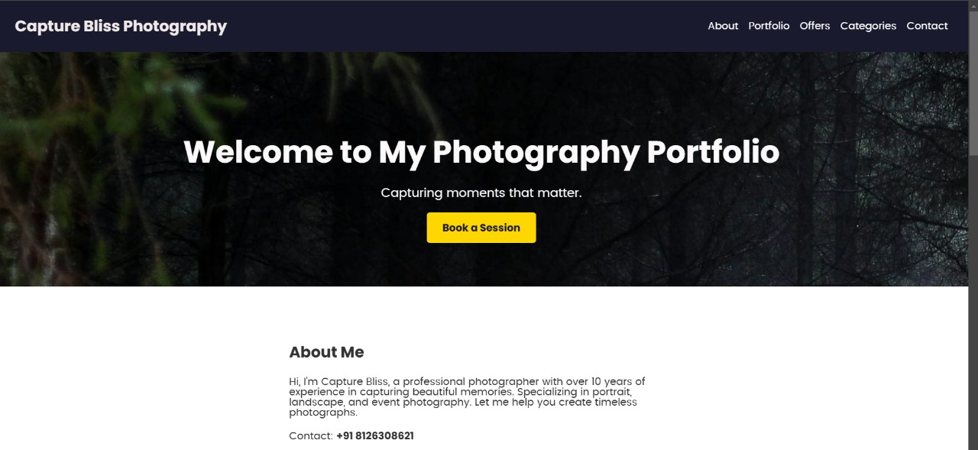

Slide 9
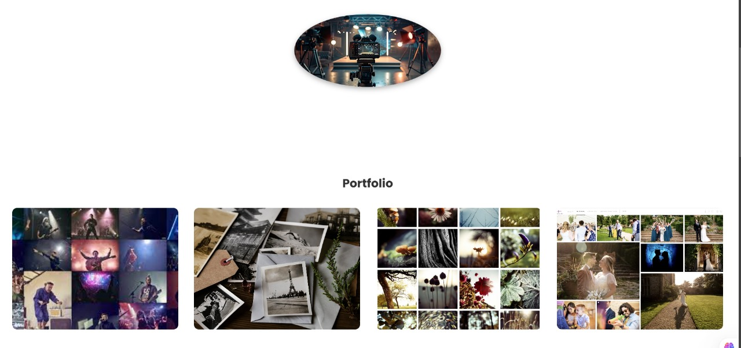

Slide 10
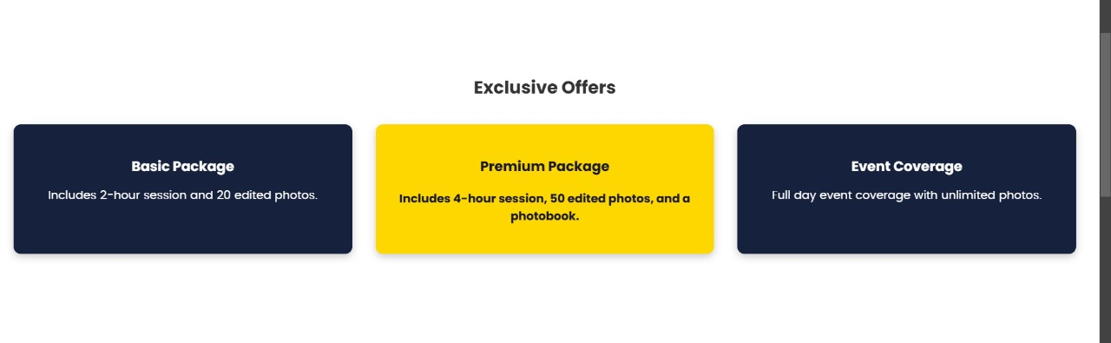

Slide 11
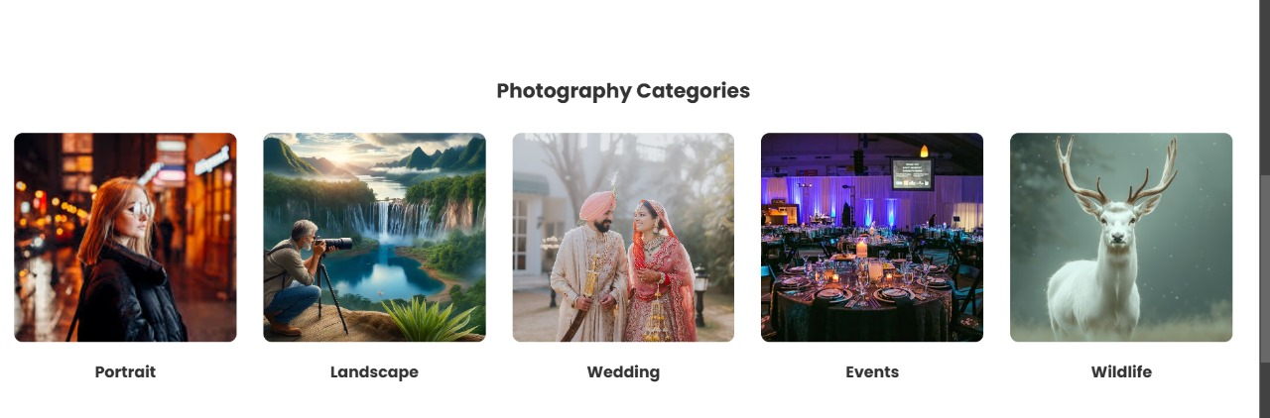

Slide 12
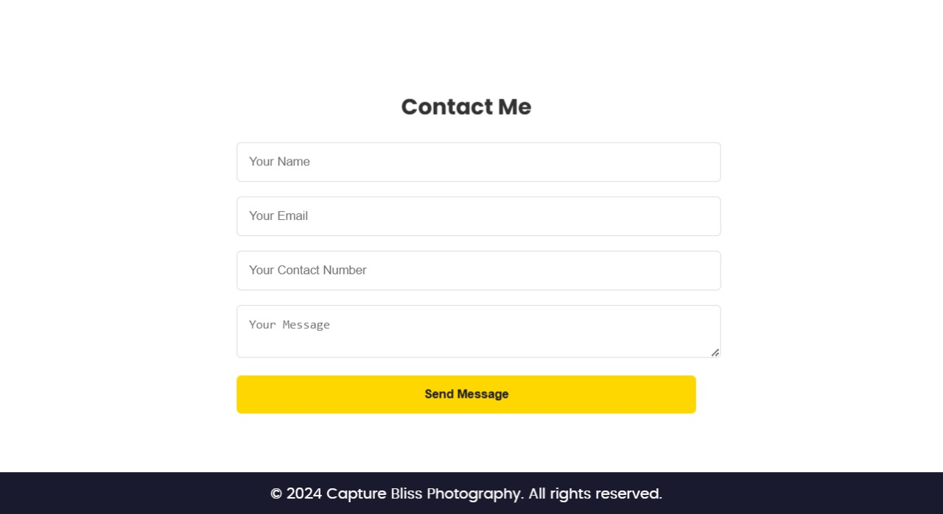

Slide 13
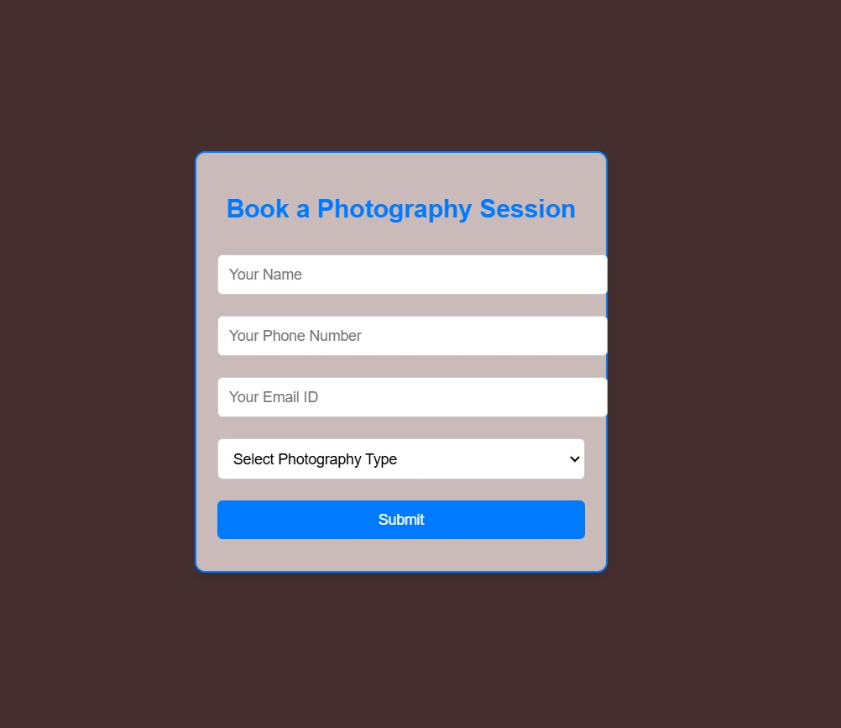

Slide 14
USES OF HTML (HYPERTEXT MARKUP LANGUAGE):
Structure and Content:
Used to create the skeleton of the web page.
Organizes the content into sections (e.g., header, hero section, about section, portfolio section, offers section, etc.).
Provides semantic meaning with tags like <header>, <section>, <footer>, etc., making the page more accessible and SEO-friendly.
Adds links, buttons, and forms for user interaction (e.g., "Book a Session" button, contact form).
Media Integration:
Embeds images (<img> tags) for portfolios and categories.

Slide 15
USES OF CSS (CASCADING STYLE SHEETS):
Styling and Layout:
Provides styling for fonts, colors, backgrounds, and layouts.
Ensures responsiveness using flexible grid systems for sections like the portfolio gallery and offers.
Adds hover effects for interactivity (e.g., enlarging gallery images and buttons when hovered).
Animations:
Implements animations for backgrounds (e.g., @keyframes for dynamic background colors and rotating images).
Smooth transitions for hover effects and scaling elements.
Thematic Design:
Creates a dark-themed aesthetic with contrasting colors to highlight content.
Ensures a visually appealing hierarchy with consistent spacing, typography, and visual cues.

Slide 16
USES OF JS (JAVA SCRIPT):
Interactivity:
Handles dynamic user interactions (e.g., "Book a Session" button click).
Potentially used to add behaviors like opening new tabs or modals.
Dynamic Background:
Could be used to control the animations triggered by events (e.g., clicking a button changes the background dynamically).
Form Handling:
Ensures proper input validation and interactivity in the contact form (e.g., checking if fields are filled before submission).
Event Listeners:
Adds functionality like scrolling to sections when navigation links are clicked.
Triggers actions such as opening a new page when offers are clicked.

Slide 17
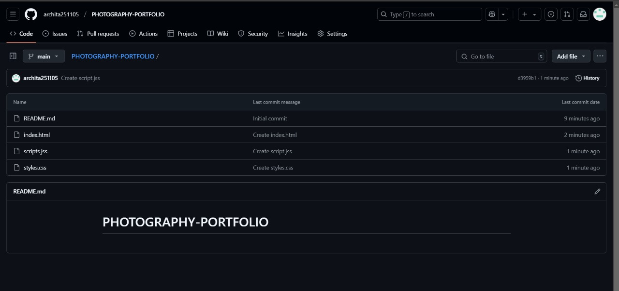
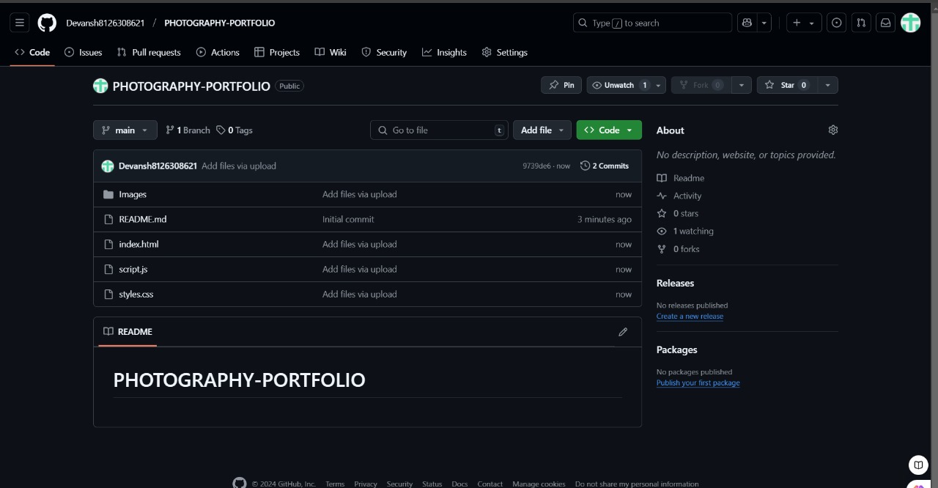
GITHUB LINK
ARCHITA SINGH
DEVANSH
https://github.com/archita251105/PHOTOGRAPHY-PORTFOLIO/tree/main
https://github.com/Devansh8126308621/PHOTOGRAPHY-PORTFOLIO

Slide 18
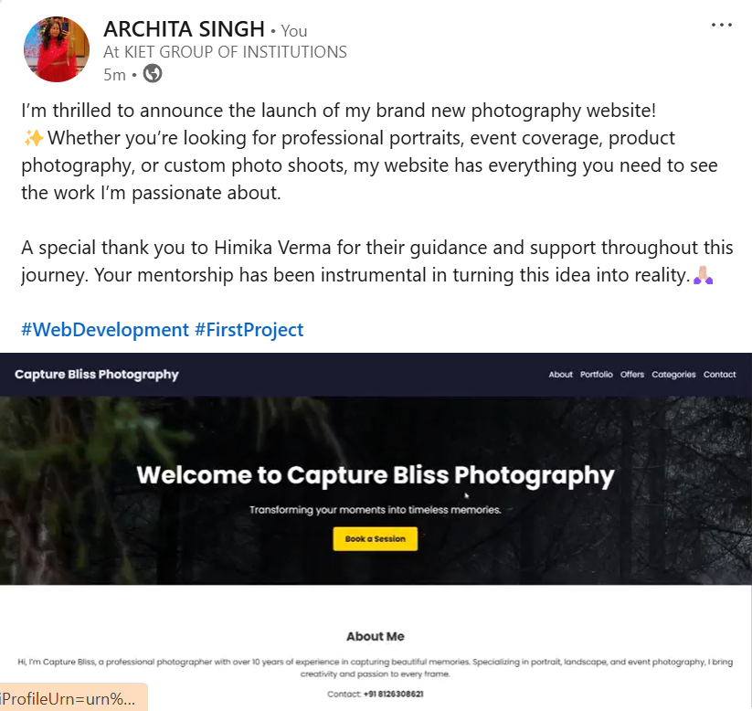
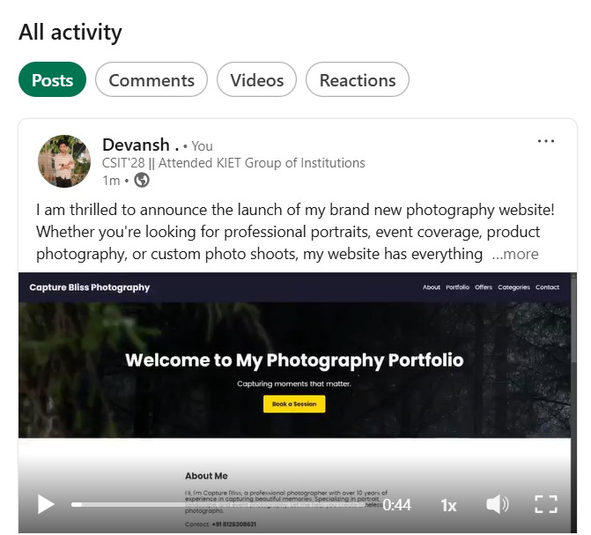
LINKEDIN LINK
ARCHITA SINGH
DEVANSH
https://www.linkedin.com/posts/archita-singh-28287a307_webdevelopment-firstproject-activity-7276878298855469056-z9C4?utm_source=share&utm_medium=member_android
https://www.linkedin.com/posts/devansh-47936a329_i-am-thrilled-to-announce-the-launch-of-my-activity-7276874773610004481-8nlS?utm_source=share&utm_medium=member_desktop

Slide 19

THANK YOU
THANK YOU

