Slide 1
TEXT TO SQL QUERY conversion
BY DEVANSH SHARMA

Slide 2
INTRODUCTION text to SQL conversion
Ques-Why convert text to SQL?
Improved accuracy in understanding user intents.
Seamless integration with databases.
Efficient querying of structured data.
Traditional databases communicate through structured query languages (SQL), while humans communicate using natural language.
Bridging the gap between these two fundamentally different languages is crucial for effective human-machine communication.
Text to SQL conversion plays a pivotal role in enabling this communication by transforming textual user inputs into actionable SQL queries.

Slide 3
Approaches for text to sql conversion
Method 1: Rule-Based Template Matching
Process:
Create a set of predefined templates for common intents (e.g., "Find flights from [origin] to [destination]").
Identify entities using named entity recognition (NER).
Replace placeholders in the template with entity values.
Generate SQL query based on the populated template.
Drawbacks:
Limited Flexibility: This method is rigid and cannot handle diverse or complex queries that fall outside predefined templates.
Maintenance Overhead: As the number of templates grows, maintaining and updating them becomes challenging.
Ambiguity Handling: Struggles with handling ambiguous queries that don't fit neatly into templates.
Scalability: Difficult to scale for various intents and entities.

Slide 4
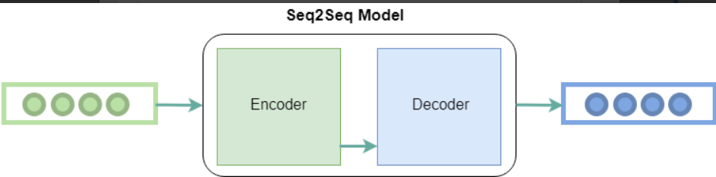
Method 2: Seq2Seq Model with Reinforcement Learning
Process:
Utilize a sequence-to-sequence (Seq2Seq) model, often used for machine translation.
Train the model to learn the mapping from input natural language text to output SQL queries.
Apply reinforcement learning to fine-tune the generated SQL queries using rewards based on query execution success.
Drawbacks:
Data Intensity: Requires a substantial amount of paired data (text-SQL) for training, which might be challenging and time-consuming to curate.
Complex Training: Training Seq2Seq models with reinforcement learning is computationally expensive and demands careful hyperparameter tuning.
Generalization Issues: The model may struggle to generalize to new query structures not seen in the training data.
Handling Ambiguity: Still, might face challenges in handling ambiguous user intents and generating accurate queries.
Domain Specificity: May not work well across different domains or industries without extensive fine-tuning.

Slide 5
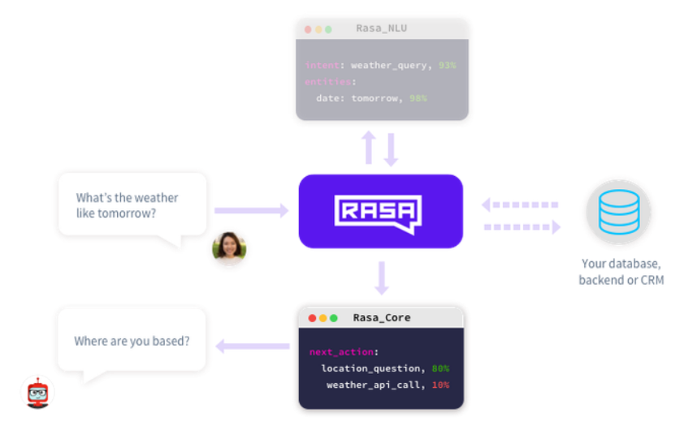
The Rasa Connection
Rasa, a leading conversational AI platform, empowers developers to create contextually-aware chatbots and assistants.
Central to Rasa's capabilities is the ability to understand user intents and extract entities from natural language inputs.
Incorporating Text to SQL conversion into Rasa workflows can elevate intent understanding and enhance interaction.

Slide 6
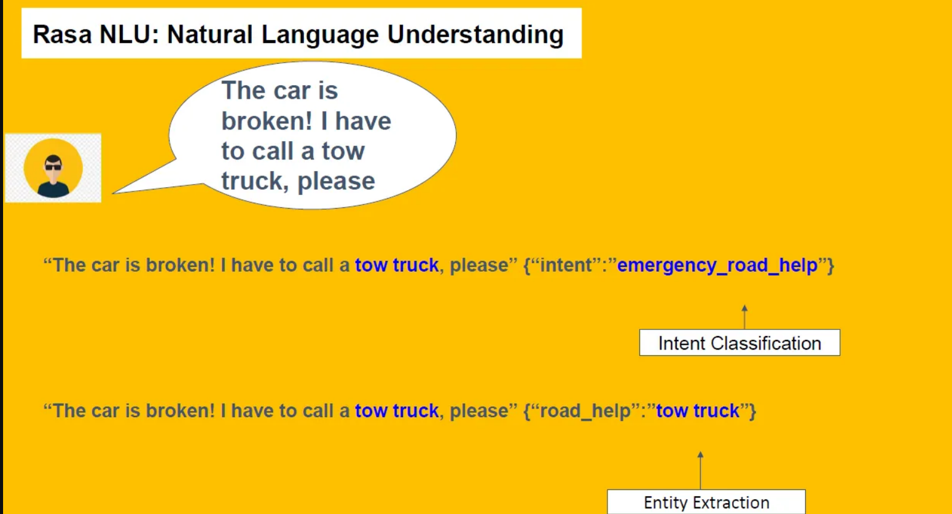
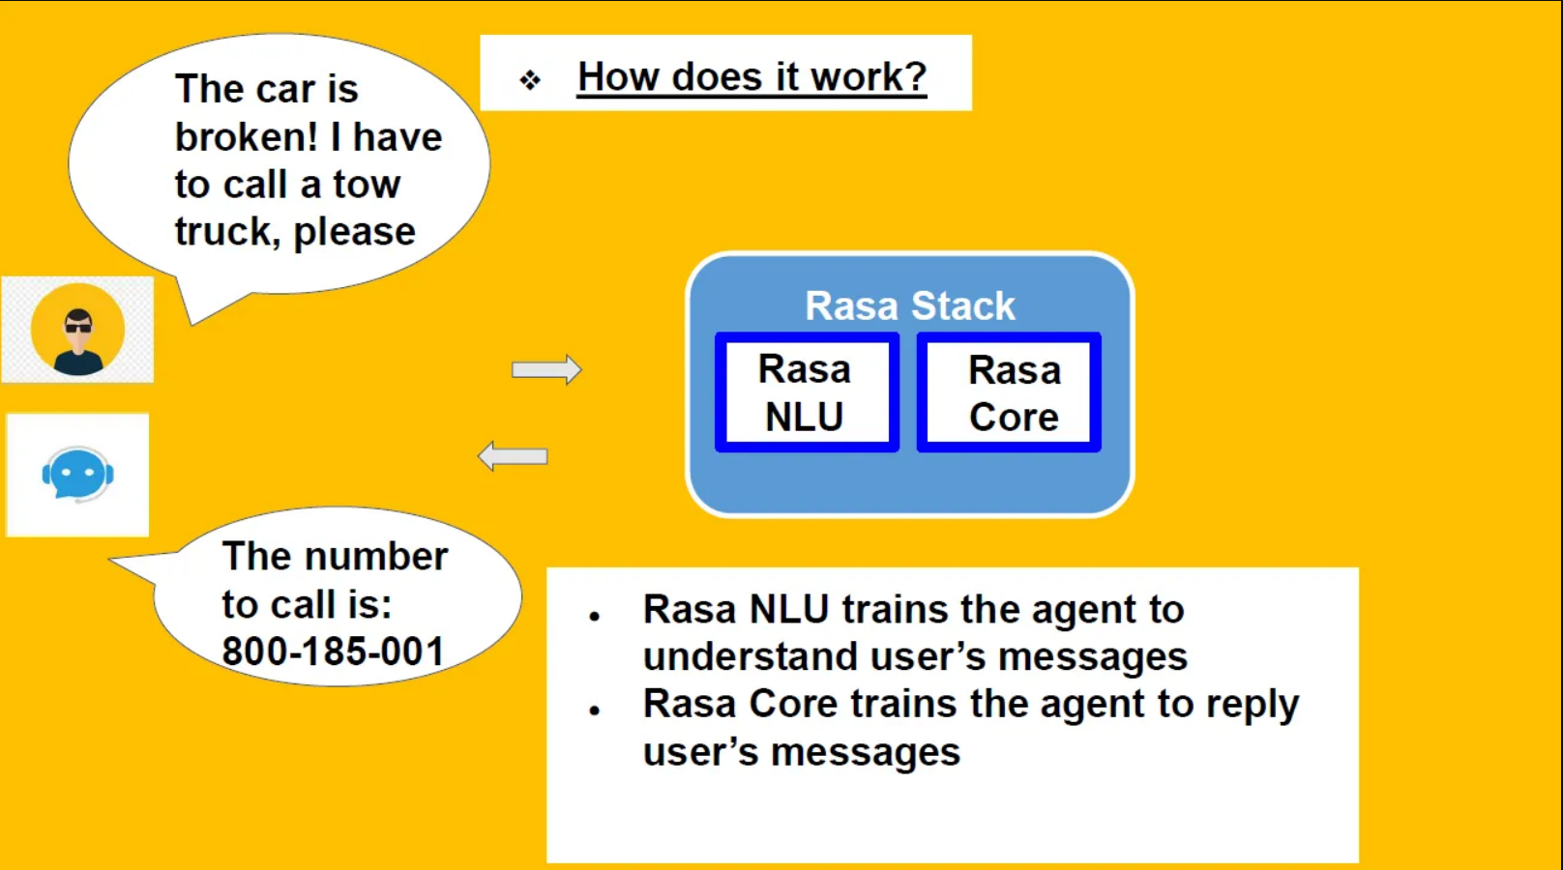
Benefits of Text to SQL for Rasa
How Text to SQL Works
Intent Recognition: Rasa's NLU component identifies user intent (e.g., "Find flights from New York to London").
Entity Extraction: Extracts entities ("New York" and "London").
SQL Query Generation: Converts intent and entities into SQL query ("SELECT * FROM flights WHERE origin='New York' AND destination='London'").
Enhanced user experience: accurate intent understanding.
Complex queries: handle intricate user requests.
Dynamic responses: real-time data retrieval.
Reduced development time: streamlined integration.

Slide 7
Challenges and Solutions
Ambiguity: Handling multiple possible interpretations.
Solution: Contextual analysis and user interaction history.
Complex Queries: Translating intricate requests.
Solution: Building a robust query generation engine.
Data Privacy: Sensitive data in queries.
Solution: Implementing secure data handling protocols.
Implementation Steps
Data Annotation: Annotate training data with intents and entities.
Query Templates: Create a library of query templates.
Query Engine: Develop a mechanism to dynamically fill query templates with extracted entities.
Testing and Validation: Rigorous testing to ensure accurate query generation.
Tools and Technologies
Rasa Framework: NLU and dialogue management.
SQL Database: Backend for data storage and retrieval.
Query Building Libraries: SQL alchemy, Knex.js, etc.
Natural Language Processing Libraries: spaCy, NLTK, etc.

Slide 8
Future Scope and Enhancements
1. Machine Learning: Incorporating ML for better query template selection.
2.Multi-language Support: Extending conversion to multiple languages.
3.Contextual Understanding: Enabling better context retention.
Conclusion
Text to SQL conversion enhances Rasa's capabilities.
Accurate intent understanding and dynamic query generation.
Improved user experience and seamless database interaction.
A step towards more intelligent and efficient conversational AI.

Slide 9
THANKYOU
THANKYOU
THANKYOU

