Slide 1
PhisTools
A Policy-Aware Phishing Risk Analysis & Prevention-Support Tool (NIS)
Course: Network Information Security (NIS)
Team: Samarth Khandelwal (23BIT0051) • Devansh Agarwal (23BIT0028) • Nakul Thombare (23BIT0013)
Guide: Dr Shantharajah S P • Institution: VIT Vellore • Date: 08-04-2026
Positioning: NIS-first triage workflow. ML gives probabilities; NIS logic turns them into risk, attack type, and response guidance.
Notes:
Slide 1: Title
[Sources]
- Team and course details are from the provided draft deck and plan.
[/Sources]

Slide 2
Problem Statement & Motivation
Phishing is a multi-signal security triage problem
Why phishing is hard
Our question
Attackers mix social engineering + infrastructure tricks (spoofing, redirects, lookalike domains).
Single-signal detectors (only keywords / only signature rules) miss new variants or over-flag benign content.
Security teams need explainable risk + next actions, not only a yes/no label.
How can we combine ML evidence with NIS indicators to triage emails safely?
Output should include: risk score, threat level, attack type, and response guidance.
What PhisTools provides
Inputs: email subject/body, optional headers, URLs, optional remote attachment URL.
Signals: email ML + URL ML + header/spoofing checks + NIS heuristics.
Outputs: risk score (0–100), verdict (safe/suspicious/phishing), attack typing, recommended actions, logs.
PhisTools • NIS Review
Notes:
Slide 2
[Sources]
- Problem framing and NIS-first motivation drawn from the rewrite plan.
[/Sources]

Slide 3
Objectives & Scope
What we built
Objectives
Scope
Build a multi-model phishing assessment system (email + URLs).
Add a risk-based scoring layer (0–100) with policy thresholds.
Include NIS indicators: spoofing/header checks, suspicious URL heuristics, attack typing, recommended actions.
In scope: triage + explainability + logs + optional enrichment.
Out of scope: full SPF/DKIM/DMARC verification, malware detonation sandbox, enterprise-scale deployment.
Goal: a strong academic NIS prototype, not “production-ready”.
Deliverable
A runnable Streamlit web app (webapp.py) that fuses ML + NIS signals into risk, verdict, attack type, and actions.
A training pipeline to regenerate models and improve calibration when false positives are observed.
PhisTools • NIS Review
Notes:
Slide 3
[Sources]
- Scope and slide structure based on the rewrite plan.
[/Sources]

Slide 4
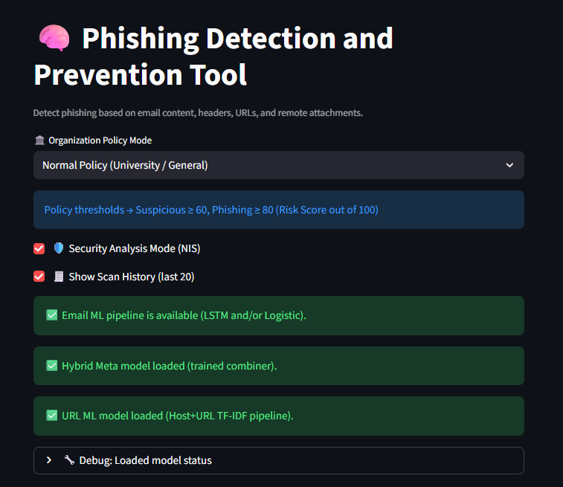
Project Overview
From inputs to actionable security output
Inputs
Evidence
Outputs
Subject / Body
Headers (optional)
URLs (optional)
Remote file URL (optional)
Email ML probs
URL ML probs
Header checks
Heuristics / intel
Risk score (0–100)
Threat level
Verdict
Attack type
Actions + logs
What makes it NIS-first
Risk scoring + policy thresholds
Spoofing/header checks
Attack typing + recommended actions
Operational scan logs + optional enrichment
PhisTools • NIS Review
Notes:
Slide 4
[Sources]
- Flow and visual recommendations from PHISTOOLS_PPT_REWRITE_PLAN.
[/Sources]

Slide 5
Runtime Architecture
webapp.py orchestrates models + security logic + logging
End-to-end runtime flow
1. Load models + metadata
2. User inputs (subject/body/headers/URLs)
3. Email ML inference (logistic + LSTM + hybrid)
4. Header analysis (spoofing signals)
5. URL ML inference + URL heuristics
6. Risk fusion + calibration
7. Policy thresholds → verdict + threat level
8. Attack type + recommended actions + logging
PhisTools • NIS Review
Notes:
Slide 5
[Sources]
- Runtime flow based on rewrite plan and project structure summary.
[/Sources]

Slide 6
NIS vs ML Positioning
ML is evidence; NIS is interpretation + action
ML Evidence Layer
Email probability (logistic + LSTM + hybrid)
URL probability (URL model)
Helps detect phishing-like patterns
NIS Analysis Layer
Spoofing/header checks
URL/domain heuristics (shorteners, IP hosts, TLDs, keywords)
Operational output: actions + logs
Hybrid Decision Layer
Risk score (0–100)
Policy thresholds → verdict
Attack typing + recommended response
PhisTools • NIS Review
Notes:
Slide 6
[Sources]
- Layer framing per PHISTOOLS_PPT_REWRITE_PLAN.
[/Sources]

Slide 7
Implemented Feature Stack
Active vs Optional vs Recently Improved
Detection Signals
Interpretation
Response & Ops
Email ML scoring
URL ML scoring
Header analysis
Risk score (0–100)
Threat level + verdict
Grouped explainability
Attack typing
Recommended actions
Scan logs + feedback
Optional Enrichment
Remote attachment URL scan: success / blocked(403) / not_found(404) / webpage / invalid_url (graceful handling).
Threat-intel enrichment: optional online checks when keys are available (kept optional).
PhisTools • NIS Review
Notes:
Slide 7
[Sources]
- Feature grouping and status tags per PHISTOOLS_PPT_REWRITE_PLAN.
[/Sources]

Slide 8
Models & Algorithms (Project Context)
What each model contributes
Model
Input
Output
Why used
Logistic Regression (TF‑IDF)
Email text
P(phishing)
Fast baseline; interpretable; strong on keywords
LSTM
Email text sequence
P(phishing)
Captures context and phrasing beyond bag‑of‑words
Hybrid / Meta
Logistic + LSTM probs
Final email prob
Stabilizes decisions by combining signals
URL Model (+ calibration)
URL/host text + structure
P(risky URL)
Detects suspicious destinations; reduces false positives
Calibration note
We optimized for practical false-positive reduction (benign domains were being over-flagged).
Notes:
Slide 8
[Sources]
- Model lineup and explanation per PHISTOOLS_PPT_REWRITE_PLAN.
[/Sources]

Slide 9
Heuristics, Risk Scoring & Attack Typing
How the NIS layer turns evidence into decisions
ML probs
NIS indicators
Fusion
Decision
Action
Email P
URL P
Spoofing
URL heuristics
Urgency/credential cues
Risk score
(0–100)
Policy thresholds
Verdict + threat
Attack type
Recommended steps
Logs
Attack types (examples)
What the user gets
Credential harvesting (fake login / verify)
Brand impersonation (Microsoft/Google/University)
Spoofing / header manipulation (Reply-To mismatch)
Link shortener / redirect abuse
Attachment delivery (possible malware lure)
A score + threat level (triage)
A clear “why flagged” explanation
Recommended prevention / response steps
Scan history for review
PhisTools • NIS Review
Notes:
Slide 9
[Sources]
- Heuristics + risk scoring + attack typing slide content based on rewrite plan.
[/Sources]

Slide 10
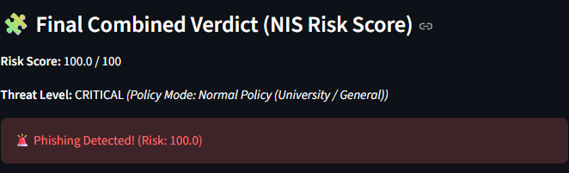
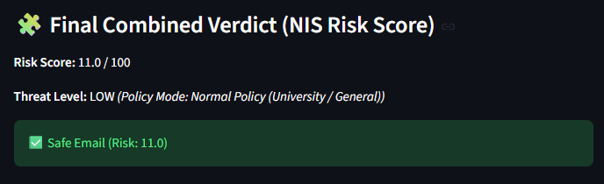
Results & Testing Observations
URL model improvement (training-side)
False positives: 2438 → 2076
FPR: 0.0804 → 0.0685
Accuracy: 0.9177 → 0.9146 (tradeoff)
ROC-AUC: 0.9760 → 0.9736
Screenshot: High-risk phishing output
Practical observations
Works best when multiple signals align (urgent language + spoofing + risky URLs).
Attack typing + recommended actions are strong for NIS demonstration.
Remaining limitation: some trusted-domain URL scores can still be high.
Screenshot: Safe / low-risk output
PhisTools • NIS Review
Notes:
Slide 10
[Sources]
- URL metric deltas from URL_MODEL_RETRAIN_REPORT.
- Slide structure from PHISTOOLS_PPT_REWRITE_PLAN.
[/Sources]

Slide 11
Recent Improvements
Before → After → Impact
Key improvements
Impact
Header confidence: incomplete/manual headers no longer inflate risk unfairly.
Final score calibration: weak evidence contributes less; strong combined evidence escalates more.
Grouped explainability: Email / Header / URL / Intel / Final reasoning blocks.
URL retraining: structural features + calibration to reduce false positives.
URL model load fix: runtime now loads URL model reliably (no neutral fallback).
More believable demo behavior on benign domains.
Better explainability for viva questions.
Remote attachment feature no longer “looks broken” during review.
Clearer NIS story: triage + action + ops.
PhisTools • NIS Review
Notes:
Slide 11
[Sources]
- Improvement list based on project improvement reports and rewrite plan.
[/Sources]

Slide 12
Limitations
Current limitations
URL calibration: still imperfect for some trusted enterprise/support domains.
Header analysis: depends on completeness/quality of provided headers.
Remote fetch: depends on remote host policy and network conditions (403 is normal).
Threat-intel: optional, depends on API keys and connectivity.
Prototype: not a full secure email gateway or SOC platform.
PhisTools • NIS Review
Notes:
Slide 13
[Sources]
- Limitations per PHISTOOLS_PPT_REWRITE_PLAN.
[/Sources]

Slide 13
Future Work
Improve reliability without overselling
Model & data
NIS depth & deployment
Curate larger benign URL corpus (academic/enterprise/government domains).
Further calibration + threshold tuning to reduce false positives.
More robust URL feature set (e.g., reputation fusion).
Richer header parsing; optional SPF/DKIM/DMARC enrichment.
Threat-intel integration with clearer caching & rate limits.
Packaging/requirements hardening for reproducible runs.
Optional browser/endpoint integration as extension/API.
PhisTools • NIS Review
Notes:
Slide 14
[Sources]
- Future work items per PHISTOOLS_PPT_REWRITE_PLAN.
[/Sources]

Slide 14
Conclusion
Key takeaway
• NIS-first phishing triage prototype (risk, verdict, attack type, actions).
• ML provides evidence (email + URL probabilities).
• NIS layer provides interpretation (spoofing checks, heuristics, policy thresholds, response guidance).
• Engineering maturity: calibration + robustness + demo-safe optional features.
Thank you.
PhisTools • NIS Review
Notes:
Slide 15
[Sources]
- Conclusion framing per PHISTOOLS_PPT_REWRITE_PLAN.
[/Sources]

