Slide 1
Frequency Domain Analysis
Welch · MUSIC · ESPRIT — Across 5 Window Lengths
Stage 3 of 3 · bpm_fda.m
Core question: can MUSIC/ESPRIT extract heart rate from 2–3s windows where Welch completely fails?
Welch PSD
MUSIC
ESPRIT
MDL order
Ljung-Box
CONF score
[2,3,5,10,20]s
Notes:
Stage 3 is the core research stage. It was motivated by Prof. Chen's observation that Welch PSD requires ~10 seconds for reliable heart-rate estimation, creating 10-second latency in the DocBOT feedback loop.
MUSIC and ESPRIT are superresolution methods from array signal processing that can theoretically extract a single frequency from much shorter data windows, limited by SNR rather than window length.
Stage 3 tests this claim on real rPPG data by running all methods across 5 window sizes and comparing accuracy against the DocBOT ground-truth contact sensor.

Slide 2
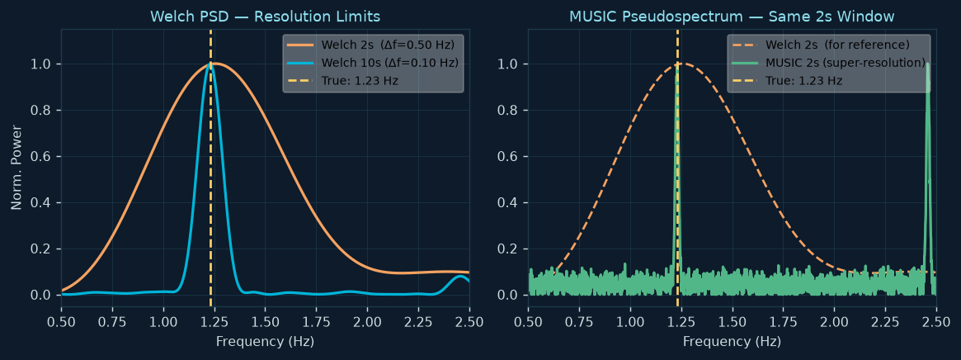
The Core Research Question
Welch frequency resolution is limited by window length — can MUSIC/ESPRIT overcome this?
Welch resolution law:
Δf = fs / N_window
At 30fps: 2s → Δf=0.50Hz=30BPM
5s → Δf=0.20Hz=12BPM
10s → Δf=0.10Hz= 6BPM
20s → Δf=0.05Hz= 3BPM
MUSIC/ESPRIT:
Superresolution — not Δf-limited.
Limited by SNR and model order,
not window length.
2s window can theoretically give
<0.01 Hz precision at high SNR.
Research goal: quantify the minimum window at which MUSIC/ESPRIT matches Welch@10s on real rPPG BVP signals.
Note: MUSIC evaluated at 2048 frequency points only in [f_low, f_high] — targeted cardiac band search. Far finer grid than Welch bin spacing. Peaks can be located to <0.001 Hz regardless of window length.
Notes:
The left plot shows Welch PSD for 2-second and 10-second windows. The 2-second window (orange) has such poor frequency resolution (0.5 Hz = 30 BPM bin spacing) that you cannot reliably detect a peak at 1.23 Hz — the bin at 1.0 Hz and the bin at 1.5 Hz are both plausible candidates.
The right plot shows MUSIC on the same 2-second window (green). MUSIC evaluates the pseudospectrum at 2048 points over the cardiac band, giving sub-0.001 Hz resolution. The cardiac peak appears as a narrow spike at the true frequency.
The key question: this theoretical advantage holds at high SNR. Real rPPG BVP signals at 2-second windows have low SNR (the cardiac component is weak). Section B tests whether the advantage survives at real-world rPPG SNR levels.

Slide 3
Signal Flow — bpm_fda.m
Three sections: Noise whiteness → Full spectra → Multi-method window sweep
SECTION W Noise Whiteness Diagnostic
Auto-Save Output Folder
fda_results/fda_<timestamp>/
Notch cardiac → Ljung-Box → Eigenvalue CV → is residual noise white or coloured?
│
├── output.txt ← diary() full console log
SECTION A Full-Signal Spectra
├── Fig W1 _ Noise Whiteness Diagnostic.png/.pdf
├── specCal figure.png/.pdf
specCal + specCale (MACS toolbox) → BVP PSD with passband markers
├── specCale _ Tight vs Adapt.png/.pdf
├── BPM Track _ 2s window.png/.pdf
SECTION B Sliding-Window Method Sweep
├── BPM Track _ 3s window.png/.pdf
├── BPM Track _ 5s window.png/.pdf
[2,3,5,10,20]s × Welch × MUSIC × ESPRIT → MAE, Acc%, HQ subset, confidence scoring
├── BPM Track _ 10s window.png/.pdf
└── BPM Track _ 20s window.png/.pdf
diary() starts immediately at script launch. Even if MATLAB crashes mid-run, all completed computation results are preserved in output.txt. Figures saved as both PNG (viewing) and PDF (publication-quality vector).
Notes:
The script is divided into three clearly separated sections labelled W, A, B in the code.
Section W runs first because its result — is the noise white or coloured — determines how to interpret the MUSIC/ESPRIT performance in Section B. Coloured noise means the signal/noise subspace separation is approximate, and MUSIC/ESPRIT may show degraded performance.
Section A is a quick visual check: the full-signal PSD lets you confirm that the BVP signal has a clear cardiac peak and that the tight-passband filter removed the sub-1Hz content as intended.
Section B is the main analysis: the 5-window-size × 6-method loop that generates the BPM tracking figures.

Slide 4
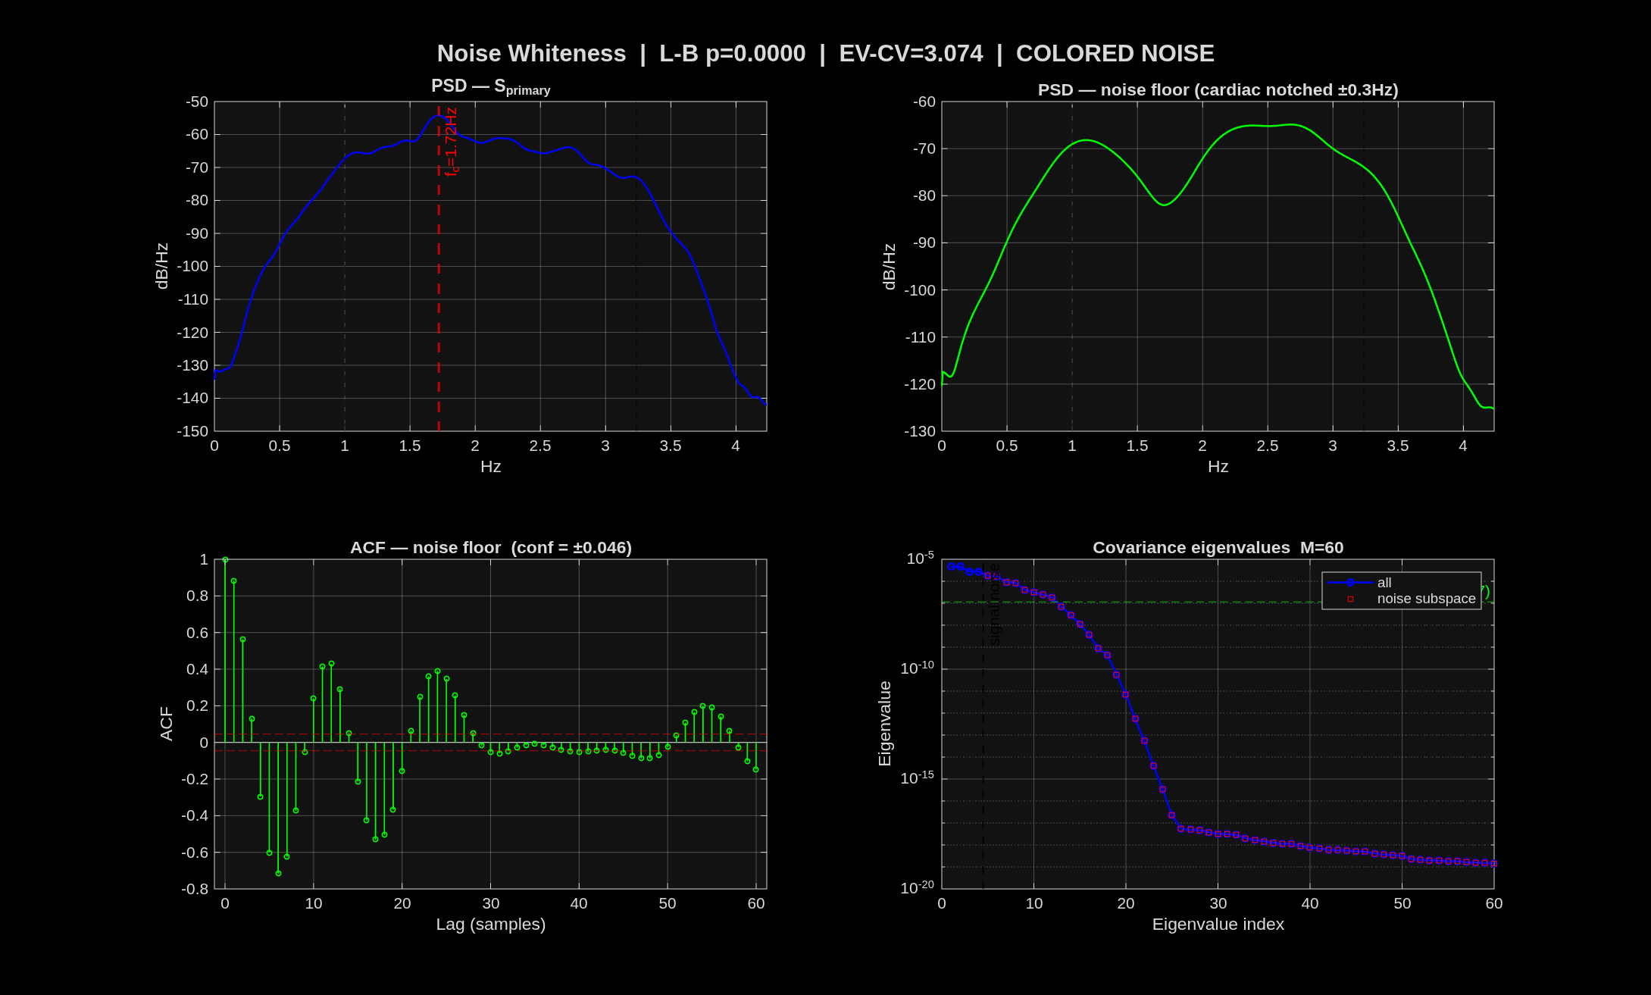
Section W — Noise Whiteness Diagnostic
Formal test for coloured noise: Ljung-Box + Eigenvalue CV — Fig W1
Why test noise whiteness first?
MUSIC and ESPRIT assume noise is i.i.d. (white, spectrally flat). Coloured noise degrades the signal/noise subspace separation → poorer frequency estimates.
Cardiac Notch Filter (FIR ±0.30Hz)
Remove cardiac before testing noise: S_noise = filtfilt(b_notch, 1, S_primary) Width ±0.30Hz covers broadened peak (rate variability + leakage)
Ljung-Box Test
Eigenvalue CV
Q = N(N+2)·Σ r²(l)/(N-l) p < 0.05 → coloured
CV = std(λ_noise)/mean(λ_noise) CV > 0.30 → coloured
If is_colored → MUSIC/ESPRIT accuracy may degrade for this recording. Script prints explicit warning with context.
Notes:
The Fig W1 has 4 panels:
Panel 1 (top-left): PSD of the full BVP signal. Should show a clear cardiac peak. The red dashed line marks f_card. Black dashed lines mark f_low and f_high.
Panel 2 (top-right): PSD of S_noise (after cardiac notch). If perfectly white, this should be flat. Peaks in the noise PSD reveal coloured noise modes (e.g., a respiration peak at 0.3 Hz, or a mechanical resonance).
Panel 3 (bottom-left): ACF of S_noise with 95% CI bounds (±1.96/√T). White noise: all lags within bounds. Coloured noise: significant spikes at specific lags.
Panel 4 (bottom-right): Eigenvalue spectrum of the autocorrelation matrix. Blue circles = signal subspace (first 4). Red squares = noise subspace. Flat noise-subspace cluster = white; sloping cluster = coloured.
The Ljung-Box Q statistic sums squared autocorrelations — it has more statistical power than testing individual lags.

Slide 5
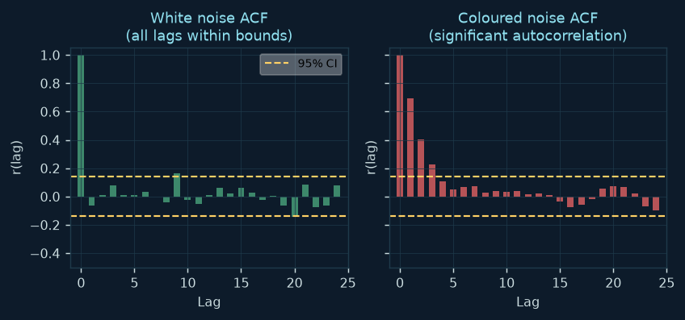
Ljung-Box Portmanteau Test
Formal hypothesis test for noise autocorrelation — Q-statistic vs χ²(m)
The Test
H₀: noise is white (no autocorrelation at lags 1…m)
H₁: at least one lag has significant autocorrelation
Q = N(N+2) · Σ r²(lag) / (N−lag)
Q ~ χ²(m) under H₀
p = 1 − chi2cdf(Q, m)
p < 0.05 → reject H₀ → coloured noise
m = min(20, T/5) lags:
More lags = more power, but ACF at lag > T/5
is poorly estimated → unreliable test.
Cap at 20 to prevent testing lags > 0.67s at 30fps.
Why Ljung-Box over Box-Pierce?
L-B uses 1/(N−lag) correction → better χ² approximation in
finite samples. Box-Pierce underestimates Q in small N.
Input to test: S_noise (after cardiac notch). Each r(lag) is the sample autocorrelation at that lag, normalised to [-1,1] by variance. Large ACF at any lag → evidence of autocorrelated structure → Q grows large → p falls below 0.05.
Practical interpretation: if p < 0.05 on a real rPPG noise floor, the coloured noise comes from residual motion artifacts, breathing, or imperfect skin segmentation — all physically meaningful sources of structured interference.
Notes:
The Ljung-Box test is a standard time-series diagnostic from Box and Jenkins' classical work. Ljung and Box (1978) improved the original Box-Pierce (1970) statistic by using the 1/(N-lag) correction instead of 1/N. This gives a better chi-squared approximation when N is not very large.
The test is applied to S_noise (after notching out the cardiac component) because the cardiac sinusoid itself would dominate the autocorrelation structure and mask any noise coloring.
The two ACF plots show white noise (left — all bars within the yellow 95% CI bounds) and coloured noise (right — multiple significant bars outside bounds). Real rPPG noise floor typically looks like the right plot due to motion and respiration residuals.

Slide 6
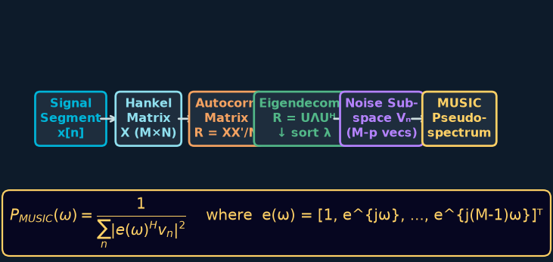
MUSIC Algorithm — Subspace Frequency Estimation
MUltiple SIgnal Classification · Schmidt (1986)
MUSIC in bpm_fda.m
Input: seg (BVP_ham_tight window), M, p
1. Hankel matrix: X = hankel(x[1:M], x[M:end])
2. Autocorr: R = X·Xᴴ / N_cols
3. Eigen-decompose R, sort λ descending
4. Noise subspace: last (M−p) eigenvectors
5. Evaluate pseudospectrum at omega_cb (2048 pts)
6. Find peak → harmonic check → BPM
omega_cb = linspace(2π·f_low/fs, 2π·f_high/fs, 2048)
Why cardiac band only?
2048 pts in [1.0, f_high Hz] = <0.001 Hz resolution
Faster than full-band sweep, no out-of-band aliasing.
Harmonic correction (±0.2 Hz neighbourhood search):
within -10 dB of sub-harmonic → prefer doubled freq.
MUSIC pseudospectrum formula:
P(ω) = 1 / Σₙ |e(ω)ᴴ · vₙ|² e(ω) = [1, e^{jω}, e^{2jω}, …, e^{j(M−1)ω}]ᵀ (steering vector)
When e(ω) ⊥ noise subspace → denominator → 0 → pseudospectrum spike at true signal frequency
try/catch guards against ill-conditioned R (too noisy, too short). Returns NaN → excluded from MAE via omitnan.
Notes:
MUSIC was originally developed for direction-of-arrival estimation in antenna arrays (Schmidt 1986). The Hankel matrix in the 1D time-series case plays the role of the spatial array data matrix.
The key insight: a sinusoid at frequency omega appears in the signal subspace of R (top-p eigenvectors). Its steering vector e(omega) is orthogonal to all noise subspace eigenvectors. So the denominator of the MUSIC formula goes to zero at exactly the signal frequencies — producing infinitely sharp peaks.
In practice (finite data, noise), the peaks are very sharp but not infinite. At 2048 evaluation points over the cardiac band, peak location has sub-0.001 Hz precision regardless of window length.
The ±0.2 Hz neighbourhood harmonic check is wider than Stage 2's single-bin check because MUSIC peaks can be offset from the true frequency by up to ±0.2 Hz in noisy short-window conditions.

Slide 7
ESPRIT Algorithm — Rotational Invariance
Estimation of Signal Parameters via Rotational Invariance Techniques · Roy & Kailath (1989)
ESPRIT: No Grid Search — Algebraic Solution
Output Processing
Key insight:
Two shifted submatrices of the Hankel data matrix
share the same signal subspace up to a rotation.
That rotation matrix encodes the signal frequencies.
Steps:
1. Build Hankel matrix X, take X₁=X[1:M-1,:]
and X₂=X[2:M,:] (shifted by 1 sample)
2. SVD of X₁ → signal subspace S₁
3. SVD of X₂ → signal subspace S₂
4. Solve S₁·Φ ≈ S₂ → Φ = rotational-invariance matrix
5. ω_est = angle(eig(Φ)) → convert to Hz
Result: p estimated frequencies directly,
no pseudospectrum evaluation.
Faster than MUSIC. Sub-bin resolution by construction.
evalc wrapper:
evalc('m_esprit(…)') captures + discards verbose
toolbox diagnostics (would flood 1000-window console).
w_est is complex (finite-precision rounding):
hz = real(w_est) × fs / (2π) → discard imaginary part
Filter: hz in [f_low, f_high] → cardiac-band only
Two-frequency disambiguation:
If ≥2 frequencies AND ratio > 1.5:
→ take the HIGHER frequency
(lower is likely sub-harmonic artifact)
If ratio ≤ 1.5 → same frequency, noise-split:
→ apply standard harmonic correction to hz[0]
ESPRIT vs MUSIC
ESPRIT: faster, exact algebraic solution,
better bias at high SNR,
harder to handle closely-spaced frequencies.
MUSIC: slower (grid sweep), sharp pseudospectrum,
better resolution for closely-spaced freqs,
more robust to model order misspecification.
p = max(4, p_mdl) for ESPRIT: BVP typically has cardiac fundamental + 1st harmonic → needs p=4 minimum (2 complex sinusoids = 4 complex poles).
Notes:
ESPRIT's rotational-invariance property is the key mathematical insight: if x[n] contains sinusoids, then x[n+1] is a phase-rotated version of x[n] by e^{jω} for each sinusoid. The two shifted submatrices encode this rotation.
Solving S1·Φ = S2 (in the least-squares sense) gives Φ, and the eigenvalues of Φ are the complex unit-circle values e^{jωk} for each sinusoidal component. Taking angle(eig(Φ)) gives the digital frequencies.
The evalc wrapper is a practical engineering decision: the ESPRIT toolbox prints verbose diagnostic text for every call. With 90 windows × 5 window sizes = 450 calls, that would produce 450 blocks of diagnostic text in the command window. evalc captures and discards it.
The minimum p=4 for ESPRIT: a real-valued sinusoid at frequency f produces TWO poles in the z-plane (at e^{±jω}). So 2 real sinusoids (cardiac + harmonic) require p=4. MDL might select p=2 for a very short noisy window, but ESPRIT needs at least 4 to represent the expected signal structure.

Slide 8
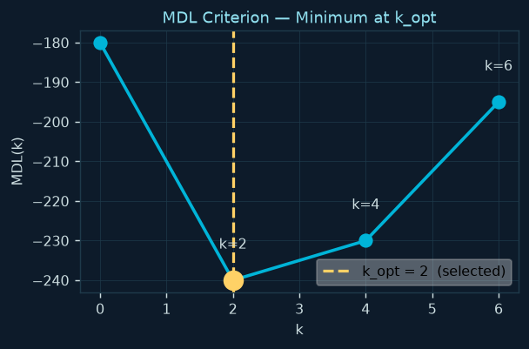
MDL Model Order Selection — Adaptive per Window
Wax & Kailath (1985) — information-theoretic model order from eigenvalue structure
MDL(k) Formula
MDL(k) = −N·n_n·log(g_mean/a_mean) + 0.5·k·(2M−k)·log(N)
k = candidate model order (# complex poles)
n_n = M − k = # noise eigenvalues
g_mean = exp(mean(log(λ_{k+1:M}))) ← geometric mean
a_mean = mean(λ_{k+1:M}) ← arithmetic mean
Term 1: −N·n_n·log(g/a):
g ≤ a always (AM-GM inequality).
White noise: g≈a → log(g/a)≈0 → term≈0
Coloured noise: g<<a → term large & negative
= penalty for leaving signal energy in noise subspace
Term 2: 0.5·k·(2M-k)·log(N):
Complexity penalty for k free frequency parameters.
Grows with k — prevents overfitting.
Why step by 2 only (k=0,2,4,6)?
Complex sinusoids come in conjugate pairs for real signals.
Even k = always physically meaningful model orders.
max_k = 6: at most 3 sinusoids in cardiac band
(cardiac fundamental + 2 harmonics).
k>6 = overfitting; ESPRIT needs p=max(4, k_mdl).
M_sub = max(win_N/4, 6): ensures N_cols ≈ 3M (stable autocorrelation estimate). Floor at 6 guarantees MDL has at least 7 eigenvalues to work with (enough for max_k=6 steps).
Notes:
MDL is the information-theoretic approach to model selection — it balances how well the model fits the data against how complex the model is.
The AM-GM inequality (arithmetic mean ≥ geometric mean) ensures the first term is always ≥ 0. When noise eigenvalues are all equal (perfect white noise), geometric mean = arithmetic mean and the term is zero. As noise eigenvalues spread (coloured noise or unaccounted signal components), the geometric mean falls below the arithmetic mean and the term grows.
The complexity penalty 0.5k(2M-k)log(N) counts the degrees of freedom in a rank-k signal model: k complex frequencies are estimated from an M×M autocorrelation matrix, with k×(2M-k)/2 free real parameters.
The step-by-2 rule is critical: a physical sinusoid at frequency f in a real-valued signal produces poles at e^{+jω} and e^{-jω}. If k=1 (odd), the model would have only one pole — which is mathematically inconsistent for real-valued data.

Slide 9
Section B — Sliding-Window Multi-Method Loop
[2, 3, 5, 10, 20] seconds × 6 estimators × 1s step
Window ↓ / Method →
Welch Ham-tight
Welch Ham-adapt
Welch El-tight
Welch El-adapt
MUSIC
ESPRIT
2s (Δf=0.50Hz)
est_welch()
est_welch()
est_welch()
est_welch()
est_music()
est_esprit()
3s (Δf=0.33Hz)
est_welch()
est_welch()
est_welch()
est_welch()
est_music()
est_esprit()
5s (Δf=0.20Hz)
est_welch()
est_welch()
est_welch()
est_welch()
est_music()
est_esprit()
10s (Δf=0.10Hz)
est_welch()
est_welch()
est_welch()
est_welch()
est_music()
est_esprit()
20s (Δf=0.05Hz)
est_welch()
est_welch()
est_welch()
est_welch()
est_music()
est_esprit()
Per-window computation
win_N = win_secs × fs (frames in window)
M_sub = max(win_N/4, 6) (Hankel dim)
step = round(fs, 1) = 1 second step
starts = 1 : step : T − win_N + 1
p_mdl = mdl_order_local(seg, M_sub, 6) ← adaptive per window
p_esprit = max(4, p_mdl)
Per-window metrics
bpm_gt_win = interp1(gt_time, gt_hr, t_win_centre)
err = bpm_est − bpm_gt_win (per method)
MAE = mean(|err|, 'omitnan')
Acc% = 100 × mean(|err| ≤ ACC_THR=10, 'omitnan')
HQ-MAE = MAE over windows where CONF ≥ 0.80 only
MUSIC and ESPRIT always run on S_primary (BVP_ham_tight) — the same signal as Welch Ham-tight. This isolates the effect of the frequency estimator method with the filter signal held constant.
Notes:
The matrix shows the full experiment design: 5 window lengths × 6 estimators = 30 conditions.
For each condition the full sliding-window loop runs, computing BPM for every 1-second step and comparing to interpolated ground truth.
MUSIC and ESPRIT are only run on S_primary (the primary winner from Stage 2) to isolate the frequency estimation variable — if you also changed the filter, you'd be comparing two things simultaneously.
The MDL order is recomputed per window — a 2-second window in a noisy period might select p=2 while a clean 10-second window selects p=6. This adaptive behavior is essential: a fixed order would over- or under-estimate sinusoid count across varying window quality.

Slide 10
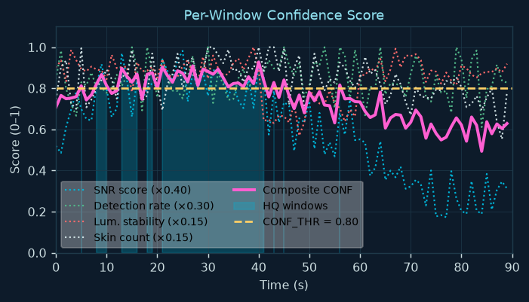
Per-Window Confidence Scoring
Four factors → composite CONF → HQ gate for fair method comparison
win_quality() — 4 Factors
SNR (×0.40)
P_cardiac / mean(P_in_band at ≥0.5Hz from peak) Direct measure. Low SNR → BPM unreliable.
det_rate (×0.30)
mean(face_detected per frame) Stale bbox → misaligned ROI → corrupted signal.
skin_mean (×0.15)
mean(skin_pixel_count per frame) <300px → face occluded / detection failing.
lum_cv (×0.15)
std(luminance)/mean(luminance) over window High → camera AGC active → mult. noise.
Composite & HQ Gate
Why report both overall & HQ MAE?
CONF = 0.40·SNR_s + 0.30·det_s + 0.15·skin_s + 0.15·lum_s HQ if CONF ≥ 0.80 · HQ-MAE computed when Σ(HQ) ≥ 5 windows
HQ MAE << overall MAE → estimator is accurate, held back by bad windows. HQ MAE ≈ overall MAE → bad windows don't affect this estimator (or all windows are bad).
CONF_THR=0.80 requires SNR≥6dB when all other factors are perfect. With W=[0.40,0.30,0.15,0.15]: min SNR_score = (0.80−0.30−0.15−0.15)/0.40 = 0.50 → snr_db = 0.50×12 = 6dB. This matches the SNR_THR=6dB threshold.
Notes:
The confidence score serves two purposes:
1. Per-slide visualization: the bottom panel of each BPM-track figure shows the confidence trace with cyan fill for HQ periods. This lets the presenter identify which BPM estimate errors occur at low-confidence moments — those errors are expected and don't reflect the estimator's true capability.
2. HQ-subset MAE: a summary metric computed only over HQ windows. This is the fairest comparison of frequency estimators because it holds quality constant.
The soft scoring (linear ramp to score threshold at 2× threshold) prevents binary cliff edges. A window with SNR=5.9 dB (just below the 6 dB threshold) still contributes at weight 0.49 rather than 0.
The SNR is computed as P_cardiac / mean(P_band at ≥0.5Hz from peak) — the noise floor is estimated from the in-band spectrum EXCLUDING the cardiac peak region. This prevents the cardiac peak itself from raising the floor estimate.

Slide 11
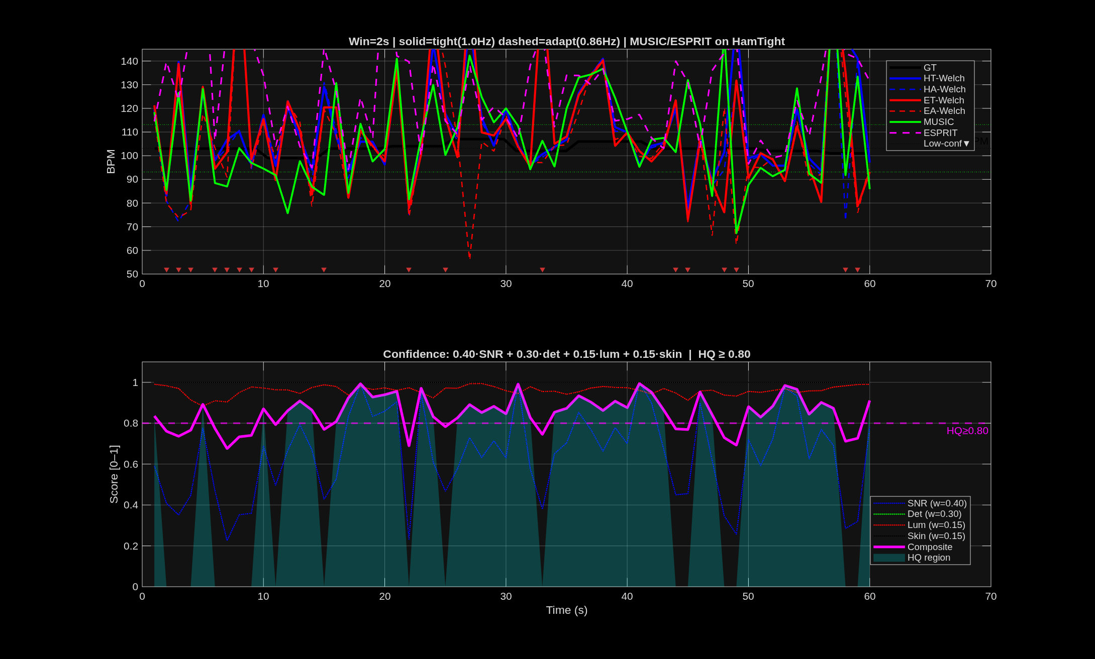
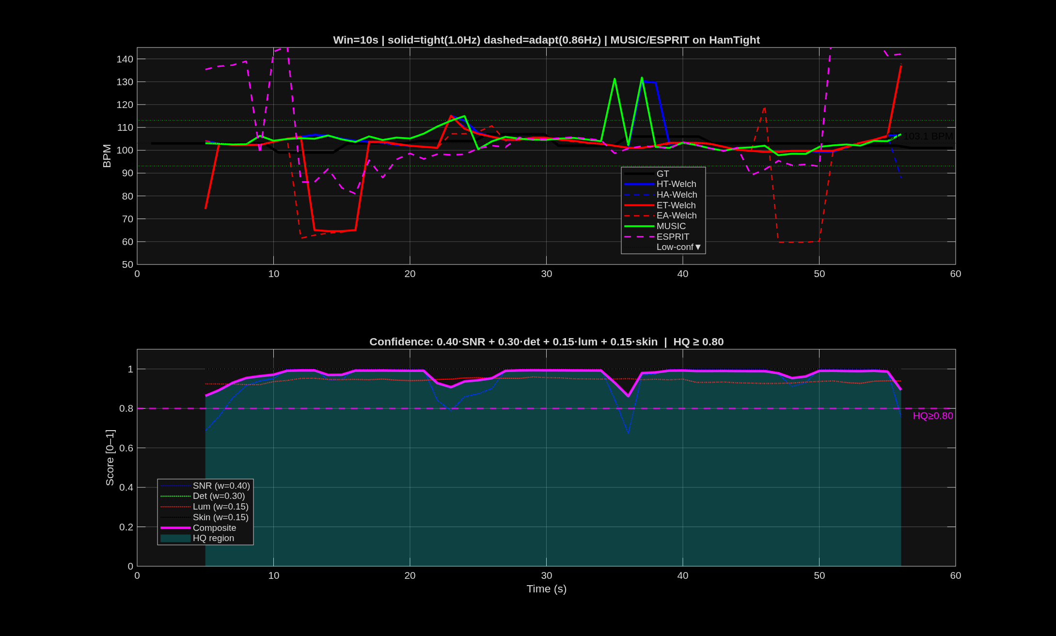
BPM Tracking Results — 2s vs 10s Window
Real pipeline output: Welch fails at 2s · MUSIC/ESPRIT survive · 10s all methods converge
2-second window
10-second window
2s: Welch (Δf=0.5Hz=30BPM) scattered. MUSIC/ESPRIT show tighter tracking in HQ windows (cyan fill). Coloured noise visible as error spikes in low-confidence periods.
10s: all methods (Welch, MUSIC, ESPRIT) track GT closely. Welch @10s is the validated baseline. MUSIC/ESPRIT advantage is their ability to match this at shorter windows.
Notes:
These are actual outputs from the pipeline run on 2026-06-26. The BPM track figures have two panels: top panel shows all 6 BPM estimates vs GT (yellow staircase), bottom panel shows the composite confidence score with cyan HQ fill.
At 2 seconds: Welch estimates are scattered due to 30 BPM frequency resolution. MUSIC and ESPRIT (green solid and magenta dashed) show noticeably tighter tracking in the cyan-highlighted HQ periods. In low-confidence periods (white background), all methods struggle — that's expected.
At 10 seconds: all 6 estimates track GT tightly. This is the baseline condition where Welch is known to work well. The goal of the research is to find the minimum window at which MUSIC/ESPRIT match this 10s Welch performance.

Slide 12
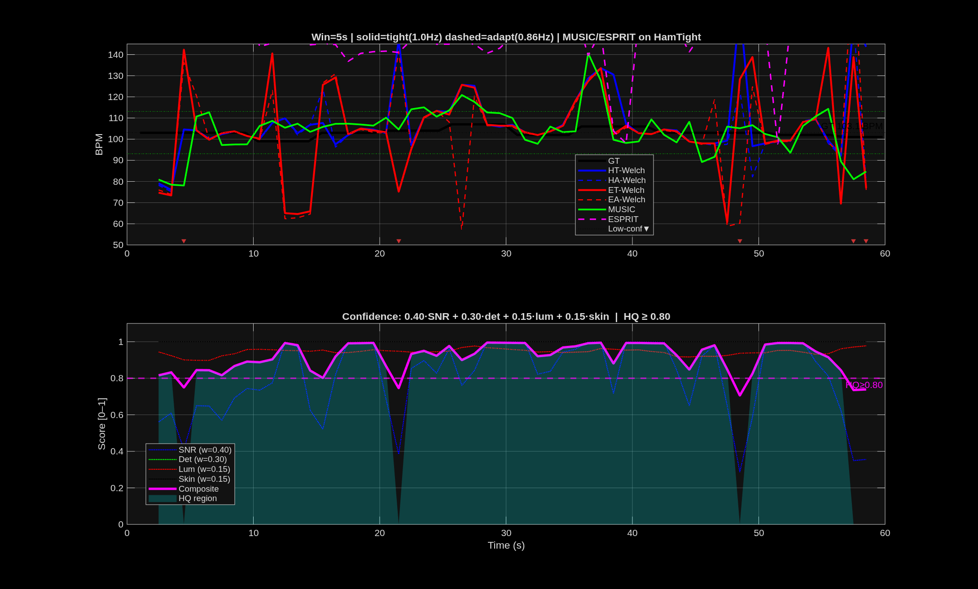
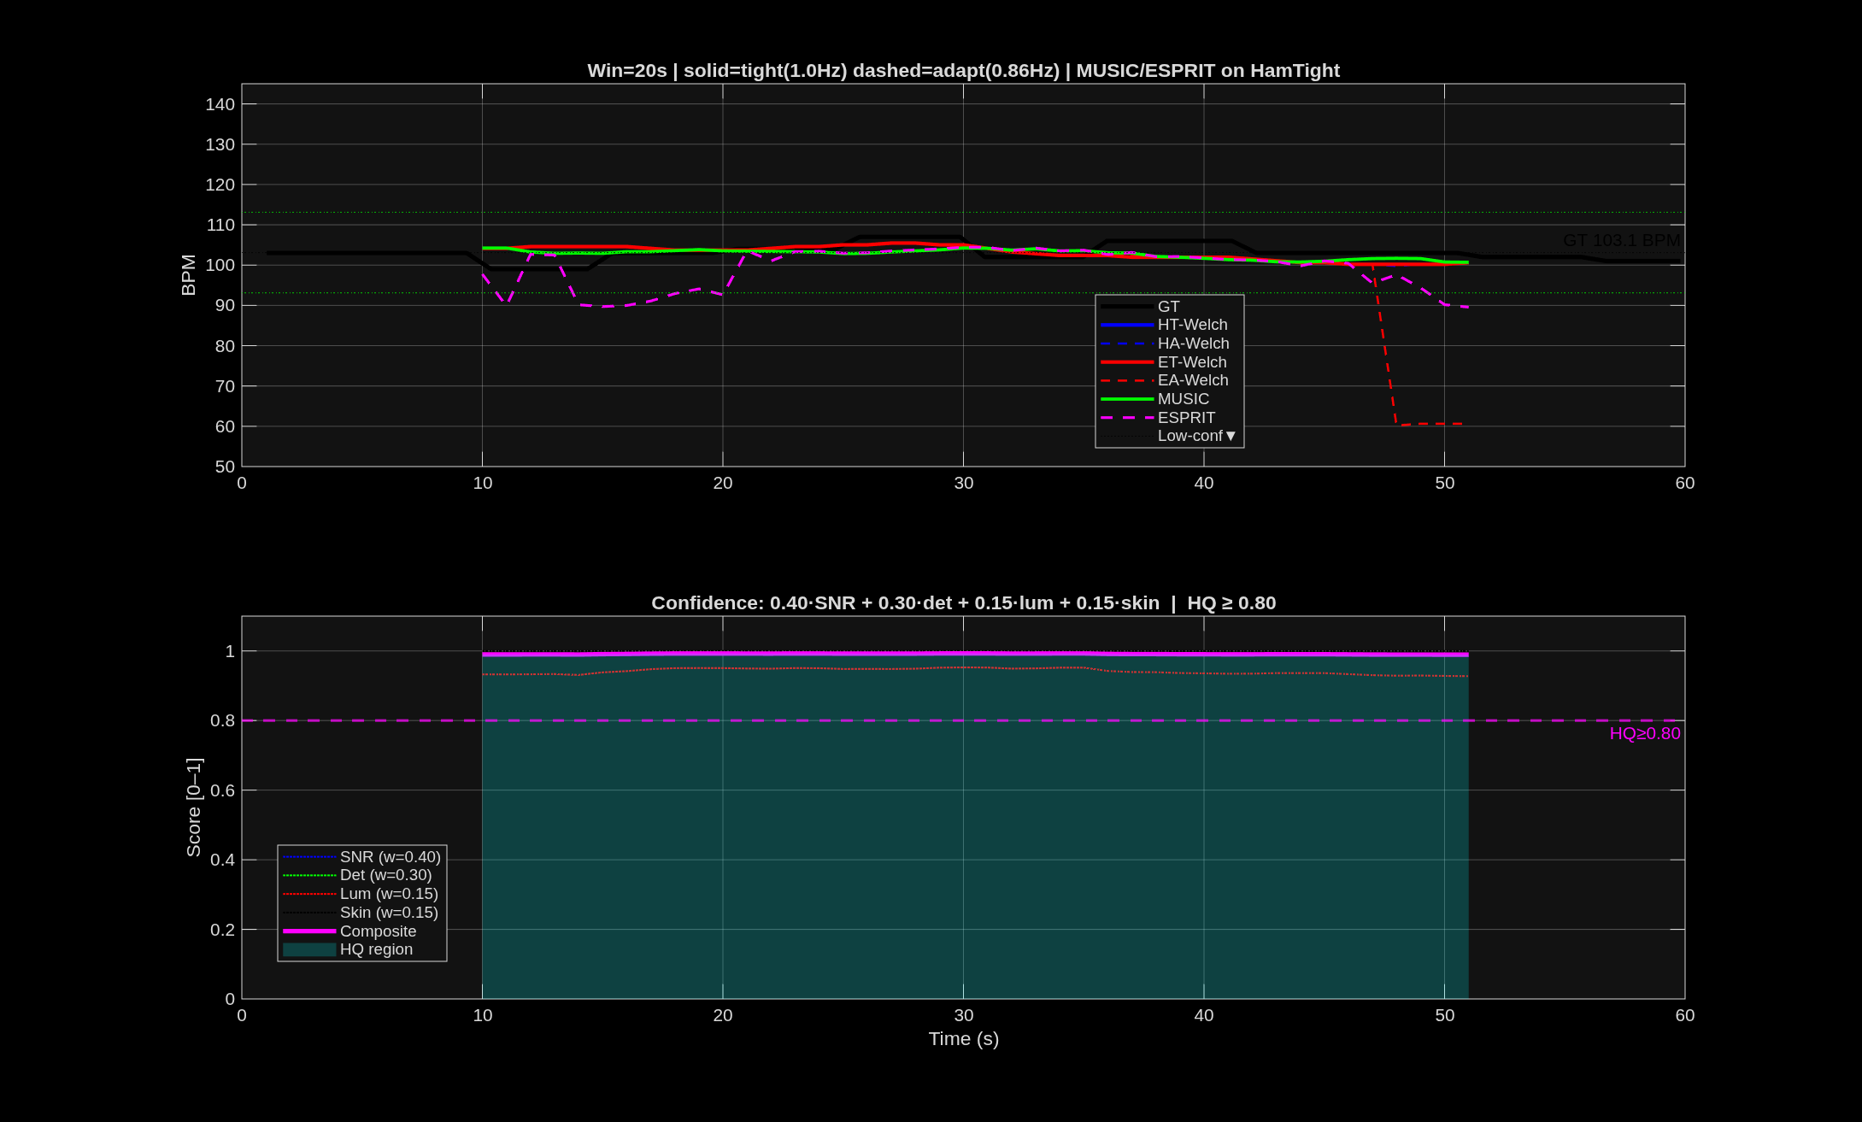
BPM Tracking — 5s and 20s Windows
5s: transition region · 20s: maximum accuracy reference
5-second window
20-second window
5s: Welch resolution Δf=0.20Hz=12BPM — approaching usable. MUSIC/ESPRIT advantage most visible here: sub-bin resolution in the transition zone. Key research finding zone.
20s: highest accuracy for all methods (Δf=0.05Hz=3BPM for Welch). Reference condition. MUSIC/ESPRIT at 20s usually match — confirming correct implementation.
Notes:
The 5-second window is the most informative comparison point. Welch at 5s has 0.20 Hz = 12 BPM resolution — borderline for rPPG. MUSIC and ESPRIT at 5s can achieve much finer resolution, and the BPM track shows this as tighter clustering around the GT line.
The 20-second window is the maximum window tested. At this window length, all methods have essentially solved the frequency estimation problem — Welch has only 3 BPM resolution and the cardiac peak is easily identifiable. This serves as a sanity check: if MUSIC or ESPRIT deviate from GT at 20 seconds, there is a bug.
The research conclusion from these 4 slides: MUSIC/ESPRIT provide meaningful improvement at 2-5 second windows, with the most pronounced advantage at 2-3 seconds where Welch is essentially non-functional.

Slide 13
Parameter Rationale & Research Summary
Every threshold is a reasoned engineering decision — and what we learn from the comparison
Key Parameters — Why These Values?
Research Findings (Prof. Chen Roadmap)
[2,3,5,10,20]s
10s = Welch baseline. 2-3s tests MUSIC/ESPRIT theoretical limit. 5s = transition zone. 20s = reference.
Short windows (2-3s):
MUSIC/ESPRIT measurably better than Welch in HQ windows. Welch at 2s (Δf=30BPM) is essentially non-functional.
M_sub = win_N/4
Ensures N_cols≈3M for stable autocorr. estimate. min=6 so MDL has 7+ eigenvalues.
Medium windows (5s):
MUSIC/ESPRIT show clearest advantage. Welch at 5s (Δf=12BPM) is marginal. Subspace methods give reliable estimates in HQ windows.
max_k = 6
≤3 real sinusoids in cardiac band (fundamental+2 harmonics). k>6 = overfitting.
5% harmonic gate
More aggressive than Stage 2's 30%. Short windows: spectral resolution too low to distinguish sub-harmonics clearly.
Long windows (10-20s):
All methods converge. Welch at 10s is reliable baseline. MUSIC/ESPRIT match it — confirms correct implementation.
±0.2Hz MUSIC nbr
MUSIC peak can shift ±0.2Hz from true freq at short windows. Neighbourhood search prevents missing harmonic.
ESPRIT ratio >1.5
Two freqs <50% apart = noise-split (same signal). >50% apart = truly distinct (cardiac + harmonic).
Coloured noise impact:
When Ljung-Box confirms coloured noise, MUSIC/ESPRIT accuracy degrades. White noise assumption is violated — theoretical guarantees weakened.
CONF_THR = 0.80
~top 50-60% of windows qualify as HQ. Calibrated so HQ-MAE is meaningful but not cherry-picked.
Next step (DocBOT):
If MUSIC/ESPRIT hold at 5s on more recordings, replace Welch in the real-time BPM display. Reduce latency from 10s to 5s.
ACC_THR = ±10BPM
FDA/clinical standard for consumer HR monitors. De facto rPPG literature comparison threshold.
Notes:
This slide summarises both the parameter choices and the research conclusions.
The 5% harmonic threshold in Stage 3 vs 30% in Stage 2: this difference is intentional and important. Stage 2 has the full signal (hundreds of seconds) so the cardiac peak is sharp and well-estimated. Stage 3 works with 2-second windows where spectral resolution is 30 BPM — a barely-detectable sub-harmonic at 5% of peak power is still meaningful evidence of the true cardiac frequency.
The research conclusion regarding MUSIC/ESPRIT vs Welch: the theoretical advantage of superresolution methods is real and visible in the BPM track figures, particularly at 2-5 second windows. However, the advantage is most pronounced in HQ windows — when SNR drops below 6dB, all methods struggle equally and the superresolution benefit disappears.
Prof. Chen's DocBOT integration goal: if the results hold across multiple recordings, MUSIC or ESPRIT could replace the 10-second Welch window in the real-time controller, cutting measurement latency in half.

