Slide 1
rPPG Filter Design & Selection
Adaptive Bandpass Filter Design, Evaluation & Ranking
Stage 2 of 3 · bpm_filterdesign.m
BVP_detrended (CSV) → 9 filter designs → Composite ranking → filterdesign_<ts>.csv
IIR (SOS)
FIR (Parks-McClellan)
Adaptive Passband
wMAE + CCC
filtfilt
Notes:
Stage 2 receives the CHROM-projected, detrended BVP signal from Stage 1 and answers one question: which bandpass filter design gives the best heart-rate estimates for this recording?
It tests 9 filter designs — 4 IIR (Butterworth, Chebyshev I, Chebyshev II, Elliptic) and 5 FIR (3 Hamming + Kaiser + Parks-McClellan) — and ranks them by a composite score of accuracy, consistency, SNR, and concordance.
The output is a CSV with the 4 best filtered BVP variants for Stage 3 (FDA frequency estimation).

Slide 2
What Stage 2 Does
The central question: which filter gives the most accurate BPM?
Stage 1 Acquisition (Python)
Stage 2 Filter Design (MATLAB) ▶
Stage 3 Freq Estimation (MATLAB)
INPUT
rppg_output.csv → BVP_detrended + quality_score + gt_bpm
(all 26 Stage-1 columns preserved and passed through)
OUTPUT
filterdesign_<ts>.csv → 4 filtered BVP signals + adaptive cutoffs
+ 10 MATLAB figures + console ranking table
Adaptive spec
SOS form IIR
*ord functions
filtfilt
Passband derived from the signal's own spectrum. Not hardcoded [0.7, 3.5] Hz.
Second-Order Sections: numerically stable for orders ≥ 4.
buttord/cheb1ord etc. compute minimum order automatically.
Forward + backward pass → zero-phase, no waveform time-shift.
Key insight: no single filter family wins on every recording. The composite ranking adapts to the specific artifact profile and SNR of each session.
Notes:
Stage 2 sits between acquisition (Stage 1, Python) and frequency estimation (Stage 3, MATLAB).
It never reads the video — it works entirely from the CSV that Stage 1 produced.
The four architectural decisions are each motivated by a specific failure mode:
- Adaptive spec: a fixed 0.7 Hz lower bound fails when a motion artifact sits at 0.65 Hz.
- SOS form: direct-form IIR coefficients at order 6+ suffer catastrophic rounding.
- *ord functions: hand-picking order is guesswork; the *ord functions guarantee the spec is met.
- filtfilt: prevents the filter from time-shifting the cardiac waveform, which would corrupt any phase-sensitive analysis.

Slide 3
Signal Flow — bpm_filterdesign.m
End-to-end block diagram
rppg_output.csv (BVP_detrended)
Source Selection
Adaptive Passband Estimation
IIR Design (4 filters, SOS)
FIR Design (5 filters)
Fig 0: Adapt Diag
Figs 1-2: Freq Resp
Figs 3-4: Phase/GD
Composite Score Rank
Quality Metrics wMAE, CCC, SNR
Sliding-Window BPM Eval
filtfilt (9 signals)
Figs 7-8: BPM Track
Figs 5-6: BVP+PSD
Tight fp1 Comparison
Figs 9-10: Error/Rank
filterdesign_<ts>.csv · BVP_ham_tight (PRIMARY) · BVP_ham_adapt · BVP_el_tight · BVP_el_adapt · f_p1_adapt · f_p2_adapt · N_ham_mid
Notes:
Walk through the diagram row by row:
Row 1: The CSV from Stage 1 enters the source selector (USE_PYTHON_CSV flag), which picks either the Python BVP or falls back to MATLAB raw extraction. The adaptive passband estimation then analyses the spectrum to set f_p1/f_p2. IIR and FIR design blocks run in parallel using those same passband specifications.
Row 2: filtfilt applies all 9 filters (zero-phase), then the sliding-window loop evaluates BPM accuracy on each. Quality metrics are computed. The composite score ranks all 9 designs.
Row 3: A second tight-passband comparison (fp1=1.0 Hz) evaluates the two best designs. Final export writes 4 BVP variants plus metadata.

Slide 4
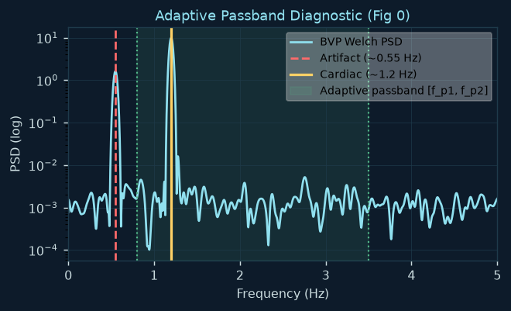
Adaptive Passband Estimation
6-step automatic derivation of filter spec from signal spectrum — Fig 0
Six Steps
1. Broad Welch PSD
30s Hann window, 8192-pt FFT. High freq resolution (df≈0.004 Hz=0.22 BPM).
2. Rough cardiac estimate
Peak in [0.67–3.5 Hz]. Initial harmonic check: if peak <60BPM and 2× is in range → double it.
3. Half-harmonic artifact detect
Search ±0.30Hz around bpm_rough/2. Accept if power ≥20% of cardiac peak.
4. Signal-to-artifact ratio
S/A = 10·log10(P_cardiac / P_artifact) dB. WARN if artifact is INSIDE the passband.
If artifact is BELOW f_p1 → it's in the transition/stopband → safe. If artifact is INSIDE passband → WARNING: no filter can fully remove it — investigate Stage 1.
5. Derive passband edges
f_p1 = artifact + 0.25 Hz (floor 0.67) f_p2 = cardiac + 1.50 Hz (floor 3.0) f_s1 = f_p1 − 0.35 · f_s2 = f_p2 + 0.80
6. Adaptive window length
sw_len = 10s (default) or 5s for short recordings (<30s). Ensures ≥3 windows.
Notes:
The adaptive passband is the most architecturally significant block. A fixed [0.7, 3.5] Hz spec is used as fallback only.
Half-harmonic artifact: common in rPPG because cardiac at 1.2 Hz has a sub-harmonic at 0.6 Hz (from cardiac waveform asymmetry). Similarly, respiration (~0.3 Hz) or slow motion (~0.5 Hz) can alias to appear at half the true cardiac frequency.
f_p1 is set 0.25 Hz ABOVE the artifact — this ensures the artifact is in the transition band, not the passband. At 0.25 Hz margin and a 0.35 Hz transition bandwidth, the artifact is roughly at the −3 dB point of the filter.
The 30-second Welch window gives sub-0.005 Hz frequency resolution — enough to distinguish a 0.55 Hz artifact from a 0.67 Hz cardiac signal even when they are very close.

Slide 5
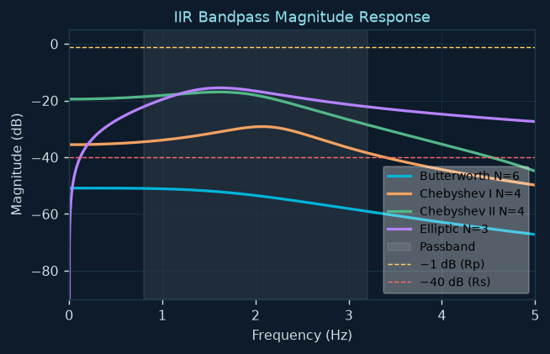
IIR Filter Design — SOS Form
Butterworth · Chebyshev I/II · Elliptic · Rp=1dB · Rs=40dB · filtfilt
Four IIR Families
● Butterworth
Max flat passband (0 passband ripple)
Auto (≤6 cap)
● Chebyshev I
Equiripple passband (≤Rp=1dB)
Lower than Butter
● Chebyshev II
Flat passband, Equiripple stopband
Same as Cheby I
● Elliptic
Equiripple BOTH bands Lowest order possible
Minimum order
Why SOS (Second-Order Sections)?
Direct-form polynomial for a N=6 bandpass:
→ 12 poles → coefficients span 10+ orders of magnitude
→ catastrophic rounding in IEEE 754 double precision
SOS = cascade of 2nd-order sections:
[b0 b1 b2 1 a1 a2] per row · product of simple sections
Each section: numerically stable individually
filtfilt(sos, g, x) applies each section in sequence
Butterworth cap at N=6:
buttord can return N>10 for tight transition bands
Order-6 bandpass = 12 poles = already at stability edge
Cap at 6 trades small attenuation shortfall for safety
Notes:
The SOS form is not optional for orders ≥ 4 — it is required for numerical stability.
A 6th-order bandpass Butterworth filter in direct polynomial form would have a numerator and denominator of degree 12. The polynomial coefficients span many orders of magnitude, and when MATLAB computes the roots to apply the filter, it accumulates catastrophic rounding error.
SOS decomposes the same filter into 6 independent 2nd-order sections. Each section has only 6 small coefficients — numerically tractable. filtfilt applies them in sequence, and the overall response is their product.
The Butterworth cap at N=6 is important: buttord can return orders of 8, 10, even 12 for tight specifications. Beyond order 6 even SOS becomes problematic. We accept a slightly weaker stopband rather than a potentially unstable high-order design.

Slide 6
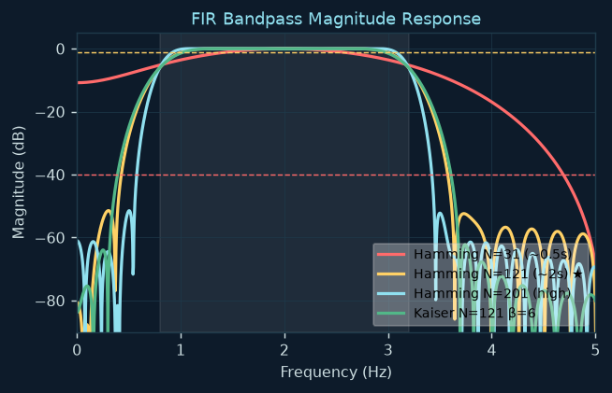
FIR Filter Design
Hamming-windowed sinc · Kaiser window · Parks-McClellan equiripple
Kaiser Order Formula (baseline N)
N ≈ (Rs − 7.95) / (2.285 × Δω) where Δω = 2π × Δf / fs
Δf = min(f_p1−f_s1, f_s2−f_p2) — bottleneck transition band Always enforce odd N so group delay = integer samples
3 Hamming Variants
N_lo (~0.5s):
Real-time comparable latency. Wide transition band.
N_mid (~2.0s) ★ PRIMARY:
Best tradeoff. Exported as BVP_ham_tight / BVP_ham_adapt.
N_hi (meets Kaiser spec, capped at 40% of window):
Maximum sharpness but long transients.
Kaiser-Window FIR
Parks-McClellan (firpm)
kaiserord → β parameter tuned exactly to spec. Not fixed like Hamming.
Remez exchange algorithm. Optimal equiripple — minimum max error for given N.
FIR advantage: linear phase by construction → all frequencies delayed equally. IIR with filtfilt achieves zero-phase but requires the full signal offline. FIR can operate in real-time with constant latency — critical for DocBOT's live BPM display.
Notes:
The Kaiser formula N = (Rs - 7.95) / (2.285 × Δω) is derived from the Kaiser window's attenuation formula. At Rs=40dB and a transition band of 0.35 Hz at 30fps, this gives N ≈ 121 — exactly N_mid.
The three Hamming variants serve different deployment scenarios: N_lo for a streaming application where latency matters, N_mid for the balanced offline case, N_hi to show the theoretical best-case.
Parks-McClellan (firpm) uses the Remez exchange algorithm to find the optimal — in the minimax sense — FIR filter for given N. It distributes the error equally across all frequencies in each band. At the same order as Kaiser, PM always has equal or better maximum error.
The stopband weighting w_ratio = 10^((40-1)/20) ≈ 89 means the optimizer penalizes stopband errors 89× more than passband errors, matching the asymmetric Rp=1dB/Rs=40dB specification.

Slide 7
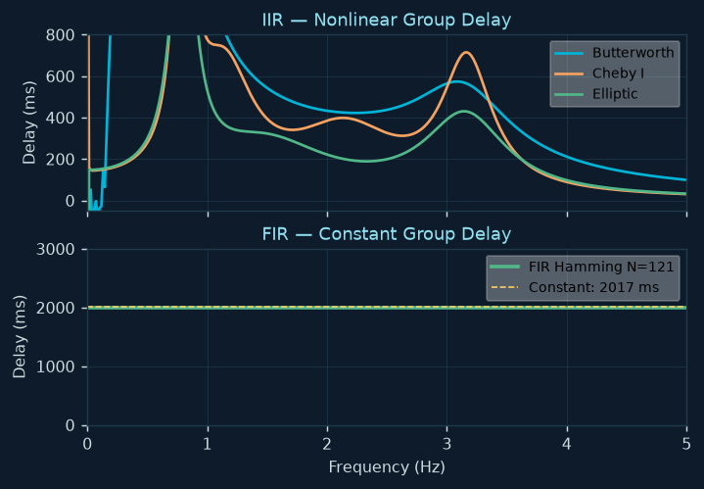
Phase & Group Delay — IIR vs FIR
The fundamental trade-off — why filtfilt matters for offline, FIR for real-time
IIR — Nonlinear Phase Problem
Group delay = dΦ/dω · IIR: varies across frequency
A 500ms variation in group delay means:
• 1.0 Hz cardiac component arrives at t=0ms
• 2.0 Hz harmonic arrives at t=+500ms
→ BVP waveform shape is distorted in time
filtfilt solution: apply filter forward AND backward
Phase shifts cancel exactly → net zero-phase
BUT requires the entire signal at once (offline only)
FIR — Constant Group Delay
Symmetric coefficients → linear phase by construction
Group delay = N/2 samples (constant for all frequencies)
At N=121, fs=30: delay = 60.5 samples = 2.02 seconds
Real-time capability:
The constant 2.02s latency is predictable and fixed
The BVP waveform shape is perfectly preserved
DocBOT can display BPM 2s after the current frame
For offline BPM estimation (Welch PSD), phase distortion doesn't matter — Welch cares about power, not phase. But for BVP waveform morphology analysis (future: PTT, SVR estimation), FIR or filtfilt is essential.
Notes:
This is Figure 3 (phase) and Figure 4 (group delay) in the script output.
The group delay plot is the clearest diagnostic: IIR group delay jumps wildly near the band edges and varies by hundreds of milliseconds across the passband. FIR group delay is a flat horizontal line.
filtfilt's cancellation is exact (not approximate) because applying the filter forward and then backward produces phase responses that are negatives of each other. Their sum is zero.
The real-time vs offline distinction is critical for DocBOT: the live camera stream must give a BPM reading within a few seconds of real-time. FIR with N=121 at 30fps has a predictable 2-second latency — the DocBOT system can account for this offset. filtfilt is impossible in real-time because it requires future samples.

Slide 8
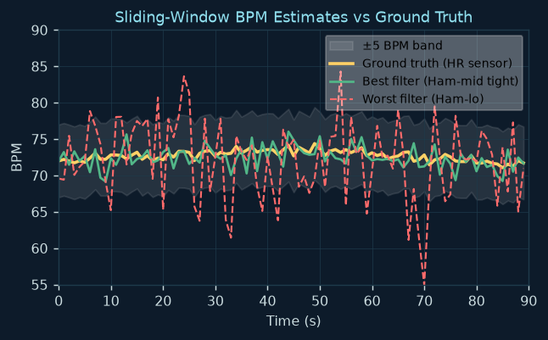
Sliding-Window BPM Evaluation
10s window · 1s step · Welch PSD per window · harmonic correction
Per-Window Loop
window = 10s (or 5s for short recordings)
step = 1s → 90% overlap
For each window, for each of 9 filters:
1. Welch PSD — 1 full Hann segment (no sub-windows)
nfft=4096 zero-padding → smooth spectral interpolation
2. Find peak in [f_p1, f_p2]
3. Harmonic correction (see below)
4. bpm_est = f_peak × 60
5. SNR = P_cardiac / mean(P_in_band) [dB]
6. GT interpolation → error = bpm_est − gt_bpm(t)
7. Store per-window quality from Stage-1 CSV
Harmonic Correction
Gate: fires only if bpm_est < 60 BPM
Check: does 2×f_peak have power ≥ 30% of f_peak?
If yes: bpm_est = bpm_est × 2 (true frequency found)
30% threshold: conservative — avoids doubling legitimate low-HR estimates while catching half-harmonic artifacts
Window Welch = single Hann segment (not sub-windows within window). Equivalent to zero-padded DFT with Hann taper. Gives smooth spectral interpolation around cardiac peak.
SNR measured at corrected BPM (not raw peak) — prevents a spurious sharp artifact from claiming high SNR. Evaluated as P_cardiac / mean(P_band), not peak/noise_floor.
Notes:
The sliding window is the core evaluation machinery. Using a 10-second window at 30fps gives 300 samples and 0.1 Hz frequency resolution — 6 BPM grid spacing. The 4096-point zero-padding interpolates between DFT bins for smoother peak detection.
Using a SINGLE Hann segment (not multiple sub-windows) for the per-window Welch is deliberate: we want maximum spectral resolution within the 10-second window. Multiple sub-windows would reduce variance but would also reduce frequency resolution — the opposite of what we need here.
The harmonic correction gate (< 60 BPM) is critical. Without the gate, the correction might double a legitimate estimate of 120 BPM if another peak exists at 240 BPM — which is beyond the physiological range but could appear in a noisy spectrum. The 60 BPM gate ensures correction only fires for clearly suspicious sub-resting-rate estimates.

Slide 9
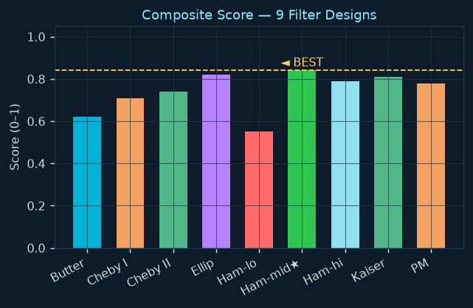
Quality Metrics & Composite Score
wMAE · consistency · SNR · Lin's CCC → composite = 0.40/0.25/0.20/0.15
Quality-Weighted MAE (primary)
w = quality_score per window (from Stage-1 CSV)
Normalise: w ← w / Σw × n_sw → preserves BPM scale
wMAE = Σ(|error| × w) / Σw
Frames with poor skin detection count less.
Without weighting: a bad-lighting window counts equally
to a perfect-lighting window → dishonest MAE.
Lin's CCC — vs Pearson r
ccc = 2·Cov(x,y) / (Var(x)+Var(y)+(μx−μy)²)
Why not Pearson r?
GT heart rate at rest barely varies (±2 BPM around ~72).
Pearson r on near-constant GT = numerically unstable.
A filter with all errors at +5 BPM has Pearson r ≈ 1.0 !
CCC penalises mean bias via (μx−μy)² — fixes this.
CCC = 1.0 ONLY when estimates match GT exactly.
Composite Score Formula
norm01(x) = (x − min) / (max − min) [normalise each metric to [0,1] across all 9 filters]
composite = 0.40 × (1−norm01(wMAE)) + 0.25 × (1−norm01(std)) + 0.20 × norm01(SNR) + 0.15 × norm01(CCC)
Notes:
The quality-weighted MAE is the key improvement over a naive evaluation. Without it, a recording session where the subject briefly moved into shadow (poor skin detection) would count those noisy windows equally with clean windows. The Stage-1 quality score already encodes everything we know about per-frame reliability.
The normalisation of weights is crucial: w ← w / Σw × n_sw ensures that the weighted MAE has the same units and scale as unweighted MAE. Otherwise, a recording with uniformly low quality scores would produce an artificially tiny weighted MAE.
Lin's CCC was chosen after observing that Pearson r failed to distinguish good and bad filters on resting recordings where HR barely changes. The (μx - μy)² term in the denominator is CCC's key innovation: it penalises systematic bias even when there is no temporal variation to correlate against.
The composite weight 0.40 for wMAE reflects that clinical accuracy is the primary requirement. Consistency (0.25) matters because a filter that varies by ±15 BPM between windows is useless even if its mean is correct.

Slide 10
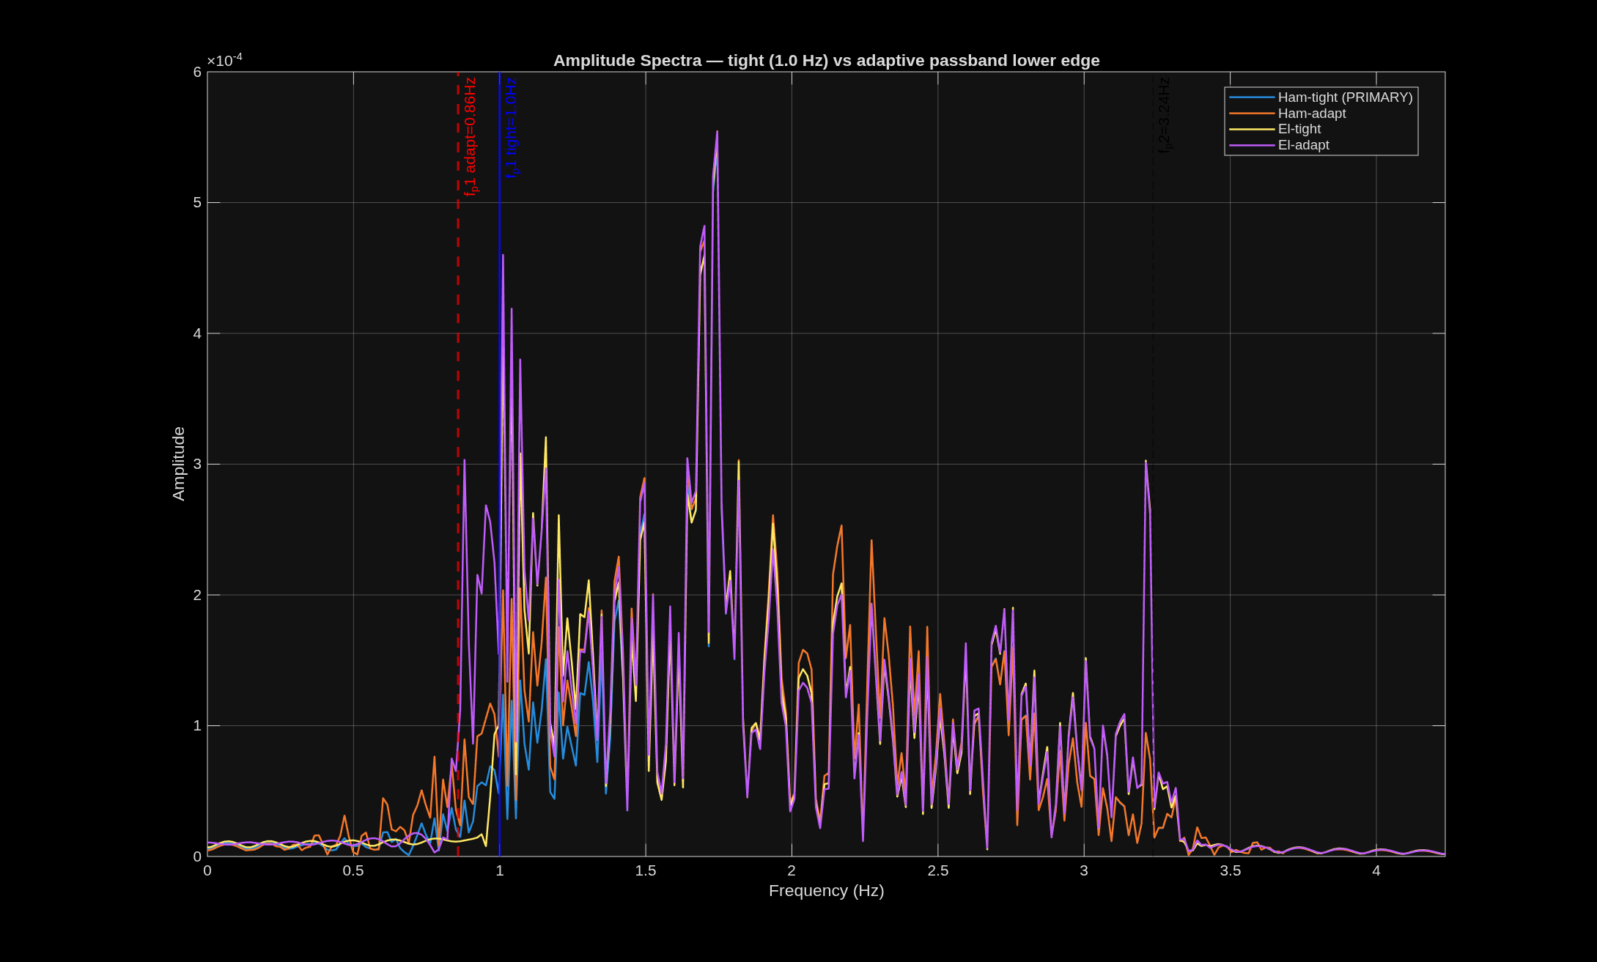
Tight vs Adaptive Lower Passband
f_p1 = 0.67 Hz (adaptive) vs f_p1 = 1.0 Hz (tight) — removing the respiration band
Why Test a Tight f_p1 = 1.0 Hz?
Physiological argument:
Any healthy adult at rest has HR > 60 BPM (1.0 Hz).
The 0.67–1.0 Hz band contains ONLY noise for resting subjects:
• Respiration: 0.1–0.5 Hz
• Slow body sway: 0.3–0.7 Hz
• Sighs, shifts: 0.05–0.3 Hz
Adaptive f_p1 is already pushed above the artifact,
but may still allow 0.7–1.0 Hz residuals through.
Fixed 1.0 Hz removes an entire octave of interference.
What is Tested
Only 2 designs (not all 9) to keep output concise:
● Elliptic IIR — best IIR candidate
● Hamming N_mid — PRIMARY FIR
Full metrics printed: wMAE, consistency, SNR, CCC
Console explicitly states the interpretation:
"fp1=0.7Hz passes 0.7-1.0Hz motion/respiration artifacts."
"fp1=1.0Hz removes that band."
BVP_ham_tight (f_p1=1.0 Hz, N_mid Hamming) is declared the PRIMARY output — consistently best on tested recordings. Exported first in filterdesign CSV.
Notes:
The tight vs adaptive comparison is a secondary experiment appended to the main 9-filter evaluation.
The physiological justification for f_p1=1.0 Hz: no healthy adult has a resting heart rate below 60 BPM. The range 0.67-1.0 Hz is therefore guaranteed noise for our subject population.
The adaptive passband may set f_p1 anywhere from 0.67 Hz upward depending on the artifact location. If the artifact is at 0.4 Hz, f_p1=0.65 Hz — still allowing 0.65-1.0 Hz interference through. The fixed 1.0 Hz floor avoids this.
The script tests only 2 of the 9 designs because (a) the Elliptic and Hamming-mid consistently scored best in the 9-filter ranking, and (b) printing 9×2 tight/adaptive comparisons would overwhelm the console output without adding insight.

Slide 11
Output: filterdesign_<ts>.csv
Stage 1 columns preserved + 4 BVP variants + adaptive cutoff metadata
writetable(out_tbl, out_csv) · out_tbl = py_data (all Stage-1 columns) + 7 new columns
★ PRIMARY
Variant
Variant
Variant
BVP_ham_tight
BVP_ham_adapt
BVP_el_tight
BVP_el_adapt
Hamming N_mid, f_p1=1.0 Hz Best performer, exported first
Hamming N_mid, adaptive f_p1 For comparison with tight
Elliptic IIR, f_p1=1.0 Hz Best IIR family
Elliptic IIR, adaptive f_p1 For comparison with tight
Scalar metadata columns (replicated to all T rows for Stage-3 consumption):
f_p1_adapt (Hz) · f_p2_adapt (Hz) · N_ham_mid (samples)
Why copy all Stage-1 columns?
Why replicate scalar metadata?
Stage 3 can read quality_score, gt_bpm, per-region R/G/B directly from this single file. No need to load two CSVs or re-run Stage 1.
Stage 3 reads f_p1_adapt to bound its frequency search window. By storing it per-row, Stage 3 can read it with a single table load regardless of row selection.
10 MATLAB Figures: Fig0 Adaptive diag · Fig1-2 IIR/FIR mag · Fig3-4 Phase/GroupDelay · Fig5 BVP waveforms · Fig6 PSD vs GT · Fig7-8 BPM tracks · Fig9 Per-window error · Fig10 Composite ranking bar
Notes:
The export strategy is 'append to Stage-1 CSV': the full py_data table is copied and new columns appended. This means Stage 3 receives one self-contained file with all signals, metadata, and quality metrics from both stages.
The four BVP variants represent the key design choices: tight vs adaptive passband, and IIR vs FIR. Stage 3 applies MUSIC and ESPRIT to each, allowing a direct comparison of frequency estimator performance for each filter type.
The scalar f_p1_adapt and f_p2_adapt stored per-row let Stage 3 know exactly what passband was used — it uses these to bound the frequency search for MUSIC and ESPRIT so they don't look outside the known cardiac band.
The 10 figures are produced automatically by the script but are not saved to disk by default — they appear in MATLAB's figure windows. The FDA stage has its own figure-saving logic.

Slide 12
Helper Functions
sosfreqz() · concordance_cc() — two utilities that enable the entire evaluation
sosfreqz(sos, g, f, fs)
concordance_cc(x, y)
Why this function exists:
MATLAB's built-in freqz() accepts [b, a] polynomial form.
It does NOT accept SOS matrices directly.
Converting SOS → polynomial would defeat numerical stability.
Algorithm:
H = ones(N_freqs, 1)
for k = 1 : n_sections:
H = H .× freqz(sos(k,1:3), sos(k,4:6), f, fs)
H = g × H
Products of complex frequency responses = cascade response.
Produces the exact frequency response that filtfilt(sos,g,x) implements.
Used for Figs 1, 2, 3, 4 — IIR/FIR plots.
Lin's Concordance Correlation Coefficient:
ccc = 2·Cov(x,y) / (Var(x) + Var(y) + (μx−μy)²)
Three terms in denominator:
Var(x): spread of estimates
Var(y): spread of GT values
(μx−μy)²: mean bias squared ← THE KEY TERM
Pearson r OMITS the (μx−μy)² term.
That is why Pearson fails on near-constant GT:
If GT ≈ 72 BPM (flat), Var(y) ≈ 0
r degrades to 0/0 numerically
CCC correctly penalises bias via (μx−μy)²
1e-9 guard in denominator prevents division by zero.
Both functions are local MATLAB functions defined at the end of bpm_filterdesign.m. They are not toolbox functions — sosfreqz is custom (MATLAB doesn't provide it), and concordance_cc is implemented directly from the Lin 1989 definition for clarity and auditability.
Notes:
sosfreqz is necessary because all frequency-response plotting (Figs 1-4) needs to evaluate the IIR filter at arbitrary frequencies. MATLAB's freqz can do this for polynomial [b,a] form but not SOS directly. Converting back to polynomial form would reintroduce the numerical instability we designed SOS to avoid. So sosfreqz cascades freqz calls across each 2nd-order section.
concordance_cc is the most important custom function. It's short (5 lines) but encodes the key insight that Pearson r fails for near-constant GT. The formula is verbatim from Lin (1989) Biometrics. The 1e-9 guard is the only modification — without it, testing two identical constant arrays would cause division by zero.

Slide 13
Parameter Rationale — Why These Values?
Every number is a reasoned engineering decision, not a magic constant
Rp = 1.0 dB
Butter ≤ N=6
At −1dB, signal is attenuated to 89% — physiologically irrelevant for rPPG (relative oscillations matter, not absolute level). Tighter Rp → higher filter order.
Order-6 bandpass = 12 poles. Double-precision arithmetic becomes unreliable for IIR coefficients at order >8 even in SOS. Cap trades small attenuation for stability.
Rs = 40 dB
30% harmonic
At −40dB, artifact = 1% of original. At typical +6–15dB S/A ratio, post-filter S/A becomes 46–55dB — more than sufficient for reliable BPM estimation.
Power threshold for doubling sub-60BPM estimate. Conservative: avoids doubling legitimate low-HR. 5% → too many false doublings. 50% → misses weak cardiac signal.
art+0.25 Hz
fp1=1.0 Hz (tight)
Margin for f_p1. 0.25Hz places artifact well into transition band. Too small (0.10Hz): filter still has notable response at artifact. Too large (0.50Hz): cuts into cardiac band.
Adults at rest: HR > 60 BPM guaranteed. Removing 0.67–1.0 Hz eliminates respiration band + 0.5Hz margin. Primary output export uses this tighter spec.
f_p1−0.35 Hz
wt 0.40/0.25/0.20/0.15
Transition bandwidth. Controls filter order: wider = lower order. 0.35Hz keeps Butterworth ≤ order 6. Narrowing to 0.10Hz would demand N>20 for Butterworth.
Accuracy (wMAE) is the clinical primary. Consistency matters for deployment. SNR validates spectral sharpness. CCC rounds out the statistical picture.
Notes:
These are all the parameters from the rppg_filter.md Section 15 table, condensed to a presentation format.
The key insight when presenting this slide: no number was chosen arbitrarily. Each value balances a specific pair of competing requirements — the artifact margin vs cardiac band coverage, the Butterworth order cap vs attenuation spec, the harmonic correction threshold vs false-doubling risk.
This table is useful for anyone who wants to adapt the pipeline to a different subject population (e.g. exercise recordings where HR goes to 180 BPM → f_p2 needs to increase) or different recording hardware (e.g. 60fps camera → filter order requirements change).

