Slide 1
Pizza Runner SQL Commands
Data Analyst
Devansh Beri

Slide 2
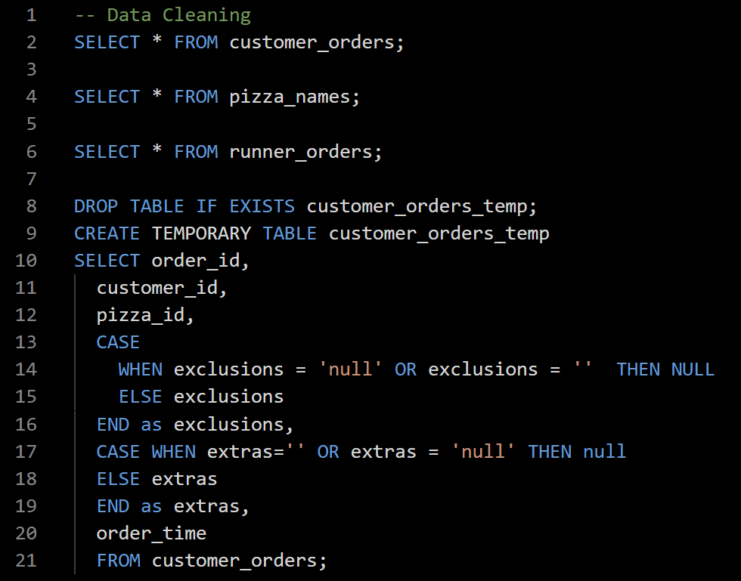
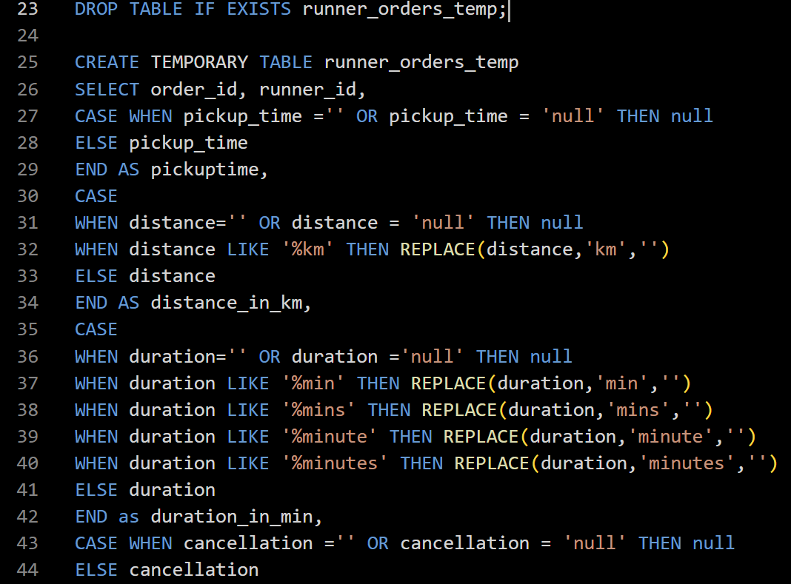
Data Cleaning

Slide 3
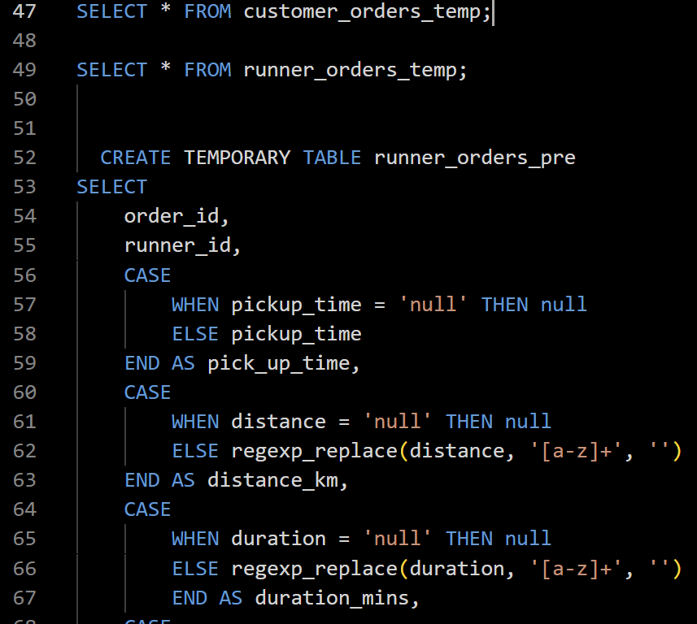
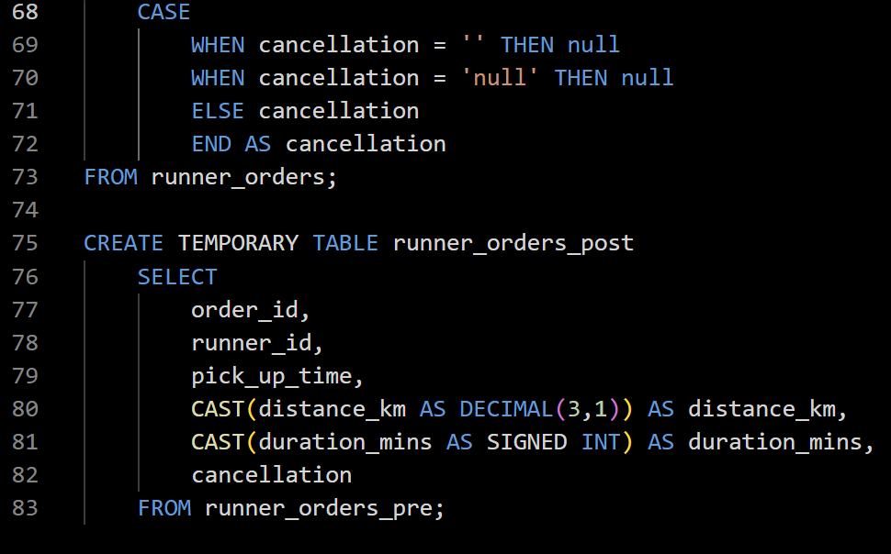
Data Cleaning

Slide 4
CASE STUDY QUESTIONS
A. Pizza Metrics
B. Runner and Customer Experience
C. Ingredient Optimisation

Slide 5

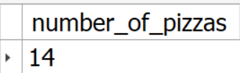
A. Pizza Metrics
1. How many pizzas were ordered?

Slide 6
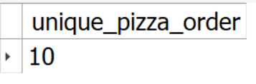
2.How many unique customer orders were made?

Slide 7
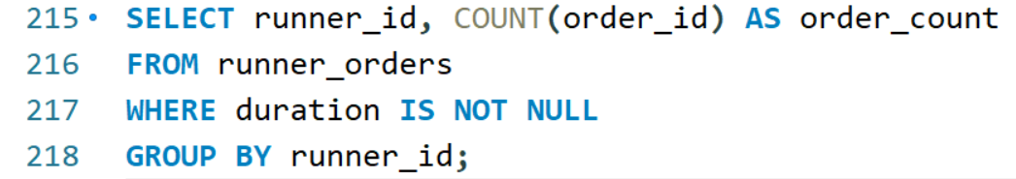
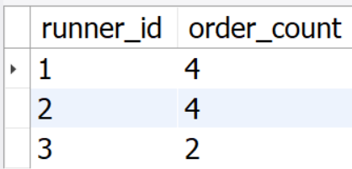
3. How many successful orders were delivered by each runner?

Slide 8
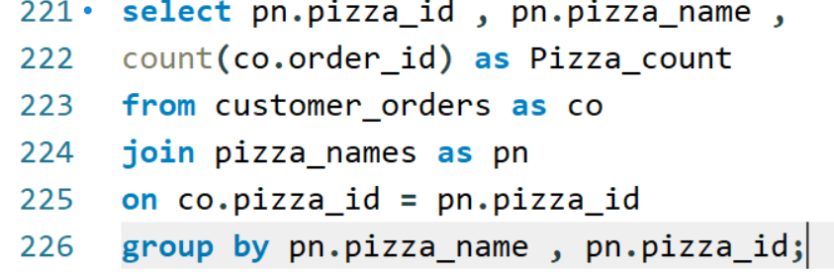
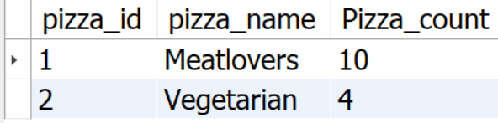
4.How many of each type of pizza was delivered?

Slide 9
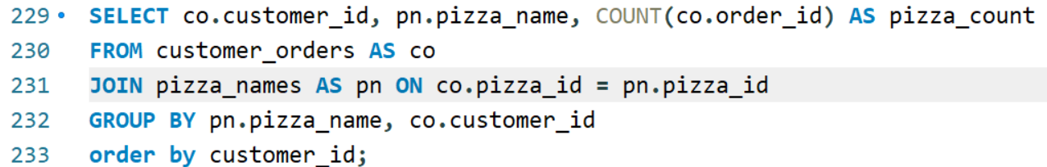
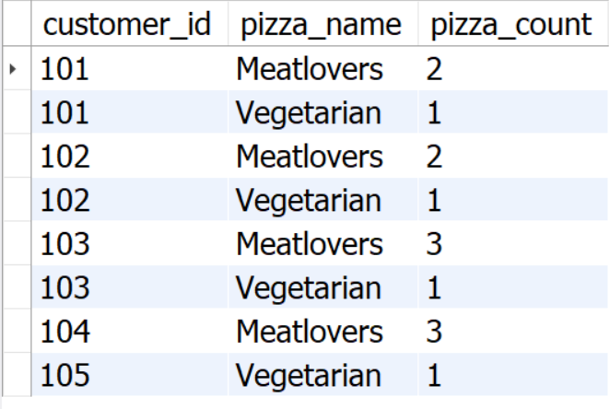
5.How many Vegetarian and Meat Lovers were ordered by each customer?

Slide 10
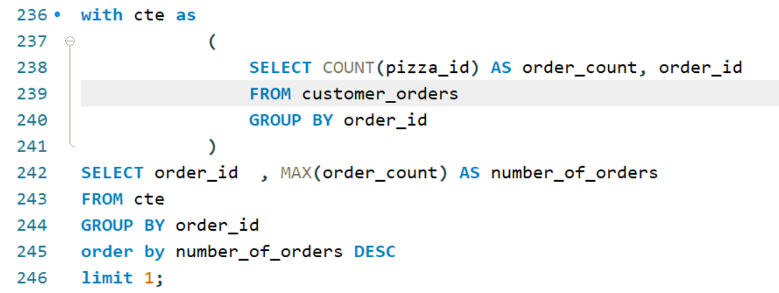
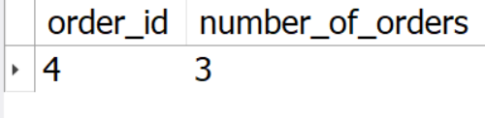
6.What was the maximum number of pizzas delivered in a single order?

Slide 11
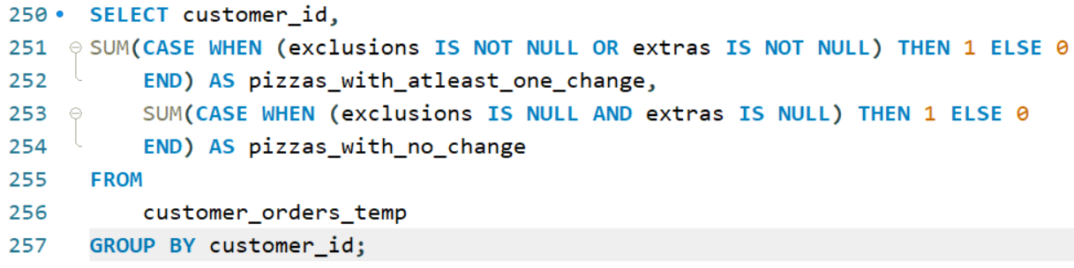
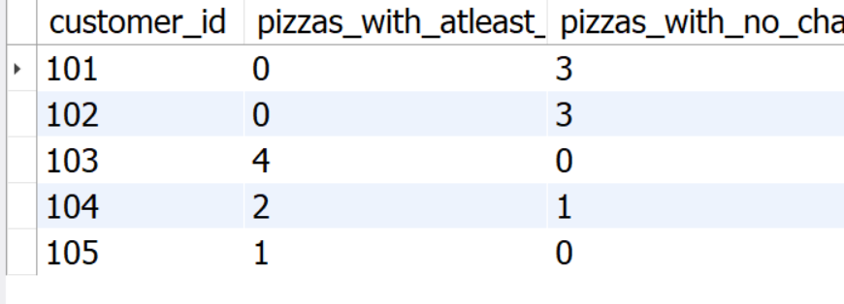
7.For each customer, how many delivered pizzas had at least 1 change and how many had no changes?

Slide 12
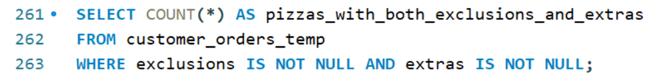
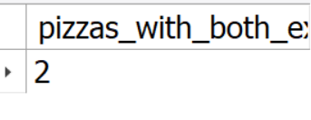
8.How many pizzas were delivered that had both exclusions and extras?

Slide 13
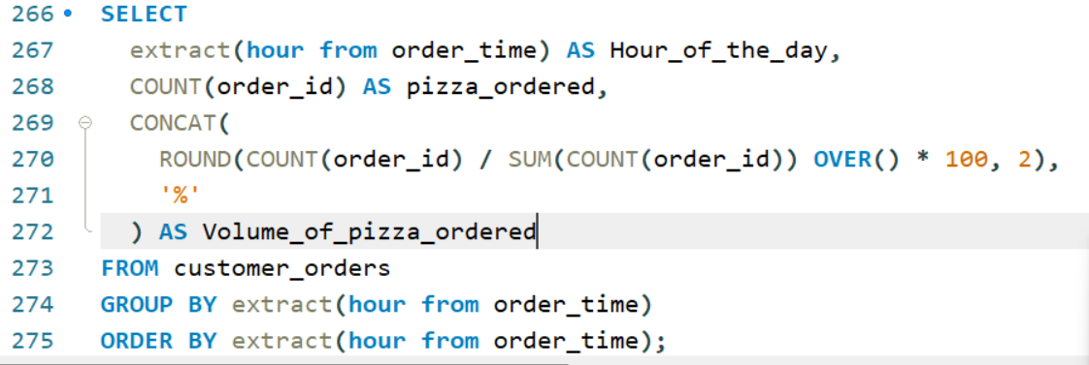
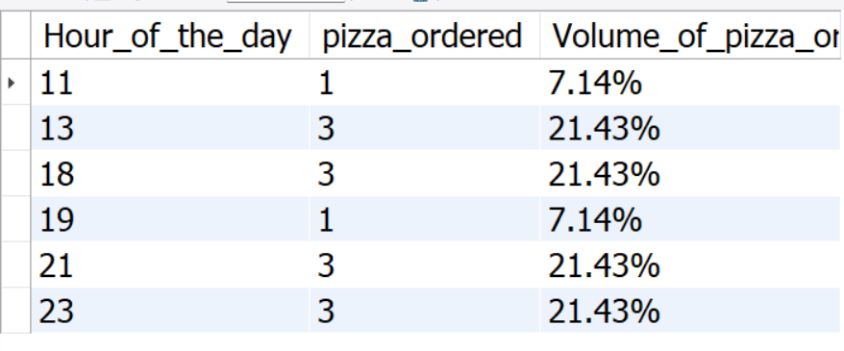
9.What was the total volume of pizzas ordered for each hour of the day?

Slide 14
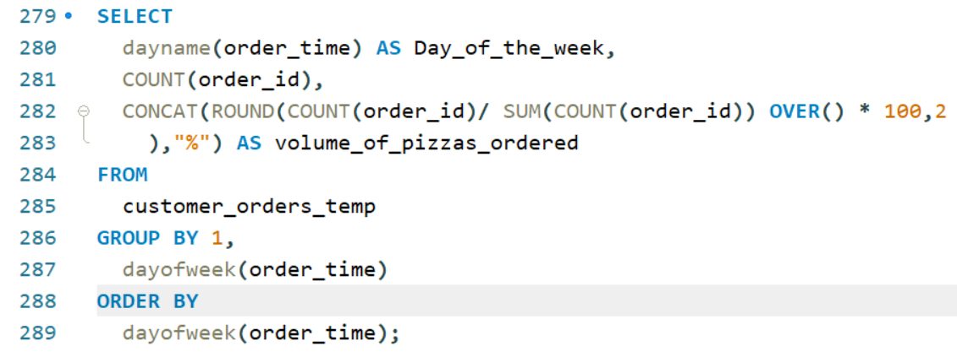
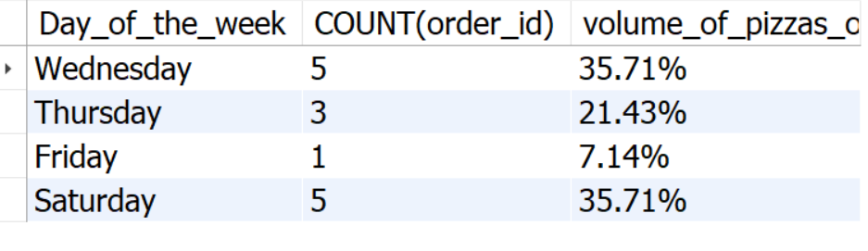
10.What was the volume of orders for each day of the week?

Slide 15
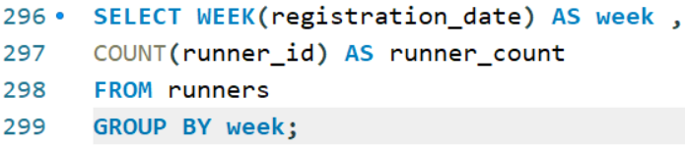
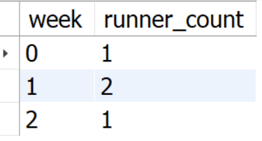
B. Runner and Customer Experience
1.How many runners signed up for each 1 week period? (i.e. week starts 2021-01-01)

Slide 16
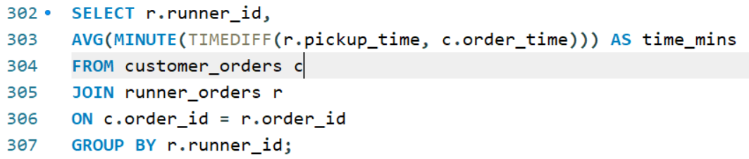
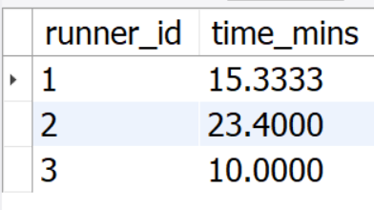
.2.What was the average time in minutes it took for each runner to arrive at the Pizza Runner HQ to pickup the order?

Slide 17
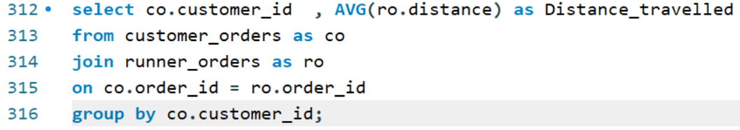
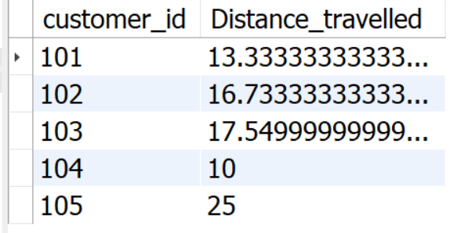
4.What was the average distance travelled for each customer?

Slide 18
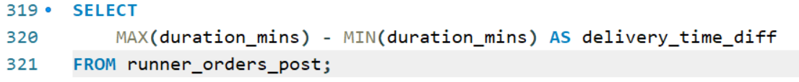
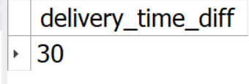
5.What was the difference between the longest and shortest delivery times for all orders?

Slide 19
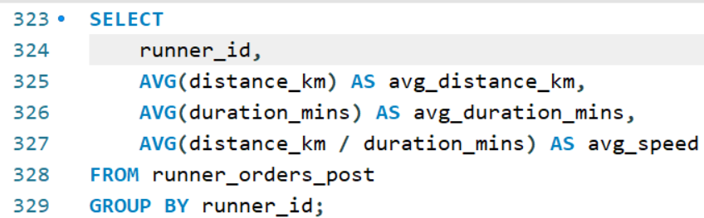
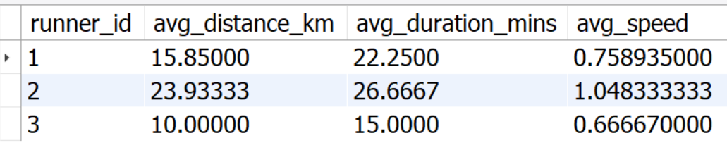
6.What was the average speed for each runner for each delivery and do you notice any trend for these values?

Slide 20
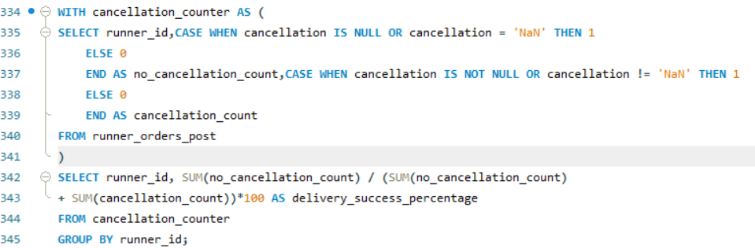
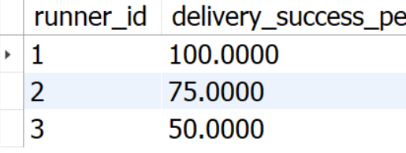
7. What is the successful delivery percentage for each runner?

