Slide 1

MINOR PROJECT
DATA SECURITY IN THE CLOUD COMPUTING ENVIRONMENT USING CRYPTOGRAPHY
MENTOR: Dr. Suyel Namasudra
MEMBERS:
Devansh Jain (1806174)
Mrinal (1806149)
Gaurav (1806146)

Slide 2
INTRODUCTION
Cloud computing is delivery of computer services such as servers , storage, database , networking , analytics and more over the Internet.
It provide an alternative to the on-premises data centre , which saves a huge cost and work.
Public cloud , Hybrid cloud and Private cloud are three types of cloud computing .
Our project consists of designing a new approach that combines Cloud Computing and cryptography.

Slide 3
ADVANTAGES
It reduces huge capital cost buying hardware and software .
Resources can be accessed very quickly .
Productivity is high as we have to put less operational effort.
Backup and recovery of data are less expensive and very fast.
We can increase or decrease requirement of resources.

Slide 4
DISADVANTAGES
You can’t do anything with cloud as long as your internet access is out.
From an angle security is also an issue with cloud computing.
There is a possibility that your cloud service provider run out of money and closes their doors forever.

Slide 5
APPLICATION
Art applications like Moo, Adobe creative cloud , Vistaprint.
Business applications like Salesforce , PayPal etc.
Data storage and backup applications.
Educational Applications .
Entertainment applications like online games.
Management applications .

Slide 6
MOTIVATION
Cloud computing helps startups manage shifting computing requirements by providing flexibility in computer service they purchase.
Cloud has a strong impact on company budgets, it improves use of resources reducing IT spending by 20 and 80%.
It allows for the possibilities to generate new income streams via the implementation of disruptive business models.
It allows a greater flexibility in the deployment of services, which permits a “granular” focus in completing or replacing capacities.

Slide 7
TERMINOLOGIES
Cloud : Technology that allows us to access files/services through internet.
Firewall : A defensive technology to keep bad guys out .
Encryption : Process of encoding data with a key to prevent theft.
Exploit : A malicious application or script used to take advantage of user.
Breach : The moment hacker successfully exploits a vulnerability of computer .

Slide 8
AGENTS INVOLVED
There are various agents involved in the process of data sharing:
Server:
A cloud server which stores all the information regarding the keys. During the time of data sharing, it helps to validate the user using the key pair generated. If the user is valid, a secure connection is established for the data transfer.
Data owner:
Data owners or service providers, are those who are the owner of the data. They store either the normal data or the entire database and depend on the server to manage data.
Client: Users are the authorized parties who could have access to the data if the server establishes connection between them.

Slide 9
LITERATURE REVIEWS
CRYPTOGRAPHY ALGORITHMS:
ELGAMAL ALGORITHM:ElGamal encryption is an public-key cryptosystem. It uses asymmetric key encryption for communicating between two parties and encrypting the message.
KNAPSACK ALGORITHM:In this algorithm we will two different knapsack problems in which one is easy and other one is hard. The easy knapsack is used as the private key and the hard knapsack is used as the public key. The easy knapsack is used to derived the hard knapsack.
OUR PROJECT:
Our project inspired from asymmetric cryptography uses RSA algorithm for key encryption-decryption and AES algorithm for message encryption-decryption .
Our’s is window based application using Java swing as frontend.

Slide 10
SHORTCOMINGS OF THE LITERATURE REVIEWS
Often fails to provide details of the overall strategy.
Often lack details on how the analysis was conducted.
Often very time consuming.
Literature reviews require a good supervision.
Google search doesn’t show relevant information/result.

Slide 11
PROBLEM STATEMENT
The amount of data produced and stored in computing devices is increasing at an alarming rate. Tremendous amounts of critical and sensitive data are transmitted between all these devices.
Thus, it is very imperative to guarantee the security of all these indispensable data.Cryptography is the best way to secure data.
Therefore, build a project for DATA SECURITY IN CLOUD COMPUTING ENVIRONMENT USING CRYPTOGRAPHY.

Slide 12
Why Cloud?
The problem with local database system is that it is prone to physical damage. In such case there is high possibility of data loss. This could affect the whole program running on the database. So, we need the cloud database system:
Data could be synced to any device.
Multiple users could access the data.
It provides security against data loss as data is stored at various data centers, so easy to recover lost data.
Users could share the data by inviting them to their server.
Now, as the multiple users could access the cloud data, so it needs to be designed in such a way that only desired users could access the given data.
For the same purpose we could encrypt the data and share the key with the receivers who want to access the same data by sender.

Slide 13
PROPOSED SCHEME
The objective of the proposed scheme is to develop a highly secured system for data transmission from a sender to a receiver. There are three entities in the proposed system:
1) Key-Pair Generator: This entity provides the public and private keys to the sender and receiver during the registration process.
2) Sender: This entity stores confidential or normal data.
3) Receiver: This entity sends requests to the sender for accessing any required data.

Slide 14
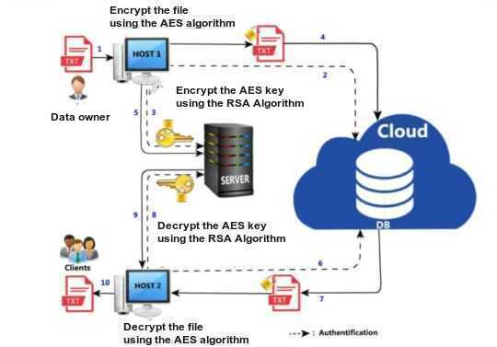
SYSTEM SETUP PHASE:
FIGURE 1: Workflow our proposed scheme

Slide 15
Java Windows Application is being implemented for our project using java programming language.
AES Algorithm is used to encrypt and decrypt the text using the key.
RSA Algorithm is used to encrypt-decrypt the text of the key when it is shared with the receiver by the sender.
Swing is the gui widget toolkit for java which is being used for our project development.

Slide 16
Steps to work on RSA Algorithm which is used in key generation:
Step 1: Generate the RSA modulus
The initial procedure begins with selection of two prime numbers namely p and q, and then calculating their product N, as shown −
N=p*q
Here, let N be the specified large number.
Step 2: Derived Number (e)
Consider number e as a derived number which should be greater than 1 and less than (p-1) and (q-1). The primary condition will be that there should be no common factor of (p-1) and (q-1) except 1

Slide 17
Steps continued:
Step 3: Public key
The specified pair of numbers n and e forms the RSA public key and it is made public.
Step 4: Private Key
Private Key d is calculated from the numbers p, q and e. The mathematical relationship between the numbers is as follows −
ed = 1 mod (p-1) (q-1)

Slide 18
Encrypting and decrypting data:
NOTE:
Encryption Formula: C = (P^e) mod n
Decryption Formula: Plaintext = (C^d) mod n
The details on the working of our application are as follows:

Slide 19
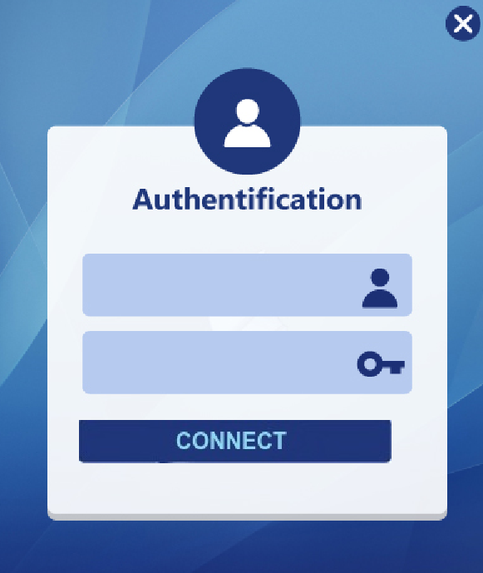
AUTHENTIFICATION
It consists of two simple input zones.
One reserved for the user name, the other for the password on which the characters entered are hidden.
Also there is a button that allows access to the main interface if the password and the login are correct.
If the password is incorrect then error message will be displayed on a dialog box.
FIGURE 2 : Login User Interface

Slide 20
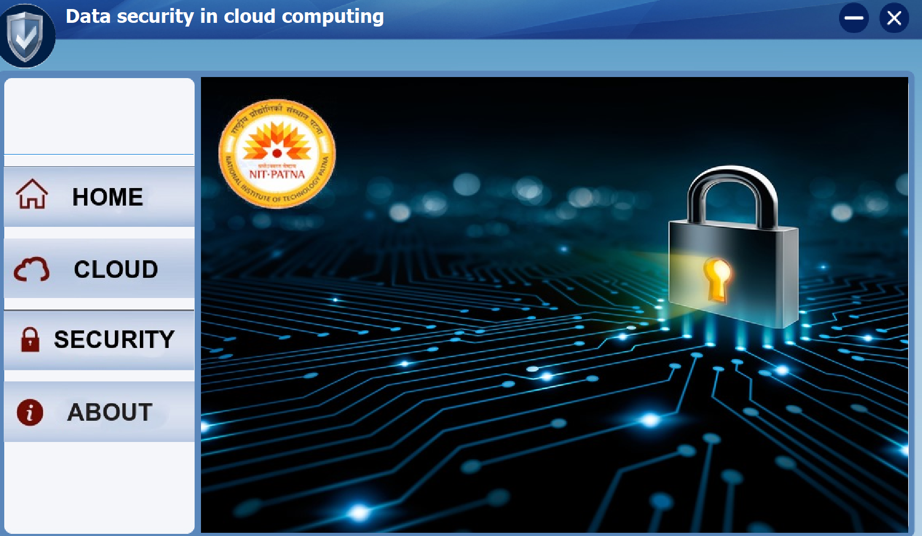
2. HOME WINDOW
The home window here, is what the window user would interact with as soon he logins to the application.
It provides the convenience to the user to navigate to various other features of the application.
FIGURE 3 : Home Page

Slide 21
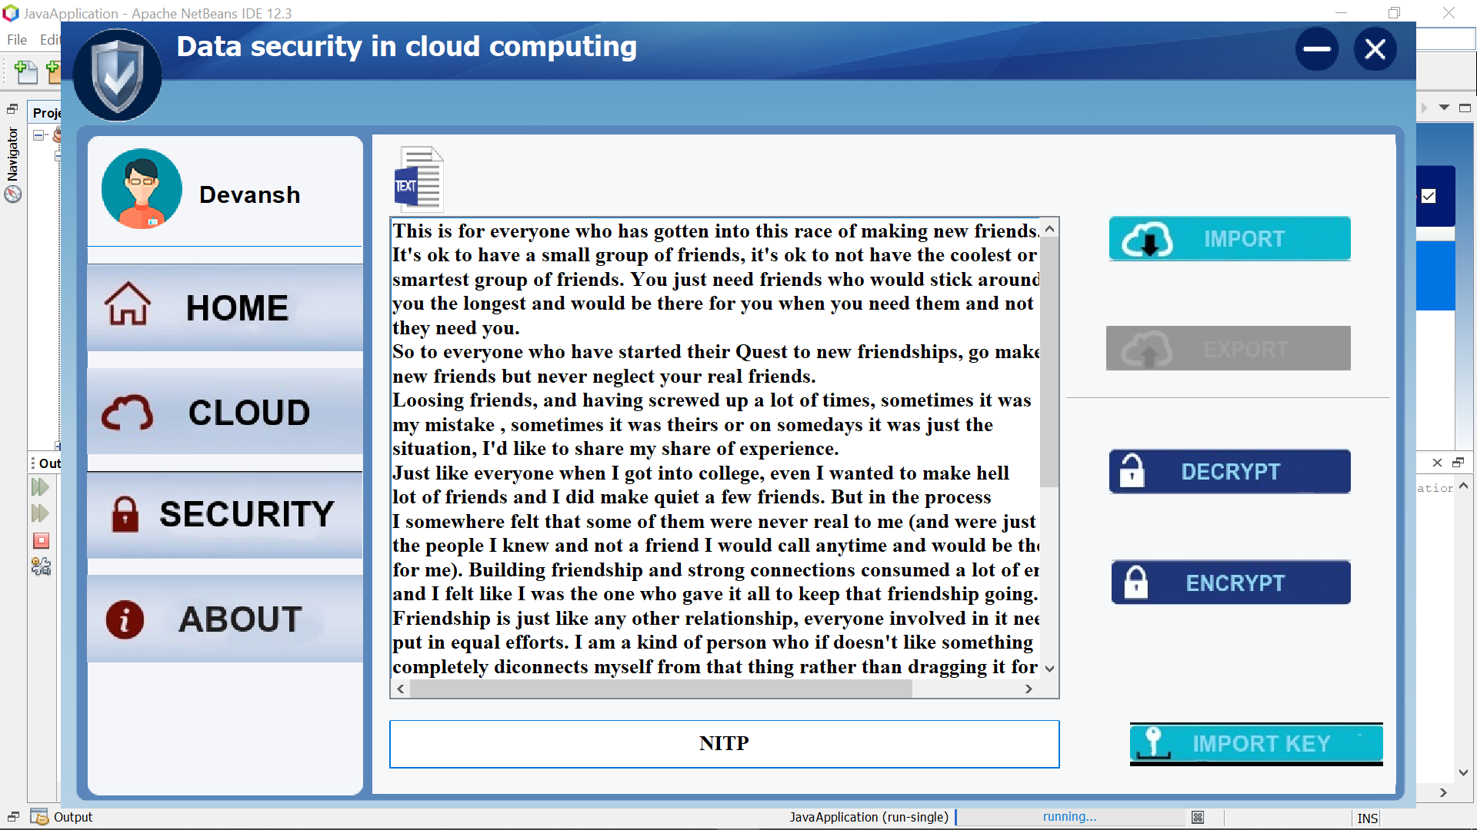
3. CLOUD WINDOW
In this window the customer can import a file (Word, Text) from his own computer.
In this case where the customer plays the sender roll, or from the cloud in the case where the client plays the recipient roll.
In both cases, the customer must import the key or enter it in the key area, to encrypt in the case of an issue.
After the encryption process, the file should be exported to the cloud.
FIGURE 4 : Cloud Window

Slide 22
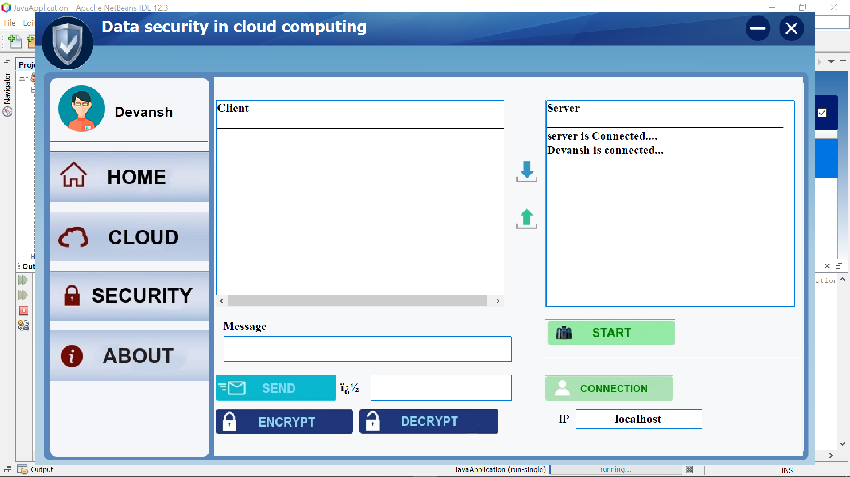
4. SECURITY WINDOW
This window is reserved for establishing a connection between the users of the application, in this case the server listens to a connection request.
After the clients are successfully connected,
the transmitter encrypts the key and send it to the server.
FIGURE 5 : Security Window

Slide 23
EXPERIMENTAL SETUP
The required setup for the development of the projectare:
TOOLS:Apache NetBeans
LANGUAGE:JAVA
LIBRARY: Swing.
Hardware: The project was run on system with following specifications
PRocessor: Intel i5-8th gen @ 2.3GHz.
RAM: 8GB
STORAGE SPACE:128GB SSD

Slide 24
RESULTS AND DISCUSSION
Successful encryption and decryption of both key and message is achieved verified through decrypting the message and key successfully with respective algorithms.
Server was starting successfully without any bug at least for what test cases we used.
Users were connecting successfully and sending encrypted keys to each other over the local cloud.
User successfully receiving the key and successfully decrypting the encrypted file.
More complex and efficient user defined algorithm can be developed and used in the project.

Slide 25
CONCLUSION
Cloud computing here is achieved on local system, using different java libraries and APIs.
This project is an example for people who still have trust issues on cloud computing for their privacy as this can be extended to a higher level.
Cloud computing is the future as we don’t have to do anything but buy the services, which is a huge advantage.
Security is still an issue but that will be resolved in coming years.

Slide 26
FUTURE WORK
As we are well aware with the use of DNA computing and it’s power to store a large amount of data consuming a very small piece. Using biological molecules to perform calculations rather silicon chips, it could revolutionize the way we store data. So, our future works include:
Incorporating DNA based data security.
Implementing a dedicated cloud space rather than local cloud.
Working and developing a better algorithm for data security, which would be more secure to implement.
Automating the cloud operations using AWS cloud automation.

Slide 27
REFERENCE
The reference were taken from:
Towards DNA based data security in the cloud computing environment:
Suyel Namasudra , Debashree Devi , Seifedine Kadry , Revathi Sundarasekar , A. Shanthini
RSA Algorithm:
https://en.wikipedia.org/wiki/RSA_(cryptosystem)
https://www.tutorialspoint.com/cryptography_with_python/cryptography_with_python_understanding_rsa_algorithm.htm
AES Algorithm:
http://web.mit.edu/6.933/www/Fall2000/aes/AES_final_6933.pdf
https://docs.oracle.com/javase/7/docs/api/javax/crypto/Cipher.html
Java and Java Swing:
https://www.javatpoint.com/java-swing
https://docs.oracle.com/javase/8/javafx/api/javafx/application/Application.html

Slide 28


