Slide 1
Smart Vehicle Parking Using Esp8266 and Cloud
L. Devansh
CS21B2023
CS5005 - IIoT and Cloud Computing Assignment

Slide 2
Table of Contents
Introduction
Aim of the Project
Hardware/ Software Required
Problem Statement
Methodology
Results
Conclusion/ Future Work

Slide 3
Introduction
Inefficient urban parking management poses challenges, such as congested and inaccessible areas.
These issues are tackled by the Smart Vehicle Parking System, which employs IoT.
It provides real-time monitoring of parking areas by integrating sensors and cloud computing.
This system is designed to reduce congestion, improve the user experience, and optimize parking space usage.

Slide 4
Aim of the Project
Aim:
The smart car parking system project aims to optimize parking management using ESP8266 microcontroller, IR sensors, and additional occupancy sensors. Integration with servo motors enables automated barrier control, enhancing user convenience and reducing congestion. Real-time parking slot availability information is accessible via web or mobile application interfaces, improving urban mobility and parking experience.
Key Aims:
Develop a smart vehicle parking system to optimize parking space utilization.
Automated entry and exit: Implement automated barrier control for entry and exit, enhancing user convenience.
Provide real-time updates on parking slot availability, reducing congestion and improving user experience.

Slide 5
Hardware/Software Required
Hardware:
ESP8266 Wi-Fi Module is designed to enable data transmission and remote management.
Vehicle detection and parking spot monitoring are made possible by IR sensors.
Servo Motor is the means of parking control, which involves managing entry and exit barriers automatically.
Jumpers: Connect components electrically to ensure a seamless connection.
A Breadboard: Offers a setting for prototyping and organizing the smart vehicle parking system.
Software:
Arduino IDE: Write and upload code for ESP8266.
Blynk: Cloud platform for storing and visualizing health data

Slide 6
Problem Definition
Problem Solved are :
Continuous Remote Monitoring: Smart vehicle parking systems keep track of the number of available parking spaces and provide real-time updates.
Efficient Space Utilization: Early detection of vacant parking spaces allows for optimized parking space management, reducing congestion and improving user convenience.
Automated Barrier Control: Integration of servo motors automates entry and exit barriers, enhancing the efficiency of the parking system and reducing manual intervention.
Improved User Experience:
The availability of real-time parking information through web or mobile application interfaces improves the overall parking experience for drivers, reducing time spent searching and increasing driver frustration.
Relevance of the Problem:
In cities, parking is a major issue that leads to wasted time and excessive traffic congestion. The implementation of parking management solutions, such as the smart vehicle parking system, can address these issues by enhancing urban mobility, reducing environmental impact, and improving overall quality of life for residents and visitors.

Slide 7
Methodology
Procedure:
Select components: NodeMCU ESP8266, IR sensors, servo motor, Blynk Cloud Platform, Wi-Fi module, wires, and breadboard.
Connect components: Wire sensors and servo motor to NodeMCU, ensuring proper connections.
Install Blynk Library: Download and integrate with Arduino IDE for Blynk Cloud integration.
Integrate Blynk: Write code to connect NodeMCU to Blynk Cloud Platform for remote monitoring.
Configure Wi-Fi: Program NodeMCU to connect to Wi-Fi network for data transmission.
Organize connections: Use wires and breadboard for neat circuit layout.
Upload code: Write and upload Arduino code to NodeMCU for system functionality.
Test functionality: Verify sensor detection and motor operation for accuracy.
Deploy system: Install in desired location and monitor performance.

Slide 8
Methodology
Querying the Sensors: Connect sensors by using appropriate libraries.
Use the analogRead() function to read data from IR sensors and identify vehicle presence.
The ESP8266WiFi library can be used to connect to NodeMCU espiron and transmit data to Blynk Cloud Platform.
Establish a Blynk authentication token to access the BLYnK Cloud Platform.
Using virtual pins and Blynk, code to send sensor data to Blin. VirtualWrite() function.
Visualize the Blynk dashboard using a web browser or mobile app.
Animate widgets that showcase sensor data, such as vehicle status and servo motor management.
Adjust the servo motor's entry and exit barrier by using sliders or buttons.

Slide 9
Analysis/ Results
• Continuous monitoring of parking space occupancy: The system continuously detects vehicle presence using IR sensors, providing real-time data on parking space availability.
• Data visualization on Blynk Cloud Platform: Users can visualize parking occupancy status through graphs and charts on the Blynk dashboard, enabling them to monitor trends and identify parking patterns.
• Early detection of parking congestion: Continuous monitoring allows for early identification of parking congestion, enabling prompt intervention and improved traffic flow.
Understanding of the Results:
Obtain real-time updates on parking availability to help users make informed decisions.
Real-time parking data enables users to make informed decisions.
Graphical representation: The Blynk dashboard enables users to comprehend parking trends.
By analyzing data, the utilization of parking areas can be optimized.
Real-time data and visual analytics are utilized to improve the efficiency of parking management.

Slide 10
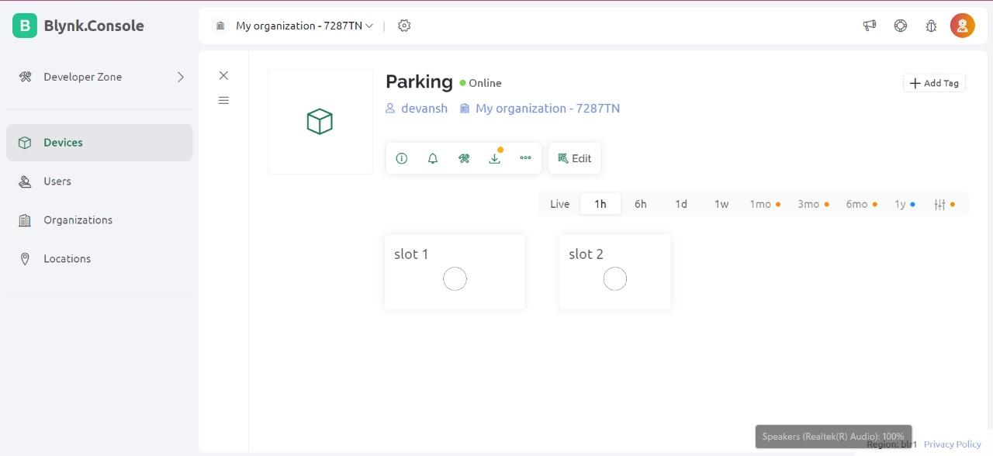
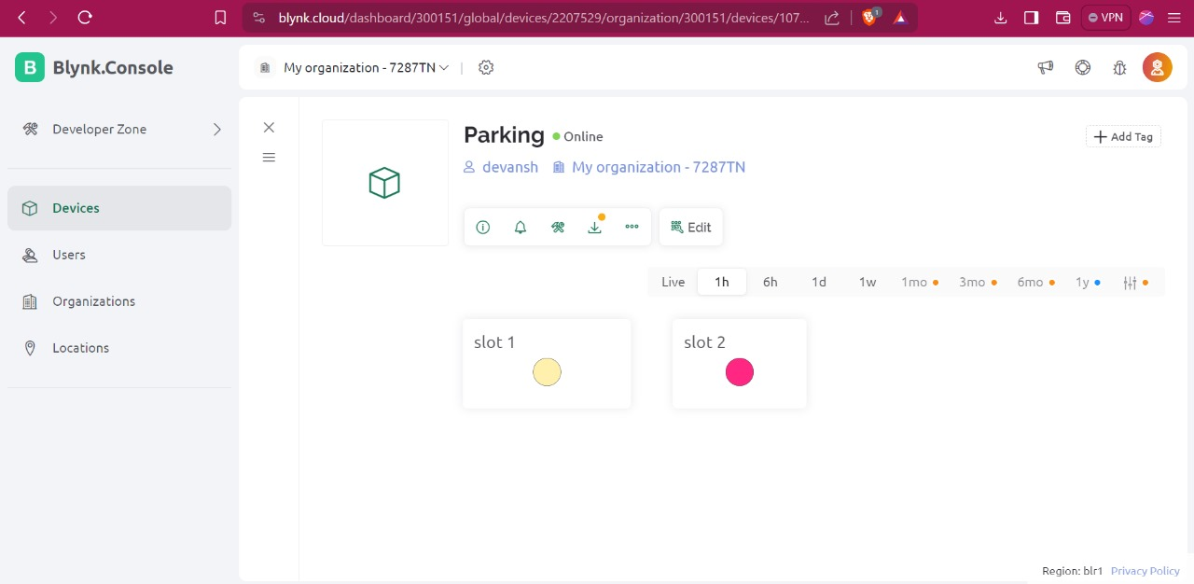
Analysis/ Results
Screenshots of the Before and After outputs:
Blynk Dashboard
Parking slot 1 and Parking slot 2
a) Before Parking b) After Parking

Slide 11
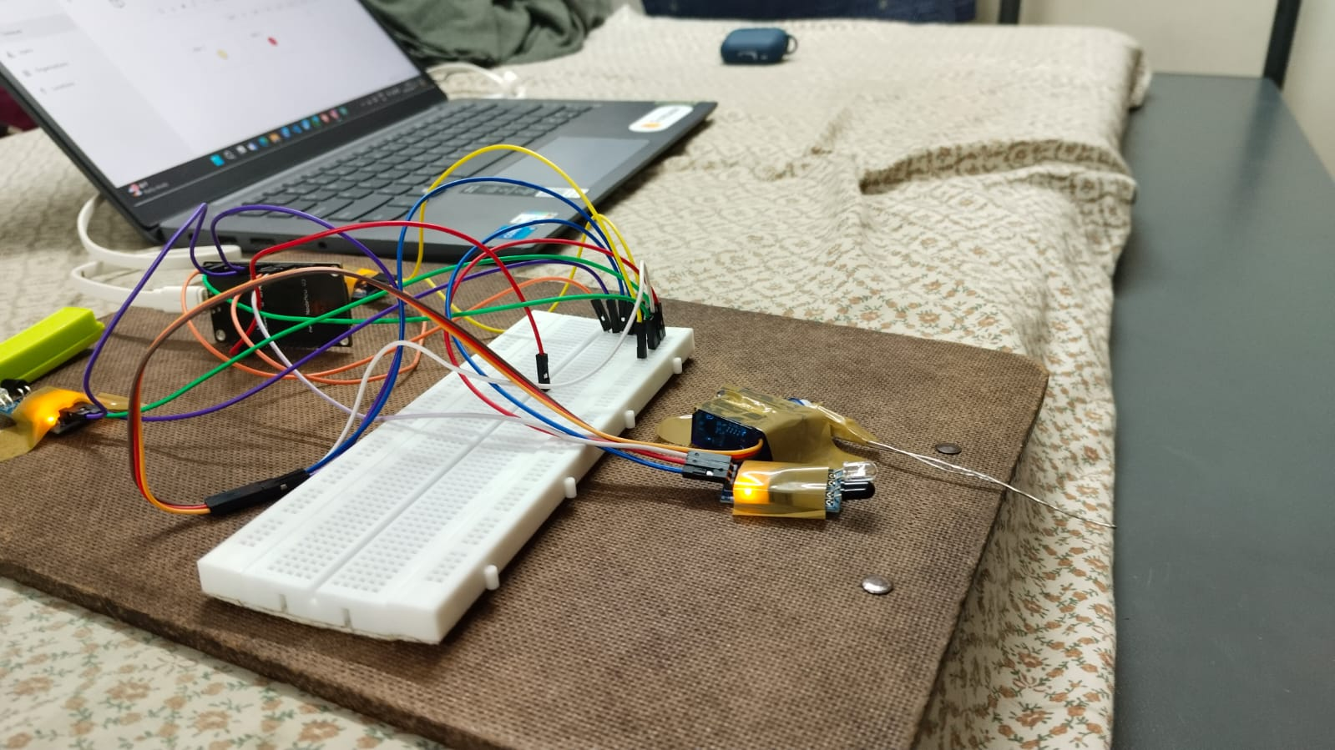
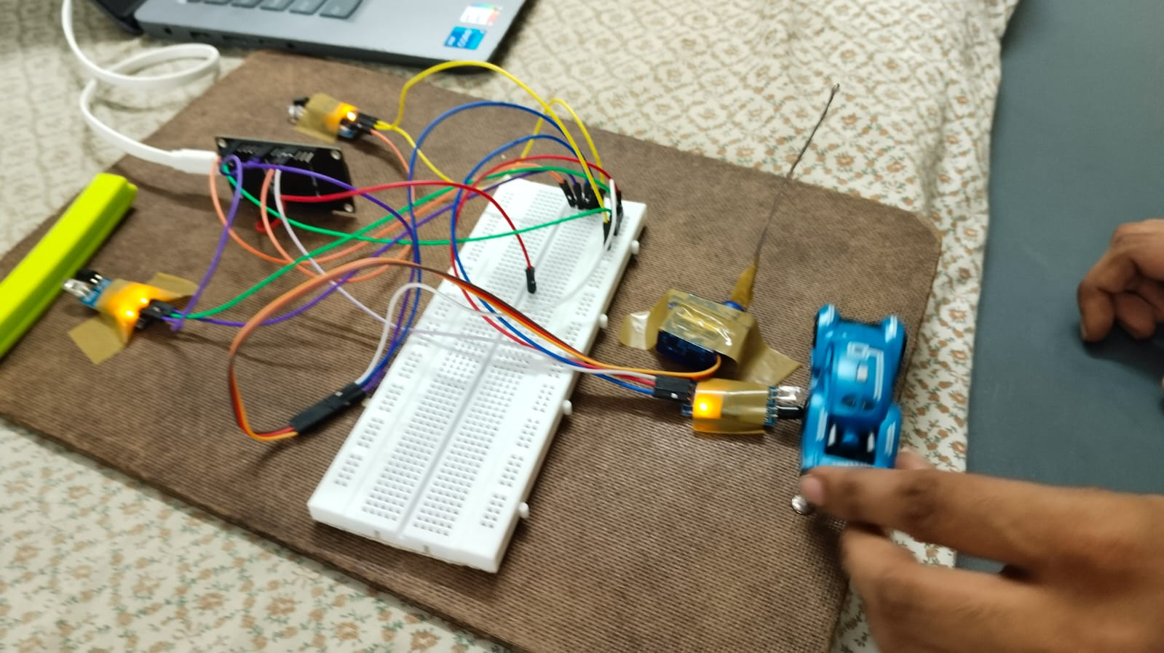
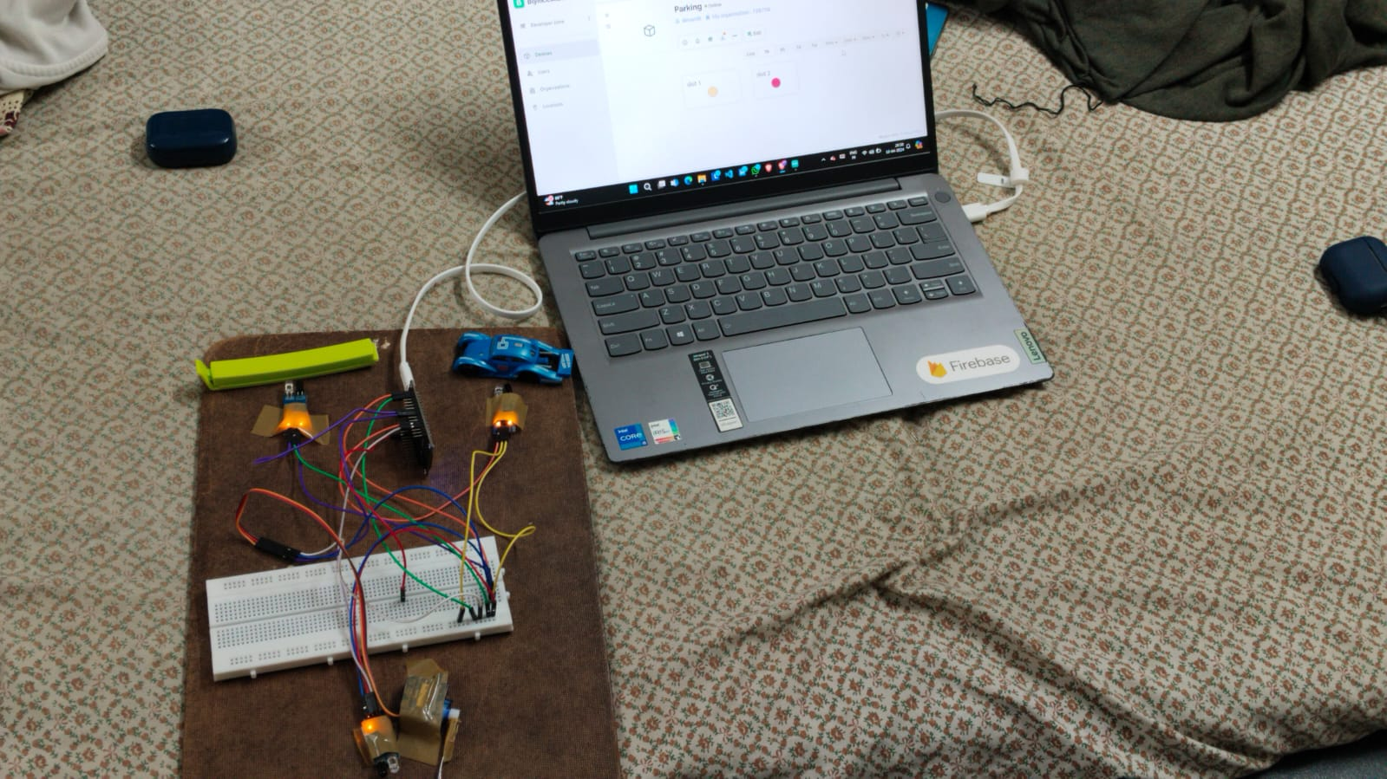
Analysis/ Results
Result for the project:

Slide 12
Conclusion
• Conclusions:
Ensures ongoing remote monitoring of parking space occupancy.
enables early intervention and improves parking management by providing real-time data.
Possible decreases in traffic congestion and enhanced urban mobility.
• Future Directions:
Enhance security by enhancing data protection for parking information and users.
Creating a mobile app that provides real-time parking information for users to make their lives easier.

Slide 13
References
Mrs. A. Kalaiyarasi, 2Dr. D. Anitha, 3Mr. M. Balamurugan,
4Mr. P. Divagar, 5Mr. S. Gowtham,6Mr. G. Suresh Department
of Information Technology, Muthayammal Engineering College
(Autonomous), Rasipuram 637 408, IJERT 2022.
Documentation of Blynk : https://docs.blynk.io/en

Slide 14
Thank You Any Questions?

