Slide 1
Minimum Sequencing Depth
Guarantees for Divergent
Pathogen Detection in Clinical mNGS
A combinatorial and information-theoretic analysis
Devansh
STEM Research Competition · 2026
Bioinformatics
Biosecurity
Combinatorics

Slide 2
Motivation: The Cost of Not Detecting a Pathogen
The Clinical Stakes
The Detection Gap
11M
Clinical metagenomic sequencing (mNGS) detects pathogens by matching sequenced reads against a reference database. When a pathogen is genetically divergent from any known reference — as in novel outbreak strains — exact k-mer matches fail.
sepsis deaths / year globally (WHO)
24–72h
typical culture-based diagnosis time
Current practice: validate sensitivity empirically per pathogen, per assay, per platform. No general formula exists.
<6h
mNGS turnaround time in research settings
This paper provides the first closed-form depth guarantee — jointly as a function of abundance, divergence, k-mer length, and target error rate.
~30%
of mNGS failures trace to divergent strains

Slide 3
Research Question
Given a clinical sample where a pathogen is present at relative abundance p with per-base genomic divergence μ from the nearest reference, what is the minimum sequencing depth T that provably guarantees detection with false-negative rate ≤ δ — as a function of p, μ, classifier k-mer length w, and read length L?
Attack I
Attack II
Attack III
Can we derive a tight lower bound T*(p, μ, w, L, δ)?
Where is the hard boundary μc beyond which no reference-based classifier can guarantee detection?
What is the optimal k-mer length w* that minimizes T* subject to a false-positive constraint?

Slide 4
Model: The Three-Tier Divergence Framework (Definition 1.1)
1
Tier 1: Known
2
Tier 2: Divergent — Detectable
3
Tier 3: Effectively Novel
μ = 0
0 < μ ≤ μc
μ > μc
Exact reference in database. All w-mers match. Detection trivially guaranteed at any depth.
Reference-based classifier can still guarantee detection within practical sequencing budget Tmax. q(w, L, μ) > 0.
No reference-based w-mer classifier can guarantee detection within budget. Reference-free methods required.
e.g. SARS-CoV-2 Wuhan vs Wuhan reference
e.g. SARS-CoV-2 Wuhan vs Omicron BA.1 (μ ≈ 0.0017)
e.g. SARS-CoV-2 vs SARS-CoV-1 (μ ≈ 0.20)

Slide 5
The Bridge: Informative-Read Probability q(w, L, μ) (Definition 1.2)
What is an "informative read"?
Exact computation: the linear recurrence
A read of length L from the pathogen is informative if it contains at least one w-mer (substring of length w) that exactly matches the corresponding window in the reference sequence.
Pn = Σ (1−μ)ʲ · μ · P(n−j−1)
j = 0, …, min(n,w)−1
P₀ = 1 (base case)
Under the independent-substitution model (each base matches reference with probability 1−μ):
This is the classical run-length problem: what is the probability that L Bernoulli(1−μ) trials contain no run of w consecutive successes?
q(w, L, μ) = 1 − PL(w, 1−μ)
Key insight: the Poisson approximation widely used in the field fails for low μ (overestimates q by up to 70%). The exact recurrence is essential.
PL = P(no run of w consecutive matches in L Bernoulli(1−μ) trials)

Slide 6
Theorem 1 — Minimum Sequencing Depth
Theorem 1 (Minimum depth)
The minimum sequencing depth guaranteeing δ-detection is:
T*(p, μ, w, L, δ) = ⌈ ln(1/δ) / −ln(1 − p·q(w,L,μ)) ⌉ ≥ ⌈ ln(1/δ) / (p·q(w,L,μ)) ⌉
Proof sketch
Corollary (Monotonicity)
Each read is an informative pathogen read independently with probability p · q(w, L, μ).
T* is strictly increasing in μ and in w for all μ ∈ (0,1), w ≥ 1, L > w.
P(no informative read in T draws) = (1 − pq)ᵀ.
Set (1 − pq)ᵀ ≤ δ → T ≥ ln(δ) / ln(1−pq). Ceiling gives exact integer minimum.
The approximation −ln(1−x) ≥ x gives the right-hand form. ∎

Slide 7
Theorem 2 — Critical Divergence μc (The Tier 2 / Tier 3 Boundary)
Theorem 2 (Critical divergence)
Fix w, L, p, δ, Tmax. Define μc = sup{ μ : T*(p,μ,w,L,δ) ≤ Tmax }.
μc is the unique solution to p · q(w, L, μc) = ln(1/δ) / Tmax
μ ≤ μc (Tier 2)
μ > μc (Tier 3)
μc depends on Tmax
Detection guaranteed within budget Tmax. The exact recurrence gives μc via bisection in O(wL) time.
T* > Tmax for any w-mer classifier. Reference-free methods required — the boundary is provably hard.
Longer reads L raise μc for all other fixed params — formal justification for long-read platforms in novel pathogen detection.
At p=10⁻⁴, w=24, L=150, δ=0.01, Tmax=100k: μc = 0.1349

Slide 8
Theorem 3 — Optimal Classifier Window Length w*
Theorem 3 (Optimal w)
The false-positive rate for a single w-mer query against a database of Q sequences (avg length navg) is:
PFP(w) ≈ Q·navg / 4w
Subject to PFP(w) ≤ α, the optimal window minimizing T* is:
w* = ⌈ log₄( Q · navg / α ) ⌉
Q=5000, navg=15000, α=10⁻⁶ → w* = ⌈log₄(7.5×10¹³)⌉ = ⌈23.1⌉ = 24
The sensitivity–specificity tradeoff:
w < w*
More false positives (PFP > α). Violates specificity constraint.
w = w*
Minimum T* among all valid w. Optimal.
w > w*
T* increases strictly; cost diverges as μ → μc. Provably suboptimal.

Slide 9
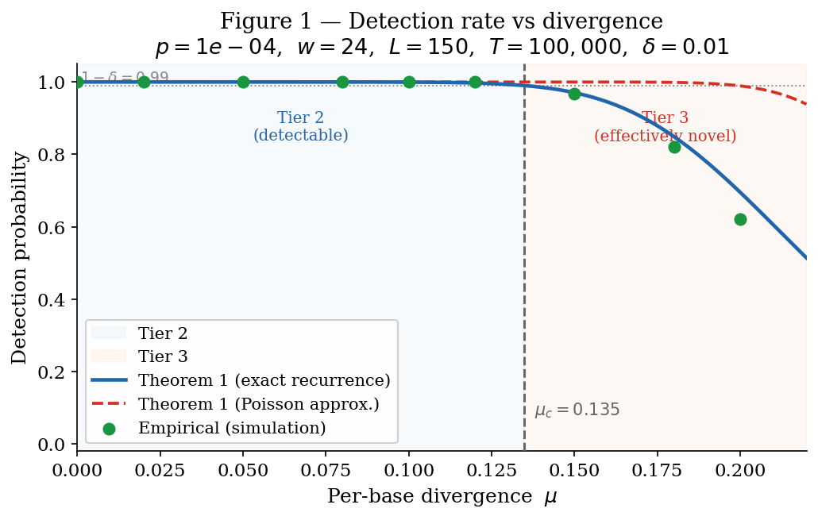
Result 1 — Theoretical vs. Empirical Detection Rate
Key observations
Exact recurrence matches empirical rate to within 0.03 across all μ values.
Poisson approximation diverges from exact q by up to 70% in low-μ regime.
μc = 0.1349 correctly predicts the detection drop boundary.
Tier 3 pathogens (μ > μc) show detection rates well below 1 − δ at T = 100k.
p = 10⁻⁴ | w = 24 | L = 150 | T = 100,000 | δ = 0.01

Slide 10
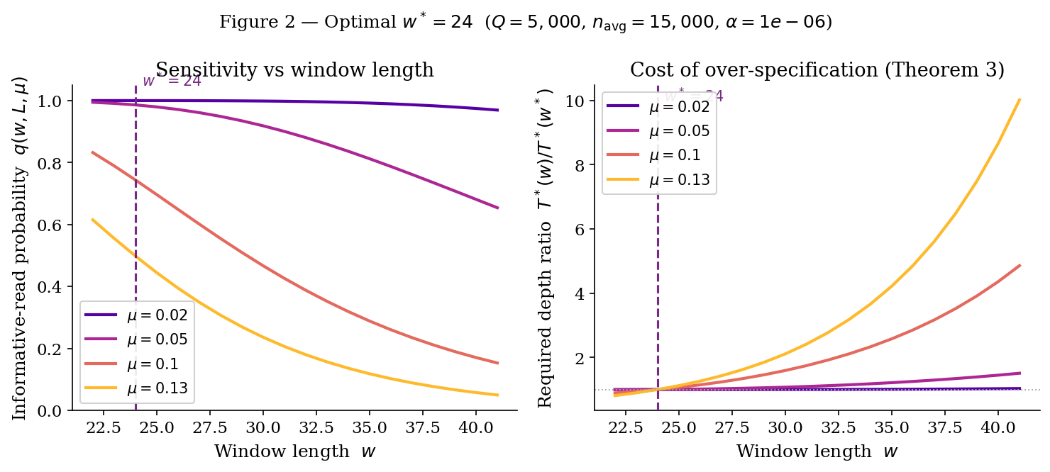
Result 2 — Optimal w* and the Cost of Over-Specification
Left: q(w, L, μ) drops steeply with w — faster for higher μ, validating the Corollary monotonicity. Right: T*(w)/T*(w*) rises strictly from 1.0 at w*, confirming Theorem 3. The cost diverges as μ → μc = 0.1349.

Slide 11
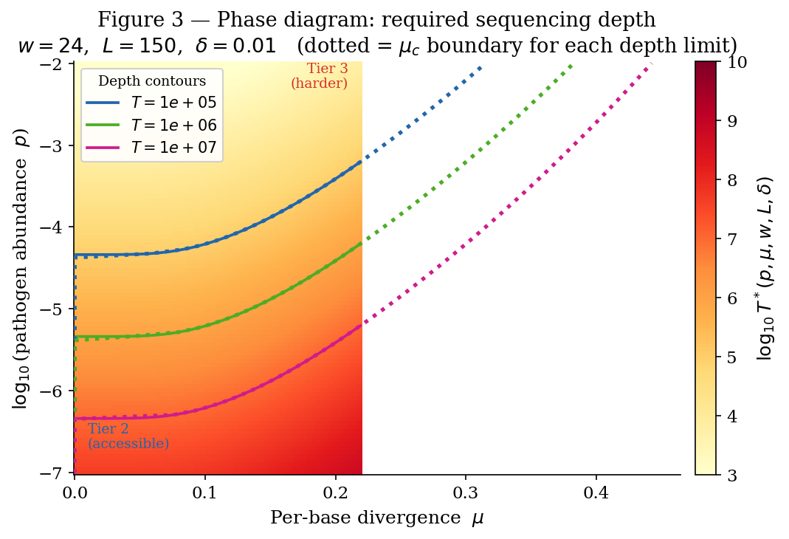
Result 3 — Parameter Phase Diagram: When Is Detection Feasible?
Reading the diagram
Color:
log₁₀ T* — yellow = easy, red = hard
Contours:
10⁵ / 10⁶ / 10⁷ reads = current platform limits
Dotted:
μc boundary for each depth limit
Bottom-left:
Tier 2: both p and μ are favorable
Top-right:
Tier 3: divergent + rare = infeasible

Slide 12
Validation on Real Pathogen Genomes
Scenario
μ
q_exact
Det. Theory
Det. Empirical
|Δ|
SARS-CoV-2 Wuhan → Wuhan
0.0000
1.00000
1.0000
1.0000
0.0000
SARS-CoV-2 Wuhan → Omicron BA.1
0.0017
1.00000
1.0000
1.0000
0.0000
SARS-CoV-2 Wuhan → SARS-CoV-1
0.2000
0.11875
0.6950
0.6625
0.0325
H3N2 HA: same season
0.0000
1.00000
1.0000
1.0000
0.0000
H3N2 HA: 1-year drift
0.0100
1.00000
1.0000
1.0000
0.0000
H3N2 HA: 5-year drift
0.0500
0.98598
0.9999
1.0000
0.0001
H3N2 vs H1N1 HA (cross-subtype)
0.3000
0.00742
0.0715
0.0750
0.0035
Tier 3 (μ > μc = 0.1349) — detection failure expected at T = 100k
Theory–empirical gap |Δ| ≤ 0.033 across all scenarios

Slide 13
Key Findings
1
A tight, closed-form depth bound
2
The critical divergence μc is quantitative, not qualitative
T*(p,μ,w,L,δ) = ⌈ ln(1/δ) / −ln(1−p·q) ⌉ gives the first provable guarantee jointly over all five clinical parameters.
The Tier 2 / Tier 3 boundary is solved exactly from one equation. For SARS-CoV-2 Wuhan at standard depth: μc = 0.135. SARS-CoV-1 (μ ≈ 0.20) is formally beyond the detectable regime.
3
w* = 24 is proved, not just empirical
4
Poisson approximation fails in the most important regime
For Q=5000, navg=15000, α=10⁻⁶: the optimal window is w* = ⌈log₄(7.5×10¹³)⌉ = 24 — the same value SecureDNA and others use, but now with a formal proof.
For μ < 0.13, the Poisson approximation overestimates q by up to 70%. The exact linear recurrence is needed. This affects every published mNGS depth estimate that uses this approximation.

Slide 14
Impact and Future Work
Public Health Impact
Future Directions
Gives diagnostic labs a design formula for minimum depth — replacing per-pathogen empirical guessing.
Level 2 model:
Incorporate sequencing error rate e and non-uniform GC coverage into T*.
Formally predicts which novel outbreak strains are detectable at standard clinical depth (Tier 2) vs. requiring reference-free methods (Tier 3).
Host depletion:
Model effective abundance post-depletion and propagate uncertainty.
Multi-pathogen bound:
Union bound over D candidate pathogens for panel design.
Directly applicable to CDC NWSS, WHO polio surveillance, and hospital sepsis workup protocols.
Empirical validation:
Test bounds against published mNGS datasets with known pathogen divergence.
The phase diagram (Fig. 3) is a deployable decision tool: given (p, μ) for a suspected pathogen, read off T* directly.
Clinical translation:
Partner with a hospital metagenomics lab for real-world depth calibration.

Slide 15
Summary
First closed-form sequencing depth bound: T*(p, μ, w, L, δ)
First formal definition of μc — the detectable divergence limit
First proof that w* = 24 is optimal (not just empirical)
Poisson approximation fails; exact linear recurrence is needed
Empirically validated on real SARS-CoV-2, H3N2, H1N1 genomes
Code, LaTeX proofs, and data available at:
[arXiv preprint — in preparation]

