Slide 1









PICT ACM STUDENT CHAPTER (PASC) | PULZION’26
Pune Institute of Computer Technology (PICT), Pune
PULZION’26 • SPONSOR: MSW
HACKNOVA’26 — SachVerify
PROJECT & PROBLEM STATEMENT DETAILS
TEAM INFORMATION
Project / Solution Title: SachVerify + Beacon citizen app
Team Name: Alebaple
Problem Statement Title: PS-2 · Disaster Information Verification Agent
Team Leader: Devansh Narlawar
GitHub Repository Link: github.com/DevanshNarlawar06/Alebaple_hacknova (dev)
Team Member 2: Akshat Patil
Live Prototype / Demo Link(Optional): Live demo on our laptop
Team Member 3: Vedant Karne
Figma / Design Link (Optional): UI designs in repo: /design
HACKNOVA’26 • PULZION’26 • PICT ACM Student Chapter (PASC)
Slide 1 / 10

Slide 2
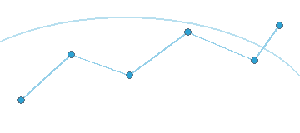








HACKNOVA’26 | PULZION’26
PICT ACM Student Chapter (PASC) — Pune Institute of Computer Technology (PICT), Pune
Problem Statement & Existing Challenges
During floods, cyclones and earthquakes, claims spread faster than anyone can check them. Responders can't tell which posts to trust.
WHAT GOES WRONG (TYPICAL CASES)
WHO IS AFFECTED
Recycled media
An old flood video (e.g. Kolhapur 2019) is forwarded years later as “today”.
Responders & SDMA / DDMA control rooms
Triage hundreds of reports
Hospitals & NGOs
Decide where to send resources
Wrong place
A real alert for one district is attributed to another city.
Citizens
Panic at fakes, or ignore real warnings
Conflicting numbers
“300 mm rain”, “dam burst”, “10,000 evacuated” disagree with official figures.
Why current tools fall short
Stale truth
A warning that expired hours ago is still being shared.
Official alerts (NDMA SACHET) are authoritative but don't answer rumours.
Fact-checking is manual: hours to days.
Platforms don't check a claim's place and time against official feeds.
Language gap
Rumours spread in Hindi and Marathi; officials cross-check in English.
Our assessment, from PS-2 context
HACKNOVA’26 | PULZION’26 • PICT ACM Student Chapter (PASC), PICT Pune
Slide 2 / 10

Slide 3


HACKNOVA’26 | PULZION’26
PICT ACM Student Chapter (PASC) — Pune Institute of Computer Technology (PICT), Pune
Proposed Solution
SachVerify checks each disaster claim against official alerts, sensors, news, place and time, and gives one of four verdicts with the evidence behind it.
Verified
Trusted sources confirm it
Conflicting
Positive evidence contradicts it
Outdated
Was true, no longer current
Unverified
Not enough evidence either way
Absence of evidence is never treated as contradiction: no source found means Unverified, never “false”.
Responder Console
Beacon citizen app
What makes it different
PS-2 core
Beyond the brief
Claims split into atomic facts; opinions excluded
Each claim tied to one real event
HISTORICAL vs CURRENT verdicts from validity windows
Copied news stories count once
Multilingual: a Hindi post checked against an English alert
Live story feed with status + confidence
Evidence For / Against: source, time, distance, NLI score
Map: official alert areas + claim pins
Current vs Historical toggle; check-a-post box
Replay demo streams posts live
Threat level for your location
RED only on an official alert or a verified claim
“Not true” rumour cards nearby
Opt-in alarm sound; check a message
“Why this alert?” shows the evidence
HACKNOVA’26 | PULZION’26 • PICT ACM Student Chapter (PASC), PICT Pune
Slide 3 / 10

Slide 4
HACKNOVA’26 | PULZION’26
PICT ACM Student Chapter (PASC) — Pune Institute of Computer Technology (PICT), Pune
Technical Approach & System Workflow
1
2
3
4
5
6
7
Ingest
Check-a-post / tipline, demo replay, live NDMA + GDACS polling
Extract
Gemini splits the post into atomic facts; grounding guard
Locate & bind
Geocode the place; tie the claim to one real event
Gather
Evidence by hazard from 5 source layers
Stance
Rules (numbers, physics, directives) + mDeBERTa NLI + e5
Validity
Validity windows give HISTORICAL vs CURRENT
Decide & explain
Rule table → status, confidence, cited evidence
Navy steps use AI models (Gemini, NLI). Every step is traced; the LLM only extracts and is grounding-checked.
DECISION RULES (FIRST MATCH WINS)
Event binding (real pilot case)
“12 m tsunami at Acapulco”, posted 20 Sep 2017, is tied to the 19 Sep Puebla M7.1 (USGS: inland, 236 km from Acapulco, no tsunami), not the 8 Sep Tehuantepec M8.2 that did cause one → Conflicting
Conflicting
a fact is contradicted by positive evidence
Outdated
CURRENT check: true at claim time, since superseded
Verified
every factual proposition is supported
Numeric conflict (synthetic demo)
“M6.8 quake hits Delhi” vs seismic record M3.1 → Conflicting
Unverified
otherwise: partial support, no coverage, place unresolved
Subjective statements (“worst quake ever”) are shown but never scored.
HACKNOVA’26 | PULZION’26 • PICT ACM Student Chapter (PASC), PICT Pune
Slide 4 / 10

Slide 5

HACKNOVA’26 | PULZION’26
PICT ACM Student Chapter (PASC) — Pune Institute of Computer Technology (PICT), Pune
System Architecture
CLAIMS IN
Backend · FastAPI (Python 3.12)
Frontend
React + Vite + Tailwind + Leaflet
Check-a-post / tipline API
Demo replay (labelled synthetic)
Pilot claims (real 2017 events)
Ingest poller
NDMA + GDACS every 3 min; typed connectors with cache
Event bus → SSE /api/stream
live verdicts, alerts, replay progress
Console
responders: feed, evidence, map
Verifier agent · bounded state graph
REST
EVIDENCE · 5 LAYERS
extract
geocode
gather
bind event
Beacon
citizens: phone web app
1 Official
NDMA SACHET CAP, GDACS
stance
validity
decide
explain
SSE
2 Sensors
USGS, Open-Meteo
deterministic steps · full trace stored per verdict
Evaluation
metrics + confusion matrix
3 Local news
Google News (hi / mr / en), YouTube
ML models
Gemini gemini-3-flash-preview (extraction)
mDeBERTa-v3 XNLI + multilingual-e5 (local)
Beacon threat engine
RED only on official alert or verified claim
4 National news
Google News, YouTube RSS
Planned (not built)
Recycled image/video checks
Mobile push notifications
Review UI + ~50-case benchmark
GPU acceleration
5 Other posts
independent posts, same story
SQLite (WAL) · schema v0.2
Extended additively from the earlier team's v0.1: claims, propositions, evidence + validity windows, versioned verdicts, eval runs
+ Nominatim geocoding (cached)
HACKNOVA’26 | PULZION’26 • PICT ACM Student Chapter (PASC), PICT Pune
Slide 5 / 10

Slide 6



HACKNOVA’26 | PULZION’26
PICT ACM Student Chapter (PASC) — Pune Institute of Computer Technology (PICT), Pune
Technology Stack & Implementation
Frontend
Backend & API
React 18 + Vite 5
Console, Beacon and Eval pages
FastAPI + Uvicorn + Pydantic
typed REST API, check-a-post / tipline endpoint
Tailwind CSS
shared design tokens (navy / teal / saffron)
sse-starlette
live verdicts and alerts over SSE
Leaflet + OpenStreetMap
alert polygons, claim pins, quake points
httpx + feedparser
connectors with timeouts and response cache
AI / ML
Data & geo
Gemini gemini-3-flash-preview
atomic-fact extraction (JSON schema); fallbacks: lighter model, rules
SQLite (WAL), schema v0.2
additive migration of the earlier team's dataset
mDeBERTa-v3 XNLI (multilingual)
stance: supports / contradicts
shapely + Nominatim
point-in-alert-polygon checks; cached geocoding
multilingual-e5-small
retrieval and copy detection
dateparser + langdetect
claimed times and languages (en / hi / mr)
Decisions: grounding guard (facts must appear in the post) · snapshot mode for an offline demo · every synthetic item labelled · keys only in .env · run_eval.py scores each run
HACKNOVA’26 | PULZION’26 • PICT ACM Student Chapter (PASC), PICT Pune
Slide 6 / 10

Slide 7
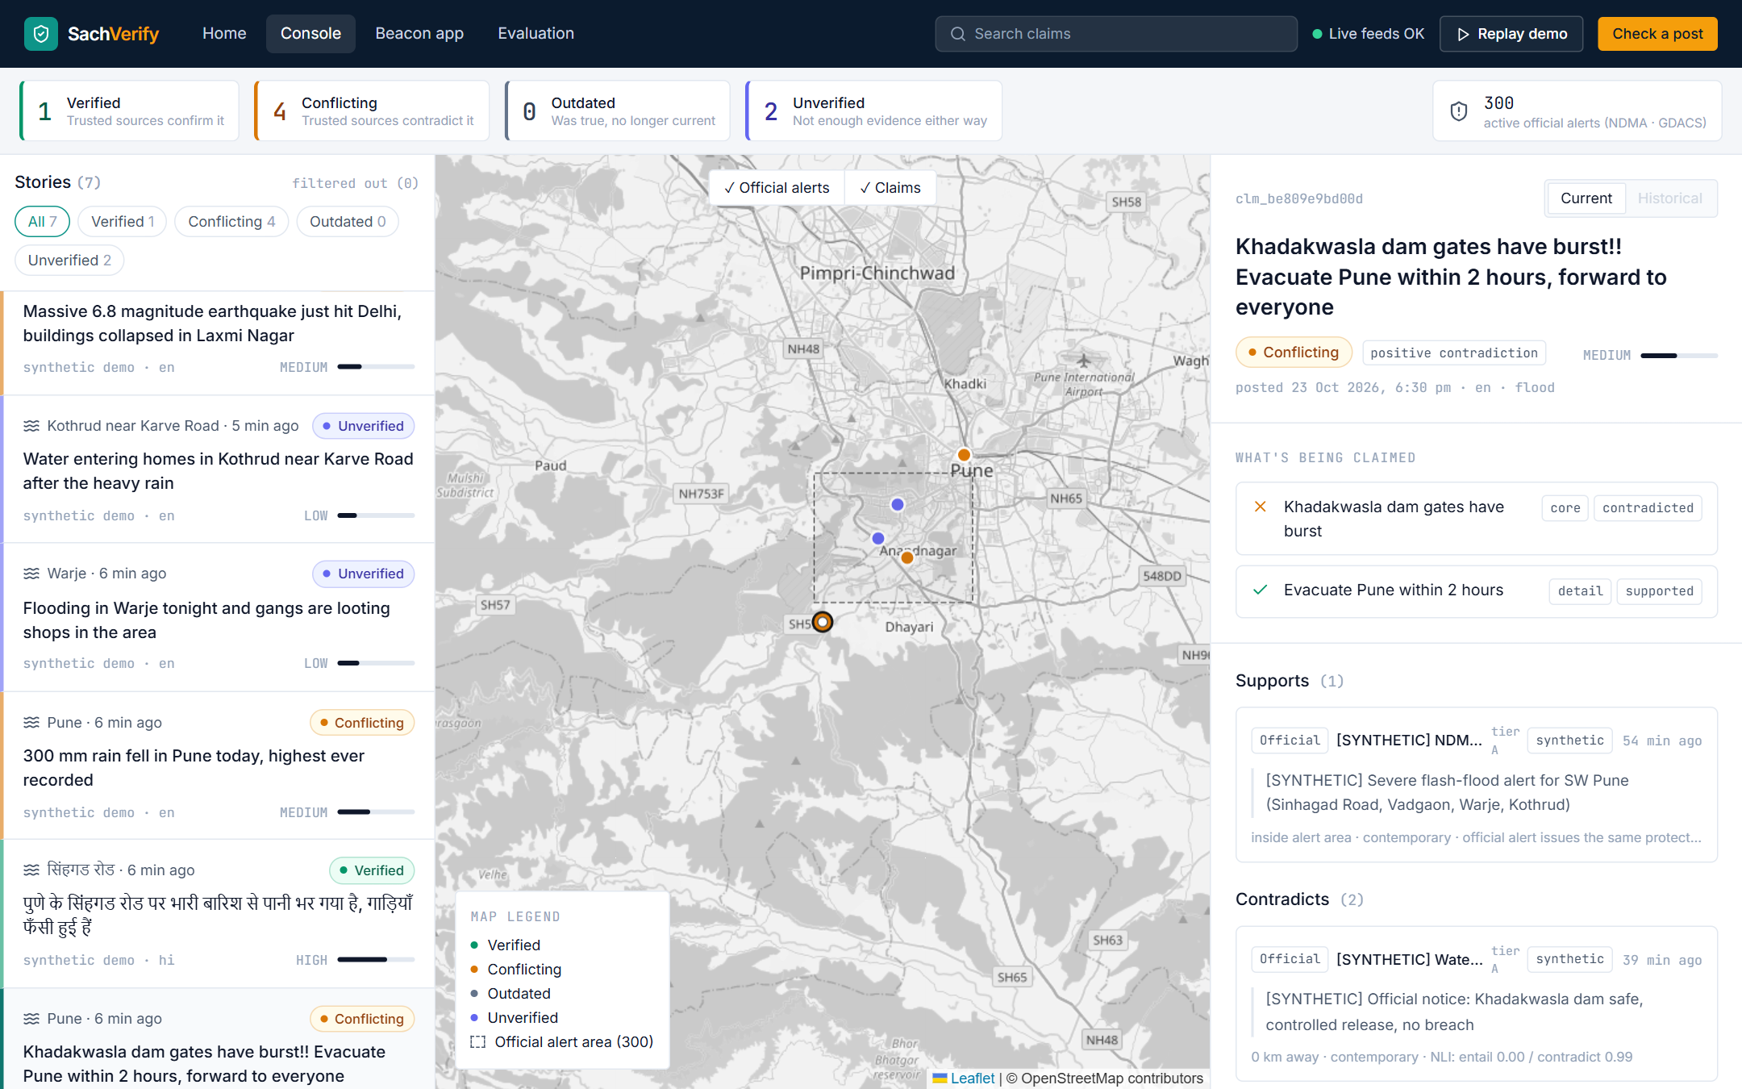
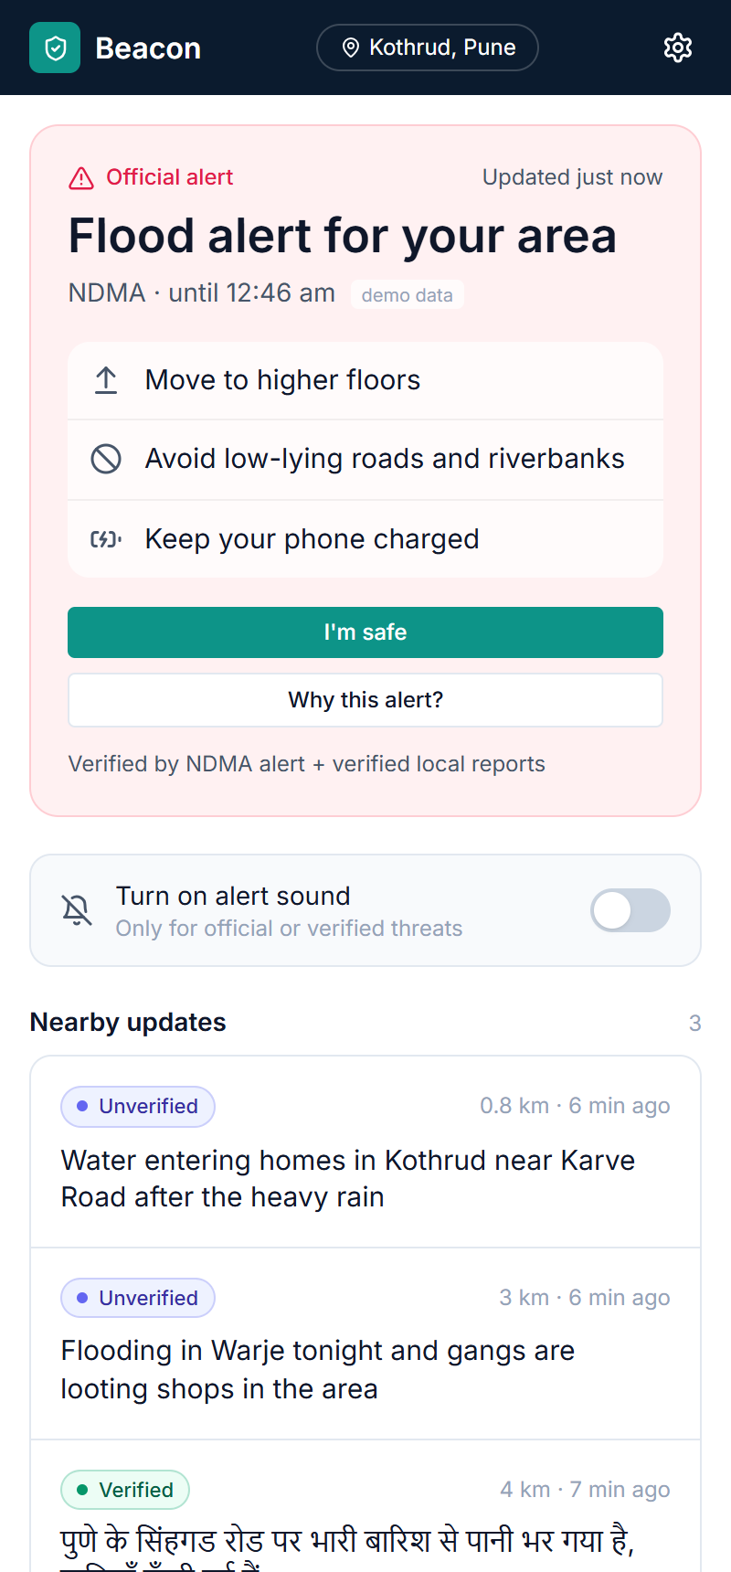
HACKNOVA’26 | PULZION’26
PICT ACM Student Chapter (PASC) — Pune Institute of Computer Technology (PICT), Pune
Prototype & Key Features
Working now
Claim → verdict with cited evidence
Map: 300 live NDMA / GDACS alert areas
Current vs Historical toggle
Hindi post verified against an English alert
Beacon alert + rumour cards
Replay demo over SSE
Data honesty
Pune flood and Delhi quake posts are synthetic and labelled in the UI.
Live NDMA / GDACS alerts are real.
Responder Console: a dam-burst rumour marked Conflicting, with the official notice that contradicts it
Beacon: official alert + rumour check
HACKNOVA’26 | PULZION’26 • PICT ACM Student Chapter (PASC), PICT Pune
Slide 7 / 10

Slide 8
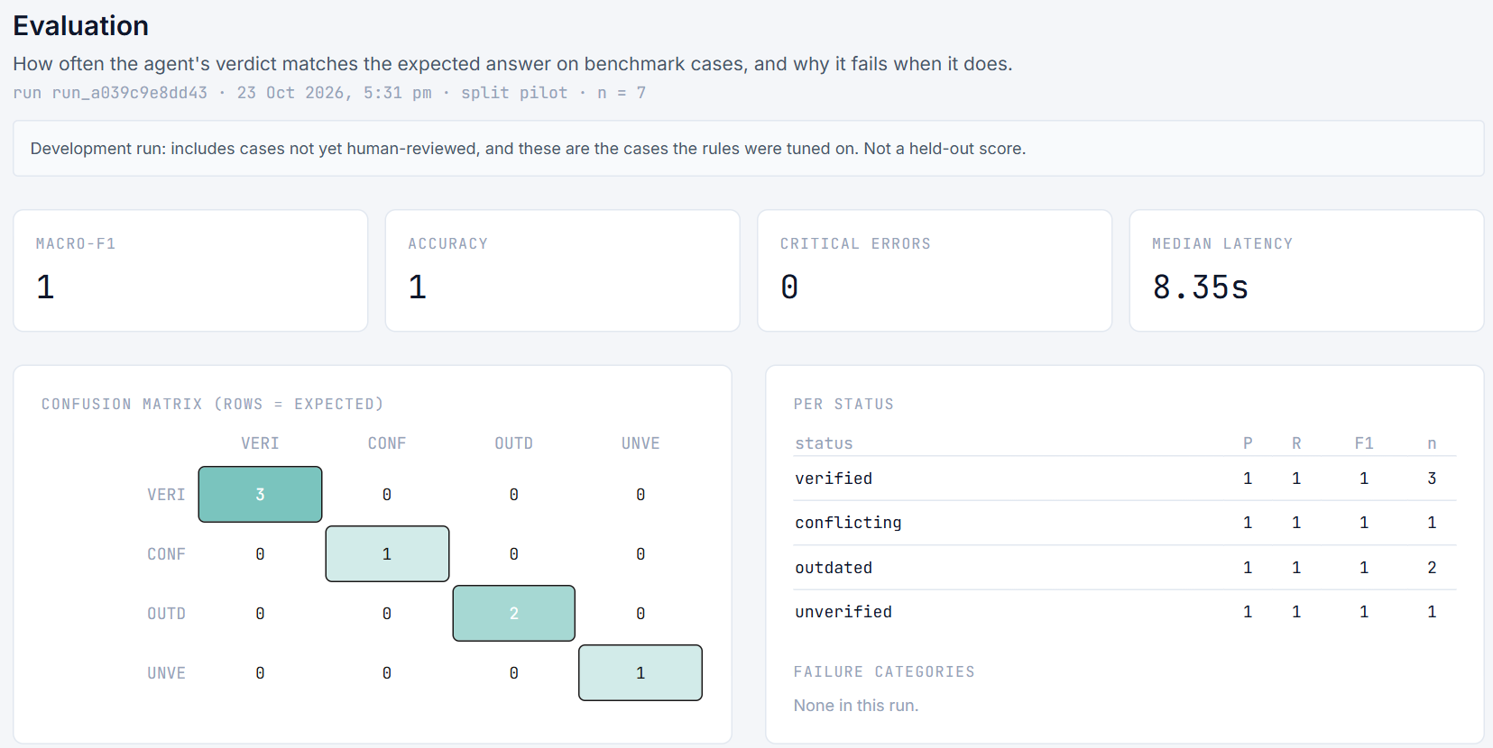
HACKNOVA’26 | PULZION’26
PICT ACM Student Chapter (PASC) — Pune Institute of Computer Technology (PICT), Pune
Feasibility, Impact & Benefits
PILOT EVALUATION · APP SCREENSHOT
RISKS & MITIGATIONS
Risk
Mitigation
NLI misreads short or slangy posts
Numeric, geo and time rules come first; disagreement → Unverified
Live feeds down at the venue
Snapshot mode serves cached feeds
Local news early but wrong
Lower trust than official / sensor layers; conflicts shown side by side
Copied stories inflate confidence
Copies grouped; each group counts once
Gemini unavailable
Retry, lighter model, then rules-only extraction
Not a held-out accuracy. 7 / 7 correct, 0 critical errors, 8.35 s median on 5 pilot claims (7 checks). Rules were tuned on these cases; not yet human-reviewed.
FEASIBILITY
Technical: one laptop; local NLI + embedding models; free public feeds, no paid APIs
Operational: NDMA SACHET CAP is public and structured; snapshot mode works offline
Workflow: control rooms already triage reports; the Console adds the evidence
BENEFITS
Responders: triage with the evidence attached
Citizens: alarms only for verified threats
Authorities: see which rumours spread where
HACKNOVA’26 | PULZION’26 • PICT ACM Student Chapter (PASC), PICT Pune
Slide 8 / 10

Slide 9


HACKNOVA’26 | PULZION’26
PICT ACM Student Chapter (PASC) — Pune Institute of Computer Technology (PICT), Pune
Implemented vs Planned
PS-2 core: implemented
Beyond the brief: implemented
Planned: not built yet
Claim extraction (atomic facts)
Beacon citizen app (verified-only alarm)
~50-case human-reviewed benchmark
Source comparison, 5 layers
Rumour-check cards
Review UI for that benchmark
Freshness via validity windows
HISTORICAL vs CURRENT verdicts
Recycled image / video checks
Contradiction detection
Event binding (Puebla vs Tehuantepec)
Mobile push notifications
Geographic verification
Copied stories count once
GPU acceleration
Evidence For / Against per claim
Hindi / Marathi posts
Why it matters
Evaluation covers 5 pilot claims so far. The reviewed benchmark comes before any accuracy claim.
Demo posts (Pune flood, Delhi quake) are synthetic and labelled; live NDMA / GDACS alerts are real.
4 statuses
Live NDMA SACHET CAP polygons
Dashboard + interactive map
Offline snapshot mode
HACKNOVA’26 | PULZION’26 • PICT ACM Student Chapter (PASC), PICT Pune
Slide 9/ 10

Slide 10
HACKNOVA’26 | PULZION’26
PICT ACM Student Chapter (PASC) — Pune Institute of Computer Technology (PICT), Pune
THANK YOU!
Questions & Discussion
SachVerify · Team Alebaple · github.com/DevanshNarlawar06/Alebaple_hacknova
HACKNOVA’26 | PULZION’26 • PICT ACM Student Chapter (PASC), PICT Pune
Slide 10 / 10

