Slide 1

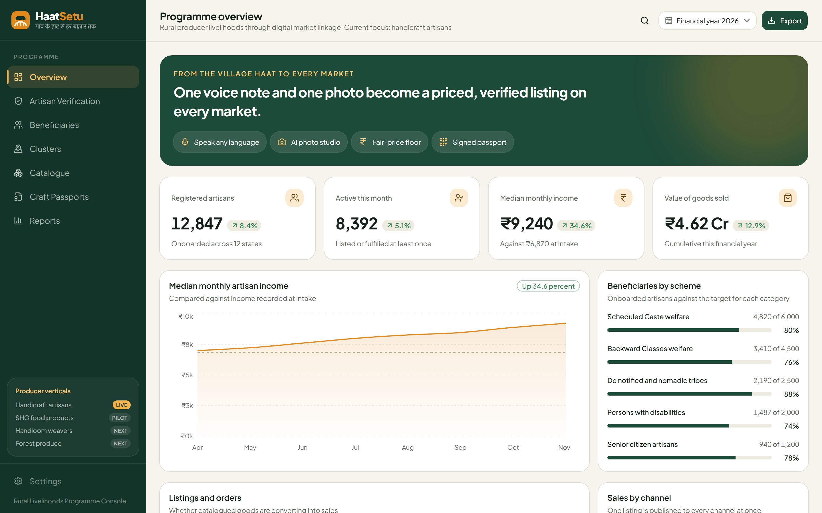
HaatSetu
From the village haat to every market
A voice-first digital market bridge for rural producers
Working prototype: programme console
Theme: Digital Empowerment for Rural Communities
Team Luminescence · [College name]
Notes:
VIDEO 0:00–0:05. Hi, we're Team Luminescence, and this is HaatSetu: a bridge from the village haat to every market.

Slide 2

Team Luminescence
WHO WE ARE
[Member 1]
[Member 2]
[Member 3]
[Member 4]
[Role · e.g. AI & backend]
[Role · e.g. Mobile app]
[Role · e.g. Web console]
[Role · e.g. Research & design]
[College name] · Same-college team of 2–4 members
Notes:
Replace the placeholders with names, photos and roles. VIDEO: each member says name and role in one line (about 8 seconds total).

Slide 3
Rural producers can't reach the market on fair terms
THE PROBLEM
Selling online assumes literacy, English, product photography, pricing knowledge and marketplace know-how. Most rural producers have none of these. They depend on the local haat, fairs and middlemen, so income is seasonal and their share of the final price stays small.
64.66 lakh
₹270 / day
handloom & handicraft artisans in India, ~64% women
gross value added per craft worker, below minimum wage
Ministry of Textiles, 2025
IHD–Crafts Council of India
We start with handicraft artisans, where the gap between the value of the craft and the maker's income is widest.
1 : 10
548 M
source-to-retail price ratio, "not at all rare"
rural internet users. Phones are there; selling tools aren't
Dilli Haat study
IAMAI–Kantar, 2025
Notes:
VIDEO 0:05–0:18. India has over 64 lakh artisans, mostly women, earning around 270 rupees of value a day. They have phones, but every selling tool assumes they can type English, take studio photos and price like a trader. So middlemen take most of the value.

Slide 4




Four barriers, and they are not unique to crafts
WHY IT HAPPENS
Access
Language & literacy
Sales depend on the local haat, seasonal fairs and middlemen who set the price
Listing means typing English into forms; most producers are comfortable speaking, not typing
Presentation
Price & trust
Cluttered phone photos make a fine product look cheap online
Pricing by guesswork; buyers can't tell genuine handmade or GI goods from copies
The same four barriers hit 10 crore SHG women (90 lakh+ groups), handloom weavers and forest-produce collectors. So HaatSetu is built for rural producers in general, starting with crafts.
Notes:
These barriers apply to every rural producer, which is why the platform generalises. SHG figure: DAY-NRLM, Ministry of Rural Development, 2025.

Slide 5

Every option is a place to sell. None creates the listing
EXISTING SOLUTIONS
Existing solution | What it offers | What's missing
Amazon Karigar, Flipkart Samarth | Marketplace seller programmes | Artisan still shoots photos, writes English, sets price
iTokri, Jaypore | Curated handmade stores | Curator-led and small; not the artisan's own tool
TRIFED / Tribes India, GeM | Government sales channels | One channel each; no listing help
ONDC seller apps | Open-network access | Assume a digitally confident seller
Etsy | Global handmade market | English-first, international, no India context
HaatSetu's gap
Turns one voice note and one phone photo into a finished, fairly priced, verified listing, then publishes it to all of these channels.
Notes:
Key line: they are destinations; HaatSetu is the on-ramp that feeds all of them.

Slide 6
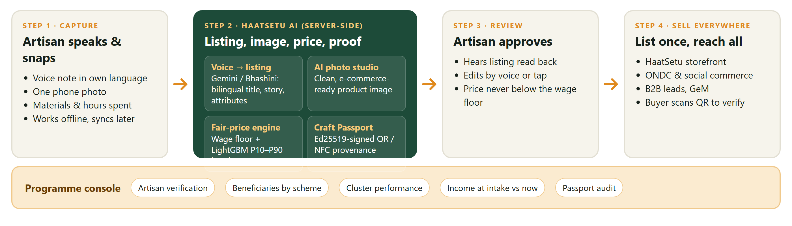



One voice note + one photo → a priced, verified listing
OUR SOLUTION
Smartphone only
Works offline
Artisan stays in control
No special hardware; Flutter app for low-end Android
Drafts save on the phone and sync without duplicates
Hears and edits every listing before it goes live
Notes:
VIDEO 0:18–0:30. With HaatSetu, an artisan just speaks about the product in their own language and takes one photo. Our AI writes a bilingual listing, turns the photo into a studio image, suggests a fair price and signs a digital passport. Then one tap publishes it to our store, ONDC, social commerce and B2B buyers.

Slide 7


What no existing platform does
TOP 3 NOVEL FEATURES
01
02
03
Speak, don't type
Fair-price floor
Signed Craft Passport
A voice note in the artisan's own language becomes a bilingual listing: title, story and attributes. Each language is generated natively, not machine-translated. Gemini, with Bhashini as fallback.
Price = materials + hours × fair wage + overhead, combined with a market band (P10–P90). The system never suggests a price below the maker's wage, and the server enforces this rule.
A QR/NFC tag with an Ed25519 signature proving artisan, region and technique. Buyers verify it, not just read a claim, which builds trust and supports GI value.
Notes:
VIDEO 0:30–0:42. Three things make us different: one, speak don't type, voice to bilingual listing. Two, a fair-price floor: we never suggest a price below the maker's wage. Three, a cryptographically signed Craft Passport buyers can verify.

Slide 8
Built on proven, India-first technology
TECHNICAL APPROACH & FEASIBILITY
Artisan app
Flutter · offline drafts · voice-first UI · language onboarding
70 / 70
backend tests pass: pricing rules, passport tampering, degraded modes
AI services
Gemini audio→listing · Bhashini (MeitY) / Sarvam fallback · AI image studio
Live
Intelligence
LightGBM quantile pricing (P10/P50/P90) · CLIP search in pgvector
programme console prototype built and running
Trust & data
FastAPI · PostgreSQL + pgvector on Supabase · Ed25519 passports
0
Programme console
Next.js dashboard: verification, schemes, clusters, income lift
special hardware: a basic smartphone is enough
Notes:
All AI runs server-side, so a model can be swapped without shipping an app update. Every provider sits behind one interface (Gemini, Bhashini, Sarvam).

Slide 9




The programme console is already working
PROTOTYPE
Beneficiaries by scheme
Coverage against target for each welfare category
Income lift
Median income now vs at intake, the measure ministries care about
Artisan verification
Review queue for ID documents before a seller goes live
Producer verticals
Artisans live; SHG food, handloom, forest produce next
Screenshot figures are sample data.
Notes:
Add artisan-app screens here (photo studio before/after, voice listing) once captured from the Flutter build. Console figures are sample data.

Slide 10



Better incomes, trusted crafts, visible impact
POTENTIAL IMPACT
Producers
Buyers
Government
Society & culture
Year-round market access
From 10+ steps to one input
Fair-wage price floor
Verified authentic crafts
Maker's story and region
Discovery by state & culture
Income lift measured per beneficiary
Plugs into GeM, ONDC, Pehchan
Cluster-level insight
Digital preservation of crafts
Women-led livelihoods (~64% women)
Less migration, local value
Notes:
VIDEO 0:42–0:52. Artisans get year-round income and fair prices, buyers get verified authentic crafts, and government finally sees income lift per beneficiary.

Slide 11
Focused today, built to generalise
IMPLEMENTATION PLAN
PHASE 1
PHASE 2
PHASE 3
Artisans
SHG food products
Handloom & forest produce
Pilot with one craft cluster: voice listing, photo studio, fair price, passport
DAY-NRLM SHGs: pickles, millets, honey. Same pipeline, new categories and "Origin Passport"
Weavers and tribal collectors; scale across ONDC, GeM and B2B buyers
Why it scales: voice-to-listing, photo studio, price floor and provenance work for any rural product. A new vertical is a configuration change (vocabulary, categories, price features), not a rewrite.
Notes:
Implementation plan for the video: pilot with one cluster, then SHG products through DAY-NRLM, then handloom and forest produce.

Slide 12
HaatSetu
गाँव के हाट से हर बाज़ार तक
Speak in your language. Sell to all of India.
Thank you · Team Luminescence · [College name]
Notes:
VIDEO 0:52–1:00. HaatSetu: speak in your language, sell to all of India. Thank you.

