Slide 1
Handwritten Digit Recognition
DEVANSH SUBNANI

Slide 2
Business Problem
As human being can recognize different elements present in images, but it is not easy for machine to recognize handwritten images accurately because there is variation in writing style of every individual. So we have to improve performance of machine.

Slide 3
To implement Handwritten Digit recognition app, MNIST dataset is used.
MNIST dataset is a large dataset of handwritten digits that is widely used for training and testing in the field of machine learning and deep learning.

Slide 4
Steps to implement the MNIST Digit Classification Project to recognise handwritten digits:
Import the libraries and load the MNIST dataset
Data Preprocess and Normalize
Create the model
Train the model
Evaluate the model
Create GUI to predict digits

Slide 5
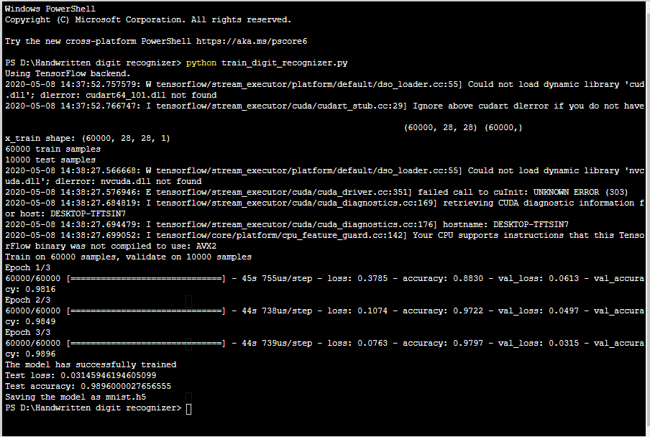
Output of train_digit_recognizer.py

Slide 6
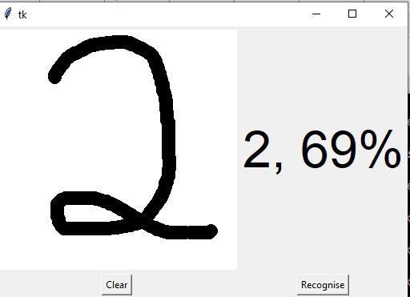
GUI Output

Slide 7
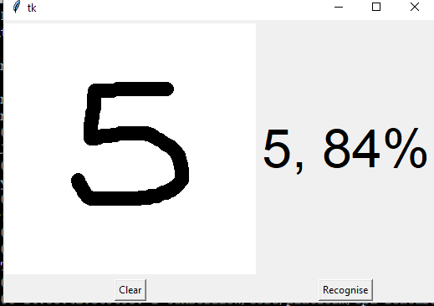
GUI Output

