Slide 1
Predictive Analysis on Chronic Kidney Disease Using ML Techniques
Mentor :
Ms.Geetika Dhand
DEVANSH SHARMA (35315002715)
KANISHK RATHI (35515002715)
MAYANK SHOKEEN (35715002715)
SAKSHI SINGH (36015002715)
(GROUP NO. – 14)

Slide 2
Objective
Chronic Kidney Disease (CKD) project is designed to provide comprehensive public health strategies for promoting kidney health.
Finding the best possible algorithm that can be used in the system in order to predict kidney disease in early stage.

Slide 3
INTRODUCTION
Chronic kidney disease is a worldwide public health problem with an increasing incidence, prevalence, and high cost.
Chronic kidney disease may be caused by diabetes, high blood pressure, hypertension, Coronary artery Disease, lupus, Anaemia, Bacteria and albumin in urine, complications from some medications

Slide 4
WORK PLAN
PHASE 1
PHASE 2
PHASE 3
PHASE 4
Literature Survey
Data Collection
Inspect Technologies
Data leaning
Transformation
Scaling
Training the Algorithms
Improve the Algorithm
Tuning parameters of Algorithms

Slide 5
PHASE 1
Phase 1 includes literature survey to understand the previous work done in the field of machine learning in healthcare field and data prediction.
Scraping the best possible dataset and parsing of data to the Appropriate level.

Slide 6
DATASET
The Indians Chronic Kidney Disease (CKD) dataset consists of 26 attributes collected from UCI machine learning repository.
The Attribute of this dataset consists of two types of attributes which are numeric and categorical attributes divided into 11 numeric features and 14 categorical features.

Slide 7
PHASE 2
Phase 2 includes the PRE-PROCESSING of Dataset.
Data cleaning (removing null values from the dataset)
Data transformation - converting data from one format or structure into another format or structure.
Categorical values present in various features converted(one hot encoded) to numeric values.
Scaling of Discrete features.

Slide 8
PRE-PROCESSING
The preprocessing of dataset is done using the python modules namely NumPy, seaborn, matplotlib, Ski-kit(sklearn) and Pandas.
The Attributes of this dataset are of two types of namely - numeric and categorical attributes. The entire dataset can be divided into 11 numeric attributes and 14 categorical attributes.

Slide 9
These are all the attributes(as shown above) which are present in the dataset. Their full forms are listed below :
Age
Blood Pressure
Specific Gravity
Albumin
Sugar
Red Blood Cells
Pus Cell
Pus Cell clumps
Bacteria
Blood Glucose Random
Blood Urea
Serum Creatinine
Sodium
Potassium
Haemoglobin
Packed Cell Volume
White Blood Cell Count
Red Blood Cell Count
Hypertension
Diabetes Mellitus
Coronary Artery Disease
Appetite
Pedal Edema
Anemia
Class

Slide 10
Data Cleaning
We worked over data cleaning [4] multiple times because the data was being lost in our initial attempt of cleaning.
We came through 3 attributes or features that were being stored as object(string) type even when their data was of floating type. So, we converted them prior to the cleaning this time.
Removing null values from the dataset with a different approach.

Slide 11
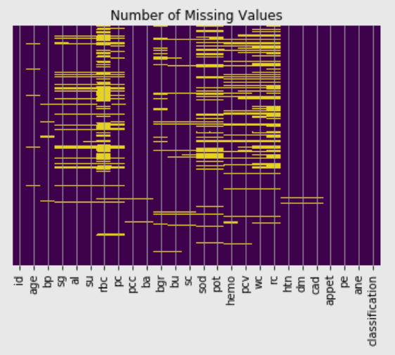
A heatmap graph was plotted using seaborn module in which we could clearly see the intensity of null values which were present in the corresponding attribute.

Slide 12
First, we tried to remove all null values starting with the nominal or discrete attributes.
Mean values of every attribute was calculated and filled out in null cells correspondingly for all discrete features.

Slide 13
Then, we started working upon the categorical features.
We manually checked every attribute for their distinct values that were present in them.
Some features had some spaces in their values making their distinct values of more than 2(every attribute came out to be having two distinctive values).
So, we had to take care of these anomalies too.

Slide 14
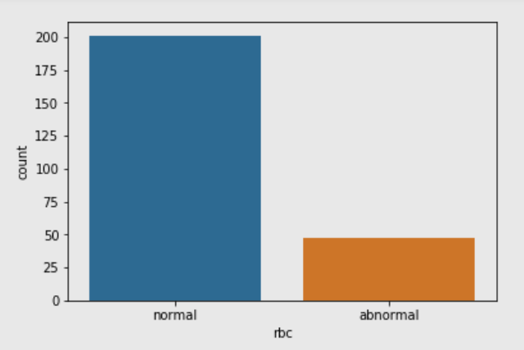
While we were checking for these anomalies, at the very same time we visualized using bar graphs for every attribute to check the majority of value which was occurring in that feature. For instance, in case of feature ‘rbc’, the graph for it came out to be something like this :

Slide 15
This visualization was enacted using ‘seaborn’ module.
In this way, we were able to check for the most frequent value present in a feature and filled that value in the null cells of that attribute.
We did the same step for all 11 categorical features, checking for unique values, plotting graph and lastly filling null values out, making them complete, i.e. no null values in the entire dataset at last.

Slide 16
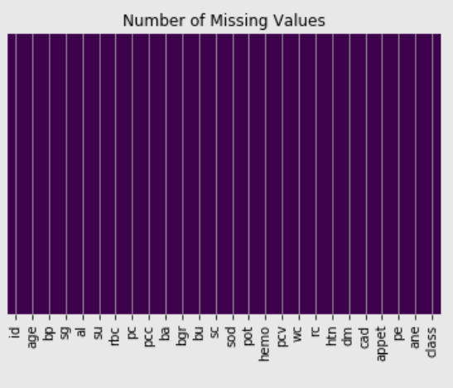
Another heatmap graph was plotted lastly just to be doubly sure about the null values rectification.
This time, it came out to be completely empty.

Slide 17
Data Transformation
The process of converting data from one format or structure into another format or structure.
In case of categorical features, they are simply converted(one hot encoded) into numeric ones [4]
Also, the target attribute is converted into numeric type.

Slide 18
Scaling of discrete features
Now we'll scale those features who have a greater difference in their minimum and maximum values.
They can cause a greater difference in accuracy.
We checked for all the features out of discrete ones that needed to be scaled.

Slide 19
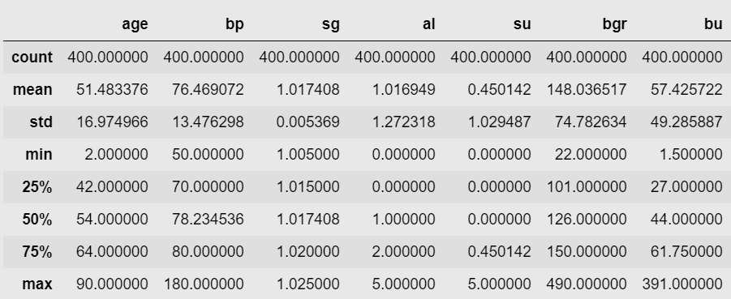
The discrete attributes were taken into consideration.
Using pandas module, we were able to check the minimum, maximum, mean and all other important aspects that signified the need to scaling a feature.

Slide 20
11 discrete features were needed to be scaled which were:
The scaling of features was done using ski-kit module’s MinMaxScaler() function.

Slide 21
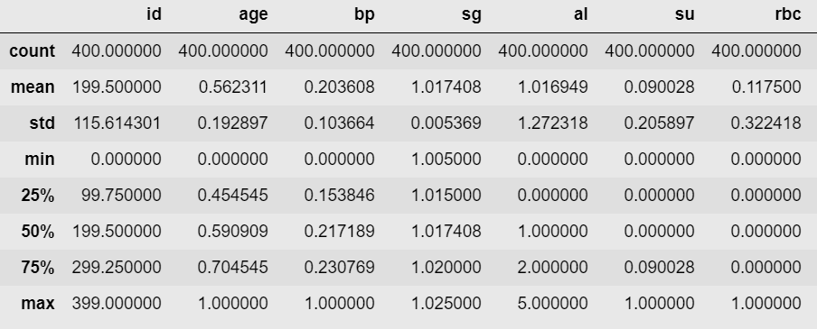
After scaling, the minimum and maximum values were changed to 0 and 1 to all the attributes which were scaled. The description of the features after cleaning can be seen :

Slide 22
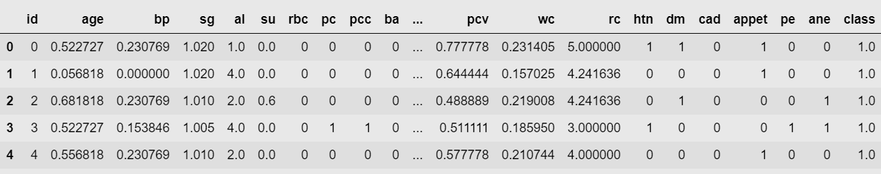
After data cleaning and transformation of the entire dataset, the first 5 rows when partially displayed had no null or non-numeric attributes as such.

Slide 23
PHASE 3
Various Machine learning techniques are used in order to train the algorithm via classifiers and the best performing model is taken in account.
Classification Algorithm used-
K-nearest neighbors (KNN)
Decision Tree
Random Forest
Naïve Bayes
Support Vector Machine(SVM)
Logistic Regression

Slide 24
Training and tuning of Algorithms
For every algorithm (classifier) used, we tried to get the maximum accuracy possible.
Used Grid search cross validation so as to get the best possible combination of parameters for every classifier.
In this way, got the best classifier possible.

Slide 25
Feature Selection
Random forest showed a better result so, we reworked over its accuracy.
Now for classification, out of all the features there might be the ones which are supporting in accuracy and the ones which are not.
We extracted the best possible features that were supporting in accuracy.

Slide 26
Plotted a graph using matplotlib showing features as per their importance.

Slide 27
Result
A graph was also plotted to compare accuracies obtained by various algorithms.

Slide 28
BEST POSSIBLE ACCURACY OBTAINED
ALGORITHM ACCURACY OBTAINED
K-Nearest Neighbor (KNN) 93.94%
Naïve Bayes 96.97%
Support Vector Machine (SVM) 97.05%
Decision Tree 97.77%
Logistic Regression (LR) 98.48%
Random Forest 99.17%

Slide 29
REFERENCES
[1] R. Kei Chiu, R. Y. Chen, S. Wang, S. Jian, “Intelligent systems on the cloud for the early detection of chronic kidney disease,” Machine Learning and Cybernetics, IEEE, pp. 1737 – 1742, July 2012.
[2] Miguel A. Estudillo-Valderrama; Alejandro Talaminos-Barroso; Laura M. Roa;David Naranjo-Hernández; Javier Reina-Tosina; Nuria Aresté- Fosalba; José A. Milán-Martín, “A Distributed Approach to Alarm Management in Chronic Kidney Disease ,” IEEE Transl. Biomedical and Health Informatics , vol. 18, pp. 1796 – 1803, November 2014.
[3] A. Charleonnan, T. Fufaung, Tippawan Niyomwong, W. Chokchueypattanakit, Sathit Suwannawach, Nitat Ninchawee, "Predictive Analytics for Chronic Kidney Disease Using Machine Learning Techniques", Proc. Management and Innovation Technology International Conference (MITiCON-2016), Oct. 2016.
[4] https://quantdare.com/data-cleansing-and-transformation/

