Slide 1


Slide 2
PLANNING
Key Components • Nature • Levels
Structure • Design

Slide 3
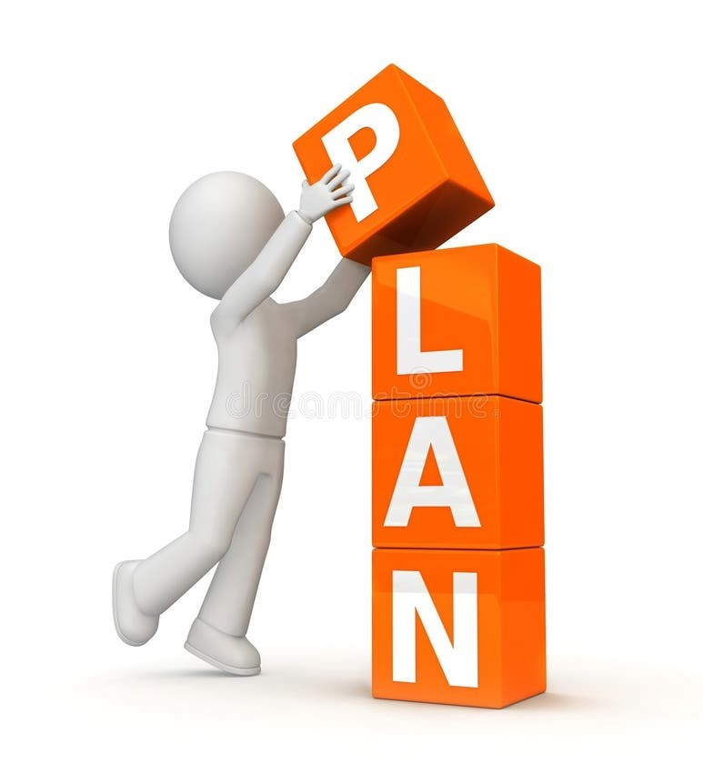
WHAT IS PLANNING?
Planning means deciding in advance what you want to achieve and how you will achieve it. It involves setting goals, choosing actions, and arranging the resources and time needed.
In short, planning helps you move from where you are now to where you want to be by thinking ahead and making smart decisions.

Slide 4
KEY COMPONENTS OF PLANNING
Objectives
Clear, measurable goals for the organization
Provide direction for all activities
Policies
General guidelines for decision-making
Ensure consistency across departments
Procedures
Step-by-step methods to carry out tasks
Standardizes workflow
Rules
Specific statements that must be followed
No flexibility allowed
Programs
Comprehensive plan combining goals, policies, procedu
Example: Training program, marketing program
Budgets
Numerical plans for allocating resources
Helps in cost control and performance measurement
Strategies
Broad long-term plans to achieve competitive advantage
Example: Market expansion, cost leadership

Slide 5
NATURE OF PLANNING
Goal-Oriented
Focuses on achieving objectives
Primary Function of Management
Foundation for organizing, staffing, directing & controlling
Pervasive
Required at all levels: top, middle, and lower
Continuous Process
Plans must be updated according to change
Future-Oriented
Anticipates future conditions and prepares accordingly
Decision-Making Activity
Involves choosing the best alternative
Flexible
Adjusts to internal and external changes
Integrated
Coordinates different departments and resources

Slide 6
LEVELS OF PLANNING
Strategic Planning (Top Level)
Long-term (5–10 years)
Focus: Vision, mission, major goals
Example: Expansion, diversification, mergers
Tactical Planning (Middle Level)
Medium-term (1–3 years)
Converts strategic plans into actionable steps
Example: Department-level goals & resource allocation
Operational Planning (Lower Level)
Short-term (daily/weekly/monthly)
Ensures smooth day-to-day operations
Example: Work schedules, shift planning, routine tasks

Slide 7
ORGANIZING
Fundamentals • Organization structure
Design

Slide 8
Fundamentals
Definition
Organizing is the process of identifying tasks, grouping them, assigning duties, and establishing authority relationships.
Key Elements
Job Identification: What tasks must be done
Departmentation: Grouping tasks (HR, Finance, Marketing)
Assignment of Duties: Who will do what
Delegation of Authority: Granting power to perform tasks
Coordination: Ensuring departments work together smoothly
Importance
Efficient use of resources
Clarity in roles and responsibilities
Reduces confusion and duplication
Improves teamwork and productivity

Slide 9
ORGANIZATION STRUCTURE
Functional Structure
Based on functions (Finance, HR, Production)
Simple and efficient
Best for small/mid-sized companies
Divisional Structure
Based on products, regions, or customer groups
Each division operates like a small company
Suitable for large diversified organizations
Matrix Structure
Combines functional & project structures
Employees report to two managers
Good for complex, innovative projects
Team-Based Structure
Organized around teams rather than hierarchy
Fast decision-making and flexibility
Network / Virtual Structure
Core company outsources non-essential activities
Highly flexible and cost-efficient

Slide 10
ORGANIZATION DESIGN
Definition
Process of creating or modifying the structure of an organization to achieve strategic goals.
Key Principles
Specialization: Dividing work into smaller tasks
Span of Control: Number of employees supervised by a manager
Chain of Command: Clear line of authority
Centralization vs Decentralization: Where decisions are made
Formalization: Rules, procedures, and documentation
Factors Affecting Design
Size of the organization
Technology used
Nature of environment (stable or dynamic)
Organizational goals
Workforce skills

Slide 11
THANK YOU

