Slide 1


Slide 2
Fundamental Counting Principle

Slide 3
What is the Fundamental Counting Principle?
The Fundamental Counting Principle (often called the Multiplication Rule) is a way of finding how many possibilities can exist when combining choices, objects, or results. This is done by multiplying each total choice count from each group being combined.

Slide 4
Fundamental principle of counting is a rule used to find the total number of outcomes possible in a given situation. Fundamental principle of counting can be classified into two types
Multiplication Rule (AND rule)
Addition Rule (OR rule)
Multiplication Rule
If a certain work W can be completed by doing 2 tasks, first doing task A AND then doing task B. A can be done in m ways and following that B can be done in n ways, then the number of ways of doing the work W is (m x n) ways.

Slide 5
Addition Rule
If work W can be completed by doing task A OR task B, and A can be done in m ways and B can be done in n ways (and both cannot occur simultaneously: in this case we call tasks A and B as mutually exclusive), then work W can be done in (m + n) ways.
For example, let’s say that a person can travel from New Delhi to Noida in 3 different types of buses, and 2 different types of trains, so, he can complete the work of going from New Delhi to Noida in 3 + 2 = 5 ways (As work can be completed by going by bus (A) OR by going by train (B))

Slide 6
QUESTION 1
A door on a classroom requires entry of 4 digits. All digits must be numbers, but the digits can not be repeated. How many unique codes are possible?
362880
40320
5040
720
Notes:
ans: c
10P4 = 5040
10*9*8*7

Slide 7
QUESTION 2
Bakery has a selection of 20 different cupcakes,10 different donuts and 15 different muffins. If you are to select a tasty treat, how many different choice of sweets can you choose from?
25
45
20
35
Notes:
Ans: b
45P1 = 45

Slide 8
QUESTION 3
How many different 4-digit ATM passwords are there? Assume you can repeat digits.
1000
1050
900
10000
Notes:
Ans: d
10^4

Slide 9
QUESTION 4
Suppose you have 5 of shirts and 4 of pants. In how many ways can you wear them?
A) 20
B) 16
C) 12
D) 15
Notes:
ANS: A
5c1 *4c1 = 20

Slide 10
PERMUTATION

Slide 11
FORMULA
^{n}P_{r} = n! /(n-r)!
The number of object is “n”
Permutation is “P”
The selection of object to be “r”

Slide 12
Question 1
How many numbers can be made with the digits 3, 4, 5, 6, 7, 8 lying between 3000 and 4000 which are divisible by 5 while repetition of any digit is not allowed in any number?
60
12
120
24
Notes:
Ans: B) 12
First digit = 3 = 1 ways; last two digits must be 25,75 (for divisibility of 25)
_ 2 5
1 ways *4 ways 3w*1w = 12 w

Slide 13
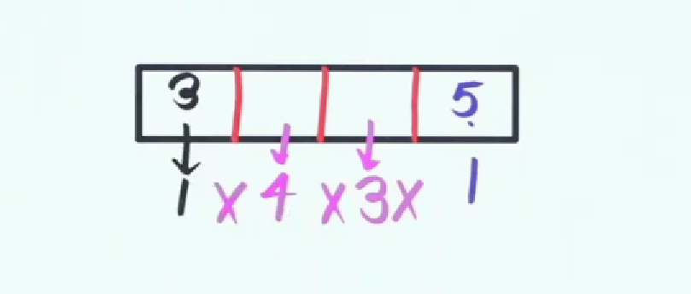
Answer

Slide 14
Question 2
The number of 5 digit numbers which are divisible by 4, with digits from the set{1,2,3,4,5} and the repetition of digits is allowed, is ________?
625
500
600
525
Notes:
Ans: A) 625

Slide 15
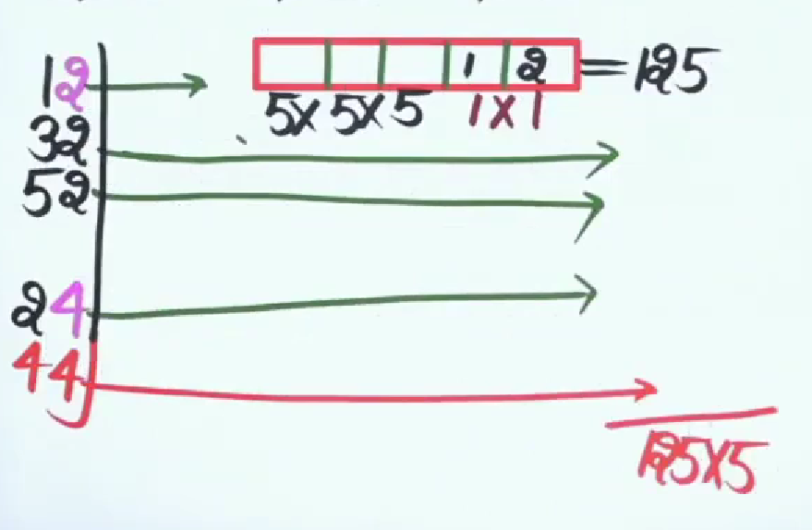
Answer

Slide 16
Question 3
N is the total number of 5-digit numbers which are divisible by 4 and the numbers are formed using the digits 1, 2, 3, 4, 5 and 6. No digit is repeated in the number. What is the value of N?
144
162
NOT
192
Notes:
Ans: D) 192

Slide 17
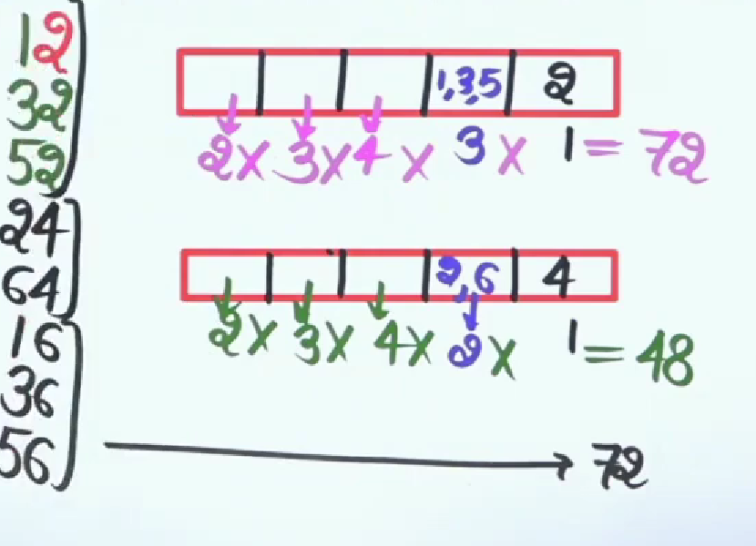
Answer

Slide 18
Question 4
How many words can be framed by the letter of the word MANISH?
720
480
360
240
Notes:
Ans: A) 720

Slide 19
Question 5
In how many ways letters of the word RUMOUR can be arranged?
180
720
360
90
Notes:
Ans : A) 180

Slide 20
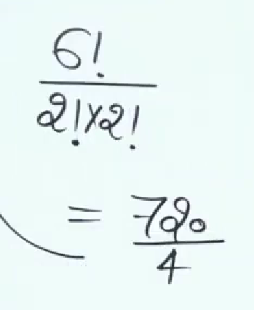
Answer

Slide 21
Question 6
In how many ways 4 boys and 3 girls can be seated in a row so that they are alternate?
144
720
256
120
Notes:
A) 144

Slide 22
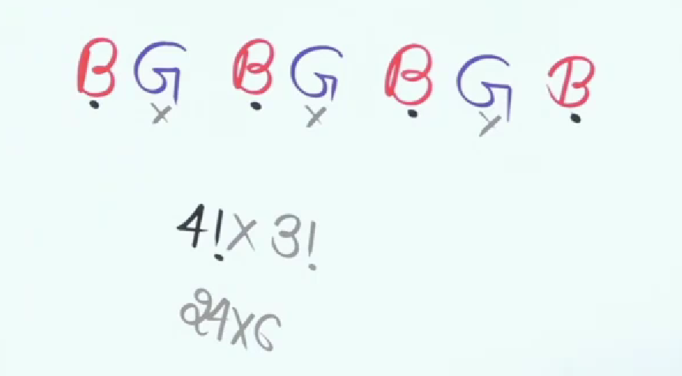
Answer

Slide 23
Question 7
How many different words can be formed from the letters of the word ‘EQUATION’ without changing the relative order of vowels and consonant?
120
240
360
720
Notes:
Ans: D) 720

Slide 24
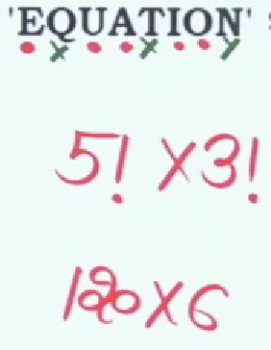
Answer

Slide 25
Question 8
In how any ways can the letter of the word MONDAY be arranged? How many begin with M and don’t end with Y?
72
96
84
90
Notes:
Ans: B) 96

Slide 26
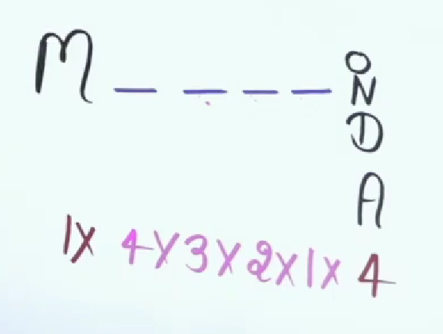
Answer

Slide 27
Question 9
In how many ways can the letters of the word 'ARRANGE' be arranged? How many of these arrangements are in which two R's come together
Notes:
Ans : A) 360

Slide 28
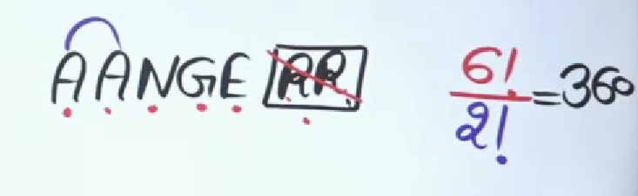
Answer

Slide 29
Question 10
In what ways the letters of the word "PUZZLE" can be arranged to form the different new words so that the vowels always come together?
280
450
630
120
Notes:
Ans: D) 120

Slide 30
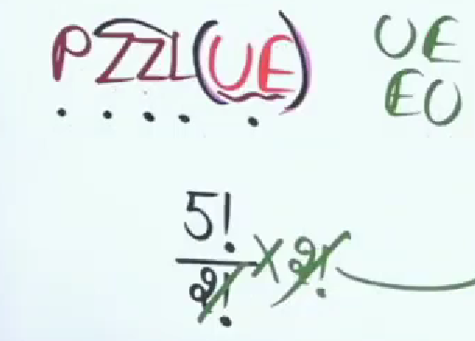
Answer

Slide 31

QUESTION 10
The number of non negative integral solutions of the equation a + b + c + d = 20 will be
1208
4042
1140
1771
Notes:
Number of ways of distributing ‘n’ identical things among ‘r’ persons when each persons may get any no. of things is n+r-1Cr-1.
Here there are 20 identical things (1,1,…1 (20 times) to 4 different people. Each one of them can get any number of identical things.
20+4-1 C 4-1 = 23C3 = 23*22*21/1*2*3 = 23*11*7 = 1771

Slide 32
Circular Permutation

Slide 33
Circular Permutation
Permutation arrangements are of many types, they range from linear to circular. Circular arrangements are the type of permutations where the people or things are organized in a circle. In other terms, this arrangement is said to be circular .
Rules of Circular Permutations
The numerous methods to organize different items along a stable (i.e., not able to chosen up out of the even and spun over) circle is Pn = (n-1)!.
The number is (n-1)! as a substitute for the normal factorial n! as all cyclic arrangements of items are equal since the circle can be swapped.
Number of arrangements possible = (n − 1)!

Slide 34
QUESTION 1
Determine the number of ways in which 5 married couples are seated on a Circular Round table if the spouses sit opposite to one another.
A) 120
B) 320
C) 384
D) 387
Notes:
Correct option: 3
Number of arrangements possible = (n − 1)!
5 Married couples means we have to arrange 10 peoples
Total number of ways 1×8×1×6×1×4×1×2×1=384 Ways

Slide 35
QUESTION 2
A necklace is made using 6 different colored beads. How many distinct necklaces can be formed by rearranging the beads?
Notes:
Solution :
Number of arrangements possible = (n − 1)!
the total number of distinct necklaces = (6-1)!/2 = 5! = 120/2 = 60

Slide 36
QUESTION 3
Anuradha invited her 5 friends for dinner. In how many ways she can make them sit around a circular table?
120
12
24
72
Notes:
Number of arrangements possible = (n − 1)!
= (5 – 1)!
= 4!
= 24
Correct option: 3

Slide 37
QUESTION 4
A gardener wants to plant some Neem trees around a circular pavement. He has 7 different sizes of Neem trees. In how many different ways can the Neem tree be planted?
2520
2400
5040
720
Notes:
Number of arrangements possible = (n − 1)!
= (7 – 1)!
= 6!
= 720
Correct option: 4

Slide 38
QUESTION 5
Five people are sitting on a round table for meeting. These are P, Q, R, S, and T. In how many ways these people can be seated?
17
24
4
5
Notes:
Ans: b
these people can arrange in (n-1)! = (5-1)! = 4! Number of ways these people can be arranged = 24

Slide 39
THANK YOU

