Slide 1


Slide 2
FORMULA
^{n}P_{r} = n! /(n-r)!
The number of object is “n”
Permutation is “P”
The selection of object to be “r”

Slide 3
Question 1
How many numbers can be made with the digits 3, 4, 5, 6, 7, 8 lying between 3000 and 4000 which are divisible by 5 while repetition of any digit is not allowed in any number?
60
12
120
24
Notes:
Ans: B) 12

Slide 4
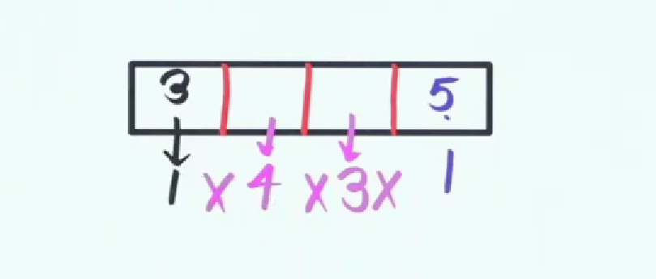
Answer

Slide 5
Question 2
The number of 5 digit numbers which are divisible by 4, with digits from the set{1,2,3,4,5} and the repetition of digits is allowed, is ________?
625
500
600
525
Notes:
Ans: A) 625

Slide 6
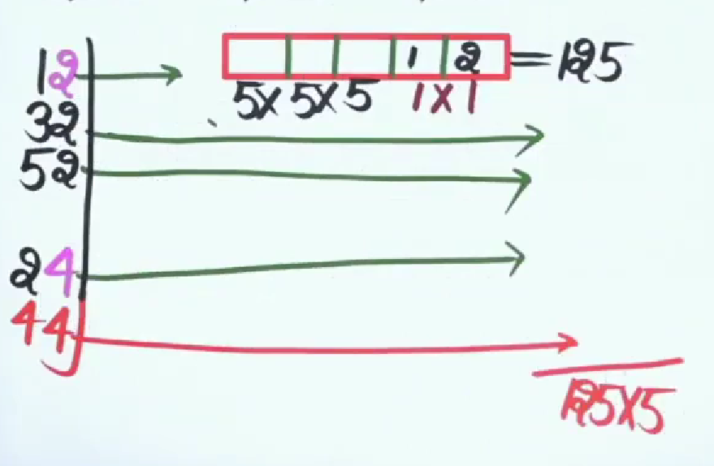
Answer

Slide 7
Question 3
N is the total number of 5-digit numbers which are divisible by 4 and the numbers are formed using the digits 1, 2, 3, 4, 5 and 6. No digit is repeated in the number. What is the value of N?
144
162
NOT
192
Notes:
Ans: D) 192

Slide 8
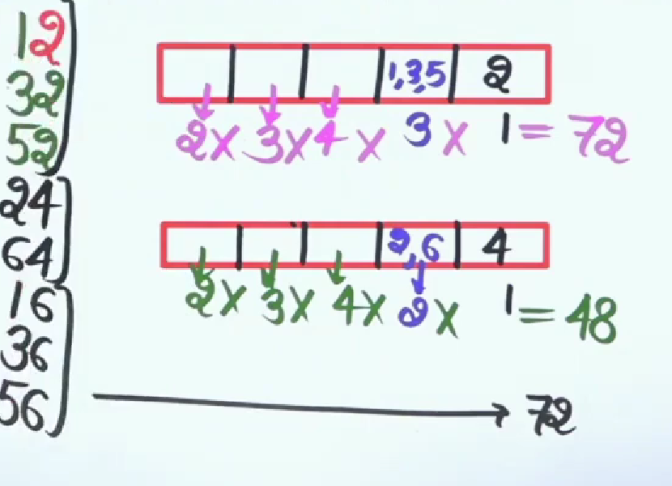
Answer

Slide 9
Question 4
How many words can be framed by the letter of the word MANISH?
720
480
360
240
Notes:
Ans: A) 720

Slide 10
Question 5
In how many ways letters of the word RUMOUR can be arranged?
180
720
360
90
Notes:
Ans : A) 180

Slide 11
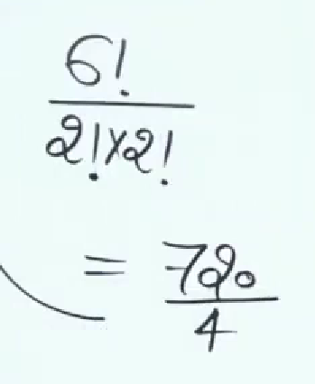
Answer

Slide 12
Question 6
In how many ways 4 boys and 3 girls can be seated in a row so that they are alternate?
144
720
256
120
Notes:
A) 144

Slide 13
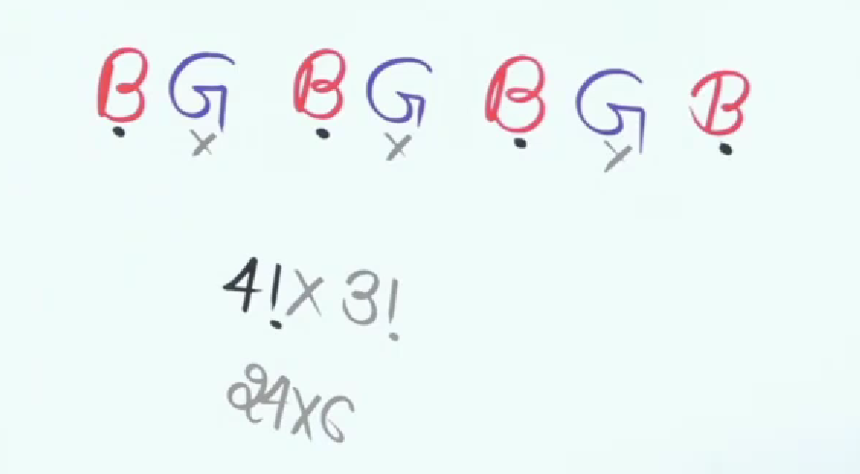
Answer

Slide 14
Question 7
How many different words can be formed from the letters of the word‘EQUATION’ without changing the relative order of vowels and consonant?
120
240
360
720
Notes:
Ans: D) 720

Slide 15
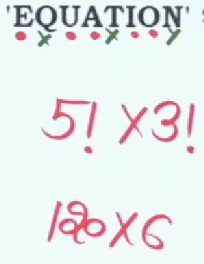
Answer

Slide 16
Question 8
In how any ways can the letter of the word MONDAY be arranged? How many begin with M and don’t end with Y?
72
96
84
90
Notes:
Ans: B) 96

Slide 17
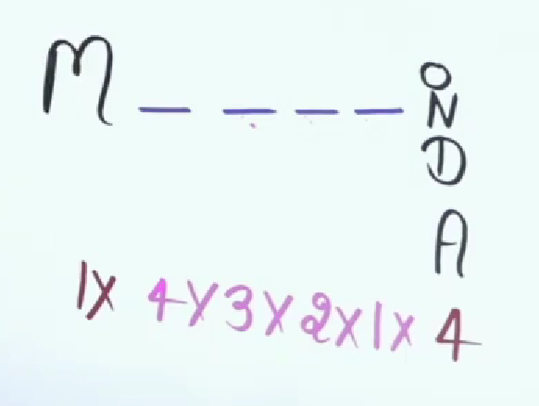
Answer

Slide 18
Question 9
In how many ways can the letters of the word 'ARRANGE' be arranged? How many of these arrangements are in which two R's come together
Notes:
Ans : A) 360

Slide 19
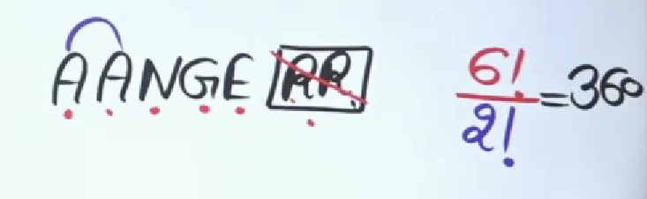
Answer

Slide 20
Question 10
In what ways the letters of the word "PUZZLE" can be arranged to form the different new words so that the vowels always come together?
280
450
630
120
Notes:
Ans: D) 120

Slide 21
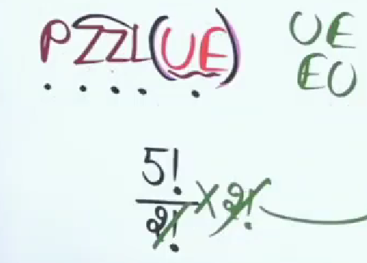
Answer

Slide 22
Circular permutation

Slide 23
QUESTION 1
Determine the number of ways in which 5 married couples are seated on a Circular Round table if the spouses sit opposite to one another.
A) 120
B) 320
C) 384
D) 387
Notes:
Correct option: 3
Number of arrangements possible = (n − 1)!
5 Married couples means we have to arrange 10 peoples
Total number of ways 1×8×1×6×1×4×1×2×1=384 Ways

Slide 24
QUESTION 2
A necklace is made using 6 different colored beads. How many distinct necklaces can be formed by rearranging the beads?
Notes:
Solution :
Number of arrangements possible = (n − 1)!
the total number of distinct necklaces = (6-1)! = 5! = 120

Slide 25
QUESTION 3
Anuradha invited her 5 friends for dinner. In how many ways she can make them sit around a circular table?
120
12
24
72
Notes:
Number of arrangements possible = (n − 1)!
= (5 – 1)!
= 4!
= 24
Correct option: 3

Slide 26
QUESTION 4
A gardener wants to plant some Neem trees around a circular pavement. He has 7 different sizes of Neem trees. In how many different ways can the Neem tree be planted?
2520
2400
5040
720
Notes:
Number of arrangements possible = (n − 1)!
= (7 – 1)!
= 6!
= 720
Correct option: 4

Slide 27
QUESTION 5
Five people are sitting on a round table for meeting. These are P, Q, R, S, and T. In how many ways these people can be seated?
17
24
4
5
Notes:
Ans: b
these people can arrange in (n-1)! = (5-1)! = 4! Number of ways these people can be arranged = 24

Slide 28
THANK YOU

