Slide 1


Slide 2
^{FORMULA}
^{n}C_{r} = n!/r!(n-r)!, when n>r
^{n}C_{r} = 0 , when n<r
Where, n = distinct object to choose from
C = Combination
R = spaces to fill (Where r can be replaced by k also)

Slide 3
Question 1
A total of 28 handshakes were exchanged at the conclusion of a
party. Assuming that each participant was equally polite towards all the others, the number of people present was:
14
7
9
8
Notes:
Ans: D) 8

Slide 4
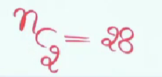
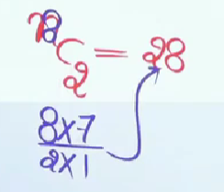
ANSWER

Slide 5
Question 2
On a new year day every student of a class sends a card to every other student. The postman delivers 600 cards. How many students are there in the class?
25
20
30
60
Notes:
Ans: A) 25

Slide 6

ANSWER

Slide 7
Question 3
In how many ways can a student choose a programme of 5 courses if 9 courses are available and 2 specific course are compulsory for every student?
25
35
70
65
Notes:
Ans: B) 35

Slide 8

ANSWER

Slide 9
Question 4
In how many ways can one select a cricket team of eleven from 17 players in which only 5 persons can bowl if each cricket team of 11 must include exactly 4 bowlers ?
3960
4040
5100
3850
Notes:
Ans: A) 3960

Slide 10
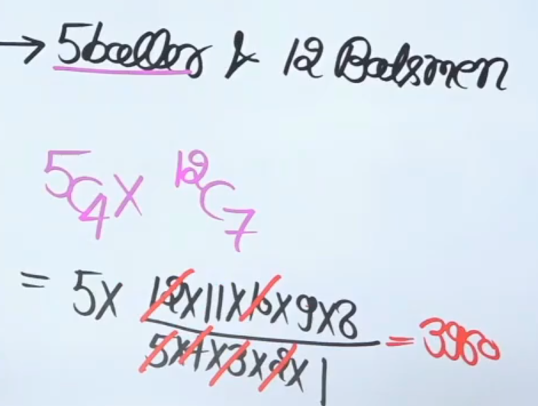
ANSWER

Slide 11
Question 5
In a touring cricket team there are 16 players in all including 5 bowlers and 2 wicket-keepers. How many teams of 11 players from these, can be chosen, so as to include three bowlers and one wicket keeper?
650
720
750
640

Slide 12
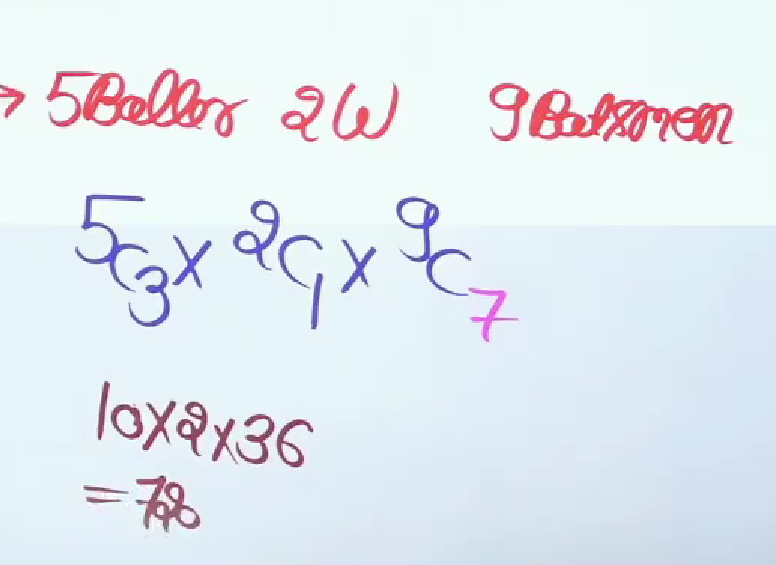
ANSWER

Slide 13
Question 6
In the 13 cricket players 4 are bowlers, then how many ways can form a cricket team of 11 players in which at least 2 bowlers included?
55
72
78
76
Notes:
Ans : c) 78

Slide 14

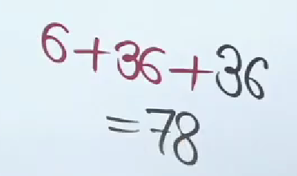
ANSWER

Slide 15
Question 7
A group consists of 4 girls and 7 boys. In how many ways can a team of 5 members be selected?
A) if the team has no girl.
B) At least one boy and one girl?
C) At least 3 girls?
Notes:
Ans: A) 21
B) 441
C) 91

Slide 16

ANSWER

Slide 17
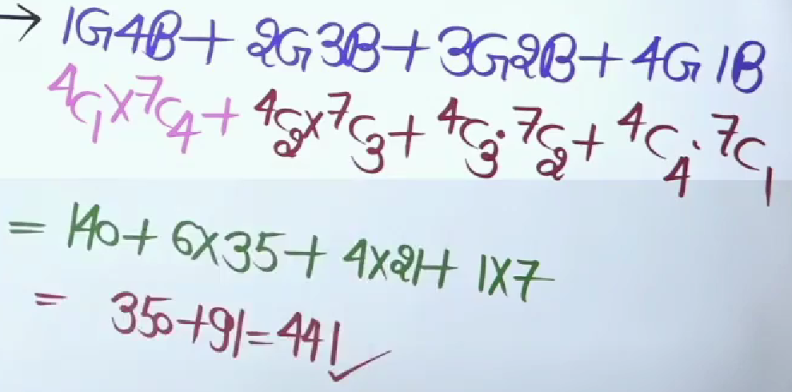
ANSWER

Slide 18

ANSWER

Slide 19
Question 8
In how many ways can 6 persons be selected from 4 officers and 8 constables, if at least one officer is to be included?
224
672
896
576
Notes:
Ans: C) 896

Slide 20
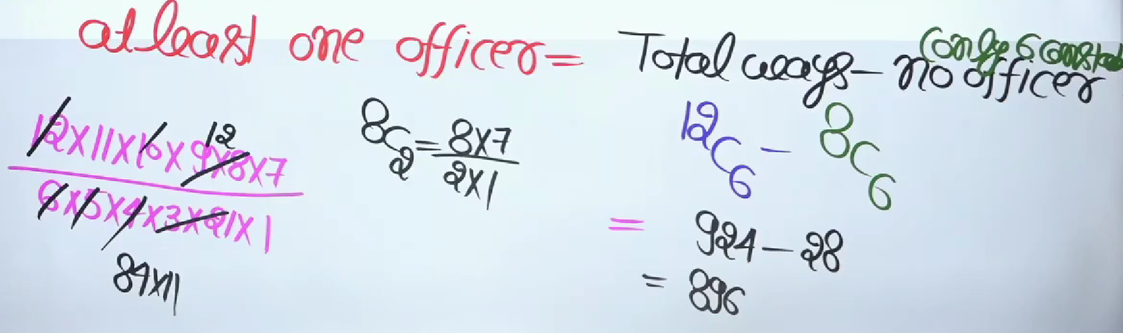
ANSWER

Slide 21
Question 9
How many different committees of 5 can be formed from 6 men and 4 women on which exactly 3 men and 2 women serve?
6
60
20
120
Notes:
Ans : D) 120

Slide 22
Question 10
From a group of 7 men and 6 women, 5 persons are to be selected to form a committee, with at least 3 men on it. In how many ways can it be done?
645
564
735
756
Notes:
Ans: d ncr = n!/(n - r)! r!
=7C3 x 6C2 + 7C4 x 6C1 + 7C5 x 6Co
= 7!/(3! x 4!) x 6!/(2! x 4!) + 7!/(4! x 3!) x 6!/(1! x 5!) + 7!/(5! x 2!) x 6!/(6!x 0!)
=35×15+35×6+21
=735 + 21
=756

Slide 23
THANK YOU

